Slide 1

CT1305
Computer Network Management
SNMPv1
Organization and Information Models
Dr. Mostafa H. Dahshan
Department of Computer Engineering
College of Computer and Information Sciences
King Saud University
mdahshan@ksu.edu.sa

Slide 2
Acknowledgements
• Notes are based on slides of:
• Network Management: Principles and Practice, 2E, Mani Subramanian.
2

Slide 3
Overview
• IETF SNMP standard
• Organization Model
• 2- and 3-tier models
• Manager and agent
• Management messages
• Structure of management information, SMI
• Object type and instance
• Scalar and aggregate managed objects
• Management information base, MIB
• IETF MIB-2 standard
3

Slide 4
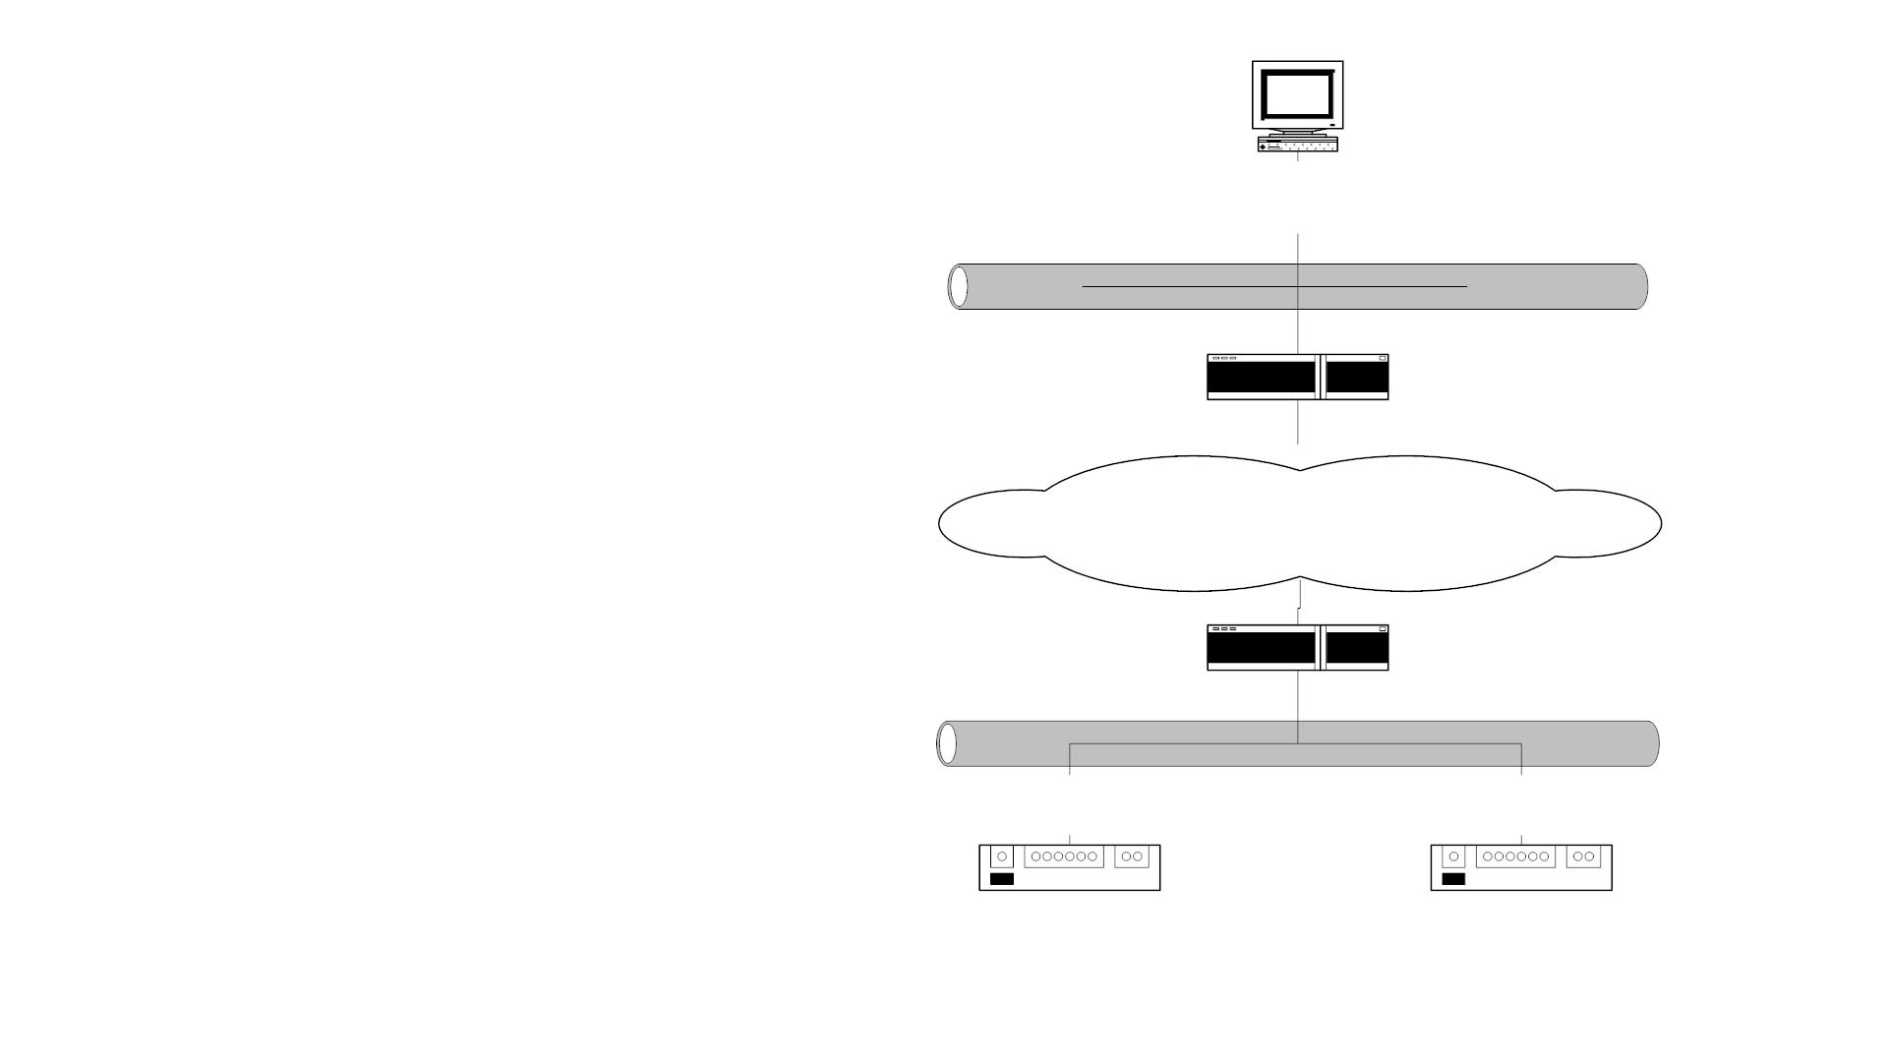
Managed LAN
NMS
192.168.252.110
• NMS on subnet 192.168.252.1
manages the router and the
hubs on subnet 172.16.46.1
across the backbone network
172.17.252.1
Router 2
Backbone Network
Router 1
172.16.46.1
Hub 1
172.16.46.2
Hub 2
172.16.46.3
Figure 4.1 Managed LAN Network
4

Slide 5
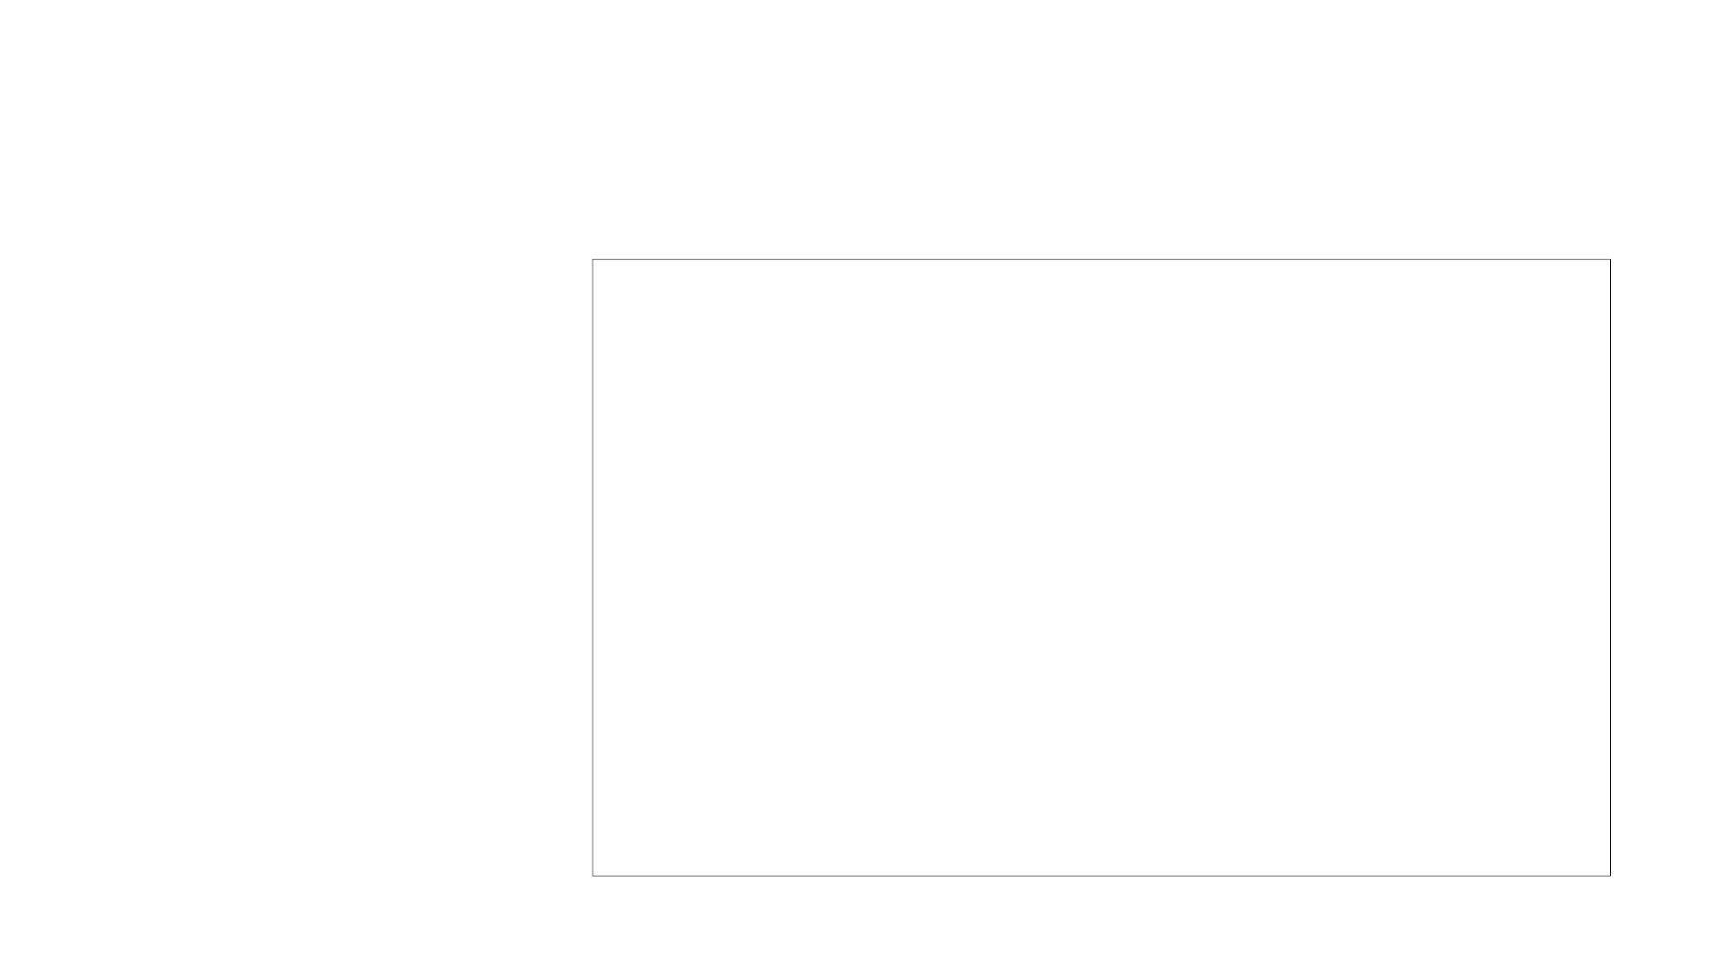
Managed Hub: System Information
• Information obtained
Title: System Information: 172.16.46.2
Name or IP Address: 172.16.46.2
System Name:
System Description: 3Com LinkBuilder FMS, SW version:3.02
System Contact:
querying the hub
• Data truly reflects what is
stored in the hub
System Location:
System Object ID:
iso.org.dod.internet.private.enterprises.43.1.8.5
System Up Time: (2475380437) 286 days, 12:03:24.37
Figure 4.2(a) System Information on 172.16.46.2 Hub
5

Slide 6
Managed Router: System Information
Title: System Information: router1.gatech.edu
Name or IP Address: 172.16.252.1
System Name
: router1.gatech.edu
System Description : Cisco Internetwork Operating System Software
: IOS (tm) 7000 Software (C7000-JS-M), Version
: 11.2(6),RELEASE SOFTWARE (ge1)
: Copyright (c) 1986-1997 by Cisco Systems, Inc.
: Compiled Tue 06-May-97 19:11 by kuong
System Contact
System Location
:
System Object ID : iso.org.dod.internet.private.enterprises.cisco.ciscoProducts.
cisco 7000
System Up Time : (315131795) 36 days, 11:21:57.95
Figure 4.2(c) System Information on Router
6

Slide 7
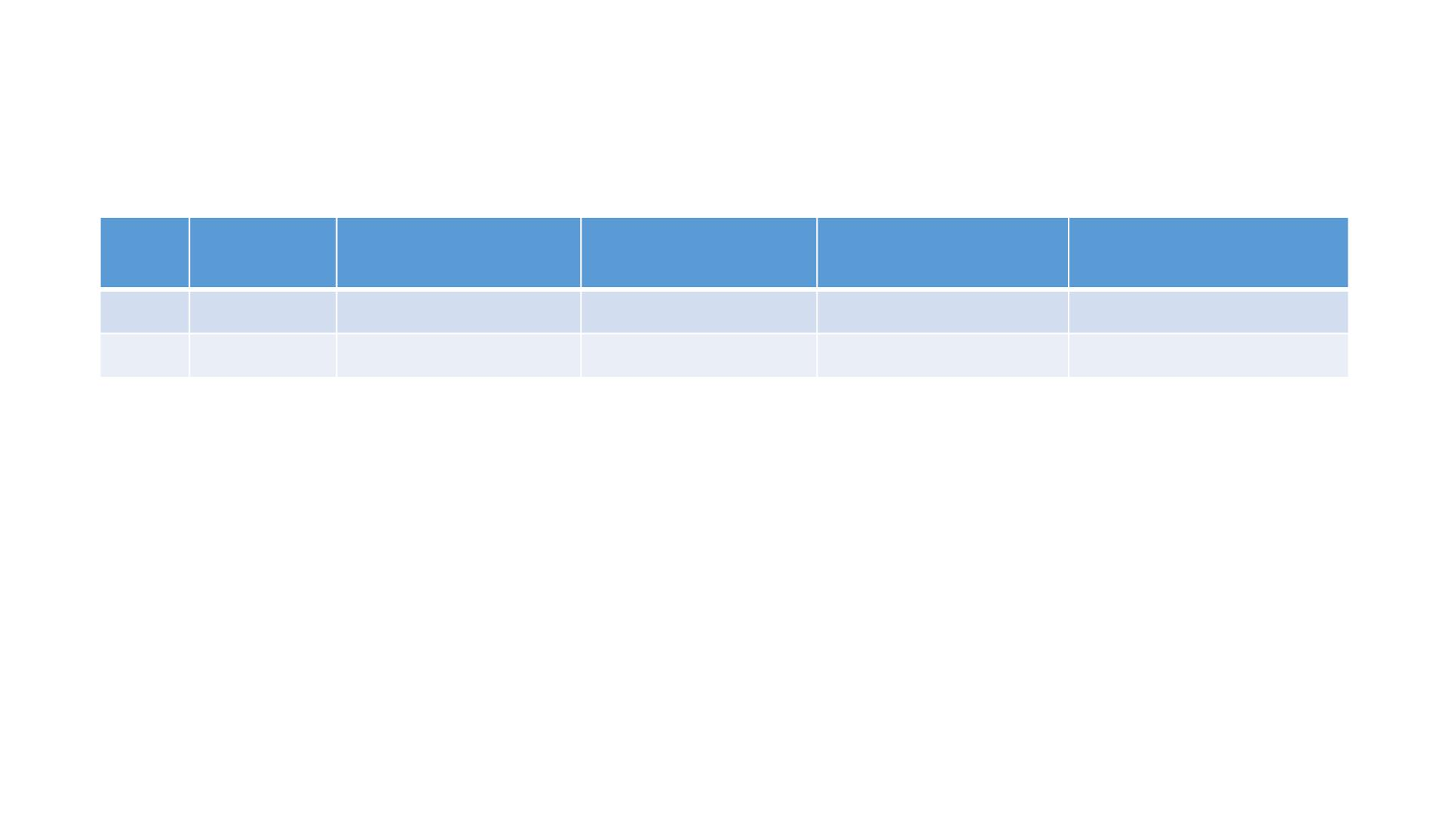
Managed Hub: Port Addresses
Index Interface IP address
Network
Mask
Network Address Link
Address
1
2
3Com 172.16.46.2
3Com 192.168.101.1 255.255.255.0 192.168.101.0 <none>
255.255.255.0 172.16 46.0
0x08004E07C25C
• Information acquired by the NMS on hub interfaces
• Index refers to the interface on the hub
• Link address is the MAC address
• The second row data is a serial link
7

Slide 8
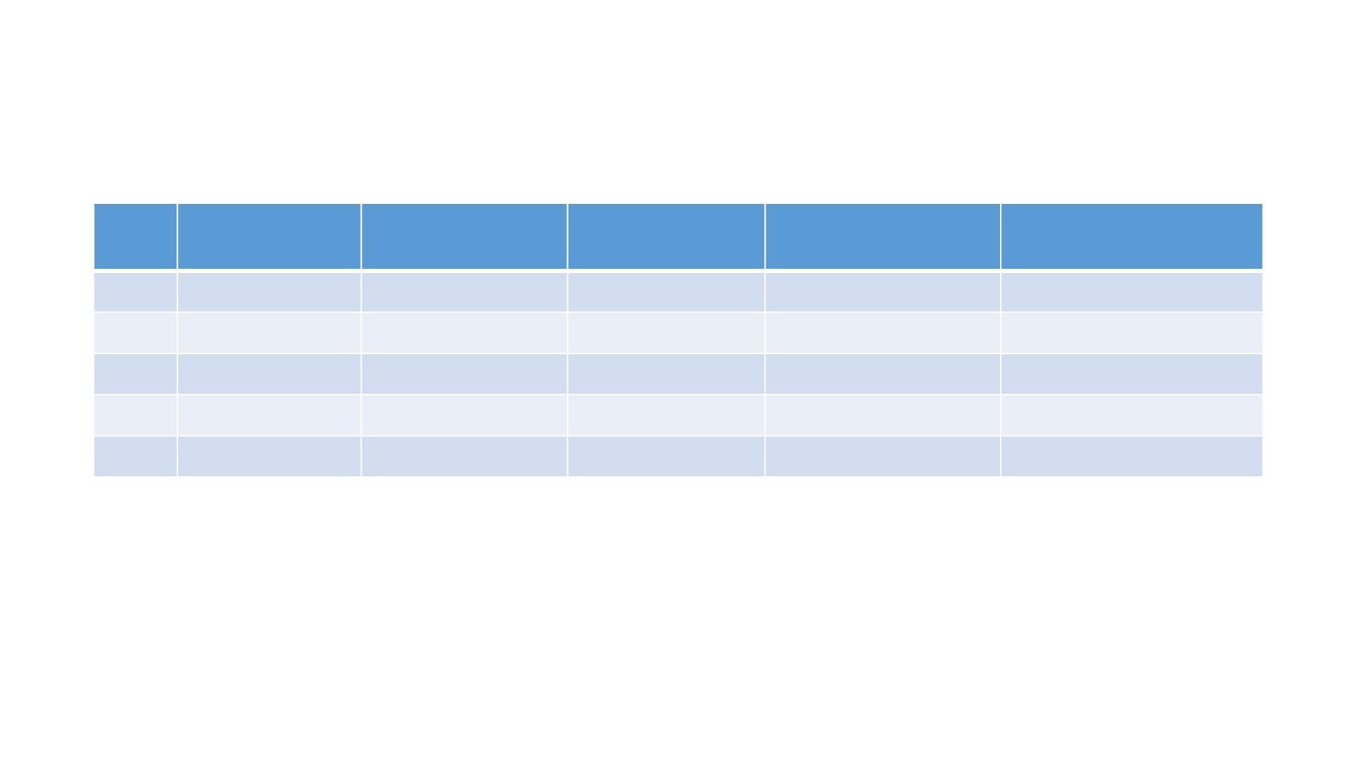
Managed Router: Port Addresses
Index Interface
IP address
Network
Mask
Network Address Link
Address
23
25
13
16
9
LEC.1.0
LEC.3.9
Ethernet 2/0 172.16..46.1
Ethernet 2/3 172.16.49.1
Ethernet 1/2 172.16.55.1
192.168.3.1
255.255.255.0 192.168.3.0
0x00000C3920B4
192.168.252.15 255.255.255.0 192.168.252.0
0x00000C3920B4
0x00000C3920AC
0x00000C3920AF
0x00000C3920A6
255.255.255.0 172.16..46.0
255.255.255.0 172.16.49.0
255.255.255.0 172.16.55.0
• Information acquired by NMS on the router interfaces
• Index refers to the interface on the router
• LEC is the LAN emulation card
• Ethernet 2/0 refers to interface card 2 and port 0 in that card
8

Slide 9
Internet SNMP Management
• Internet Engineering Task Force (IETF)
• 1990 SNMPv1
• 1995 SNMPv2
• 1998 SNMPv3
• Internet documents:
• Request for Comments (RFC)
• IETF STD Internet Standard
9

Slide 10
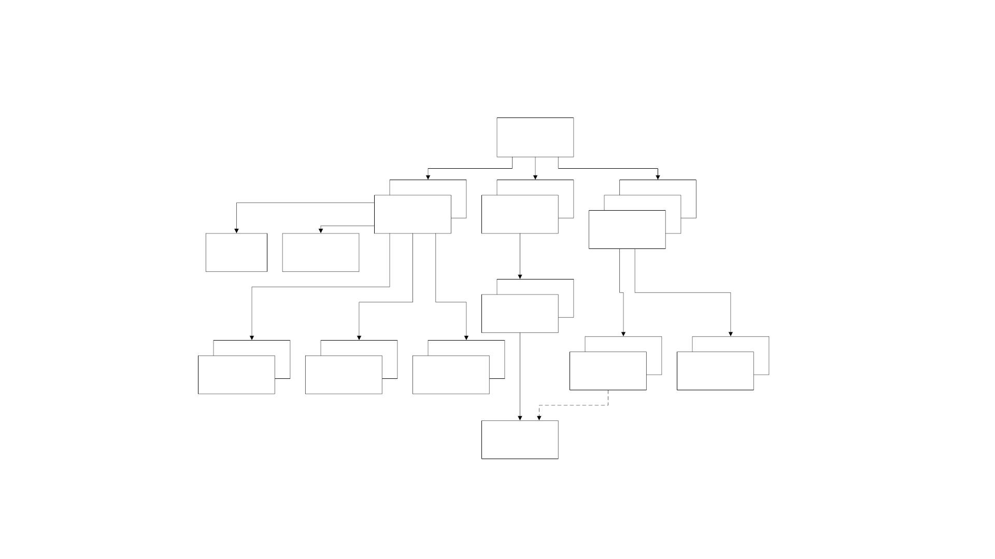
SNMPv1 and SNMPv2 Documents
SNMP
Management
Documents
RFC 1065
SMI
RFC 1155
STD 16
RFC 1066
MIB I
RFC 1156
RFC 1067
RFC 1098
SNMPv1
RFC 1157
STD 15
SNMPv1
Traps
RFC 1215
Concise SMI
RFC 1212
STD 16
RFC 1158
MIB II
RFC 1213
STD 17
RFC 1442
RFC 1443
SMIv2 Txt
Conventions
RFC 1903
RFC 1444
SMIv2
Conformances
RFC 1904
RFC 1448
SNMPv2
Protocol Ops
1905
RFC 1449
SNMPv2
Transport Map.
RFC 1906
SMIv2
RFC 1902
MIB II for
SNMPv2
RFC 1907
Figure 4.4 SNMP Document Evolution
10

Slide 11
SNMP Model
• Organization Model
• Relationship between network element, agent, and manager
• Hierarchical architecture
• Information Model
• Uses ASN.1 syntax
• SMI (Structure of Management Information)
• MIB ( Management Information Base)
• Communication Model
• Transfer syntax
• SNMP over TCP/IP
• Communication services addressed by messages
• Security framework community-based model
11

Slide 12

Two-Tier Organization Model
SNMP
SNMP
SNMP
Manager
Manager
Manager
SNMPAgent
Network Agent
Network
Element
Network
Element
(a) One Manager - One Agent Model
(b) Multiple Managers - One Agent Model
Figure 4.5 Two-Tier Organization Model
Any host that could query an agent is a manager.
12

Slide 13
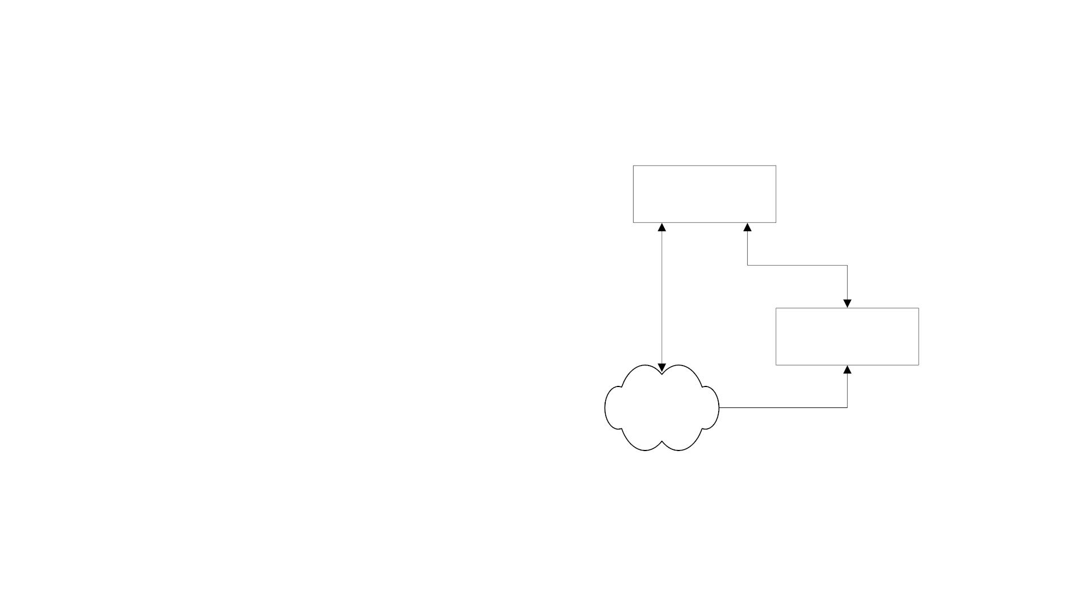
Three-Tier Organization Model: RMON
• Managed object comprises network
SNMP
Manager
element and management agent
• RMON acts as an agent and a
manager
• RMON (Remote Monitoring) gathers
data from MO, analyses the data, and
stores the data
RMON
Probe
Managed
Objects
• Communicates the statistics to the
manager
Figure 4.6 Three-Tier Organization Model
13

Slide 14
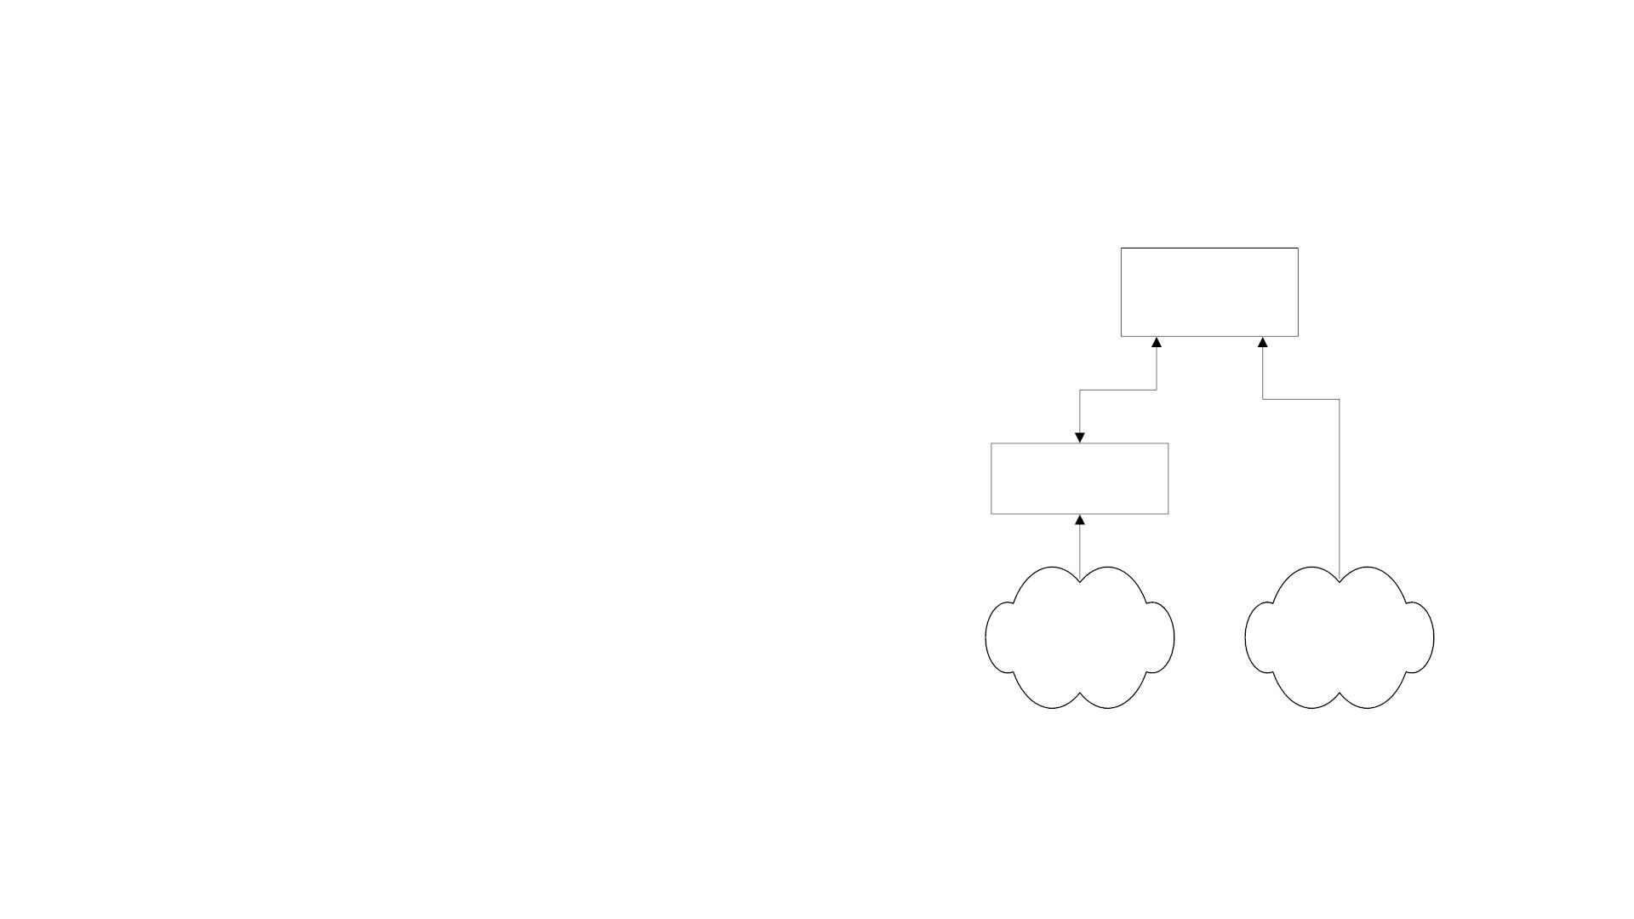
Three-Tier Organization Model: Proxy Server
• Proxy server converts non-SNMP
SNMP
Manager
data from non-SNMP objects to
SNMP compatible objects and
messages
Proxy
Server
Non-SNMP
Managed
Objects
SNMP
Managed
Objects
Figure 4.7 Proxy Server Organization Model
14

Slide 15
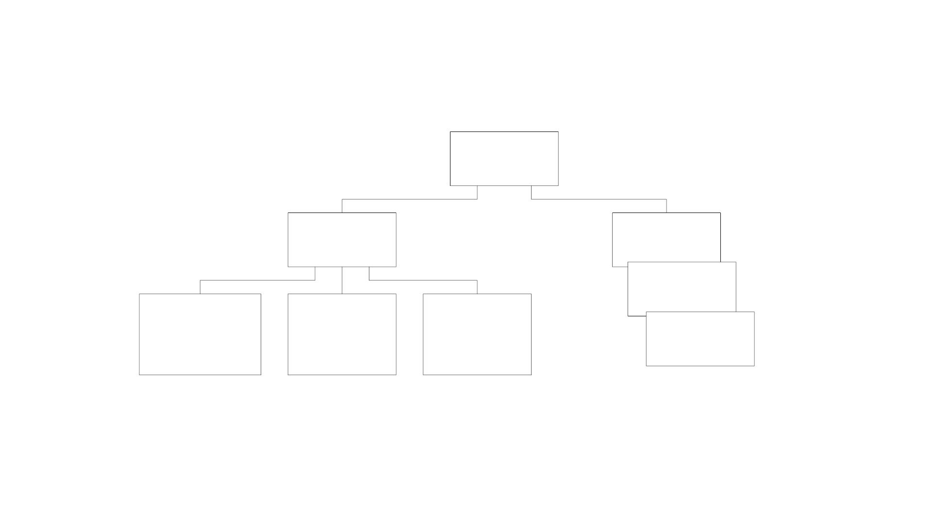
Managed Object
Object
Object
Type
Object
Instance 3
Object
Instance 2
Name:
Syntax:
Encoding:
BER
Object
Instance 1
OBJECT
ASN.1
IDENTIFIER
Figure 4.11 Managed Object : Type with Multiple Instances
15

Slide 16
Managed Object
• Object type and data type are synonymous
• Object identifier is data type, not instance
• Object instance IP address (See Figure 4.2)
• All hubs of the same version have identical identifier
• They are distinguished by the IP address
• Each IP address is an instance of the object
16

Slide 17
Name
• Uniquely defined by
• DESCRIPTOR
• OBJECT IDENTIFIER
• Examples
• internet OBJECT IDENTIFIER ::= {iso org(3) dod(6) 1 }.
• internet OBJECT IDENTIFIER ::= {iso(1) standard(3) dod(6) internet(1)}
• internet OBJECT IDENTIFIER ::= {1 3 6 1}
• internet OBJECT IDENTIFIER ::= {iso standard dod internet }
• internet OBJECT IDENTIFIER ::= { iso standard dod(6) internet(1) }
• internet OBJECT IDENTIFIER ::= { iso(1) standard(3) 6 1 }
17

Slide 18
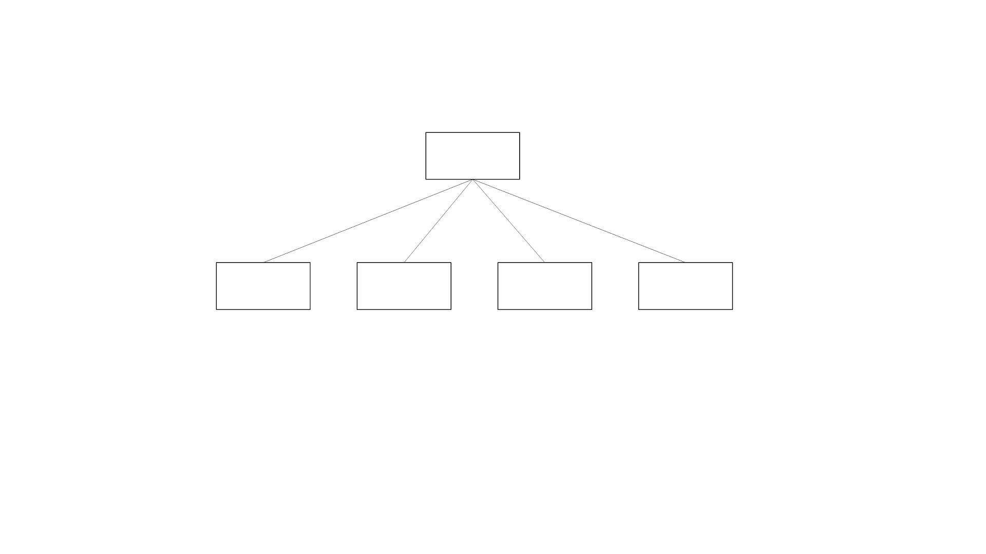
Internet Subnodes
Internet
{1 3 6 1}
directory
(1)
mgmt
(2)
experimental
(3)
private
(4)
Figure 4.13 Subnodes under Internet Node in SNMPv1
directory
mgmt
experimental
private
OBJECT IDENTIFIER ::= {internet 1}
OBJECT IDENTIFIER ::= {internet 2}
OBJECT IDENTIFIER ::= {internet 3}
OBJECT IDENTIFIER ::= {internet 4}
18

Slide 19
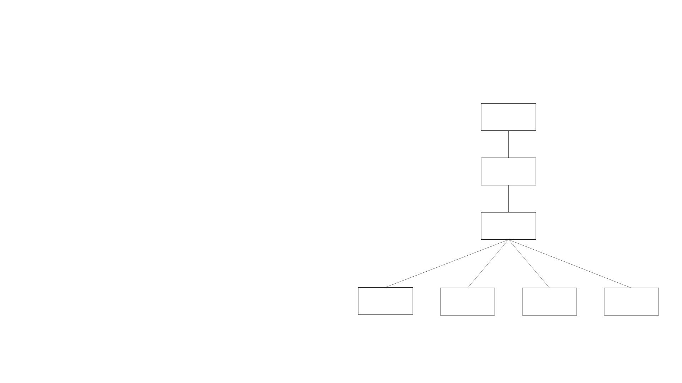
Private MIB Example
Notes
Internet
{1 3 6 1}
• private MIB intended for vendor
equipment
private
(4)
• IANA (Internet Assigned Numbers
Authority) assigns identifiers
enterprises
(1)
cisco
(9)
hp
(11)
3Com
(43)
Cabletron
(52)
Figure 4.14 Private Subtree for Commercial Vendors
19

Slide 20
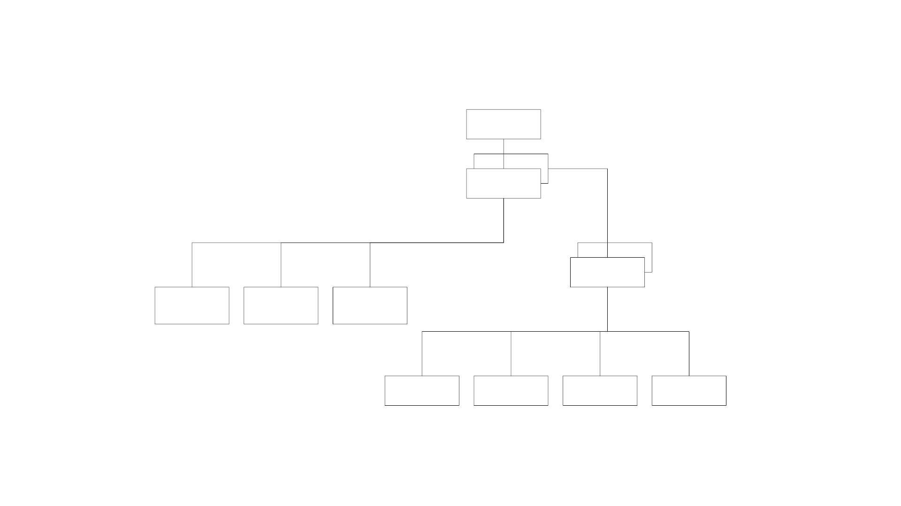
SNMP ASN.1 Data Type
SNMP ASN.1
Data Type
Tag
Structure
Number
Class
Simple
or
Defined
or
Constructor
or
Primitive
Application
Structured
Universal
Application
Context-
specific
Private
Figure 4.15 SNMP ASN.1 Data Type
20

Slide 21
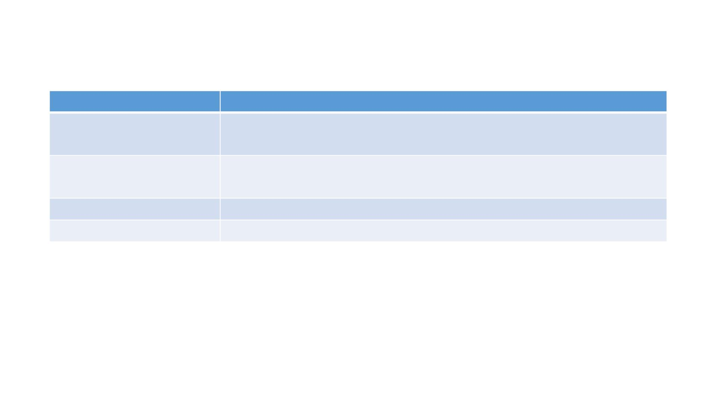
Primitive Data Types
Data Type
INTEGER
Comments
Subtype INTEGER (n1..nN)
Special case: Enumerated INTEGER type
8-bit bytes binary and textual data
Subtypes can be specified by either range or fixed
OCTET STRING
OBJECT IDENTIFIER Object position in MIB
NULL
Placeholder
Notes
• get-request message has NULL for value fields and get-response from agent has the values filled
in subtype:
• INTEGER (0..255)
• OCTET STRING (SIZE 0..255)
• OCTET STRING (SIZE 8)
21

Slide 22
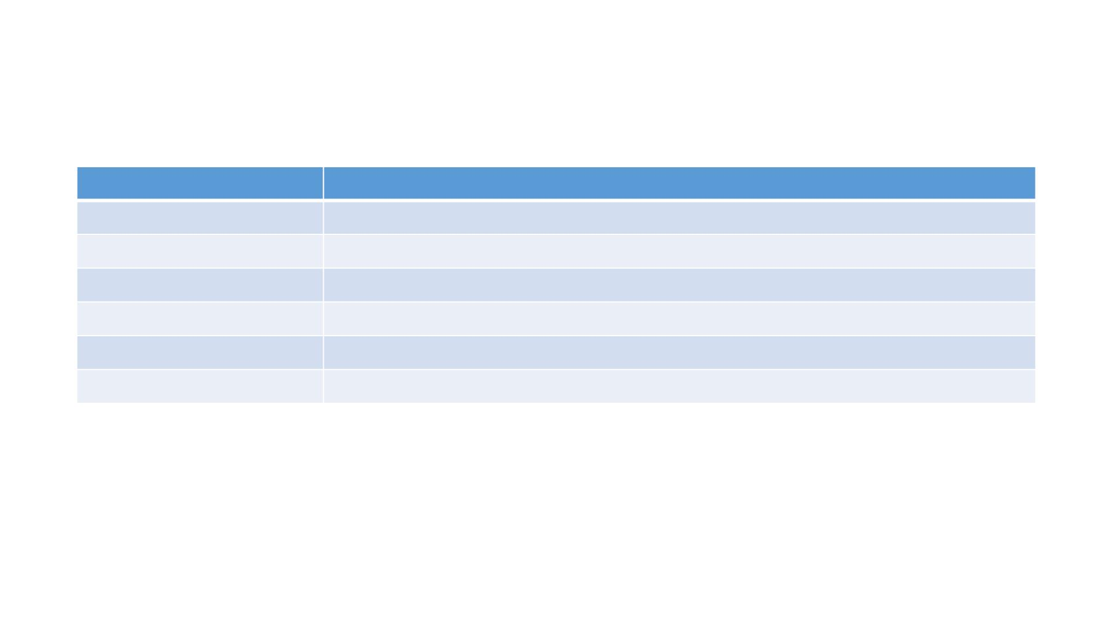
Defined or Application Data Type
Data Type
NetworkAddress
IpAddress
Counter
Comments
Not used
Dotted decimal IP address
Wrap-around, non-negative integer, monotonically increasing, max 2^32 -1
Capped, non-negative integer, increase or decrease
Non-negative integer in hundredths of second units
Application-wide arbitrary ASN.1 syntax, double wrapped OCTET STRING
Gauge
TimeTicks
Opaque
Notes
• Defined data types are simple or base types
• Opaque is used to create data types based on previously defined data types
22

Slide 23
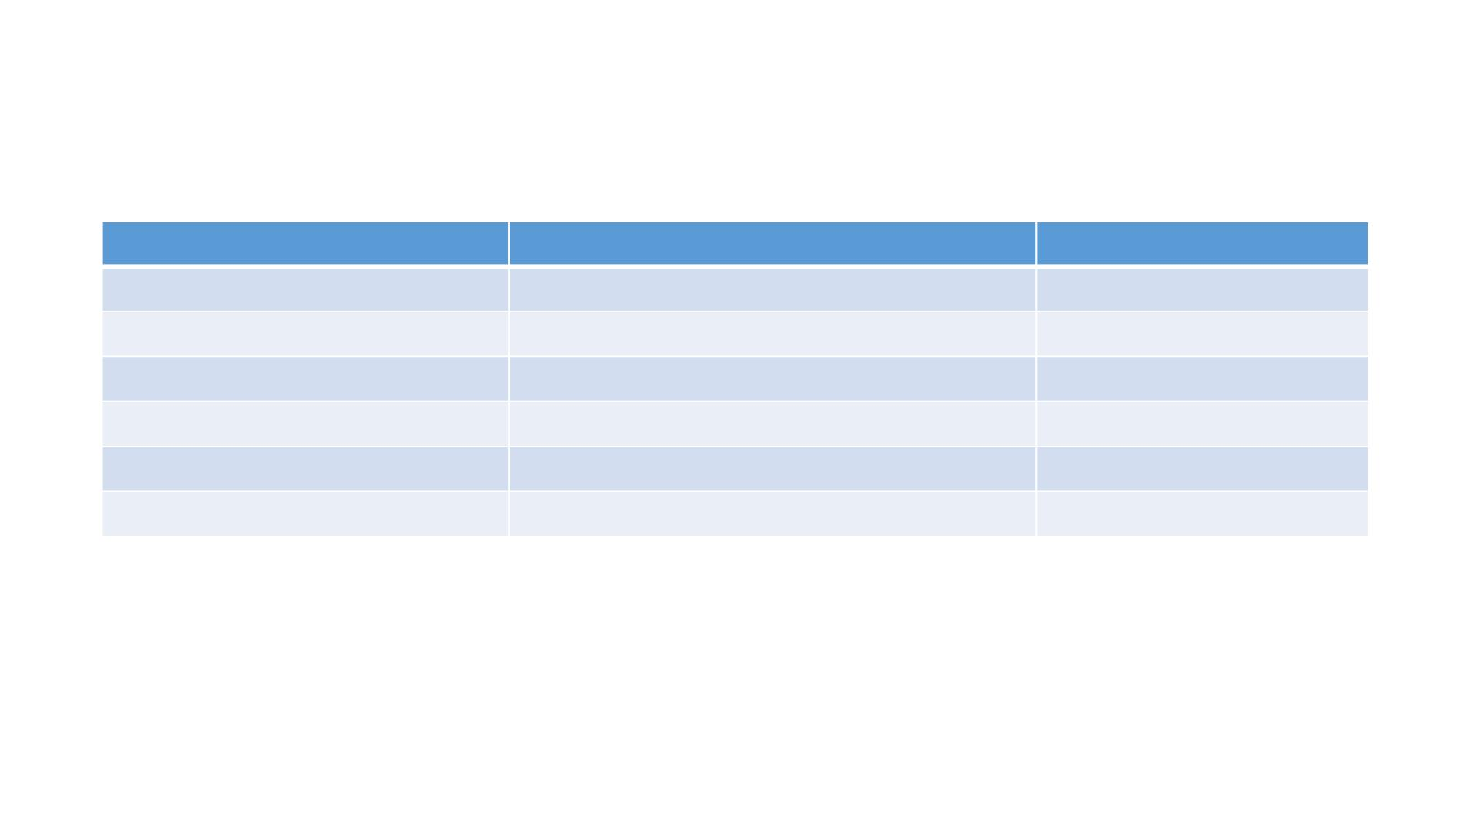
Constructor or Structured Data Type: SEQUENCE
SEQUENCE { <type1>, <type2>,…, <typeN> }
Object
ipAddrEntry
ipAdEntAddr
ipAdEntIfIndex
ipAdEntNetMask
ipAdEntBcastAddr
OBJECT IDENTIFIER
{ipAddrTable 1}
{ipAddrEntry 1}
{ipAddrEntry 2}
{ipAddrEntry 3}
{ipAddrEntry 4}
ObjectSyntax
SEQUENCE
IpAddress
INTEGER
IpAddress
INTEGER
INTEGER
ipAdEntReasmMaxSize {ipAddrEntry 5}
IpAddrEntry ::= SEQUENCE {
ipAdEntAddr
ipAdEntIfIndex
ipAdEntNetMask
IpAddress
INTEGER
IpAddress
Managed Object IpAddrEntry as a list
ipAdEntBcastAddr INTEGER
ipAdEntReasmMaxSize INTEGER (0..65535)
}
23

Slide 24
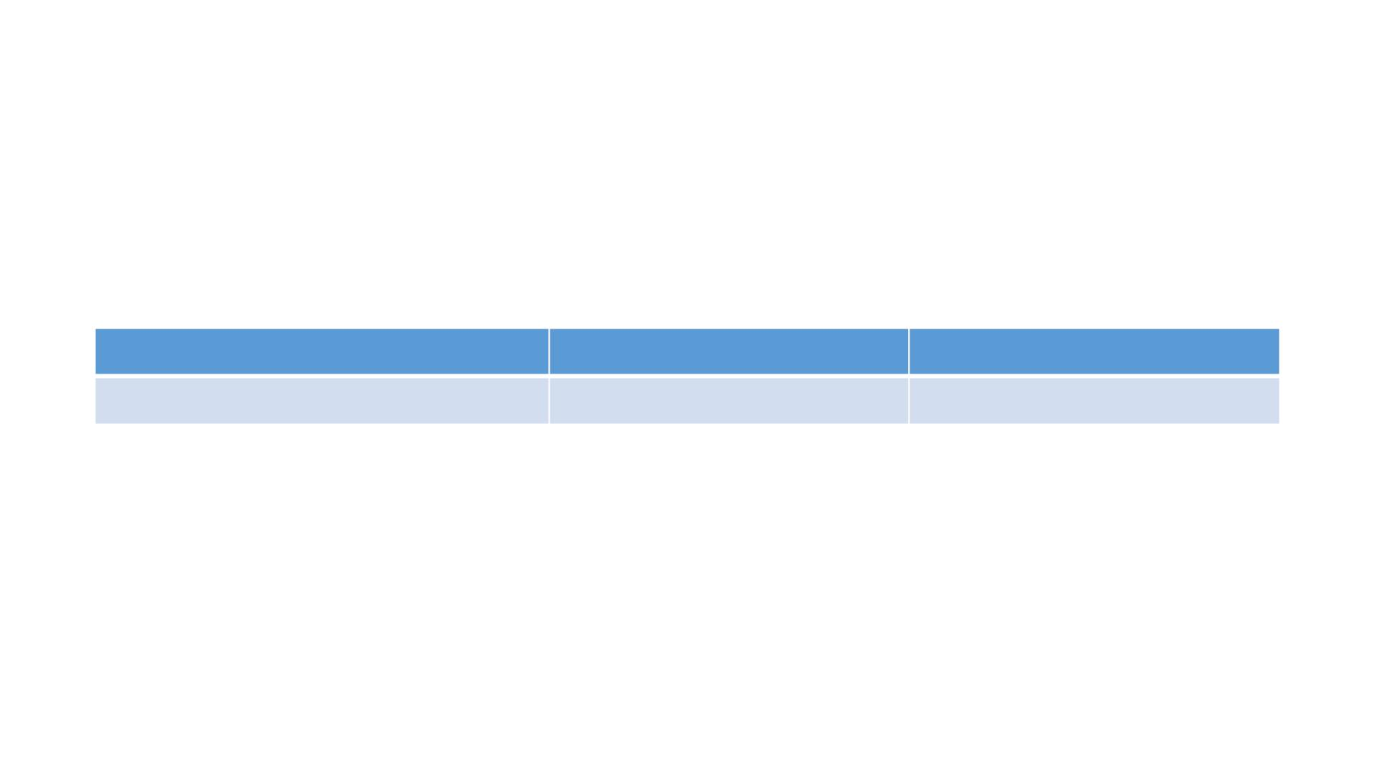
Constructor or Structured Data Type:
SEQUENCE OF
SEQUENCE OF <entry>
where <entry> is a list constructor
Object Name
ipAddrTable
OBJECT IDENTIFIER
{ip 20}
Syntax
SEQUENCE OF
IpAddrTable ::= SEQUENCE OF IpAddrEntry
Managed Object ipAddrTable as a table
24

Slide 25
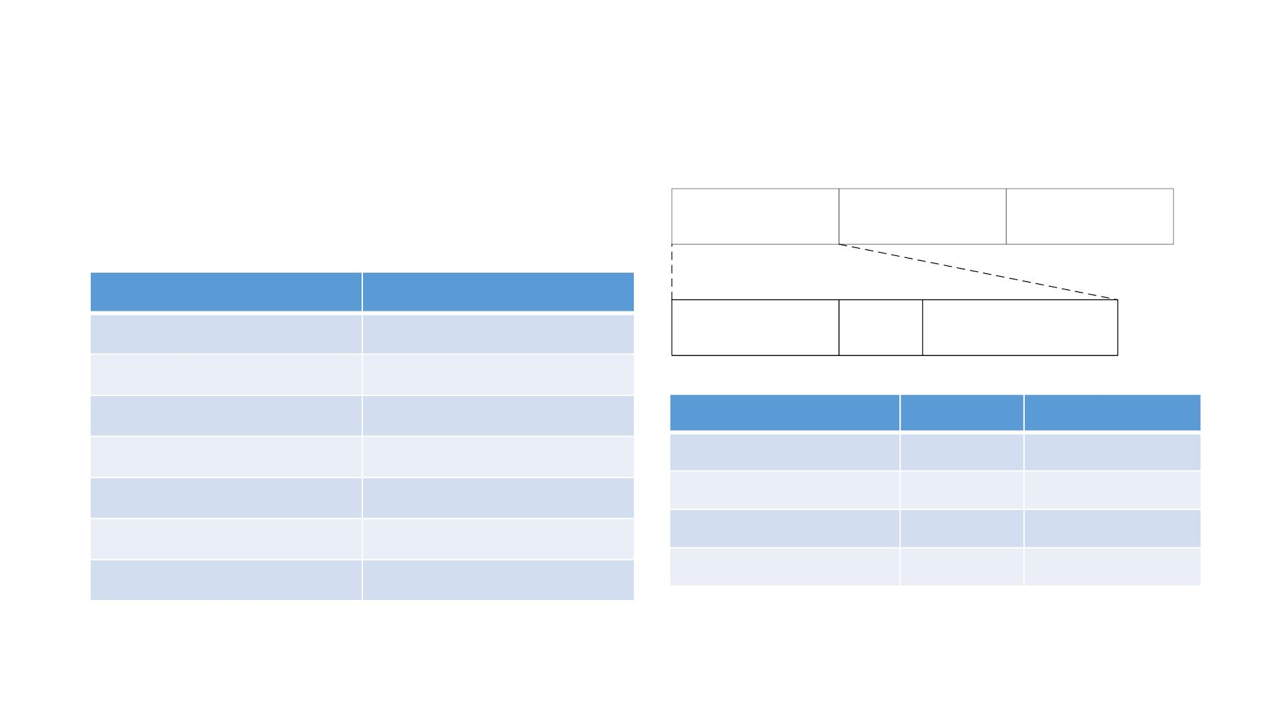
Encoding
Basic Encoding Rules (BER)
Tag, Length, and Value (TLV)
SNMP Data Types and Tags
Type
Length
Value
Type
Tag
OBJECT IDENTIFIER UNIVERSAL 6
Class
(7-8th bits)
P/C
(6th bit)
Tag Number
(1-5th bits)
SEQUENCE
IpAddress
Counter
Gauge
TimeTicks
Opaque
UNIVERSAL 16
APPLICATION 0
APPLICATION 1
APPLICATION 2
APPLICATION 3
APPLICATION 4
Class
Universal
Application
Context-specific 1
8th bit
0
0
7th bit
0
1
0
1
Private
1
25

Slide 26
Managed Object: Macro
Managed Object: Macro
OBJECT-TYPE MACRO ::=
BEGIN
TYPE NOTATION ::= "SYNTAX" type(TYPE ObjectSyntax)
"ACCESS" Access
"STATUS" Status
VALUE NOTATION ::= value(VALUE ObjectName)
Access ::= "read-only" | "read-write" | "write-only" | "not-accessible"
Status ::= "mandatory" | "optional" | "obsolete"
END
Figure 4.18(a) OBJECT-TYPE Macro [RFC 1155]
26

Slide 27
Managed Object: Macro
sysDescr OBJECT-TYPE
SYNTAX DisplayString (SIZE (0..255))
ACCESS read-only
STATUS mandatory
DESCRIPTION
"A textual description of the entity. This value should include the
full name and version identification of the system’s hardware type,
software operating-system, and networking software. It is mandatory that
this only contain printable ASCII characters.”
::= {system 1 }
Figure 4.18(b) Scalar or Single Instance Macro: sysDescr [RFC 1213]
27

Slide 28
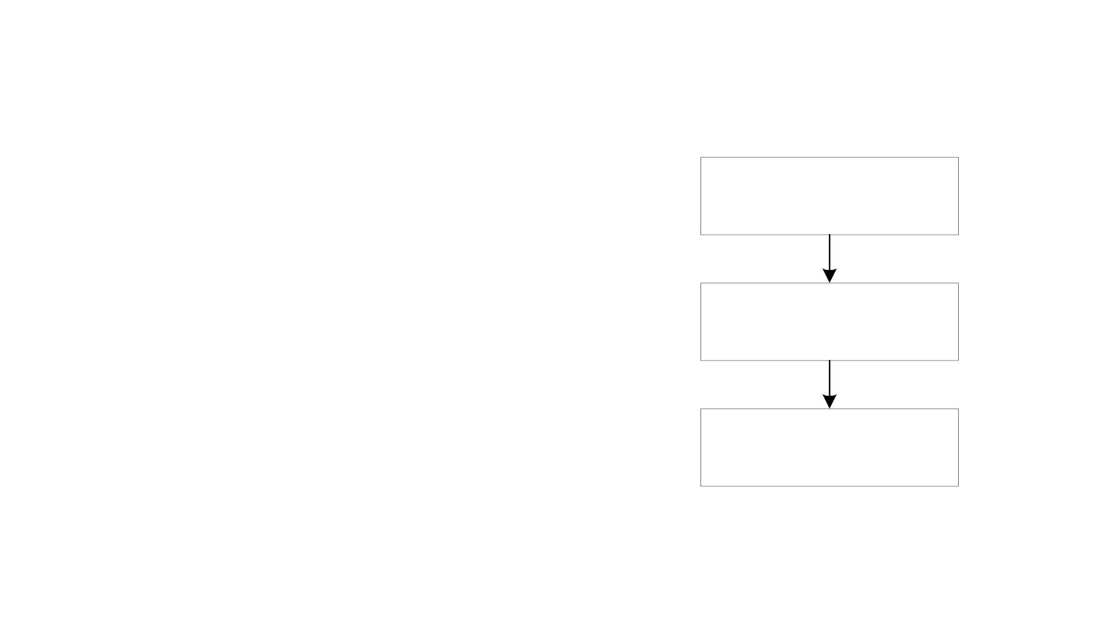
Aggregate Object
• A group of objects
• Also called tabular objects
• Can be represented by a table with
• Columns of objects
• Rows of instances
• Example: IP address table
Table of Objects
List of Objects
Objects
• Consists of objects:
• IP address
• Interface
• Subnet mask
• Broadcast address
• Largest IP datagram
28

Slide 29
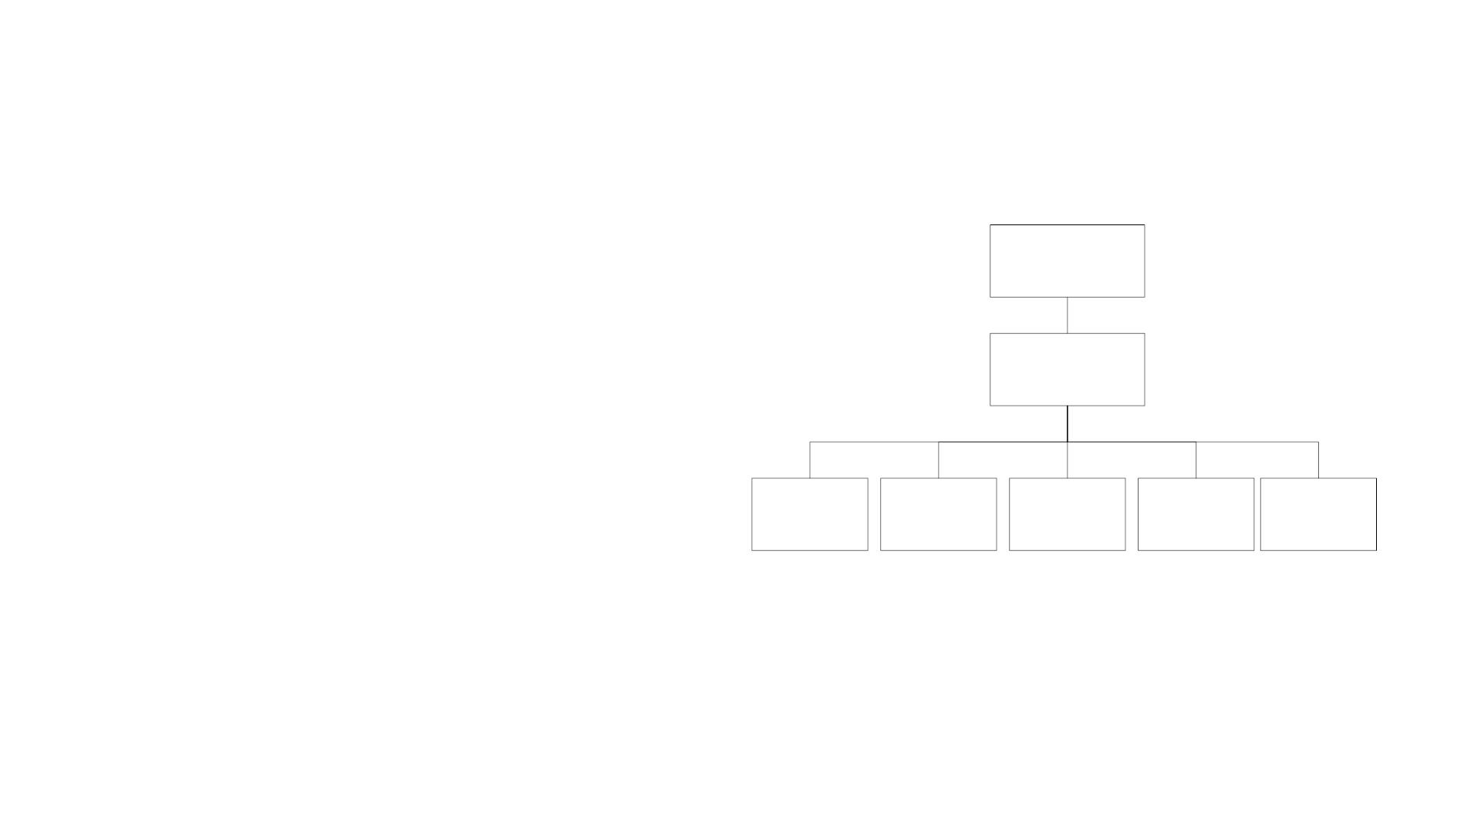
Tabular Representation of Aggregate Object
• TABLE T and ENTRY E are objects
TABLE
that are logical objects
T
• They define the grouping and are
not accessible
ENTRY
E
• Columnar objects are objects that
represent the attributes and hence
are accessible
COLUMNAR COLUMNAR COLUMNAR COLUMNAR COLUMNAR
OBJECT 1
OBJECT 2
OBJECT 3
OBJECT 4
OBJECT 5
• Each instance of E is a row of
columnar objects 1 through 5
Figure 4.22(a) Multiple Instance Managed Object
• Multiple instances of E are
represented by multiple rows
29

Slide 30
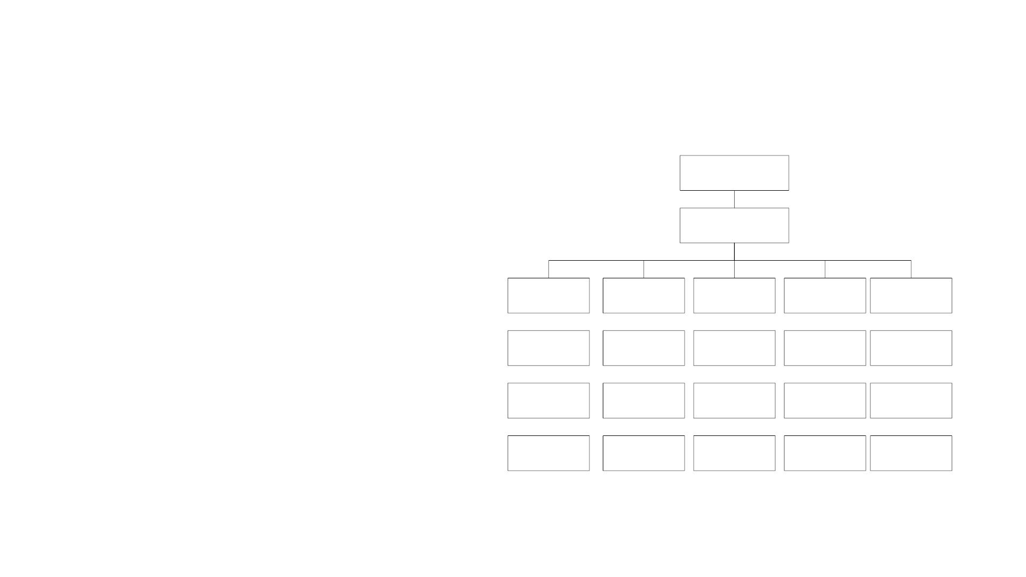
Tabular Representation of Aggregate Object
• Notice the column-row numeric
T
designation
• Is reverse of what we are used
T.E
to as row-column
T.E.1.1
T.E.1.2
T.E.1.3
T.E.1.4
T.E.2.1
T.E.2.2
T.E.2.3
T.E.2.4
T.E.3.1
T.E.3.2
T.E.3.3
T.E.3.4
T.E.4.1
T.E.4.2
T.E.4.3
T.E.4.4
T.E.5.1
T.E.5.2
T.E.5.3
T.E.5.4
Figure 4.22(b) Example of 5 Columnar Object with 4 Instances (rows)
30

Slide 31
Multiple Instances of Aggregate Managed Object
+--ipAddrTable (1.3.6.1.2.1.4.20)
|
+--ipAddrEntry(1)
| Index: ipAdEntAddr
|
+-- -R-- IpAddr
+-- -R-- INTEGER ipAdEntIfIndex(2)
+-- -R-- IpAddr ipAdEntNetMask(3)
+-- -R-- INTEGER ipAdEntBcastAddr(4)
ipAdEntAddr(1)
Range: 1..2147483647
Range: 0..1
+-- -R-- INTEGER ipAdEntReasmMaxSize(5) Range: 0..65535
Columnar object ID of ipAdEntBcastAddr is (1.3.6.1.2.1.4.20.1.4):
iso org dod internet mgmt mib ip ipAddrTable ipAddrEntry ipAdEntBcastAddr
1 3 6 1
2 1 4 20
1
4
Figure 4.23(a) Columnar objects under ipAddrEntry
31

Slide 32
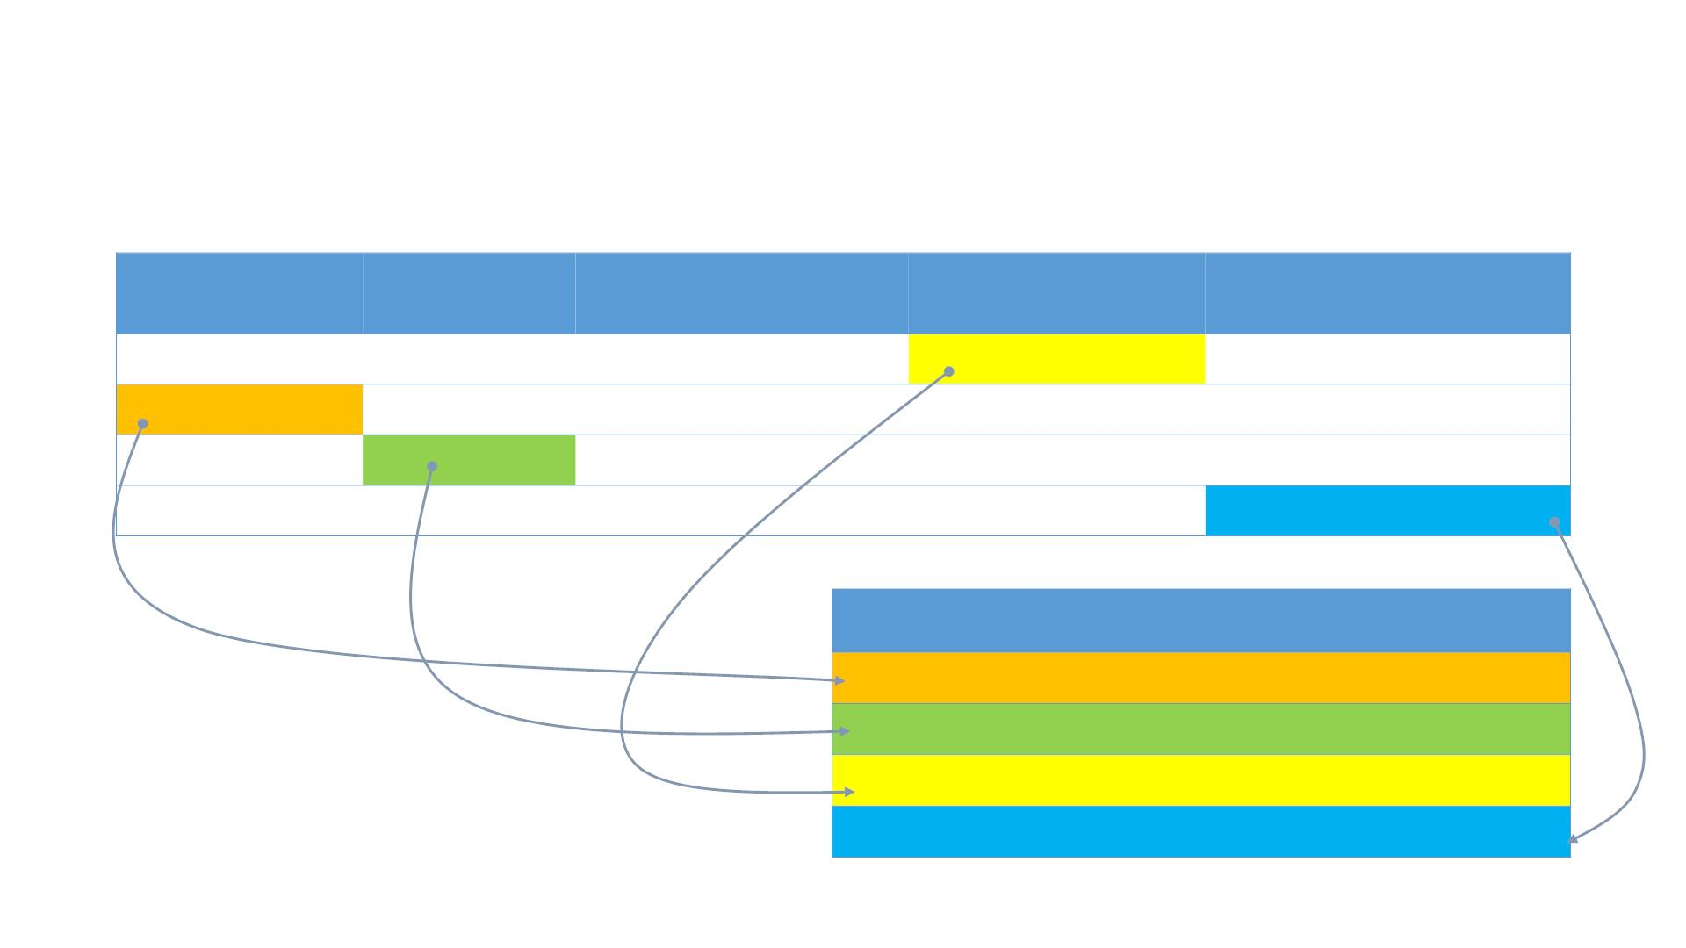
Multiple Instances of Aggregate Managed Object
Figure 4.23(b) Object instances of ipAddrTable (1.3.6.1.2.1.4.20)
ipAdEntAddr
ipAdEntIfIndex
IpAdEntNetMask
IpAdEntBcastAddr
IpAdEntReasmMaxSize
123.45.2.1
123.45.3.4
165.8.9.25
9.96.8.138
1
3
2
4
255.255.255.0
255.255.0.0
255.255.255.0
255.255.255.0
0
1
0
0
12000
12000
10000
15000
Object Identifier for Specific Instance
{1.3.6.1.2.1.4.20.1.1.123.45.3.4}
{1.3.6.1.2.1.4.20.1.2.165.8.9.25}
{1.3.6.1.2.1.4.20.1.4.123.45.2.1}
{1.3.6.1.2.1.4.20.1.5.9.96.8.138}
32

Slide 33
SMI Definition STD 16 / 1155 RFC
SMI DEFINITIONS ::= BEGIN
EXPORTS -- EVERYTHING
internet, directory, mgmt, experimental, private, enterprises,
OBJECT-TYPE, ObjectName, ObjectSyntax, SimpleSyntax,
ApplicationSyntax, NetworkAddress, IpAddress, Counter, Gauge,
TimeTicks, Opaque;
-- the path to the root
internet OBJECT IDENTIFIER ::= { iso org(3) dod(6) 1 }
directory OBJECT IDENTIFIER ::= { internet 1 }
mgmt
experimental OBJECT IDENTIFIER ::= { internet 3 }
private OBJECT IDENTIFIER ::= { internet 4 }
enterprises OBJECT IDENTIFIER ::= { private 1 }
OBJECT IDENTIFIER ::= { internet 2 }
Notes
• EXPORTS identifies the objects that any other module could import
33

Slide 34
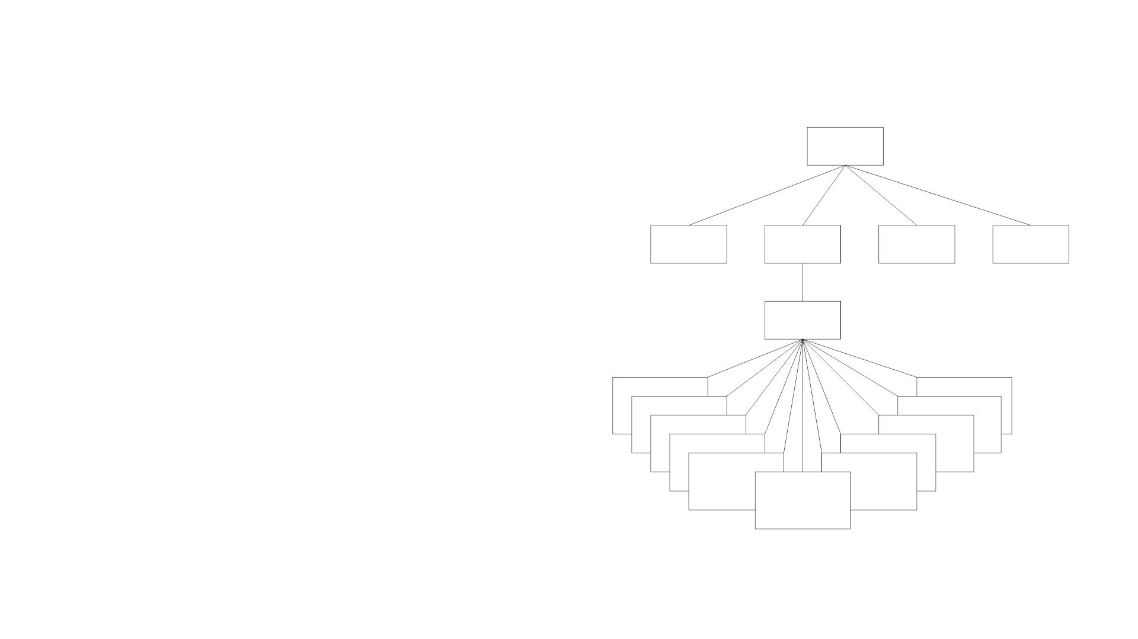
MIB
Internet
{1 3 6 1}
• MIB-II (RFC 1213) is superset of MIB-I
• Related objects grouped into object
directory
(1)
mgmt
(2)
experimental
(3)
private
(4)
groups
• MIB module comprises module
name, imports from other modules,
and definitions of current module
mib-2
(1)
system (1)
snmp (11)
interfaces (2)
transmission (10)
cmot (9)
• RFC 1213 defines 11 groups
at (3)
ip (4)
icmp (5)
egp (8)
udp (7)
tcp (6)
Figure 4.26 Internet MIB-II Group
34

