Slide 1
Network Topologies
CS 1202

Slide 2
Objectives
Describe the basic and hybrid LAN physical topologies, and their uses, advantages and disadvantages.
Describe the backbone structures that form the foundation for most LANs

Slide 3
Simple Physical Topologies
Physical topology: physical layout of nodes on a network
Four fundamental shapes:
Bus
Ring
Star
Mesh
May create hybrid topologies
Topology integral to type of network, cabling infrastructure, and transmission media used

Slide 4
Why we need a topology
Choosing one topology over another can impact :
type of equipment the network needs
capabilities of the equipment
network’s growth
way a network is managed

Slide 5
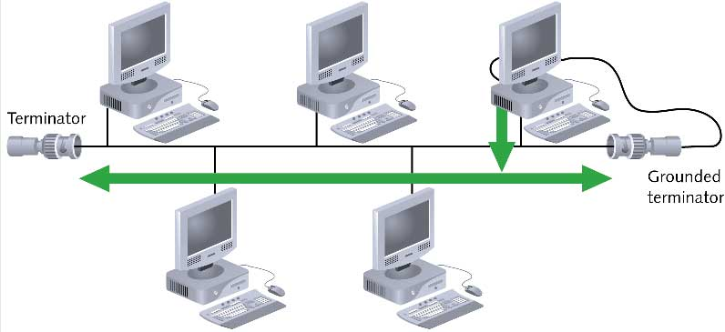
Bus

Slide 6
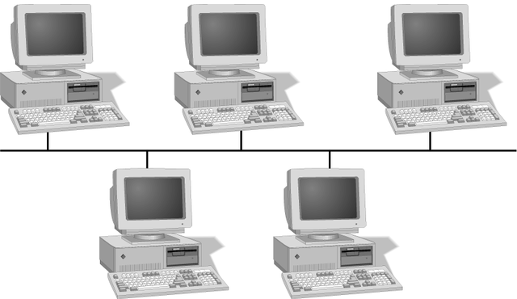
Simple Physical Topologies
A Bus topology consists of a single cable—called a backbone— connecting all nodes on a network without intervening connectivity devices

Slide 7
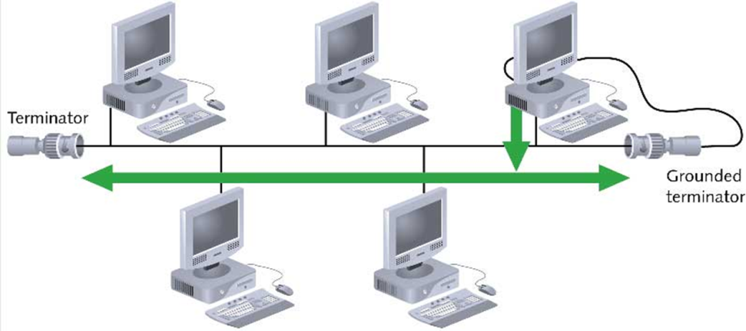
Bus (continued)
Devices share responsibility for getting data from one point to another
Terminators stop signals after reaching end of wire
Prevent signal bounce
Inexpensive, not very scalable
Difficult to troubleshoot, not fault-tolerant

Slide 8
Bus
Advantages
Disadvantage
Works well for small networks
Easy to install
Relatively inexpensive to implement
Management costs can be high
Network disruption when computers are added or removed
A break in the cable will prevent all systems from accessing the network.
Difficult to troubleshoot

Slide 9
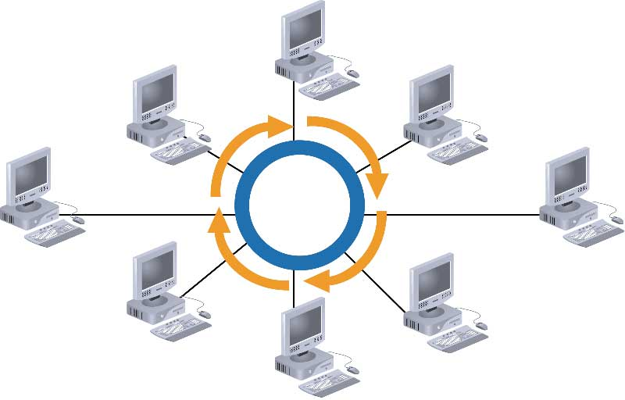
Ring

Slide 10
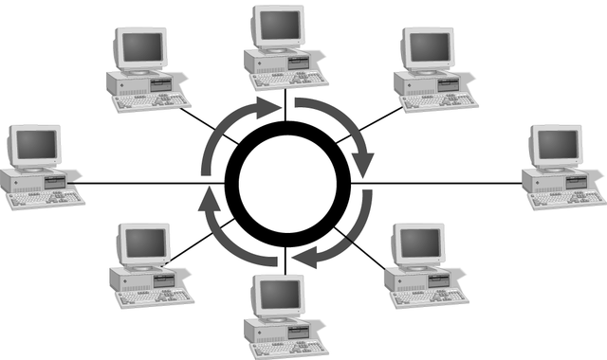
Simple Physical Topologies
Ring topology
Each node is connected to the two nearest nodes so the entire network forms a circle
One method for passing data on ring networks is token passing
Data travels around the network
Traffic flows in one direction
Slow performance
One workstation goes down; whole network goes down
Network is highly dependent

Slide 11
Ring
Advantages
Disadvantage
Cable faults are easily located, making troubleshooting easier
Ring networks are moderately easy to install
Expensive
Requires more cable and network equipment at the start
Expansion to the network can cause network disruption
A single break in the cable can disrupt the entire network

Slide 12
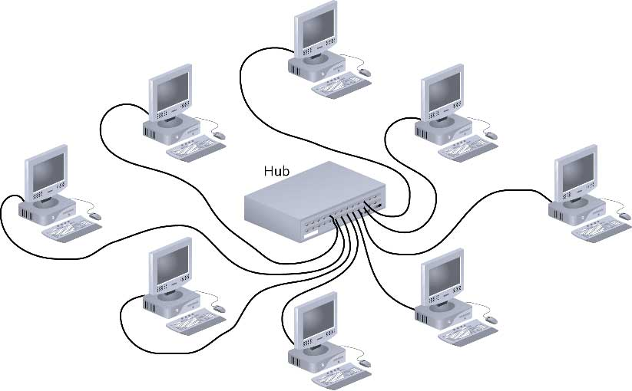
Star

Slide 13
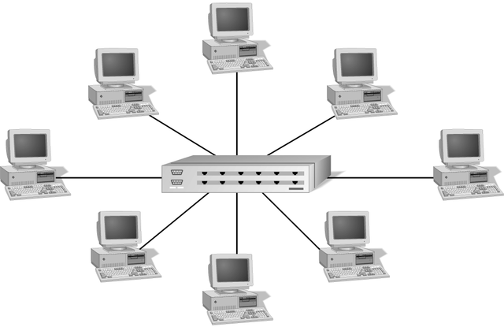
Simple Physical Topologies
Star topology
Every node on the network is connected through a central device called hub or switch.

Slide 14
Star (continued)
Any single cable connects only two devices
Cabling problems affect two nodes at most
Requires more cabling than ring or bus networks
More fault-tolerant
Easily moved, isolated, or interconnected with other networks
Scalable
Supports max of 1024 addressable nodes on logical network

Slide 15
Star
Advantages
Disadvantage
Good option for modern networks
Low startup costs
Easy to manage
Offers opportunities for expansion
Most popular topology in use; wide variety of equipment available
Hub is a single point of failure
Requires more cable than the bus

Slide 16
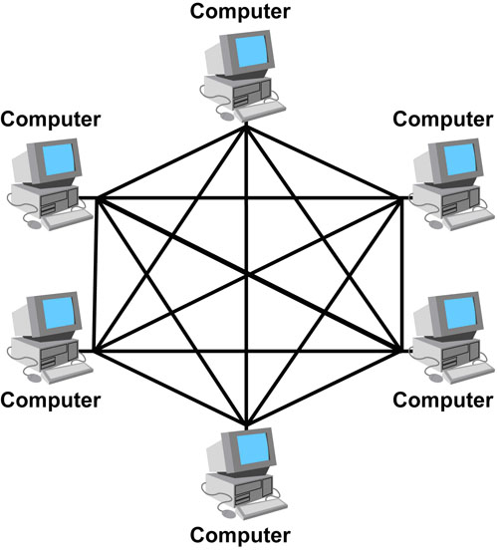
Mesh

Slide 17
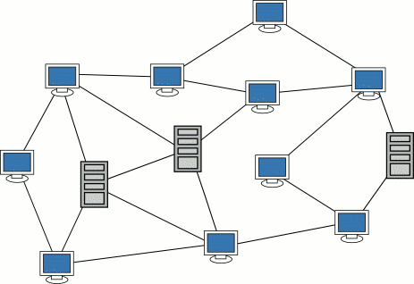
Simple Physical Topologies
Mesh Topology: Each computer connects to every other.
High level of redundancy.
Rarely used.
Wiring is very complicated
Cabling cost is high
Troubleshooting a failed cable is tricky
A variation hybrid mesh – create point to point
connection between specific network devices, often
seen in WAN implementation.

Slide 18
Mesh
Advantages
Disadvantage
Robust
There is the advantage of privacy or security
The network can be expanded without disruption to current uses
Point to point links make fault identification and fault isolation easy
Requires more cable than the other LAN topologies
Complicated implementation
Installation and reconnection are difficult.
Sheer bulk of wiring can be greater than the available space can accommodate
Expensive

Slide 19
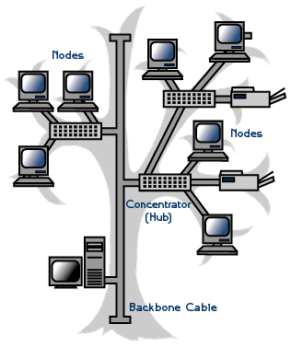
Hybrid Physical Topologies
One example of Hybrid Topology is Tree topology
Tree topology: is a combination of Bus and Star topology.
It consists of groups of star-configured
workstations connected to a linear bus backbone cable.
If the backbone line breaks, the entire
segment goes down
An example of this network could be
cable TV technology

Slide 20
Choosing a Topology
BUS
network is small
network will not be frequently reconfigured
least expensive solution is required
network is not expected to grow much
STAR
it must be easy to add/remove PCs
it must be easy to troubleshoot
network is large
network is expected to grow in the future
RING
network must operate reasonably under heavy load
higher speed network is required
network will not be frequently reconfigured

