Slide 1
Chapter 1 Pseudocode & Flowcharts
1st Semester 2015

Slide 2
Levels of Program Development
Define the problem. →Human thought
Plan the problem solution. → writing the algorithm [pseudo-natural language (English, Arabic) or drawing the flowchart diagram).
Code the program. → High Level Programming Language (C, C++, Java, …)
Compile the program. → Machine Code
Run the program.
Test and debug the program.

Slide 3
From Lec1 we learn that
When planning for a problem solution, algorithms are used to outline the solution steps using
English like statements, called pseudocode.
or
A flowchart , which is a graphical representation of an algorithm.

Slide 4
Pseudocode
Pseudocode is a detailed description of what a computer program must do, expressed in an English like language rather than in a programming language.

Slide 5
Pseudocode Example
Write a Program to Print the Sum of two integer Numbers
Start the program
Read the first number and save in the variable ( N1 )
Read the second number and save in the variable ( N2 )
Sum the both numbers and save the result in the variable ( Sum ) ➔ Sum = N1 + N2
Print the variable ( Sum )
End the program

Slide 6
Flowchart
A flowchart is a type of diagram that represents an algorithm , showing the steps as boxes of various kinds [ex: rectangles, diamonds, ovals], and their order by connecting these with arrows.

Slide 7
Flowcharts Symbols
Start/End
End
Start
Read/Print (input/output)
Print n1
Read n1
Arithmetic Operations (process)
N2 = n1+3
N2 = 5
Decision , can be used with loops
n1 > 3
Move from step to step

Slide 8
Solution
start
Draw a flowchart for a program that calculates
and print the area and the perimeter of
a rectangle.
Input
Length
width
Processing
Area = length*width
Perimeter = 2*( length + width)
Output
Area
Perimeter
Read L, W
area = L * W
perimeter = 2 (L+W)
Print area
Print perimeter
End

Slide 9
Example 2
Draw the flow chart for a program that calculates the total salary for an employee using this equation:
Total_Sal = Salary +Overtime

Slide 10
Solution
start
Input
Salary
Overtime
Processing
Total_Sal = Salary +Overtime
Output
Total_Sal
Read Salary
Read Overtime
Total_Sal =
Salary +Overtime
Print Total_Sal
End

Slide 11
Example 3
Draw a flowchart for a program that determine if the temperature degree is above or below freezing.
Input
Temp.
Processing
Check if Temp is below the 32 → below freezing.
Check if Temp is above the 32 → above freezing.
Output
Print “below freezing” or “above freezing”

Slide 12
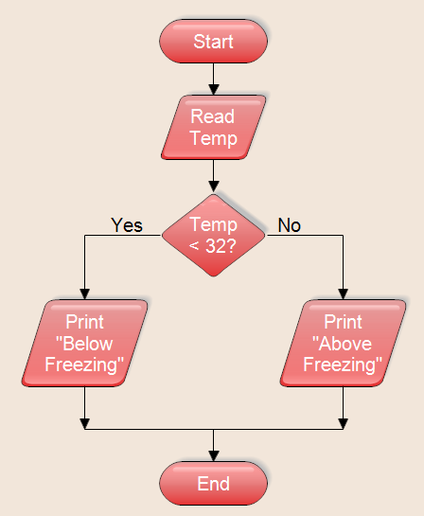
Solution

Slide 13
Example 4
Draw a flowchart for a program that calculates the Zakat, where the user enter the amount of money then the program show the zakat.
Zakat =(2.5/100) * amount.
Zakat is not calculated if the amount is less than 1000 S.R

Slide 14
Solution
Input
amount.
Processing
Check if amount is below 1000 → Zakat =0.
Check if amount is above 1000→ Zakat =(2.5/100) * amount
Output
Zakat

Slide 15
Solution
Start
Read amount
no
Amount > 1000
yes
Zakat =0.
Zakat =(2.5/100)*amount
Print Zakat
End

Slide 16
Example 5
Draw a flowchart to find the sum of first 50 natural numbers.
1+2+3+ ….. +50

