Slide 1

CT1305
Computer Networks Management
Standards, Models and Language
Dr. Mostafa H. Dahshan
Department of Computer Engineering
College of Computer and Information Sciences
King Saud University
mdahshan@ksu.edu.sa

Slide 2
Acknowledgements
• Notes are based on slides of:
• Network Management: Principles and Practice, 2E, Mani Subramanian.
• Computer Networking, a Top-Down Approach, 6E, J. Kurose and K. Ross.
2

Slide 3
Overview
• Standards
• Network Models
• Management communication protocols
• ASN.1 language
• Basic encoding rule
• Management application functions
3

Slide 4
Standards
• Standards organizations
• Protocol standards of transport layers
• Protocol standards of management (application) layer
4

Slide 5
Table 3.1 Network Management Standards
Standard
Notable Points
OSI/CMIP
1. International standard (ISO/OSI)
2. Management of data communications network - LAN and WAN
3. Deals with all 7 layers
4. Most complete
5. Object oriented
6. Well structured and layered
7. Consumes large resource in implementation
SNMP/Internet 1. Industry standard (IETF)
2. Originally intended for management of Internet components,
currently adopted for WAN and telecommunication systems
3. Easy to implement
4. Most widely implemented
5

Slide 6
Table 3.1 Network Management Standards
Standard Notable Points
TMN
1. International standard (ITU-T)
2. Management of telecommunications network
3. Based on OSI network management framework
4. Addresses both network and administrative aspects of management
IEEE
1. IEEE standards adopted internationally
2. Addresses LAN and MAN management
3. Adopts OSI standards significantly
4. Deals with first two layers of OSI RM
6

Slide 7
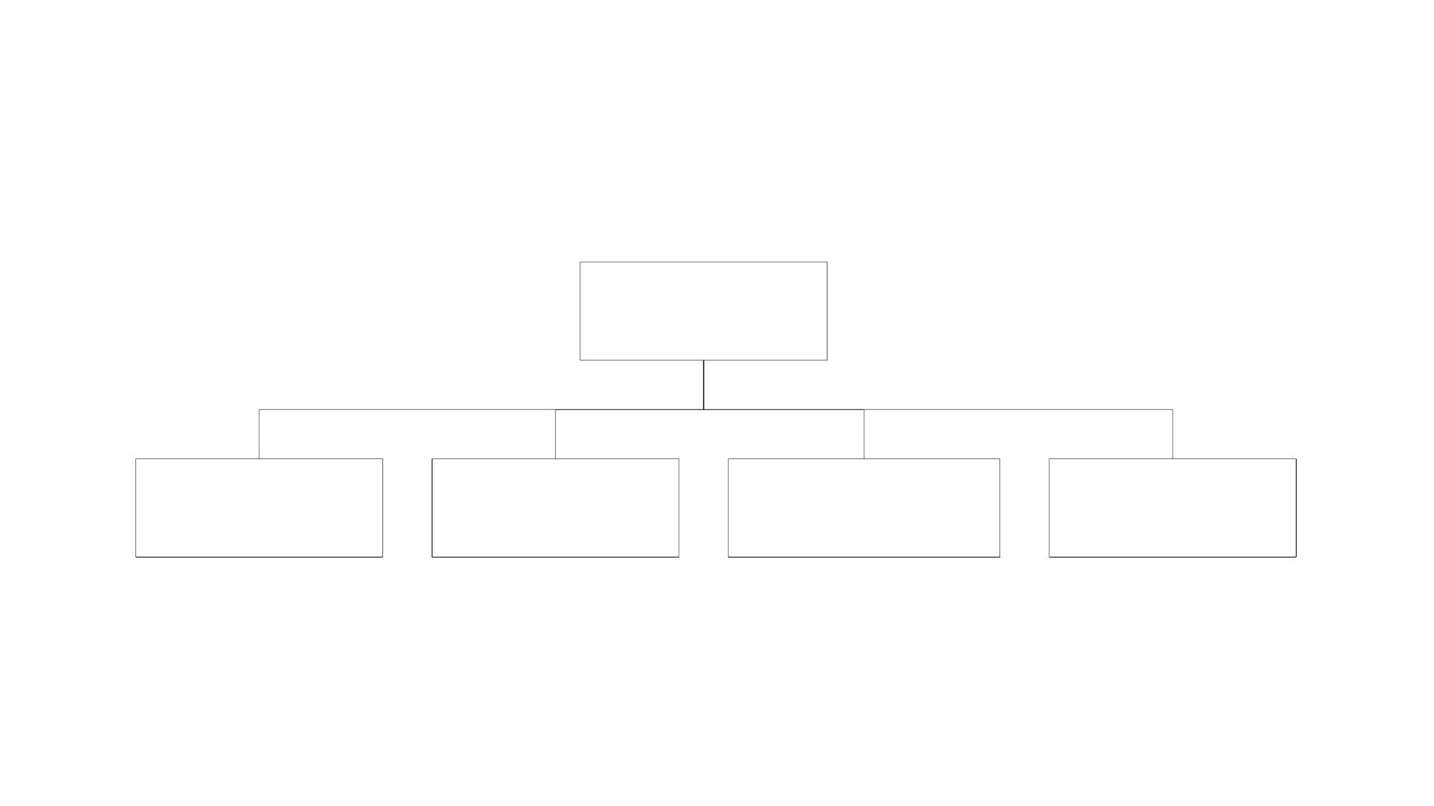
OSI Architecture and Model
Network
Management
Organization
Model
Information
Model
Communication
Model
Functional
Model
Figure 3.1 OSl Network Management Model
7

Slide 8
OSI Architecture and Model
• Organization
• Network management components
• Functions of components
• Relationships
• Information
• Structure of management information (SMI)
• Syntax and semantics
• Management information base (MIB)
• Organization of management information
• Object-oriented
8

Slide 9
OSI Architecture and Model
• Communication
• Transfer syntax with bidirectional messages
• Transfer structure (PDU)
• Functions
• Application functions
• Configure components
• Monitor components
• Measure performance
• Secure information
• Usage accounting
9

Slide 10
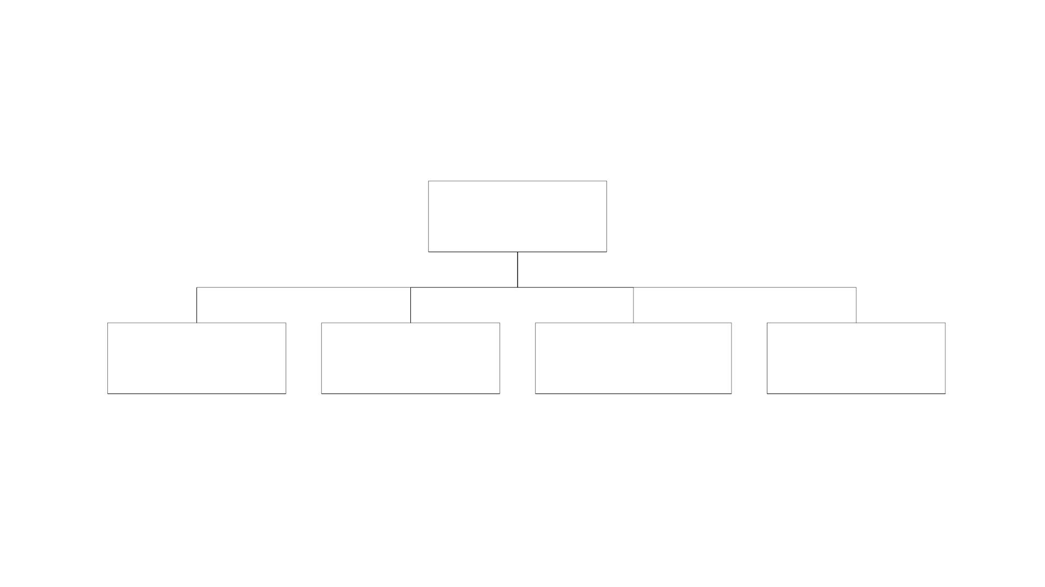
SNMP Architecture and Model
Network
Management
Organization
Model
Information
Model
Communication
Model
Functional
Model
10

Slide 11
SNMP Architecture and Model
• Organization
• Same as OSI model
• Information
• Same as OSI, but scalar
• Communication
• Messages less complex than OSI and unidirectional
• Transfer structure (PDU)
11

Slide 12
SNMP Architecture and Model
• Functions
• Application functions
• Fault management
• Configuration management
• Account management
• Performance management
• Security management
12

Slide 13
TMN Architecture
• Addresses management of telecommunication networks
• Based on OSI model
• Superstructure on OSI network
• Addresses network, service, and business management
13

Slide 14
Organizational Model
• Manager
• Manages the managed objects.
• Sends requests to agents
• Monitors alarms
• Houses applications
• Provides user interface
14

Slide 15
Organizational Model
• Agent
• Gathers information from objects
• Configures parameters of objects
• Responds to managers’ requests
• Generates alarms and sends them to managers
• Managed object
• Network element that is managed
• Houses management agent
• All objects are classified as either not managed / manageable
15

Slide 16
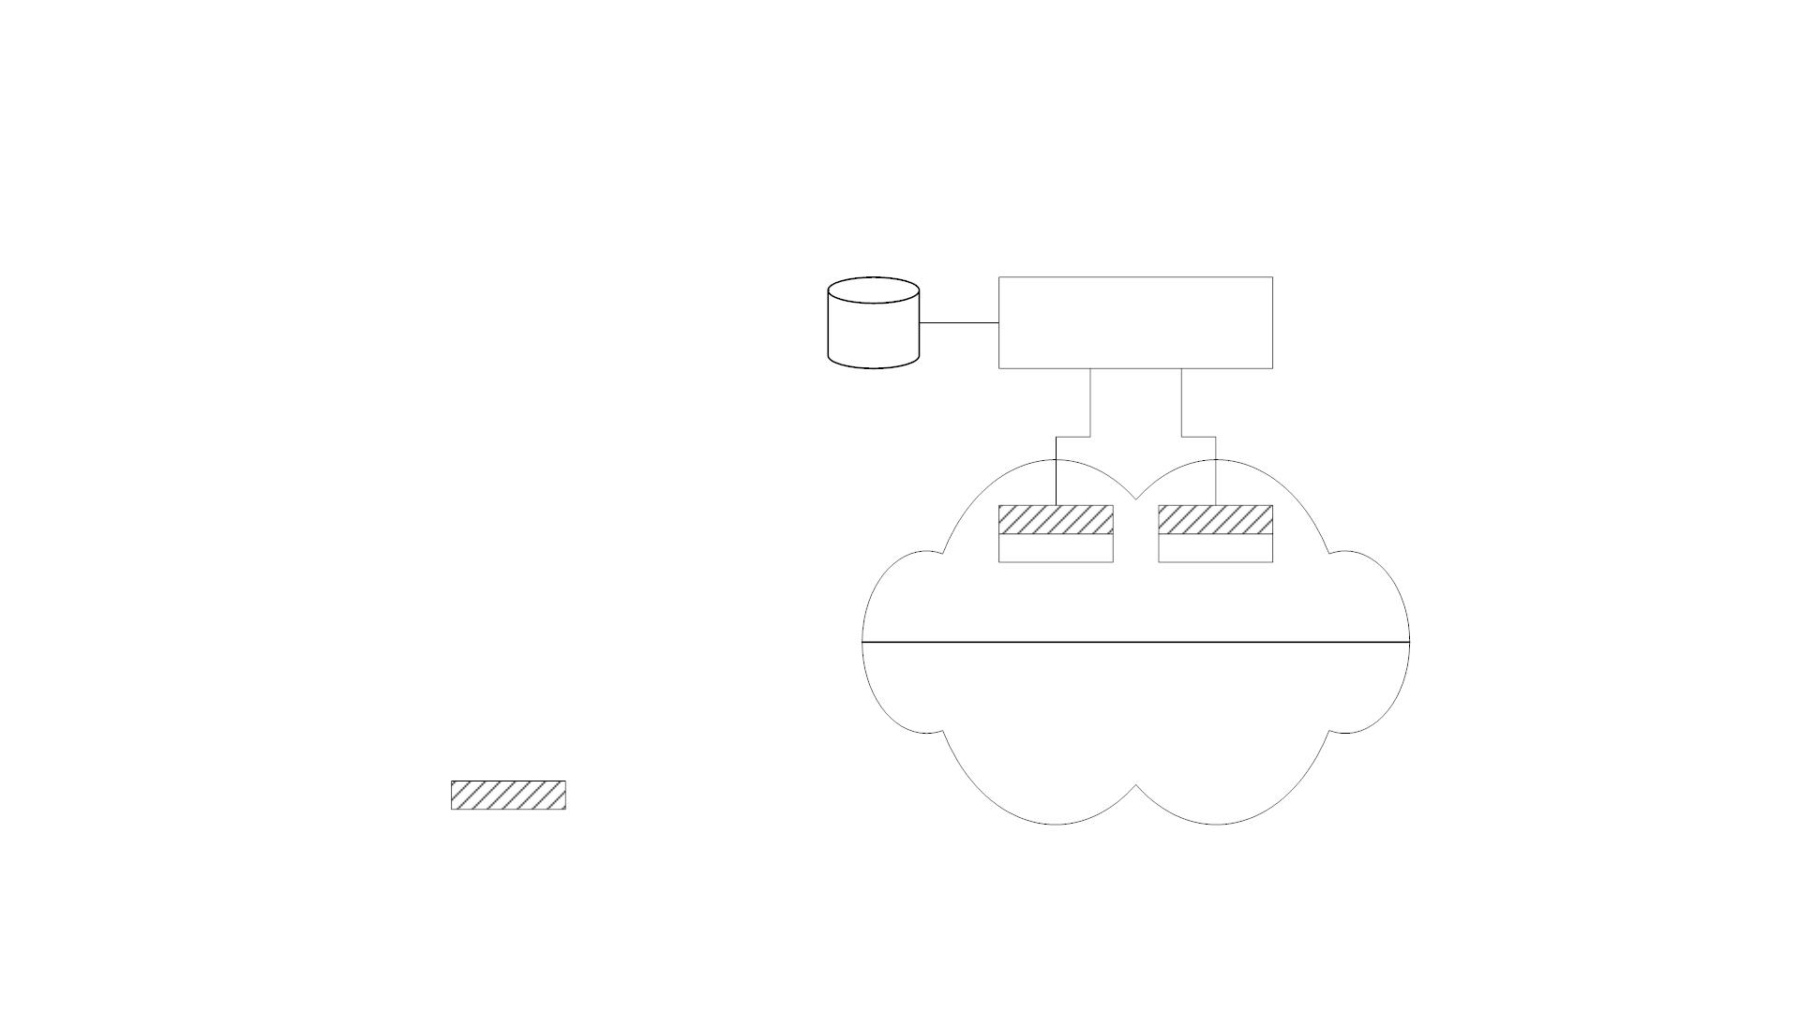
Two-Tier Model
MDB
Manager
Managed objects
Unmanaged objects
MDB Management Database
Agent process
Figure 3.2 Two-Tier Network Management Organization Model
16

Slide 17
Two-Tier Model
• Agent built into network element
• Example: Managed hub, managed router
• An agent can manage multiple elements
• Example: Switched hub, AT M switch
• MDB is a physical database
• Unmanaged objects are network elements that are not managed -
both physical (unmanaged hub) and logical (passive elements)
17

Slide 18
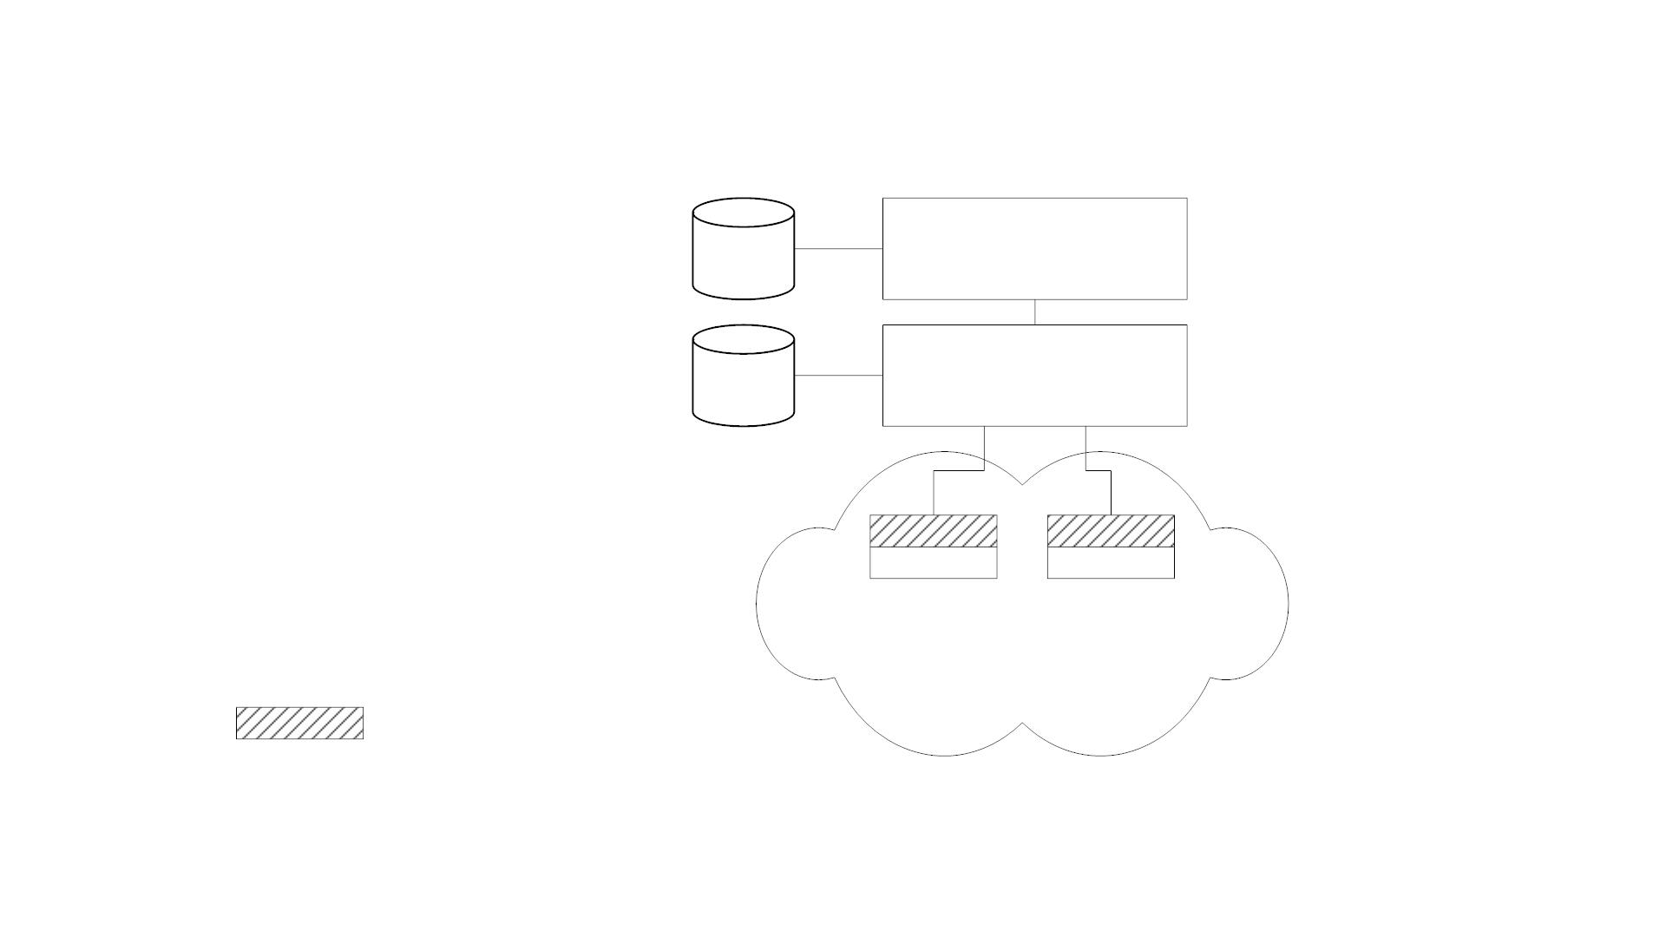
Three-Tier Model
MDB
MDB
Manager
Agent / Manager
Managed objects
MDB Management Database
Agent process
Figure 3.3 Three-Tier Network Management Organization Model
18

Slide 19
Three-Tier Model
• Middle layer plays the dual role
• Agent to the top-level manager
• Manager to the managed objects
• Example of middle level: Remote monitoring agent (RMON)
19

Slide 20
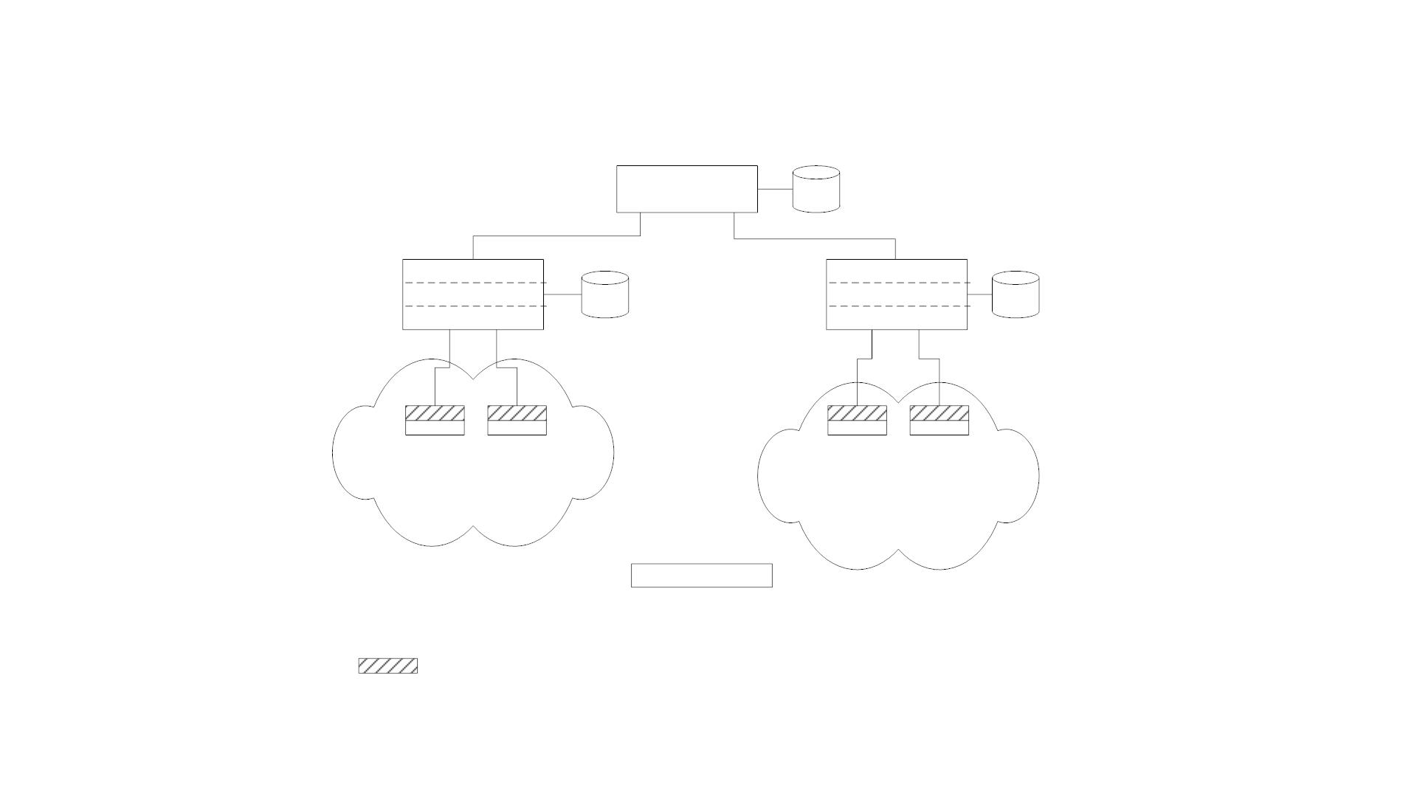
Manager of Managers
MoM
MDB
Agent
Agent
Agent NMS
Manager
MDB
Agent NMS
Manager
MDB
Managed objects
Managed objects
Agent NMS
MoM Manager of Managers
MDB Management Database
Agent
Manager
Agent process
Figure 3.4 Network Management Organization Model with MoM
20

Slide 21
Manager of Managers
• Agent NMS manages the domain
• MoM presents integrated view of domains
• Domain may be geographical, administrative, vendor-specific
products, etc.
21

Slide 22

Peer NMSs
• Dual role of both NMSs
Agent NMS
Manager NMS
Agent NMS
• Network management system
acts as peers
Manager NMS
• Manager and agent functions
are processes and not systems
Figure 3.5 Dual Role of Management Process
22

Slide 23
Information Model: Analogy
• Information model – Structure & storage of information
• Ex. Figure in a book uniquely identified by
• ISBN, Chapter, and Figure number in that hierarchical order
• ID: {ISBN, chapter, figure}
• The three elements above define the syntax
• Semantics is the meaning of the three entities according to Webster ’s
dictionary
• The information comprises syntax and semantics about an object
23

Slide 24
Structure of Management Information (SMI)
• SMI defines for a managed object
• Syntax
• Semantics
• Plus additional information such as status
• Example
sysDescr: { system 1 }
Syntax: OCTET STRING
Definition: "A textual description of the entity. "
Access: read-only
Status: mandatory
24

Slide 25
Structure of Management Information (SMI)
Management information model =
objects representation (SMI) +
management information of objects (MIB)
SMI defines the syntax & semantics of management
information stored in the MIB
Information model specifies the information base to
describe managed objects and their relationships
(i.e., MIB)

Slide 26
Management Information Base (MIB)
• Information base contains information about objects
• Organized by grouping of related objects
• Defines relationship between objects
• It is NOT a physical database. It is a virtual database that is compiled
into management module
25

Slide 27
MIB View and Access of an Object
• A managed object has many attributes – its information base
• There are several operations that can be performed on the objects
• A user (manager) can view and perform only certain operations on
the object by invoking the management agent
• The view of object attributes that agent perceives is the MIB view
• The operation that a user can perform is the MIB access
26

Slide 28
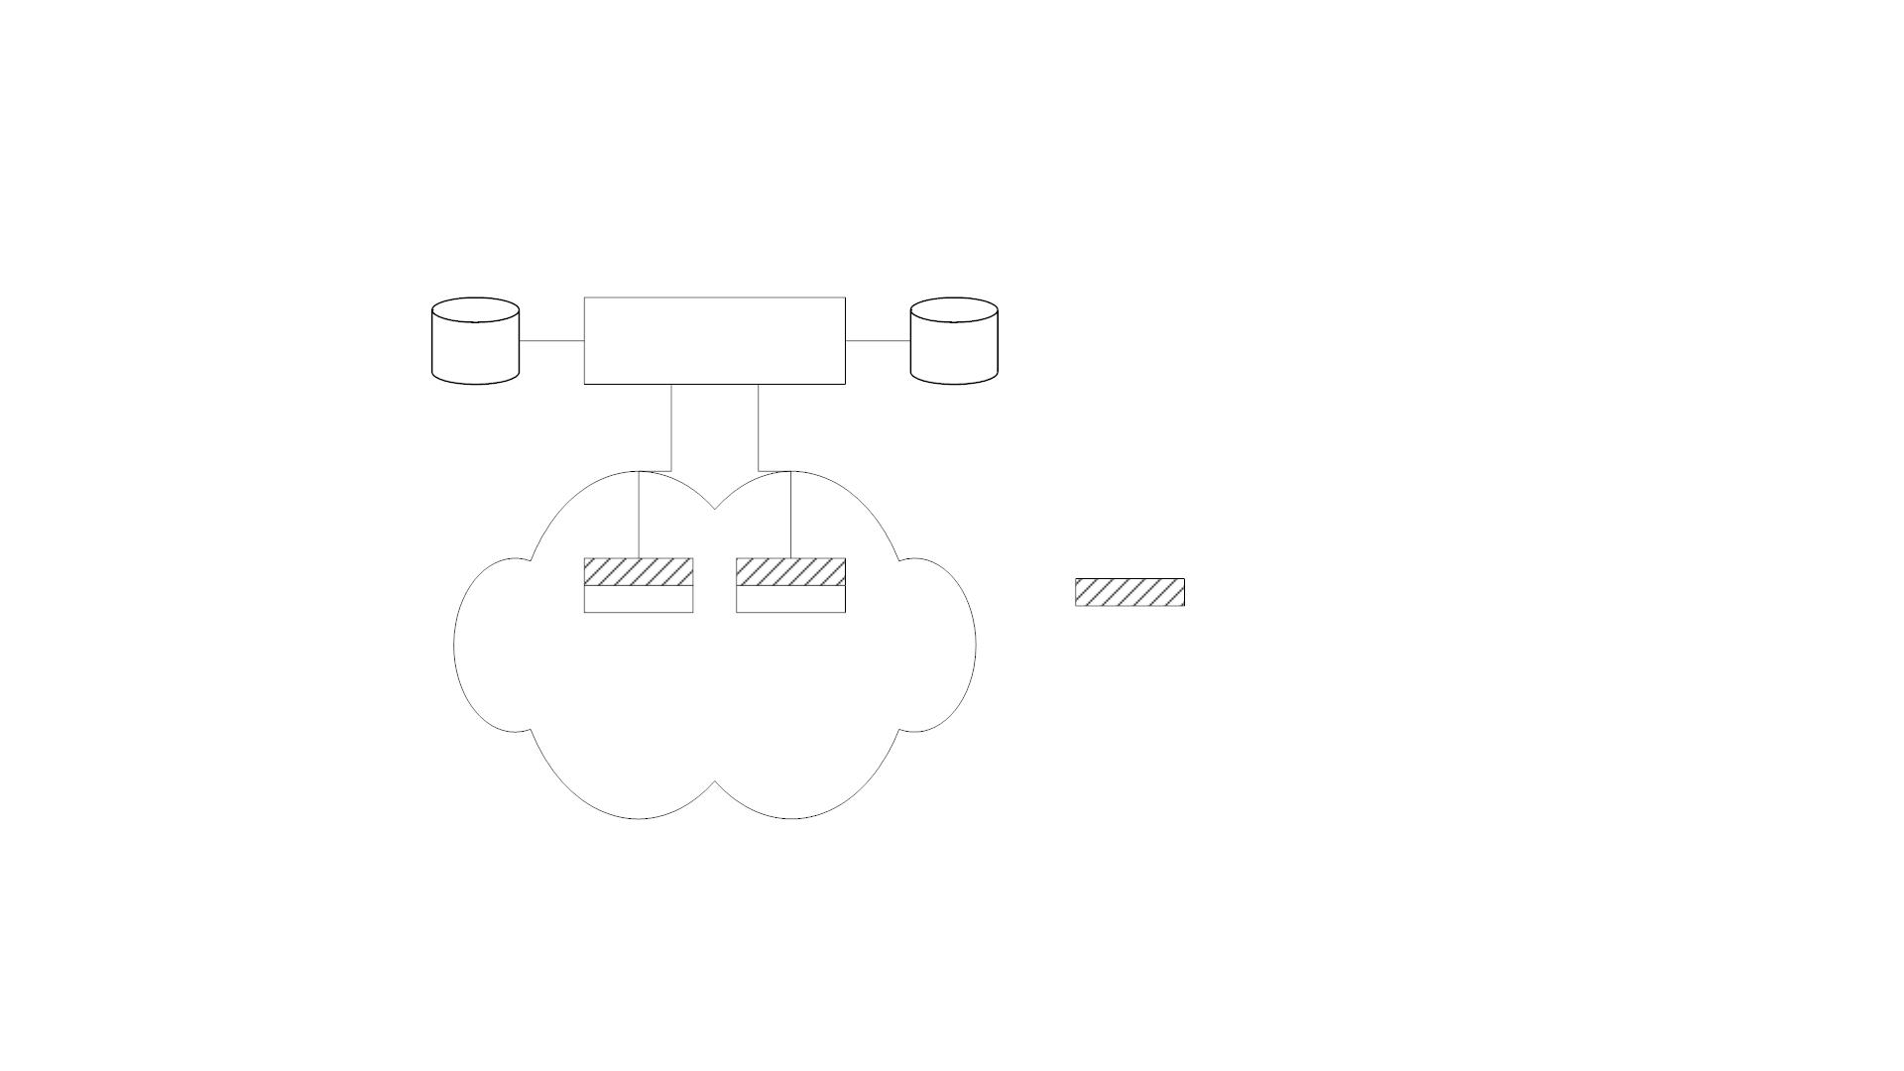
Management Data Base / Information Base
MDB
Manager
MIB
MDB Management Database
MIB Management Information Base
Agent process
Managed objects
Figure 3.6 Network Configuration with Data and Information Base
27

Slide 29
Management Data Base / Information Base
• Distinction between MDB and MIB
• MDB physical database; e.g., Oracle, Sybase
• MIB virtual database; schema compiled into management software
• An NMS can automatically discover a managed object, such as a hub,
when added to the network
• The NMS can identify the new object as hub only after the MIB
schema of the hub is compiled into NMS software
28

Slide 30
Managed Object
• Managed objects can be
• Network elements (hardware, system)
• Hubs, bridges, routers, transmission facilities
• Software (non-physical)
• Programs, algorithms
• Administrative information
• Contact person, name of group of objects (IP group)
29

Slide 31
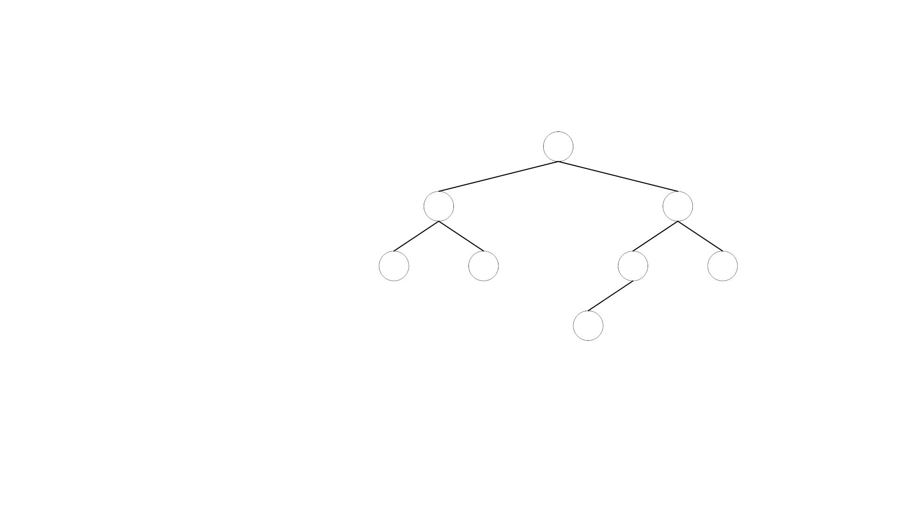
Management Information Tree
Root
Level 1
Level 2
Level 3
Figure 3.7 Generic Representation of Management Information Tree
30

Slide 32
OSI Management Information Tree
• iso International Standards Organization
itu International Telecommunications Union
dod Department of Defense
• Designation:
• iso
• org
• dod
1
1.3
1.3.6
• internet 1.3.6.1
31

Slide 33
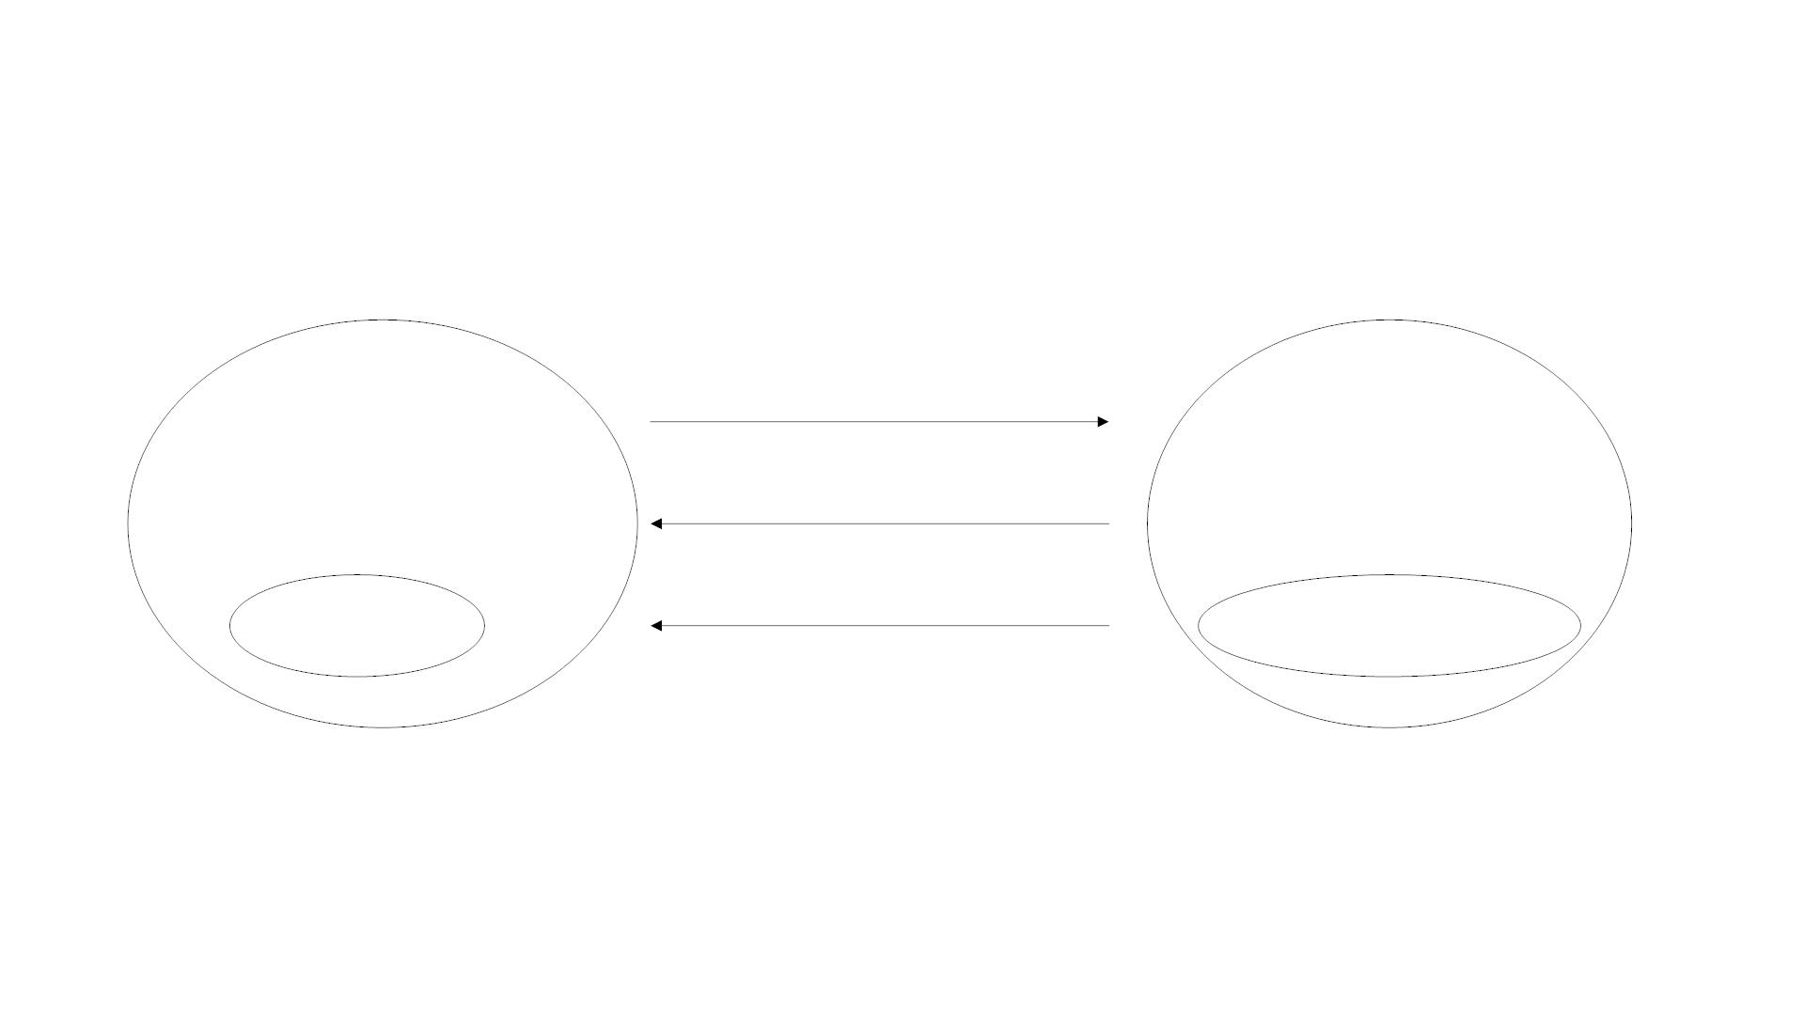
Management and Communication Model
Operations / Requests
Manager
Responses
Agent
Network Elements /
Managed Objects
Applications
Notifications / Traps
Figure 3.11 Management Message Communication Model
32

Slide 34
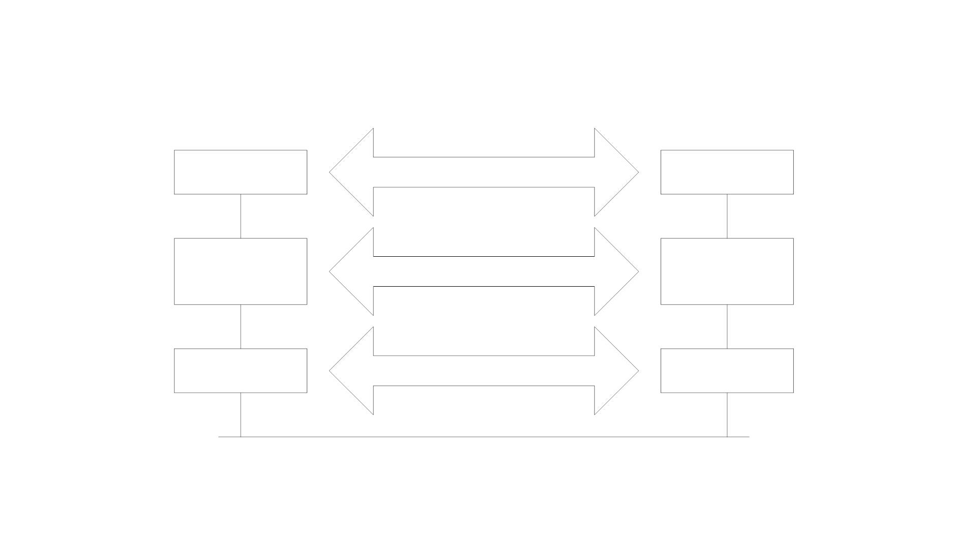
Transfer Protocols
Manager
Operations / Requests / Responses
Agent
Applications
Traps / Notifications
Applications
Manager
Communication
Module
SNMP (Internet)
CMIP (OSI)
Agent
Communication
Module
Transport Layers
UDP / IP (Internet)
OSI Lower Layer Profiles (OSI)
Transport Layers
Physical Medium
Figure 3.12 Management Communication Transfer Protocols
33

