Slide 1
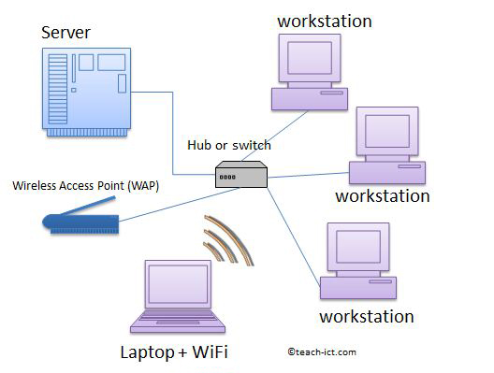
Lecture 1: Introduction to Network Operating Systems
By: Elham Sunbu

Slide 2
OUTLINES
What is Operating Systems ??
Types of computers in the network
Features of operating systems
Types of Operating Systems
Networks Operating Systems
Review of LAN and WAN
Advantages of Wide area network
Disadvantages of Wide area network

Slide 3
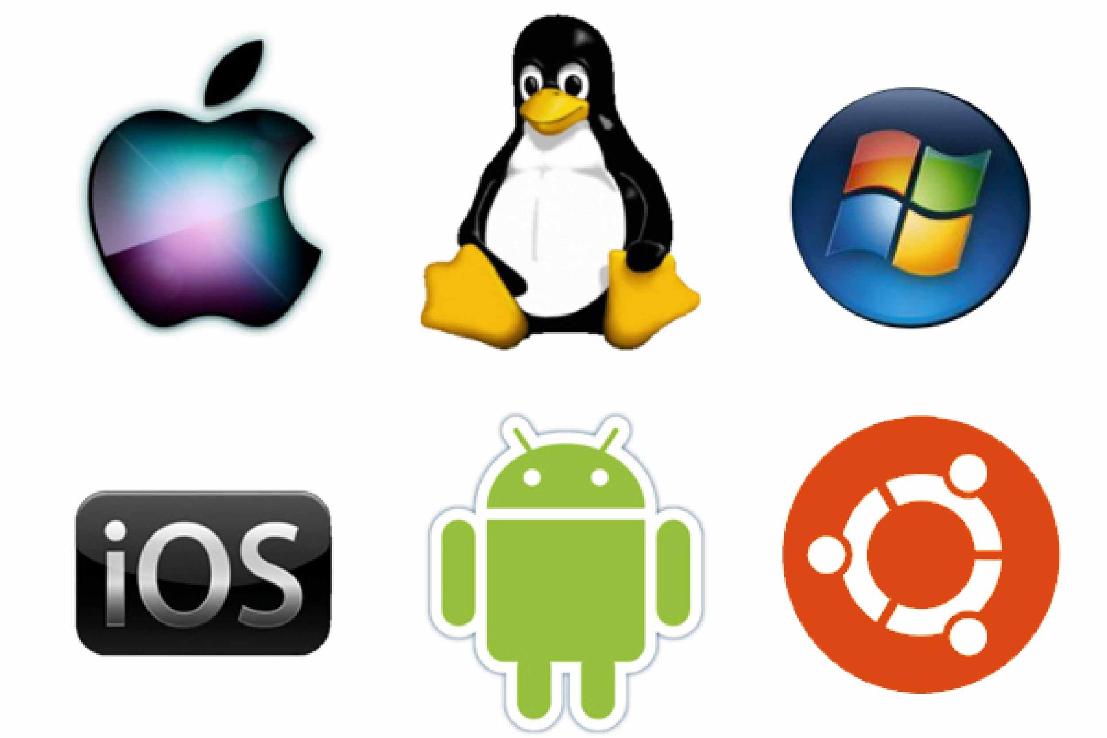
What is Operating Systems ??
is software that manages computer hardware and software resources and provides common services for computer programs.
Operating systems form an essential component of the system software in a computer system. Application programs usually require an operating system to function.

Slide 4
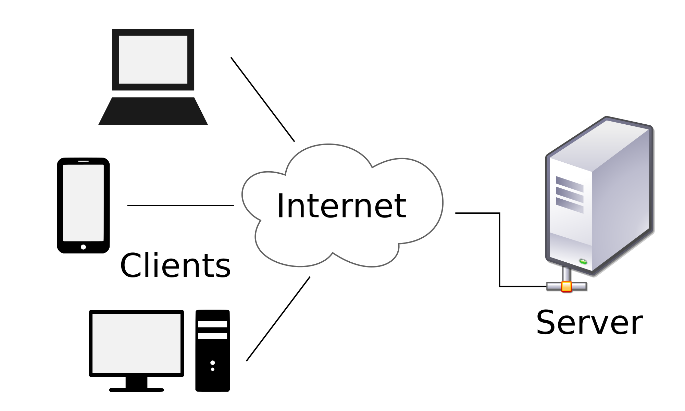
Types of computers in the network:
The client: The client requests data services from servers on the network.
SERVER: Server supplying services or data to clients on the network.

Slide 5
Features of operating systems
Process management
Memory management
Disk and file system
Networking
5

Slide 6
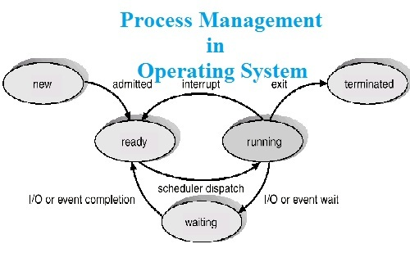
Process management
It deals with running multiple processes. Most operating system allow a process to be assigned a priority which affects its allocation of CPU time.
Interactive operating systems also employ some level of feedback in which the task with which the user is working receives higher priority. In many systems there is a background process which runs when no other process is waiting for the CPU.
6

Slide 7
Memory management
The memory manager in an OS coordinates the memories by tracking which one is available, which is to be allocated or deallocated and how to swap between the main memory and secondary memories.
The operating system tracks all memory used by each process so that when a process terminates, all memory used by that process will be available for other processes.
7

Slide 8
Disk and file systems:
Operating systems have a variety of native file systems that controls the creation, deletion, and access of files of data and programs.
8

Slide 9
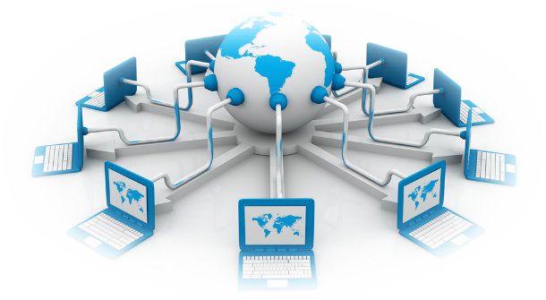
Networking
Most current operating systems are capable of using the TCP/IP networking protocols. This means that one system can appear on a network of the other and share resources such as files, printers, and scanners. Many operating systems also support one or more vendor-specific legacy networking protocols as well.
9

Slide 10
Types of Operating Systems
Single-user, (single task and , multi-tasking)
Multi-user
Embedded
Real time
10

Slide 11
SINGLE USER
2
TWO TYPES:
Single user, single task
Single user, multi tasking

Slide 12
Single user, single task
3
As the name implies, this operating system is designed to manage the computer so that one user can effectively do one thing at a time.
Example: The Palm OS for Palm handheld computers

Slide 13
Single user, multi tasking
4
This is the type of operating system most people use on their desktop and laptop computers today. Microsoft's Windows and Apple's MacOS platforms are both examples of operating systems that will let a single user have several programs in operation at the same time.
Designed with a single user in mind but can deal with many applications running at the same time
Type of operating system most people use on their desktop and laptop computers today
For Example: It's entirely possible for a Windows user to be writing a note in a word processor while downloading a file from the Internet while printing the text of an e-mail message.
3/1/2015

Slide 14
Multi-user
7
A multi-user operating system allows many different users to take advantage of the computer's resources simultaneously. The operating system must make sure that the requirements of the various users are balanced, and that each of the programs they are using has sufficient and separate resources so that a problem with one user doesn't affect the entire community of users.
Allows multiple users to access the computer system at the same time
Time Sharing system and Internet servers as the multi user systems
Examples: UNIX, VMS and Mainframe Operating systems

Slide 15
MULTI TASKING
9
Allows more than one program to run concurrently.
The tasks share common processing resources, such as a CPU and main memory
In the process, only one CPU is involved, but it switches from one program to another so quickly that it gives the appearance of executing all the programs at the same time.
screenshot of Debian Linux (version 7.1, "Wheezy") running the GNOME desktop environment, Firefox, Tor, and VLC media player, all at the same time.

Slide 16
EMBEDDED OS
13
Designed to be used in embedded computer systems
Are able to operate with a limited number of resources on small machines like PDAs
Are very compact and extremely efficient by design
is a computer that is part of a different kind of machine
Examples include computers in cars, digital televisions, ATMs, airplane controls, digital cameras, GPS navigation systems, elevators, and among many other possibilities.
Embedded OS in a car
Android OS in digital camera

Slide 17
REAL TIME OPERATING SYSTEM
15
is a multitasking operating system that aims at executing real-time applications.
The main objective of real-time operating systems is their quick and predictable response to events
In it, the time interval required to process and respond to inputs is so small that it controls the environment
Examples: QNX, RTLINUX
Are used to control machinery, scientific instruments and industrial systems

Slide 18
Networks Operating Systems
Network operating system refers to software that implements an operating system of some kind that is oriented to computer networking.
For example, one that runs on a server and enables the server to manage data, users, groups, security, applications, and other networking functions.
The network operating system is designed to allow shared file and printer access among multiple computers in a network,
typically a local area network (LAN),
18

Slide 19
Review of
LAN & WAN
19

Slide 20
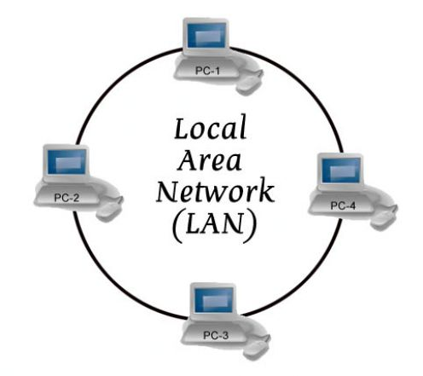
Local area network (LAN)
A local area network (LAN) is a computer network within a small geographical area such as a home, school, computer laboratory, office building or group of buildings.
20

Slide 21
Advantages of LAN or Local Area Network
Resource Sharing
Computer resources like printers, modems, DVD-Rom drives and hard disks can be shared with the help of local area networks. This will reduce cost of hardware purchases.
Software Applications Sharing
It is cheaper to use same software over network instead of purchasing separate licensed software for each client in a network.
Easy and Cheap Communication
Data and messages can easily be transferred over networked computers.
21

Slide 22
Advantages of LAN or Local Area Network
Centralized Data
The data of all network users can be saved on hard disk of the server computer. This will help users to use any workstation in a network to access their data. Because data is not stored on workstations locally.
Data Security
Since, data is stored on server computer centrally, it will be easy to manage data at only one place and the data will be more secure too.
Internet Sharing
Local Area Network provides the facility to share a single internet connection among all the LAN users. In Net Cafes, single internet connection sharing system keeps the internet expenses cheaper.
22

Slide 23
Disadvantages of LAN or Local Area Network
High Setup Cost
Although the LAN will save cost over time due to shared computer resources but the initial setup costs of installing Local Area Networks is high.
Privacy Violations
The LAN administrator has the rights to check personal data files of each and every LAN user. Moreover he can check the internet history and computer use history of the LAN users.
Covers Limited Area
Local Area Network covers a small area like one office, one building or a group of nearby buildings.
23

Slide 24
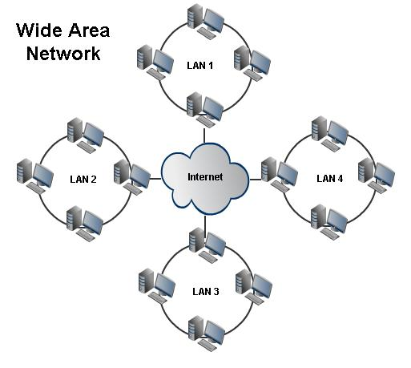
Wide area network (WAN)
A wide area network (WAN) is a geographically distributed private telecommunications network that interconnects multiple local area networks (LANs).
24

Slide 25
Advantages of Wide area network
Covers a large geographical area
So long distance businesses can connect on the one networkShares software.
Speed
Messages can be sent very quickly to anyone else on the network. These messages can have pictures, sounds.
25

Slide 26
Disadvantages of wide area network
High setup costs — WANs are complicated and complex, so they are rather expensive to set up. Obviously, the bigger the WAN, the costlier it is to set up.
Security Concerns —WANs open the way for certain types of internal security breaches, such as unauthorized use, information theft, and malicious damage to files.
Maintenance Issues — Maintaining a WAN is a challenge, no doubt about it. Guaranteeing that your data center will be up and operating 24/7 is the biggest maintenance challenge of all.
26

Slide 27
Any Question?

