Slide 1
Introduction to Data Communication and Computer Networks
2nd semester 2018 - 2019

Slide 2
205NET LOC
-Introduction to Communication Systems , Networks architecture, and OSI Reference Model.

Slide 3
Outline
DATA COMMUNICATION
COMPUTER NETWORKS
THE OSI MODEL
What is Data Communication
Communication System Model
Network definition, elements, purposes.
Different Network Classifications
The Functions of the LAYERS IN THE OSI MODEL

Slide 4
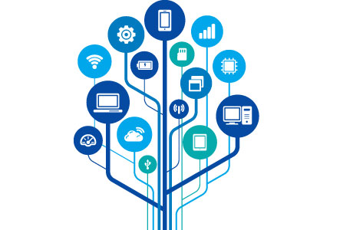
Data Communication

Slide 5
Communication
Notes:
Communication is the transmission of information.

Slide 6
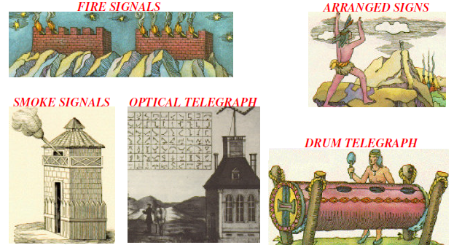
Long Distance Communication
Notes:
Communicating over long distances has been a challenge throughout history. Man has been seeking different ways of doing this since the beginning of time. The transmission of signals over a distance for the purpose of communication began thousands of years ago.
early methods of long-distance communication included runners to carry important messages, smoke signals, chains of searchlights, drums, carrier pigeons, the Pony Express and the telegraph.
Source Destination Signal

Slide 7
What is Data Communication
Communication → Sharing of Information.
Local Sharing: face to face
Remote Sharing: over some distance.
Data → information being shared, e.g. text, numbers, images, audio, video.
Data Communications: exchange of data between two (or more) devices via some transmission medium.
Notes:
Sharing of information can be local or remote during communication. Local communication can be face to face or between human beings, while remote communication takes place over distance.
Data communication provide the exchange of data between two devices, some form of transmission medium such as a wire cable are required. The communicating devices must be part of a communication system made up of a combination of hardware (physical equipment) and software (programs) for data communication to occur

Slide 8
Communication
Communication System
Notes:
Communication is the transmission of information.

Slide 9
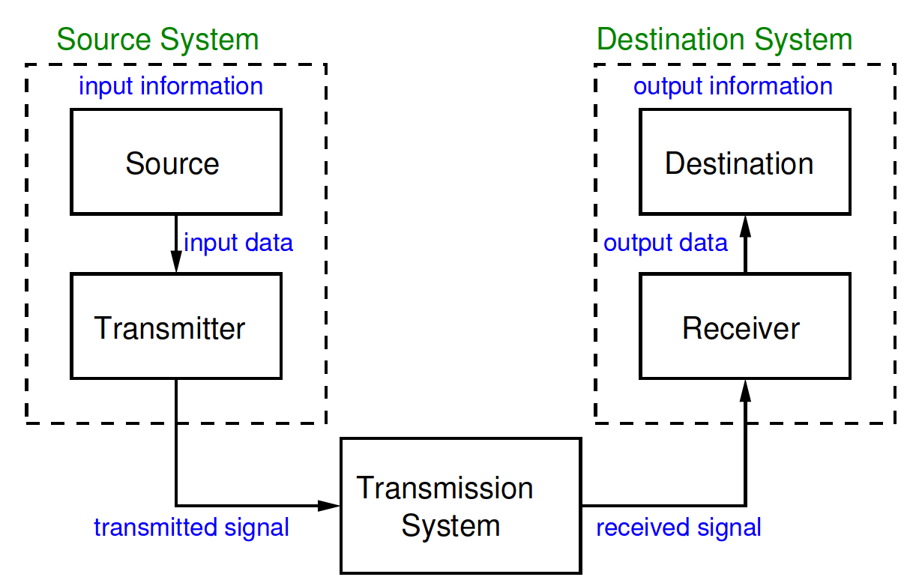
Communication System Model
A communication system is combination of hardware (physical equipment) and software (programs) that transfer information from source to destination
Notes:
The communicating devices must be part of a communication system made up of a combination of hardware (physical equipment) and software (programs) for data communication to occur

Slide 10
Device that generates data to be transmitted.
Converts data from source into transmittable signals.
Carries data from source to destination
Maybe simple as a single link/cable.
Or a complex network, e.g. the Internet.
Converts received signal into data.
Takes and uses incoming data.
Source
Transmitter
Destination
Receiver
Transmission
system

Slide 11
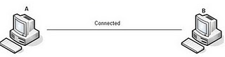
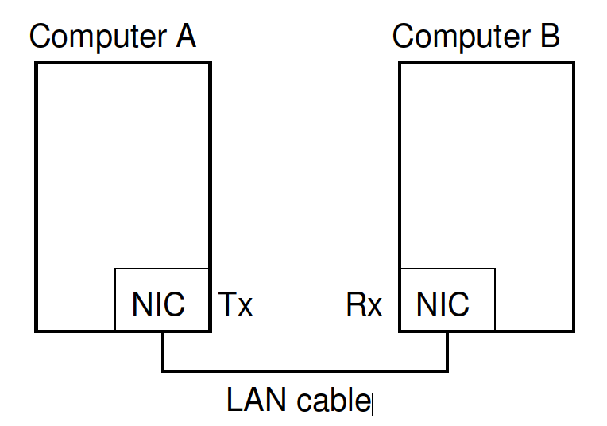
Example: Computer to Computer
Transmitter (Tx) is built into source computer (Network Interface Card)
Receiver (Rx) is built into destination computer
Transmission system is single link between two computers

Slide 12
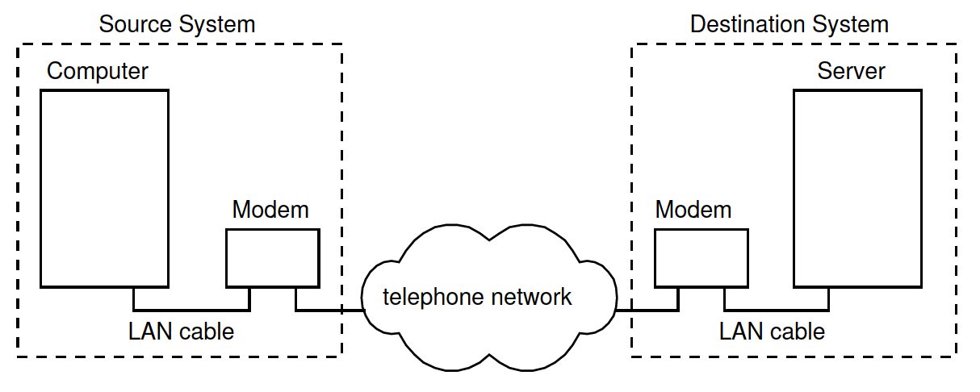
Example: Old Dialup Connection
Source and transmitter are separate devices (similar at destination).
Transmission system is telephone network.

Slide 13
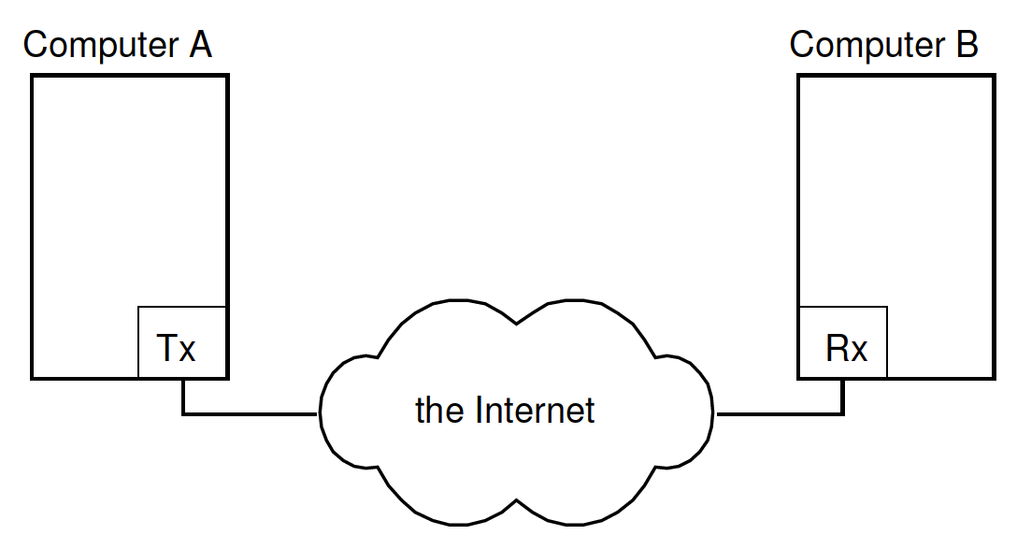
Example: Communications via the Internet
Source and transmitter may support different Technologies
Transmission system is the Internet

Slide 14
General Model for Communications via a Network
Source system generates data
Intermediate systems receive signal from previous system and then transmit to next system
Destination system receives and processes the data
Source and destination are connected via multiple transmission systems (or links) to form a network

Slide 15
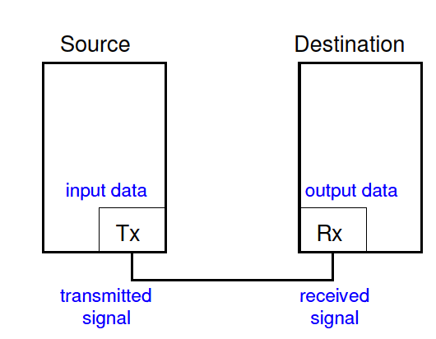
Challenges with Link Communications
How to convert information into transmittable signals?
What are the characteristics of signals?
What transmission media to use?
How to know who is at other end?
How to deal with errors?
How to share media amongst two or more transmitters?

Slide 16
Challenges with Networked Communications
How do intermediate systems receive/send data?
How to select which intermediate systems to send via?
What happens if failures within intermediate systems?
How to create applications without knowing the details of underlying network and technologies?

Slide 17
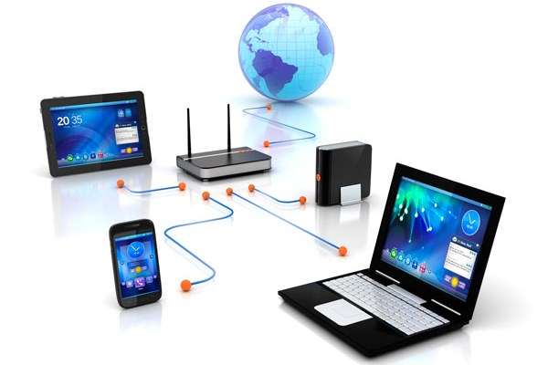
Computer Networks

Slide 18
What is a Network?
A computer network, often simply referred to as a network, is
a collection of computers or other hardware devices
that are connected together by communication channels
in order to communicate , exchange files, and share resources.

Slide 19
Elements of Network
Hardware equipment.
Network OS/ software.
Communication channel / Transmission media.
Information / data / resource.
Protocol.

Slide 20
Why Networking?
Resource Sharing
Hardware (computing resources, disks, printers)
Software (application software)
Information Sharing
Easy accessibility from anywhere (files, databases)
Search Capability (WWW)
Remote computing
Distributed processing
Communication
Email
Message broadcast
Centralize administration and support.

Slide 21
Network Classification
We can classify networks in different ways:
transmission media
Wired network
Wireless network
Network size
LAN
WAN
Management method
MAN
Peer-to-peer
Client/Server
Topology (connectivity)
Bus
Star
Ring
….

Slide 22
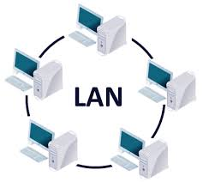
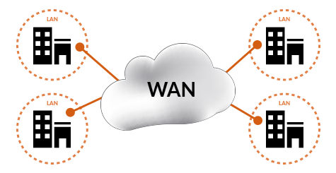
LAN and WAN

Slide 23
Local Area Network (LAN)
A network that connects a relatively small number of machines in a relatively close geographical area.
Wide Area Network (WAN)
A network that connects two or more local-area networks over a potentially large geographic distance
Notes:
Communication between networks is called internetworking
The Internet, as we know it today, is essentially the ultimate wide-area network, spanning the entire globe

Slide 24
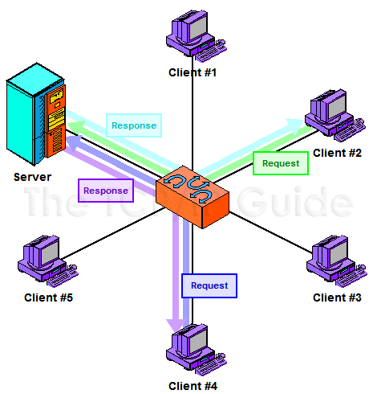
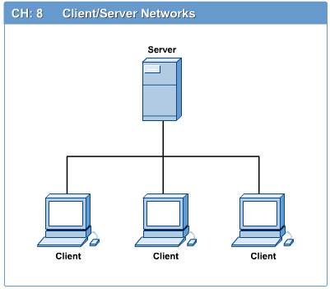
Clients and Servers
In a client/server network arrangement, network services are located in a dedicated computer whose only function is to respond to the requests of clients.

Slide 25
Network Clients (Workstation)
Computers that request network resources or services
Network Servers
Computers that manage and provide network resources and services to clients
Usually have more processing power, memory and hard disk space than clients
Run Network Operating System that can manage not only data, but also users, groups, security, and applications on the network
Servers often have a more stringent requirement on its performance and reliability
Notes:
Server computer is a core component of the network, providing a link to the resources necessary to perform any task.
A server computer provides a link to the resources necessary to perform any task.
The link it provides could be to a resource existing on the server itself or a resource on a client computer.
Client computers normally request and receive information over the network client. Client computers also depends primarily on the central server for processing activities
File server A computer that stores and manages files for multiple users on a network
Web server A computer dedicated to responding to requests (from the browser client) for web pages

Slide 26
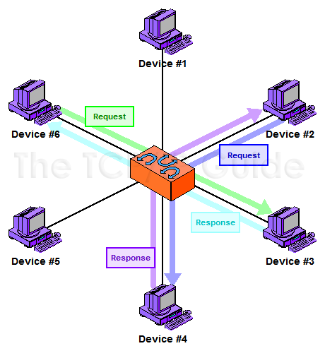
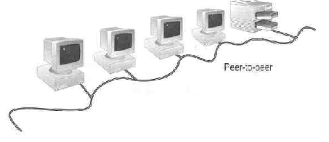
Peer-to-Peer Networks
Peer-to-peer network is also called workgroup
No hierarchy among computers  all are equal
No administrator responsible for the network

Slide 27
Where peer-to-peer network is appropriate:
10 or less users
No specialized services required
Security is not an issue
Only limited growth in the foreseeable future

Slide 28
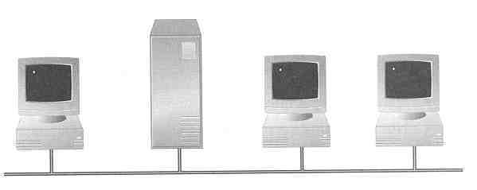
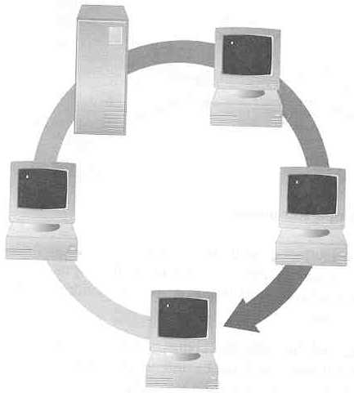
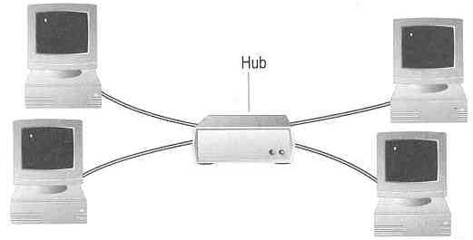
Network Topology
A topology is a way of “laying out” the network. Topologies can be either physical or logical.
3 basic types
Ring Topology
Bus Topology
Hub
Star Topology
Notes:
Physical topologies describe how the cables are run.
Logical topologies describe how the network messages travel
Bus (can be both logical and physical)
Star (physical only)
Ring (can be both logical and physical)

Slide 29
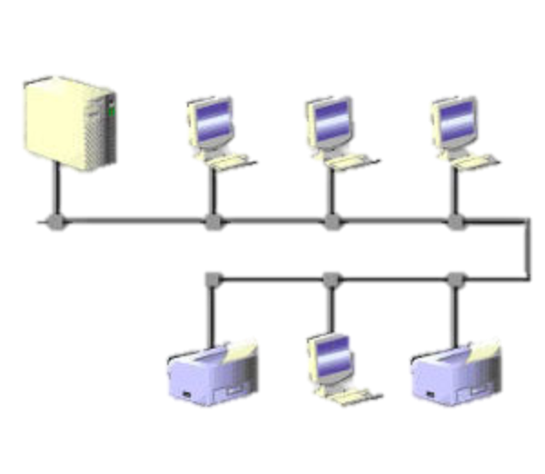
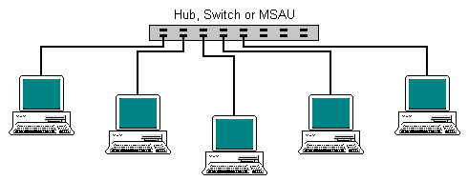
Bus Topology
Simple and low-cost
A single cable called a trunk (backbone, segment)
Only one computer can send messages at a time
Passive topology - computer only listen for, not regenerate data
Star Topology
Each computer has a cable connected to a single point
More cabling, hence higher cost
All signals transmission through the hub; if down, entire network down
Depending on the intelligence of hub, two or more computers may send message at the same time

Slide 30
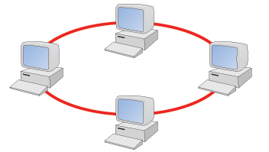
Ring Topology
Every computer serves as a repeater to boost signals
Typical way to send data:
Token passing: only the computer who gets the token can send data
Disadvantages
Difficult to add computers
More expensive
If one computer fails, whole network fails

Slide 31
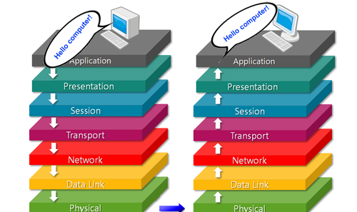
OSI Network model
Notes:
Proprietary system A system that uses technologies kept private by a particular commercial vendor
One system couldn’t communicate with another, leading to the need for
Interoperability The ability of software and hardware on multiple machines and from multiple commercial vendors to communicate
Leading to
Open systems Systems based on a common model of network architecture and a suite of protocols used in its implementation

Slide 32
Introduction
A network
Hardware
Software
Protocols
OS
…etc
Notes:
is a combination of hardware and software that sends data from one location to another.
The hardware consists of the physical equipment that carries signals from one point of the network to another.
The software consists of instruction sets that make possible the services that we expect from a network.

Slide 33
The OSI Model
OSI Model
Stands for Open Systems Interconnection
Developed by ISO – ‘International Organization of Standardization‘, 1974
It is a 7 layer architecture with each layer having specific functionality to performed.
All these 7 layers work collaboratively to transmit the data from one device to another
Notes:
The layered model that dominated data communication and networking literature before 1990.
Established in 1947, the International Standards Organization (ISO) is a multinational body dedicated to worldwide agreement on international standards. An ISO standard that covers all aspects of network communications is the Open Systems Interconnection (OSI) model. It was first introduced in the late 1970s.

Slide 34
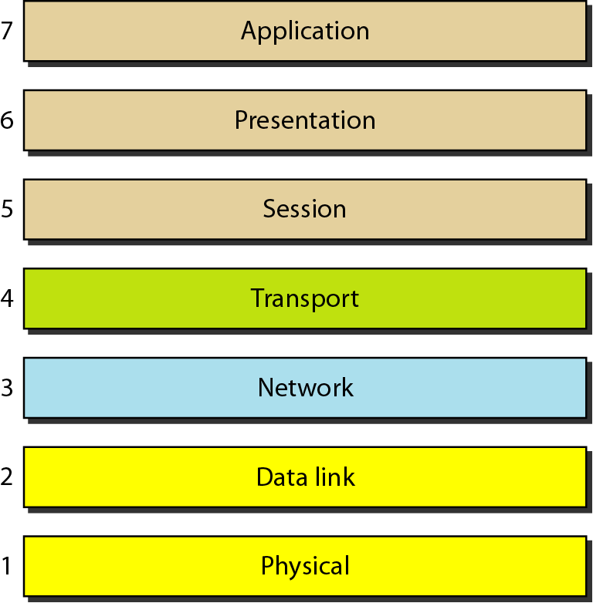
Seven layers of the OSI model

Slide 35
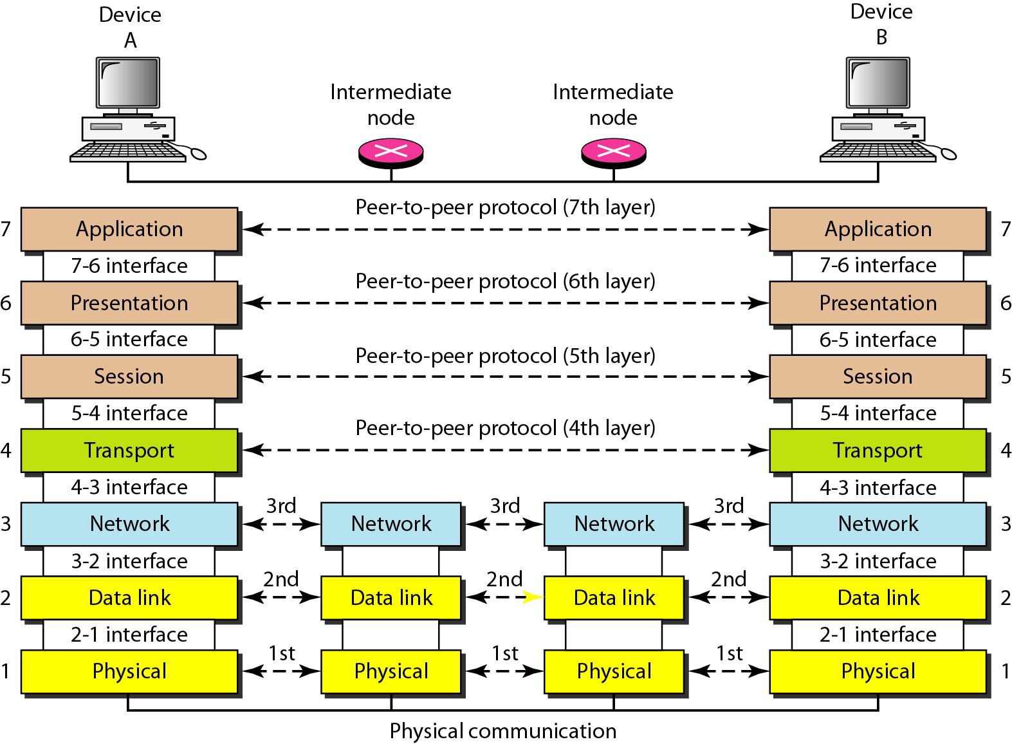
The interaction between layers in the OSI model

Slide 36
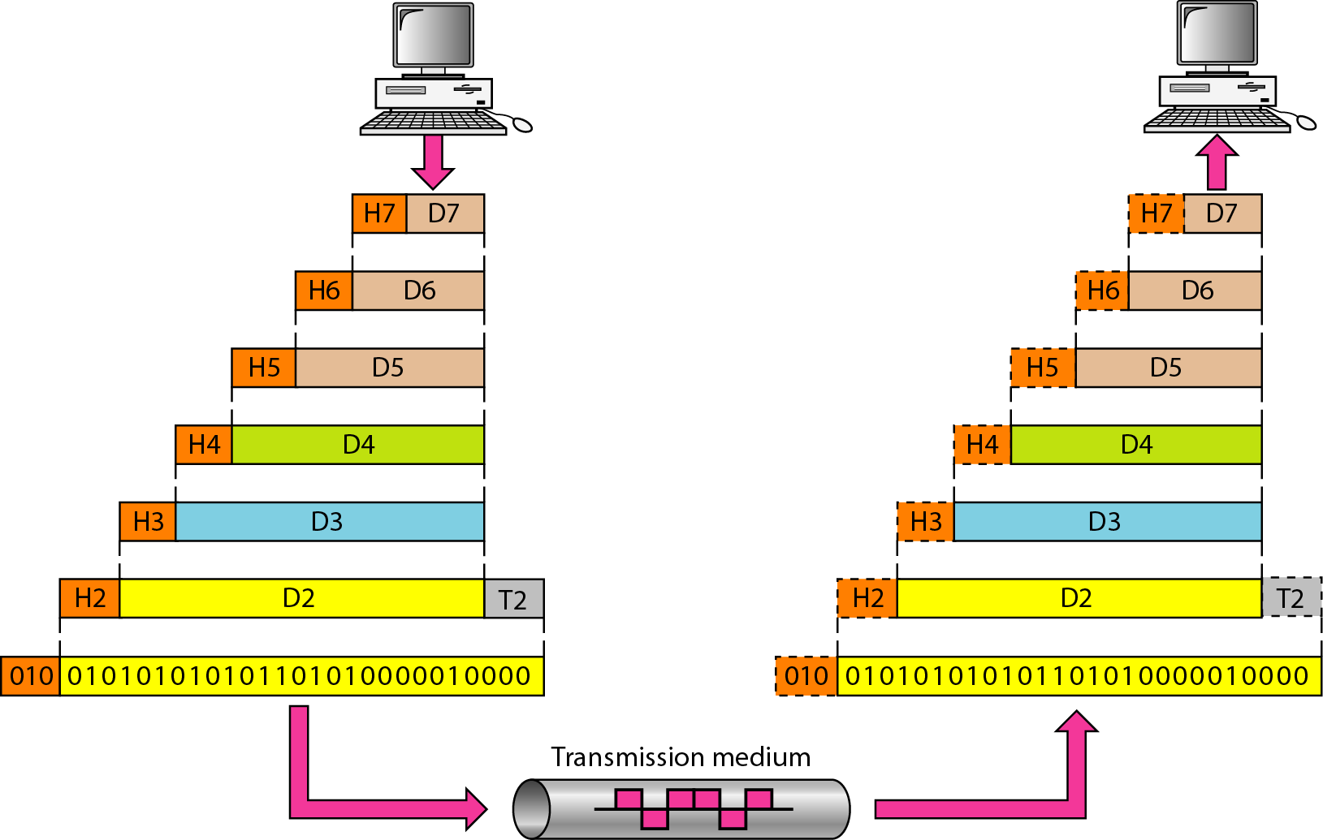
An exchange using the OSI model

Slide 37
Layers In The OSI Model
In this section we briefly describe the functions of each layer in the OSI model.
Topics discussed in this section:
Physical Layer
Data Link Layer
Network Layer
Transport Layer
Session Layer
Presentation Layer
Application Layer

Slide 38
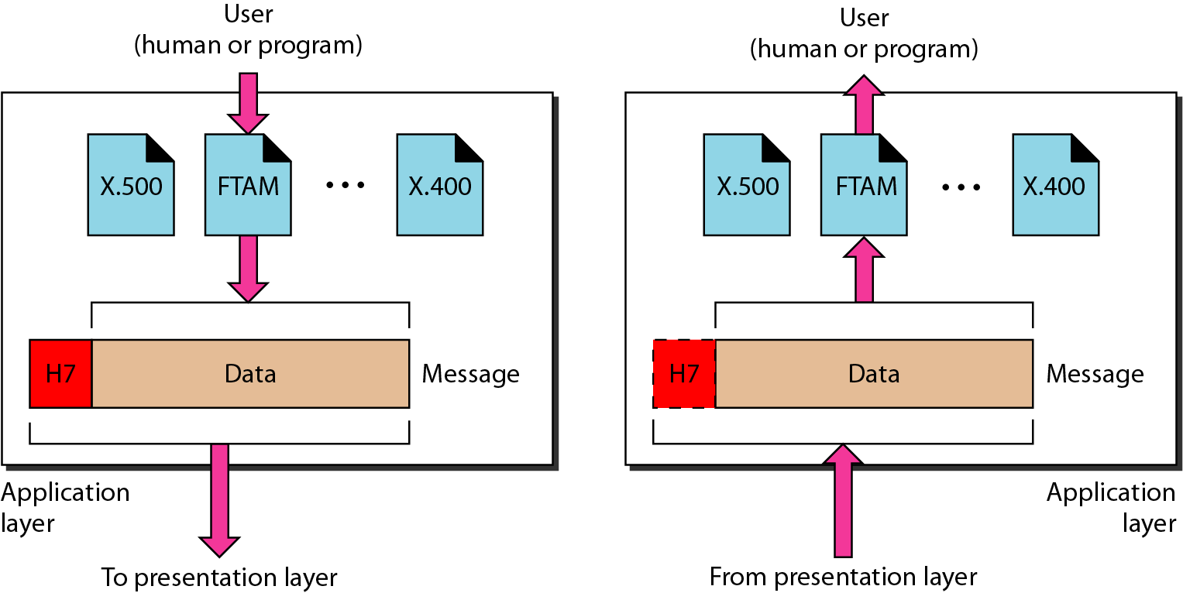
The Application Layer
The application layer enable the user to access the network.
These applications produce the data, which has to be transferred over the network.
This layer also serves as window for the application services to access the network and for displaying the received information to the user.

Slide 39
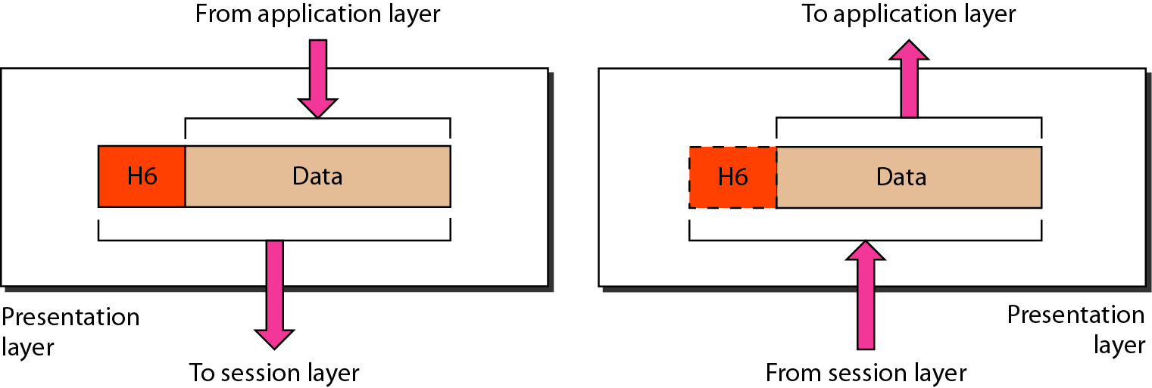
The Presentation Layer
The presentation layer is responsible for translation, compression, and encryption.

Slide 40
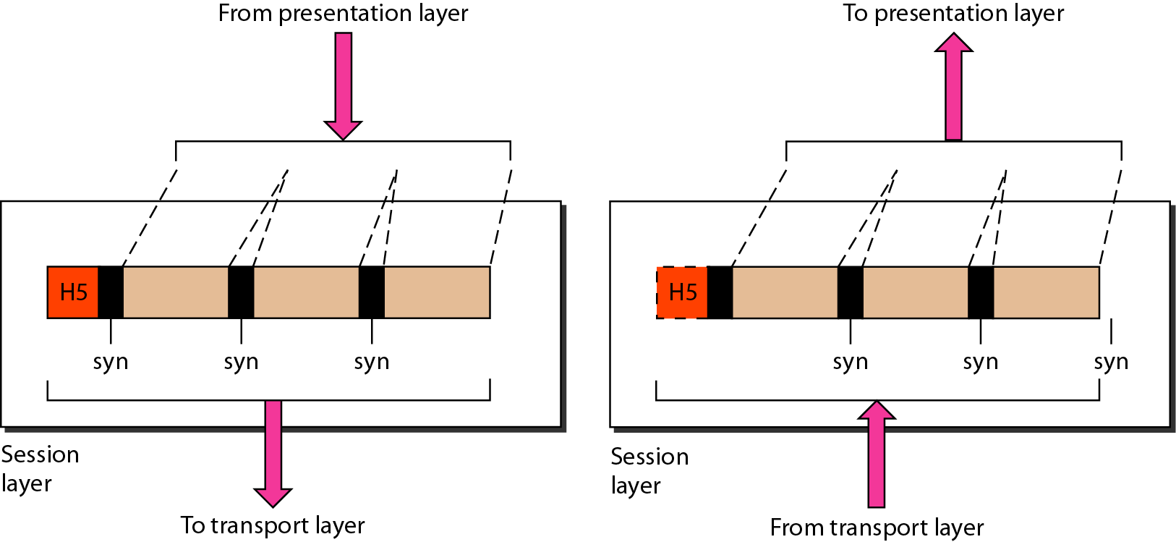
The Session Layer
This layer is responsible for establishment of connection, maintenance of sessions, authentication and also ensures security.

Slide 41
The Session Layer ‘s Functions
The functions of the session layer are :
Session establishment, maintenance and termination: The layer allows the two processes to establish, use and terminate a connection.
Dialog Controller : The session layer determines which device will communicate first and the amount of data that will be sent.
Synchronization : This layer allows a process to add checkpoints which are considered as synchronization points into the data.
Notes:
Synchronization : This layer allows a process to add checkpoints which are considered as synchronization points into the data. These synchronization point help to identify the error so that the data is re-synchronized properly, and ends of the messages are not cut prematurely and data loss is avoided

Slide 42
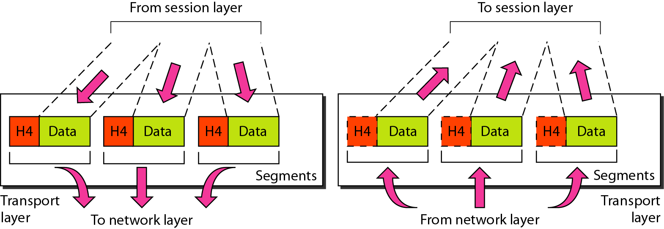
The Transport Layer
Transport layer is responsible for process-to-process delivery of the entire message
The data in the transport layer is referred to as Segments.

Slide 43
The Transport Layer ‘s Functions
The functions of the transport layer are :
Segmentation and Reassembly: This layer accepts the message from the (session) layer , breaks the message into smaller units . Each of the segment produced has a header associated with it. At the destination station it reassembles the message.
Service Point Addressing: In order to deliver the message to correct process, transport layer header includes a type of address called service point address or port address. Thus by specifying this address, transport layer makes sure that the message is delivered to the correct process.

Slide 44
The Network Layer
The network layer is responsible for:
the source- to-destination delivery of packet, possibly across multiple networks (links).
The sender & receiver’s IP address are placed in the header by network layer.
routing i.e. selection of best path to transmit the packet, from the number of routes available.

Slide 45
Network layer
The network layer is responsible for the delivery of individual packets from
the source host to the destination host.

Slide 46
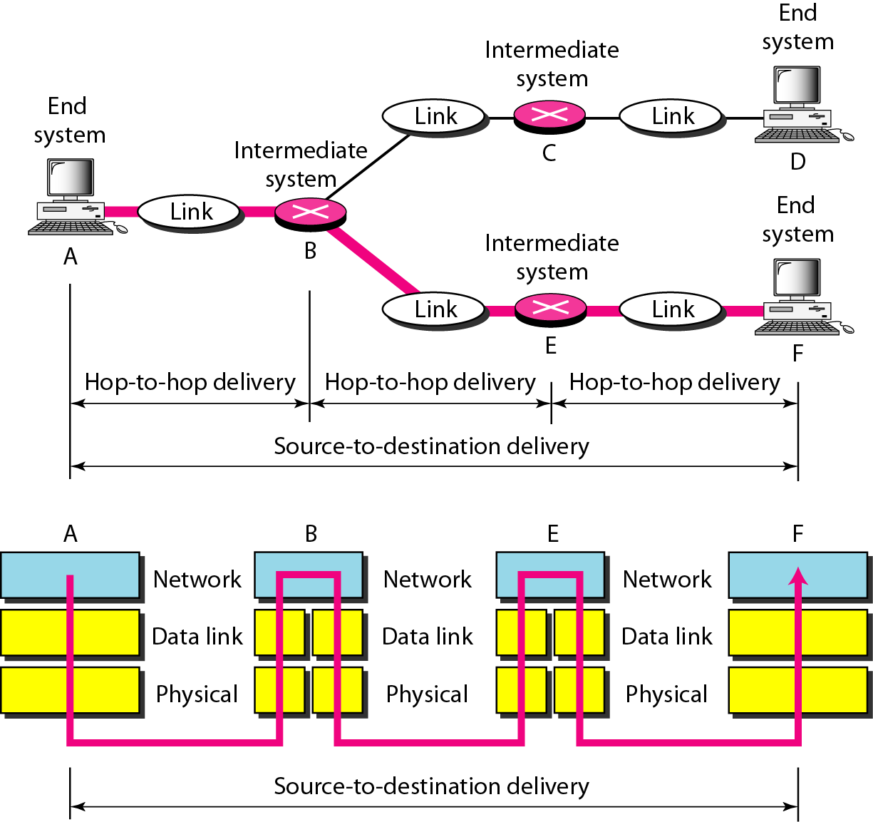
Source-to-destination delivery

Slide 47
The Network Layer ‘s Functions
The functions of the Network layer are :
Routing: determining which route is suitable from source to destination..
Logical Addressing: In order to identify each device on internetwork uniquely, network layer defines an addressing scheme. The sender & receiver’s IP address are placed in the header by network layer. Such an address distinguishes each device uniquely and universally.

Slide 48
The Data Link Layer
The data link layer is responsible for the node to node delivery of the message.
The data link layer is responsible for moving frames from one hop (node) to the next.

Slide 49
The Data Link Layer
The main function of this layer is to make sure data transfer is error free from one node to another, over the physical layer.
When a packet arrives in a network, it is the responsibility of DLL to transmit it to the Host using its MAC address.

Slide 50
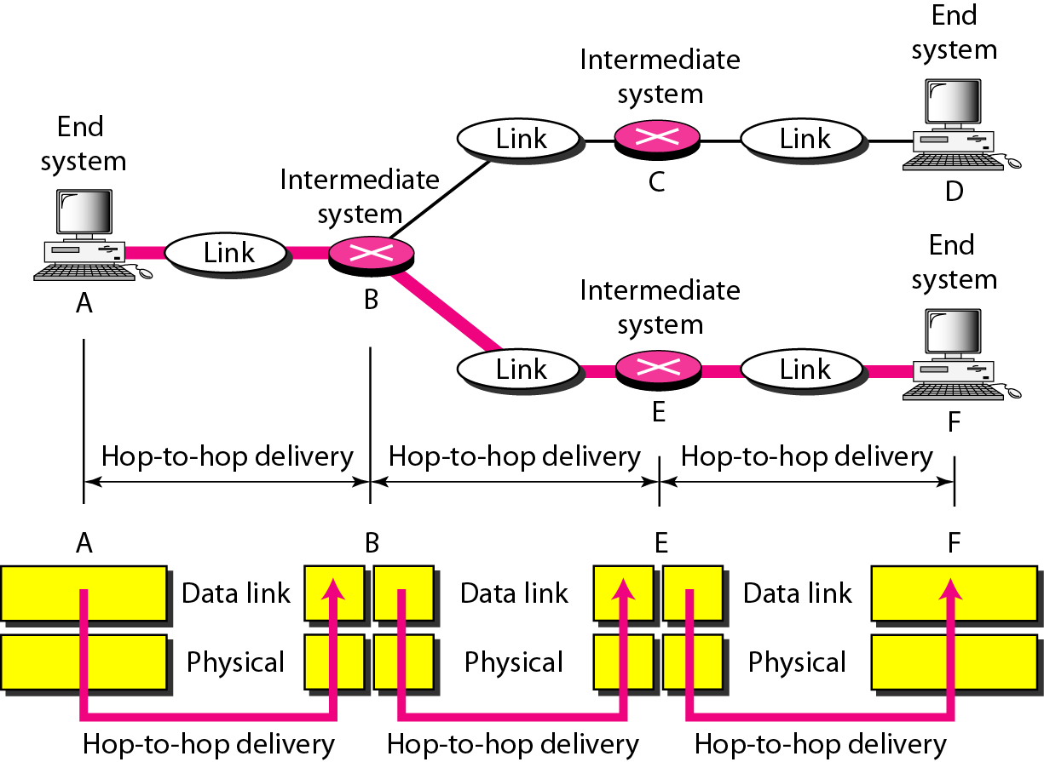
Hop-to-hop delivery

Slide 51
The Data Link Layer ‘s Functions
The functions of the data Link layer are :
Framing: providing a way for a sender to transmit a set of bits that are meaningful to the receiver. This can be accomplished by attaching special bit patterns to the beginning and end of the frame.
Physical addressing: After creating frames, Data link layer adds physical addresses (MAC address) of sender and/or receiver in the header of each frame.

Slide 52
Error control: providing a mechanism of error control in which it detects and retransmits damaged or lost frames.
Flow Control: flow control coordinates that amount of data that can be sent before receiving acknowledgement.
Access control: When a single communication channel is shared by multiple devices, data link layer helps to determine which device has control over the channel at a given time.
Notes:
Flow Control: The data rate must be constant on both sides else the data may get corrupted thus , flow control coordinates that amount of data that can be sent before receiving acknowledgement

Slide 53
The Physical Layer
The lowest layer of the OSI reference model.
The physical layer is responsible for movements of
individual bits from one hop (node) to the next.

Slide 54
The Physical Layer
It is responsible for the actual physical connection between the devices.
information → in the form of bits.
For sending Bits → signal
When receiving data the received signal convert into 0s and 1s.
Notes:
and send them to the Data Link layer, which will put the frame back together

Slide 55
The Physical Layer’s Functions
The functions of the physical layer are :
Bit synchronization: provides a clock that controls both sender and receiver thus providing synchronization at bit level.
Bit rate control: defines the transmission rate i.e. the number of bits sent per second.
Notes:
Bit synchronization: provides the synchronization of the bits by providing a clock. This clock controls both sender and receiver thus providing synchronization at bit level.
Bit rate control: defines the transmission rate i.e. the number of bits sent per second.

Slide 56
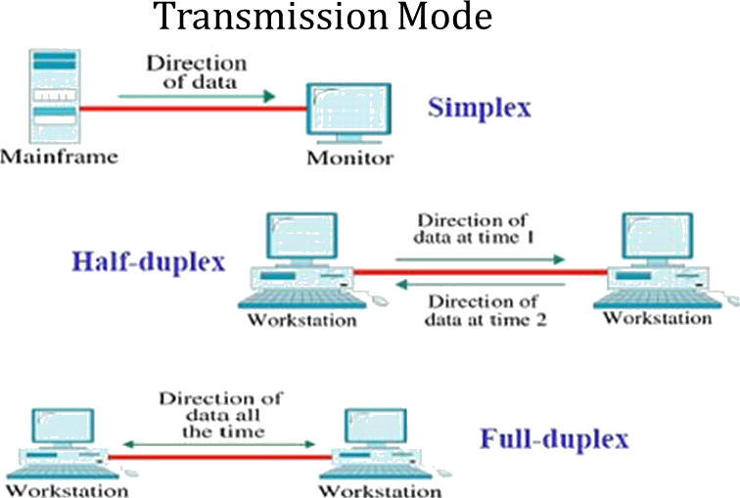
Physical topologies: specifies the way in which the different devices are arranged in a network i.e. bus, star or mesh topology.
Transmission mode: defines the way in which the data flows between the two connected devices: Simplex, half-duplex and full-duplex.

Slide 57
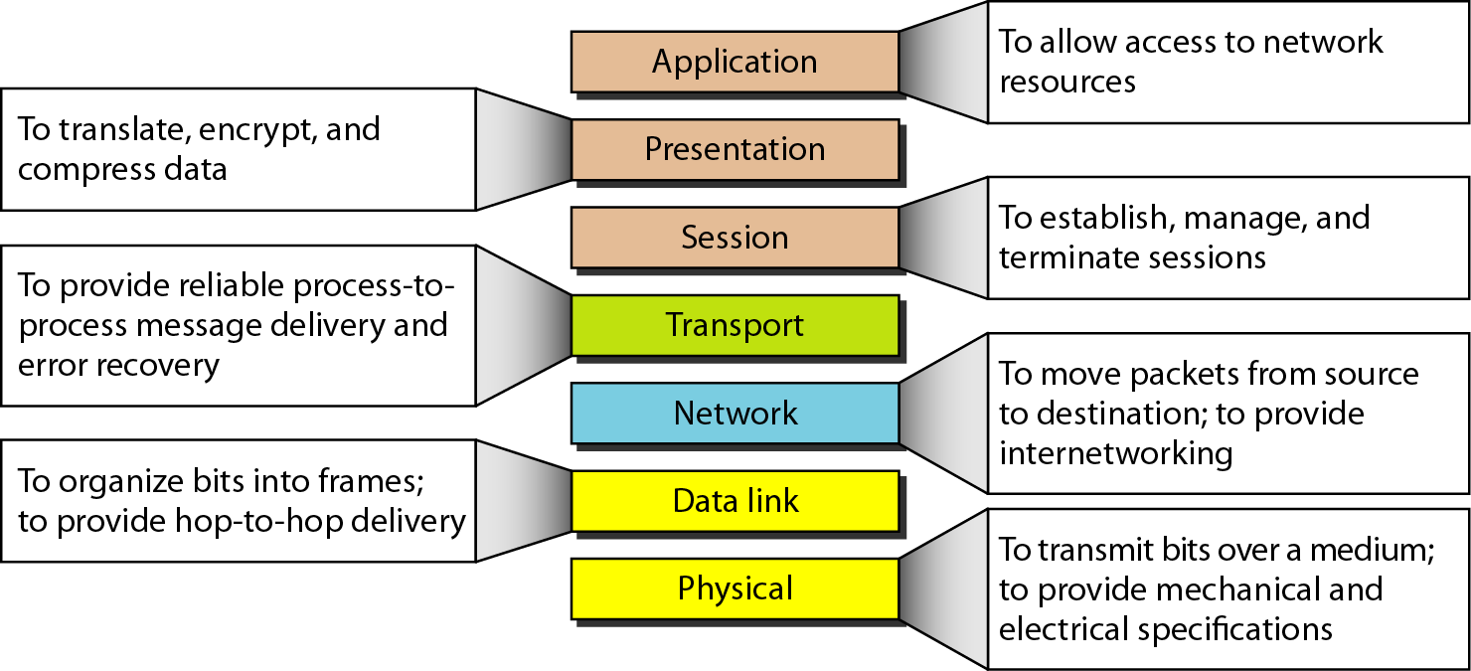
Figure 2.15 Summary of layers

