Slide 1
Chapter 6 Arrays in C++
King Saud University
College of Applied studies and Community Service
CSC 1101
By: Fatimah Alakeel
Edited By: Mashael almutlaq Noor Alhareqi
2nd Semester 1433 -1434

Slide 2
Array - One Dimensional Array
A one dimensional array is a list of related variables have the same data type and the same name .
Represented as a group of consecutive memory locations .
To refer to a particular location or element in the array, we specify the name of the array and the position number of the particular element in the array.

Slide 3
Defining Arrays
When defining arrays, specify :
Array Name .
Type of array .
size of the arrays .

Slide 4
Defining Arrays
The general form :
Type array_Name [ size ];
Type declares the base type of the array that determines the data type of each element in the array .
Size defines how many elements the array will hold. The Size must be an integer constant greater than zero.

Slide 5
Defining Arrays - Examples-
int A[10];
An array of ten integers .
Char str[20];
An array of twenty characters .
int a[ 100 ], b[ 27 ] ;
Defining multiple arrays of same type .

Slide 6
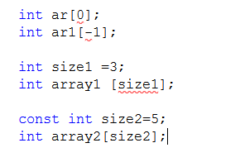
Defining Arrays - Examples-
The Size must be an integer constant greater than zero.

Slide 7
Defining and Initializing an Array
Define an array temperature of 5 elements contains float numbers , array size 5 :
double temperature [5];
Initialize it with these numbers :
12.3 , 7.5 , 65 , 72.1, 87.5 .
double temperature [5] = {12.3 , 7.5 , 65 , 72.1, 87.5 } ;

Slide 8
Defining and Initializing an Array
double temperature [5] = {12.3 , 7.5 , 65 , 72.1, 87.5 };
temperature [0]
12.3
temperature [1]
7.5
temperature [2]
65.0
Elements
temperature [3]
72.1
temperature [ 4 ]
87.5
Index

Slide 9
Initializing Arrays
int N[ ] = { 1, 2, 3, 4, 5 };
If size omitted, the size is determined from the 5 initializers .
int N[5] = { 0 } ;
int B[20] = {2, 4, 8, 16, 32};
Unspecified elements are guaranteed to be zero .
If not enough initializers, rightmost elements become 0 .
int C[4] = {2, 4, 8, 16, 32};
Error — compiler detects too many initial values .
C++ arrays have no bounds checking .
int D[5] = {2*n, 4*n, 8*n, 16*n, 32*n};
Automatically only ; array initialized to expressions .

Slide 10
Accessing Array Elements
An individual element within array is accessed by use of a subscript (index) that describes the position of an element in the array , it must be an integer or integer expression .
Array named c of size n:
c[0],c[1],...,c[ n–1 ]
int A[10];
A[0], A[1], …, A[9]
In C++ , all array have zero as the index of first element .

Slide 11
Get values into array elements
Initialize arrays with the variable declaration .
double temperature [ 5 ] = { 12.3 , 7.5 , 65 , 72.1 , 87.5 } ;
Use Assignment statements .
Read input values into the array from the keyboard.

Slide 12
Accessing Array Elements
Array elements are like normal variables :
temperature [3] = 12.7 ;
cin >> temperature [3] ;
or
N = 3; temperature [N] = 12.7;
temperature [5-2] == temperature [3] == temperature [N]

Slide 13
Assigning Values
You cannot assign one array to another :
int a[10] , b[10] ;
a=b ; //error … illegal
Instead, we must assign each value individually .
We can use them as values in assignment statements:
char str[ ] =“Hello amal”; str[6] = ‘A’;
Notes:
scalar variable - a single data item
vs.
data structure - a data aggregate

Slide 14
Examples
For example, if we assume that variable a is equal to 5 and that variable b is equal to 6, then the following statement adds 2 to array element c[11].
To print the sum of the values contained in the first three elements of array c, we’d write
To divide the value of c[6] by 2 and assign the result to the variable x, we would write

Slide 15
Manipulating Arrays
For loops are used to:
Initializing array elements .
Reading elements .
Printing elements .
Performing operations :
Sum elements .
Find largest/ smallest element .
Search for an element .
Sort elements .

Slide 16
Manipulating Arrays
Initializing Array Elements :
To access all elements of an array a for loop is used. It will start from index 0 to the last element in the array which has an index of array size-1.
Define and initialize array a of size 10 with zeros
int a[10],index;
for(index =0; index <= 9; index++)
a[index] = 0;

Slide 17
Manipulating Arrays
Reading Elements :
for (index =0; index <= size-1; index++ )
{
cout << “Enter value : ”;
cin >> a[index];
}
Printing Elements :
for (index =0; index <= size-1; index++)
cout << a[index];
Sum Array elements Elements :
for (sum = 0, j=0; j < size; j++) sum += a[j];

Slide 18
Examples
All of the following are valid:
score[0] = 4 ;
score[0] += 7 ;
score[0] = x + y ;
x = y – score[0] ;
score[2] = score[1] + 5 * score[0] ;
score[ j ] = score[ j + 1] ;
Note: index can be any integral expression.

Slide 19
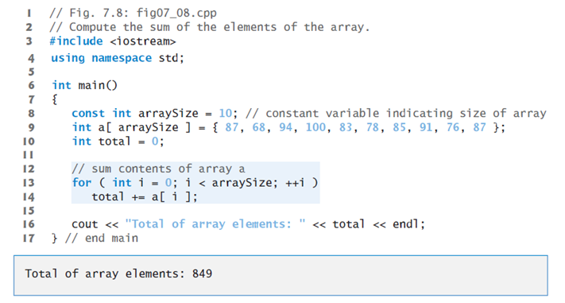
Example –sum of elements

Slide 20
Element Value
0 32
1 27
2 64
3 18
4 95
5 14
6 90
7 70
8 60
9 37

Slide 21
Element Value
0 0
1 0
2 0
3 0
4 0
5 0
6 0
7 0
8 0
9 0

Slide 22
