Slide 1
Chapter 4 Repetition Structures
King Saud University
College of Applied studies and Community Service
CSC1101
By: Asma Alosaimi
Edited By: Fatimah Alakeel & Noor Alhareqi
1st Semester 1433 -1434

Slide 2
Conditional Loops
In many programming situations, we will not be able to determine the exact number of loop repetitions before loop execution begins.
Sentinel-Controlled loops
Flag-Controlled loop

Slide 3
Sentinel-Controlled while Loop
Used when exact number of entry pieces is unknown, but last entry (special/sentinel value) is known.
i.e. the user uses a special value called a sentinel value to indicate “end of data entry.”
The sentinel value must be chosen so that it’s not confused with an acceptable input value.
General form:
Input the first data item into variable;
while (variable != sentinel)
{
.
.
.
input a data item into variable;
.
.
.
}

Slide 4
Sentinel-Controlled while Loop example1
Read input before loop
Program to compute the product of entered numbers
prod= 1;
cout << "Enter a value, 0 will stop the program:";
cin >> value;
while(value != 0) {
prod = prod * value;
cout << "Enter a value, 0 will stop the program:");
cin >> value;
}
cout << "The product is:” << prod;
It is very common for loops to have identical initialization and update steps while performing input operations where the number of input values is not known in advance.
Initialization
Testing
Update

Slide 5
Sentinel-Controlled while Loop example2
/* Compute the sum of a list of exam scores. */
#include <iostream>
using namespace std;
#define SENTINEL -99
void main()
{ int sum = 0, /* sum of scores input so far */
score; /* current score */
cout<<"Enter first score or “<< SENTINEL<< “to quit: ";
cin>>score;
while (score != SENTINEL) {
sum += score;
cout << "Enter next score or “<< SENTINEL<< “to quit: ";
cin>>score;
}
cout<< " \nSum of exam scores is:"<< sum<<endl;
}

Slide 6
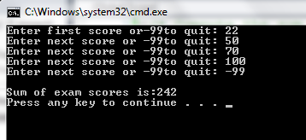

Slide 7
Convert Sentinel Controlled while loop for loop
Because the for statement combines the initialization, test, and update in once place, some programmers prefer to use it to implement sentinel-controlled loops.
cout<<"Enter first score or ”<< SENTINEL << “to quit:”;
for( cin >> score; score != SENTINEL; cin >> score)
{
sum += score;
cout << "Enter next score or ” << SENTINEL << “to quit:”;
}

Slide 8
Flag-Controlled while Loop
int value used to control loop ( true 1 or false 0) .
General form:
bool found = false;
while (!found)
{
.
.
.
if (expression)
found = true;
.
.
.
}

Slide 9
Example
#include<iostream>
using namespace std;
int main()
{
bool found = false;
int num =0;
while(!found) {
num++;
if (num == 3)
{ found = true;
cout<< "3 is found“ << endl;
cout<< "value of flag is:" << found << endl;
}
cout << "inside loop"<<endl;
}
}
OUTPUT:
inside loop
inside loop
3 is found
value of flag is:1
inside loop

Slide 10
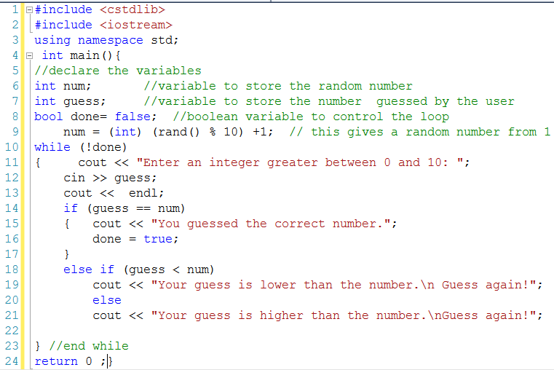
Flag-Controlled while Loop- Example 1(Guessing the number game)
C Standard General Utilities Library It defines several general purpose functions such as rand()

Slide 11
Nested Loops
Usually used to work with two dimensional arrays (later).
Nested loops consist of an outer loop with one or more inner loops.
Each time the outer loop is repeated, the inner loops are reentered
Their loop control expressions are reevaluated
All required iterations are performed again.

Slide 12
Example: Sum of Scores of 3 sections calculate the total scores in each section for 3 sections. Each section's * scores are terminated by the sentinel -99. */
#include <iostream>
using namespace std;
#define SENTINEL -99
#define NUM_SECTIONS 3
int main(){
int sec, score, sum;
cout << "sum of scores for each section\n";
for (sec= 1 ; sec <= NUM_SECTIONS ; ++sec)
{
sum = 0;
for (cin>> score; score != SENTINEL; cin>>score)
{sum += score; }
cout << "Section: " <<sec << " sum of scores : "<< sum<<endl;
}
return 0;}

Slide 13
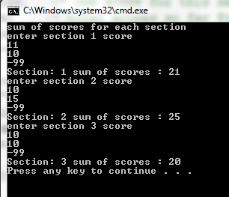

Slide 14
What is the Output?
#include <iostream>
using namespace std;
int main()
{ int o, i; /* loop control variables */
cout << " O I\n";
for (o = 1; o < 4; ++o)
{
cout << "Outer "<< o <<endl;
for (i = 0; i < o; ++i)
{ cout << "Inner " << i <<endl; }
}
return 0;}

Slide 15
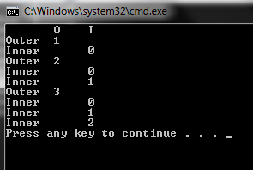

Slide 16
do while statement
Both the for statement and the while statement evaluate the loop condition before the first execution of the loop body.
In most cases, this pretest is desirable and prevents the loop from executing when there may be no data items to process.
There are some situations, generally involving interactive input, when we know that a loop must execute at least one time.

Slide 17
do while Example1
#include <iostream>
using namespace std;
#define KMS_PER_MILE 1.609
/* converts miles to kilometers - repeatedly */
int main() {
double kms, miles;
char res; //for user response [y/n]
do {
cout << "Enter the distance in miles> ";
cin>> miles;
kms = KMS_PER_MILE * miles;
cout << "That equals”<< kms << “kilometers.”<<endl;
cout << “Do you wish to try again [y/n]? “<<endl;
cin>> res;
} while (res == 'Y' || res == 'y');
return 0;}

Slide 18
do while Example2
#include <iostream>
using namespace std;
int main () {
// Another use of do-while is to check valid input
int n_min, n_max, /* minimum and maximum values*/
inval; /* data value which user enters*/
// check validity of input. n_min must be < n_max
do {
cout << "Enter minimum and maximum valid values> ";
cin>> n_min >> n_max;
if (n_min >= n_max)
cout << "Wrong input\n";
} while ( n_min >= n_max);
// condition of while is true as long as the input is wrong

Slide 19
do while Example3
/* next do-while checks that the entered value is between n_min and n_max */
do {
cout << "Enter an integer between “<< n_min << “ and “<< n_max << “inclusive “;
cin>> inval ;
if (inval < n_min || inval > n_max)
cout << "Sorry wrong input, try agin\n”;
} while (inval < n_min || inval > n_max) ;
cout << "input checked successfully”;
return 0;
}

Slide 20
break Statements
Used to
exit early from a loop. (while, for, and do...while)
skip remainder of switch structure.
Can be placed within if statement of a loop.
If condition is met, loop is exited immediately.
After the break statement executes, the program continues to execute with the first statement after the structure

Slide 21
break Statements
Example :
int count ;
for ( count = 1 ; count <= 10 ; count ++ )
{ if ( count == 5)
break ;
cout << count
}
Output
1 2 3 4

Slide 22
continue Statements
Used in while, for, and do...while structures.
When executed in a loop, the remaining statements in the loop are skipped; proceeds with the next iteration of the loop.
When executed in a while/do…while structure, expression is evaluated immediately after continue statement.
In a for structure, the update statement is executed after the continue statement; the loop condition then executes.

Slide 23
continue Statements
Example :
int count ;
for ( count = 1; count <= 10 ; count ++ )
{ if ( count == 5)
continue;
cout << count ;
}
Output
1 2 3 4 6 7 8 9 10

