Slide 1
Chapter 4 Repetition Structures
King Saud University
College of Applied studies and Community Service
CSC1101
By: Asma Alosaimi
Edited By: Fatimah Alakeel & Noor Alhareqi
1st Semester 1433 -1434

Slide 2
Overview
Repetition in Programs
Counting Loops
Using while statement
Using for statement
Conditional Loops
Sentinel-Controlled loops
Flag-Controlled loop
Nested loop
Do-While loop
break and continue statement

Slide 3
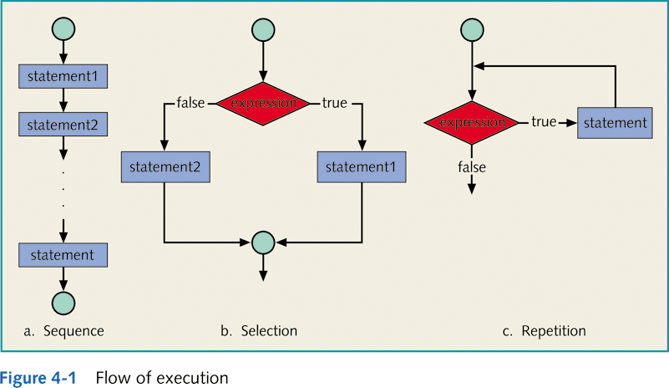
Types of Control Structures

Slide 4
What is Meant by Loops? Why Do We Need Them?
Loop
Group of instructions that a computer executes repeatedly while some condition remains true
Why do we need them?
To repeat statements until a certain condition becomes false.

Slide 5
Loop Statementes
Loop statements are:
For loop
While loop
Do While loop
Loop
Counting loop
For loop
Counter-controlled while loop
Conditional Loop
Flag-Controlled while loop
Sentinel-Controlled while loops

Slide 6
Loop Statements
while
statement
…
do
while
statement
for
statement
T
F
T
T
F
F
while (condition)
{
…
}
do {
..
}
while ( condition);
for (initialize; condition; update)
{
..
}

Slide 7
Counting Loop
Definite repetition: know how many times the loop will execute
Control variable used to count repetitions
Two types of Counting loop:
Counter-Controlled while loop
For loop

Slide 8
Counter–controlled while loop
The loop shown below in pseudo code is called a counter-controlled while loop because its repetition is managed by a loop control variable whose value represents a count.
Set loop control variable to an initial value
While loop control variable < final value
... //Do something multiple times
Increase loop control variable by 1 (or step size).

Slide 9
Counter–controlled while loop Example 1
This slide shows a program fragment that computes and displays the gross pay for seven employees. The loop body is the compound statements (those between { and }).
The loop repetition condition controls the while loop.
count_emp = 0;
while (count_emp < 7)
{
cout<<"Hours:";
cin>>hours;
cout<<"Rate:";
cin>>rate;
pay = hours * rate;
cout<<"Pay is:”<< pay;
count_emp = count_emp + 1; // or count_emp++;
}
Cout<<"\nAll employees processed\n";
loop repetition condition
count_emp = 1;
while (count_emp <= 7)

Slide 10
Counter–controlled while loop while Statement
Syntax of the while Statement:
Initialization. i.e. count_emp = 0;
Testing(condition). i.e. count_emp < 7
Updating i.e. count_emp = count_emp + 1;
The above steps must be followed for every while loop.
If updating is skipped, it produce an infinite loop

Slide 11
Counter–controlled while loop Example 2: Computing Sum
If we want to compute , we need to do 1+2+3+...+100
We can use a while loop.
/* computes the sum: 1 + 2 + 3 + ....+ 100 */
#include <iostream>
using namespace std;
int main()
{
int sum =0, i = 1;
while (i <= 100) {
sum = sum + i;
i = i + 1; //or i++; ++i; i+=1;
}
cout<<"Sum is :"<<sum <<endl;
return 0;
}

Slide 12
The for loop
A better way to construct a counting loop is to use the for statement.
C++ provides the for statement as another form for implementing loops.
As before we need to
Initialize the loop control variable
Test the loop repetition condition
Update the loop control variable.
An important feature of the for statement in C++is that it supplies a designated place for each of these three components.

Slide 13
The for Repetition Statement
No semicolon (;) after last expression

Slide 14
General Form of for statement
for (initialize; loop repetition condition ; update)
{
//Steps to perform each iteration
}
First, the initialization expression is executed.
Then, the loop repetition condition is tested.
If the condition is true, the statement enclosed in { } are executed.
After that the update expression is evaluated.
Then the loop repetition condition is retested.
The statement is repeated as long as the condition is true.
For loop can be used to count up or down by any interval.
If there’s more than one statement in the body of the for, braces are required to enclose the body of the loop.

Slide 15
for - Example 1
To compute the sum of 1 to 100:
int sum = 0;
int i;
for (i = 1; i <= 100; i++)
{
sum = sum + i;
}
Note: i++ is the same as i = i + 1
and as i += 1.

Slide 16
for - Syntaxes
You can write:
int i;
for (i = 1; i <= 100; i++)
OR
for (int i = 1; i <= 100; i++)
If the initialization expression declares the control variable (i.e., its type is specified before its name), the control variable can be used only in the body of the for statement— the control variable will be unknown outside the for statement. This restricted use of the control variable name is known as the variable’s scope.
The scope of a variable specifies where it can be used in a program.

Slide 17
for and while

Slide 18
Example 2 – using while loop
Example: Print the number from 1 to 10
1
2
3
4
5
6
7
8
9
10

Slide 19
Example 3– using for
Example: Print the number from 1 to 10
1
2
3
4
5
6
7
8
9
10

Slide 20
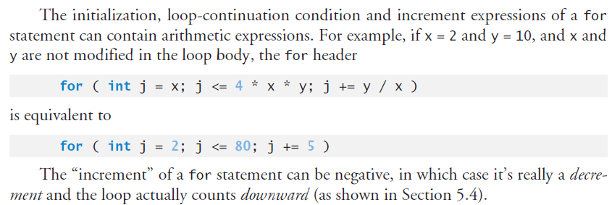
for statement

Slide 21
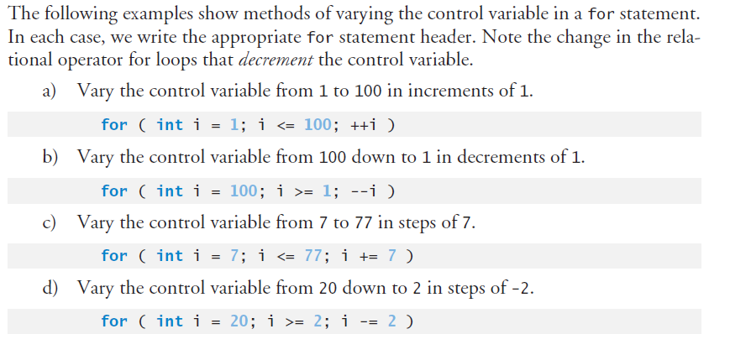
Examples for using for statement

Slide 22
Examples for using for statement

Slide 23
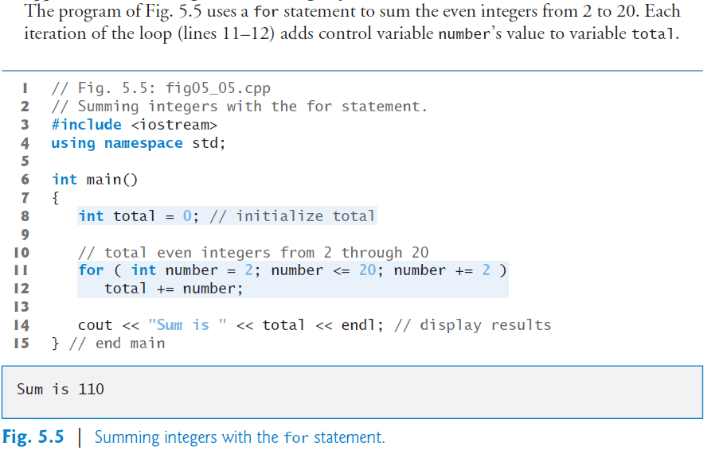
for - Example 4

