Slide 1
2 - Price and Availability of Materials
Key Points
Long term increase in raw material prices
Short term fluctuations due to market forces
Use patterns for materials in developed countries
Mix of materials
Rate of consumption
Resource base vs reserves
Materials substitution & recycling

Slide 2
Material Costs (Table 2.1)
Material
$/ton

Slide 3
Elemental Abundance in Earth’s Crust
Element
%

Slide 4
Production of Engineering Materials is Energy Intensive
Material
Energy Content (GJ/ton)

Slide 5
Growth in Consumption
Let our consumption be called C
Assume that each year we consume r% more of a given material
Fig. 2.2
Consumption
dC
r
=
C
dt
100
C_{o}
Time
doubling-time, t_{D} ~ 70/r

Slide 6
Substitution Properties, vs. the material itself
New or alternative materials can replace scarce conventional materials
Bridges: Stone & wood→concrete & steel
Plumbing: Copper → polyethylene
Replacement may involves new costs
Plant & equipment
Processing & manufacturing methods
Workforce training

Slide 7
Recycling
If energy costs, capital costs, or resource costs (e.g. through scarcity or depletion) are high, recycling can be an effective method for reducing material costs
Labor intensive
Requires design for recycling
May involve its own capital and training costs

Slide 8
Materials and Energy in Car Design Key Concepts
Stiffness and Yield-Limited Materials Selection
Other Materials Selection Issues

Slide 9
Materials in Car Design

Slide 10
Energy to Manufacture and Use Cars (per Year)
Energy to Produce Cars | 0.8-1.5% of Total Energy Consumed by Nation
Energy to Move Cars | 15% of Total Energy Consumed by Nation
Total Energy to Transport People and Goods | 24% of Total Energy Consumed by Nation

Slide 11
How Can We Reduce the Energy Needed to Move Cars?
Goal:
“Production prototype" by 2004 of a full sized car that will get three times the mileage of today's models (80 mpg) with no sacrifice in safety, performance, affordability or compliance with emission standards.
How can you do this?
Improve engine efficiency
Reduce the weight of the car

Slide 12
Comparison Steel Vs SMC
$0.35/lb
0.03 thick
7.6 lb
40% scrap
$4.25 mat’l cost
400/hr
5 workers
$18.90/hr (Union)
$0.24 labor cost
$5,000,000 equipment
$900,000 tools
$7.71 unit cost at 100,000 units
$0.65/lb
0.12 thick
7.0 lb
6% scrap
$4.84 mat’l cost
40/hr
$12.50/hr (non-Union)
$0.63 labor cost
$1,200,000 eqipment
$250,000 tools
$7.75 unit cost at 100,000 units

Slide 13
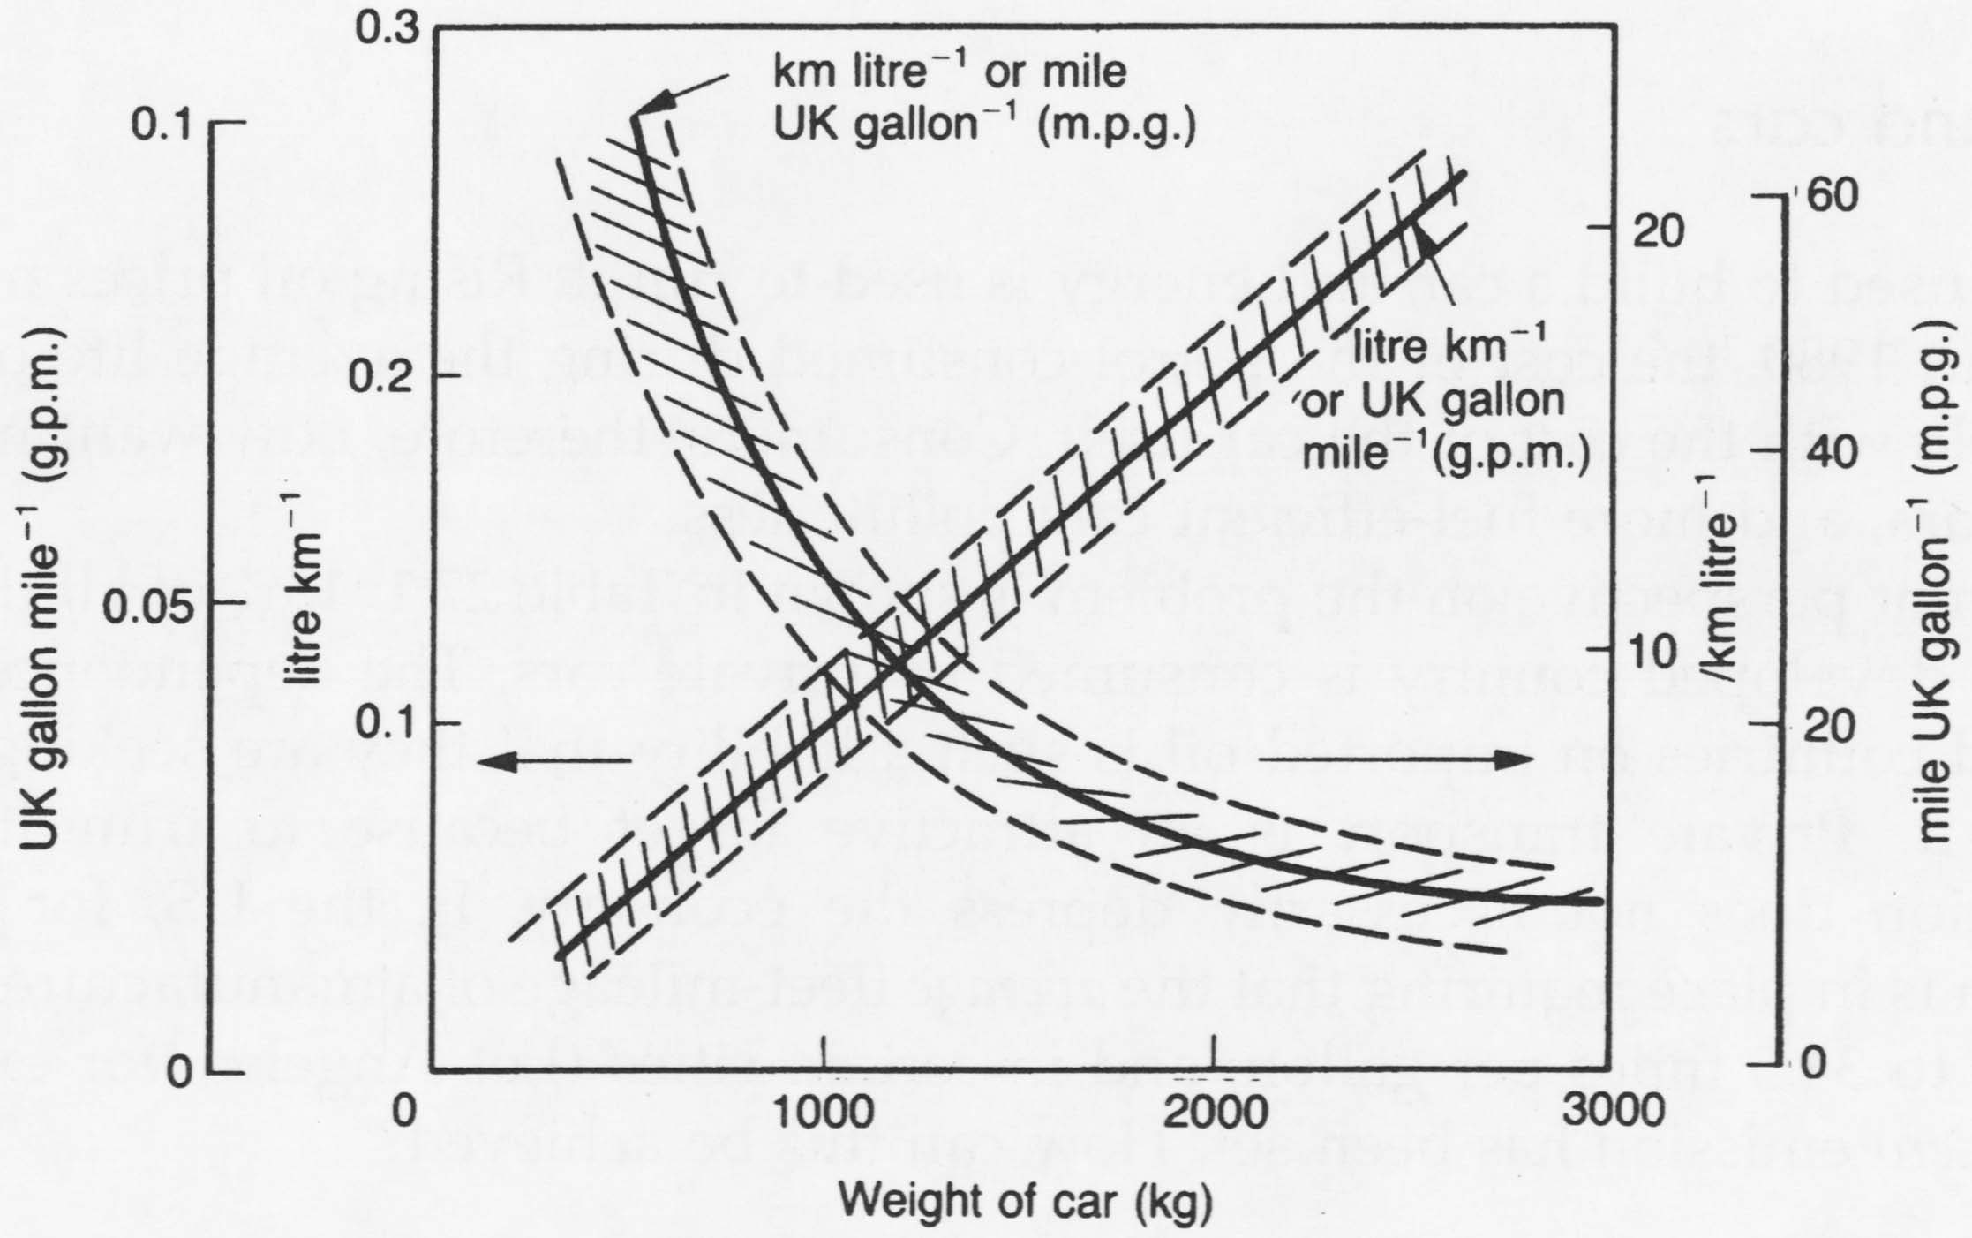
Vehicle Weight is Important!

Slide 14
Automotive Materials
Current vehicles consist primarily of iron and steel
~255 lbs. Aluminum (2001 Vehicles)
~253 lbs. Plastics (2001 Vehicles)
Candidate alternative materials
High strength steel (>120 lbs)
Aluminum (600 lbs)
Glass fiber reinforced polymers (150 lbs)
Magnesium, Titanium, MMC’s

Slide 15
Weight Reduction Targets--PNGV
Subsystem | Current Wt (lbs) | Target Wt (lbs) | Reduction (%)
Body | 1134 | 566 | 50
Chassis | 1101 | 550 | 50
Power Train | 868 | 781 | 10
Fuel/Other | 137 | 63 | 55
Curb Weight | 3240 | 1960 | 40

Slide 16
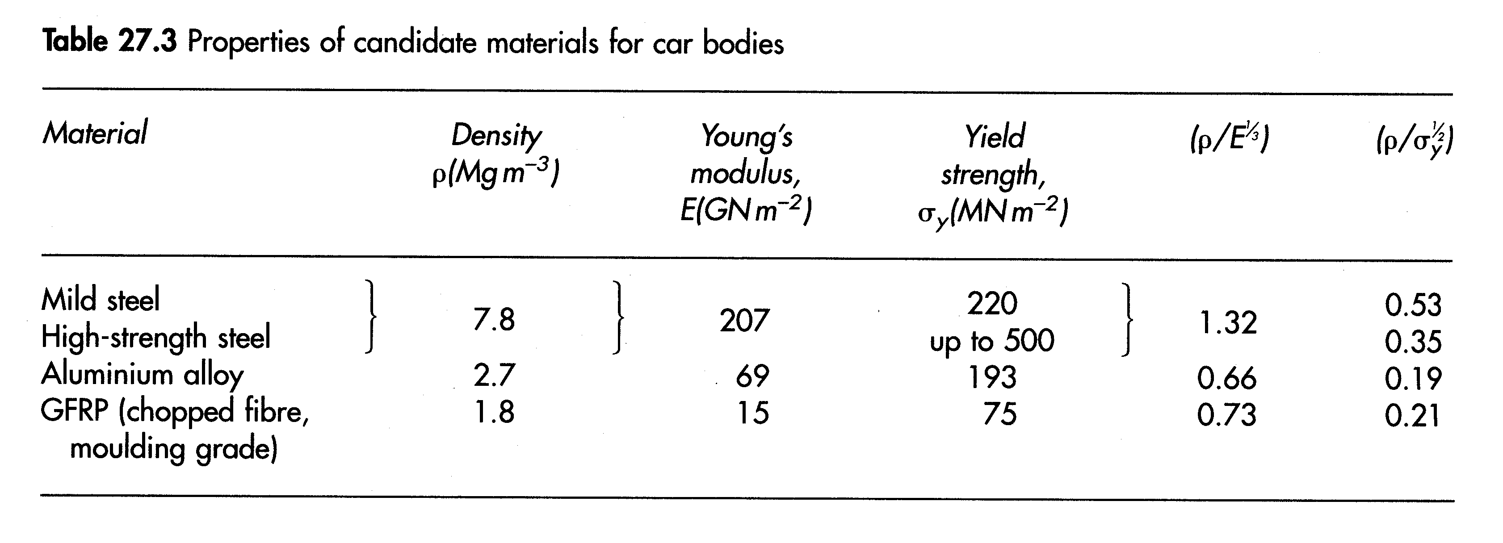
Candidate Materials for Car Bodies

Slide 17
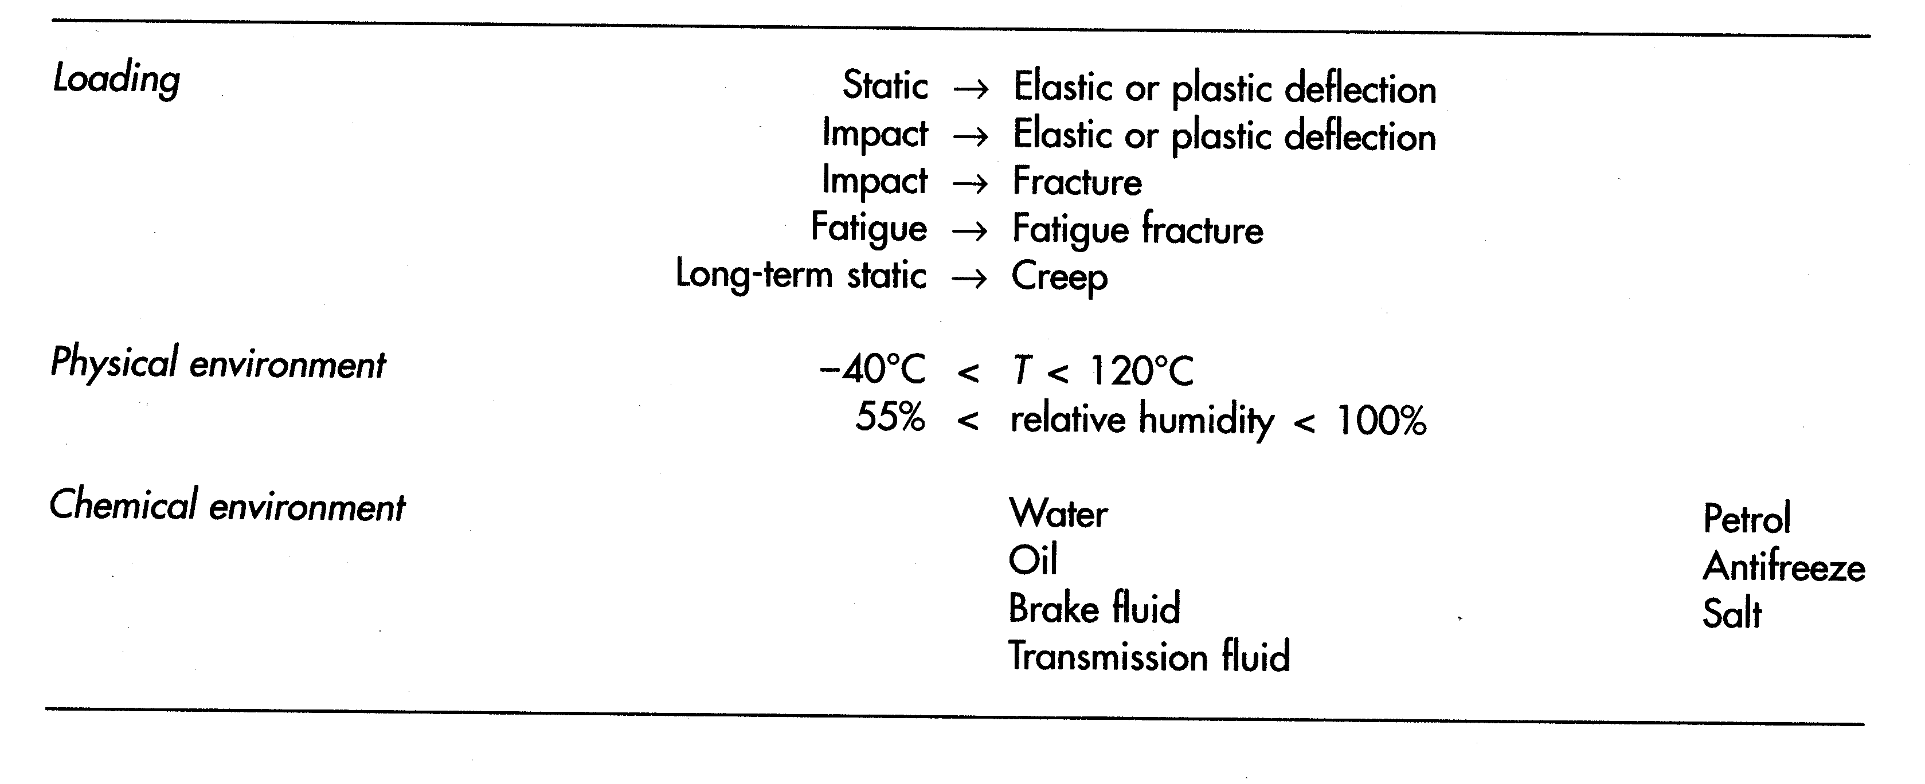
Automotive Materials —Service Requirements —

Slide 18
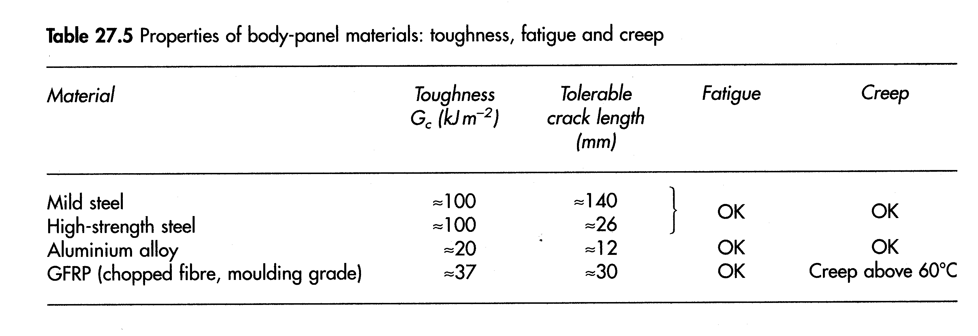
Other Properties of Body-Panel Materials

Slide 19
And what about PRICE!
“Most of the steel used for automotive applications costs well under $0.50 per pound, while most product forms of aluminum and magnesium cost more than $1 per pound and extremely lightweight titanium and carbon fiber are more than $8 per pound. Furthermore, manufacturing processes need to be improved or developed to fabricate lightweight parts and components of these materials affordably and quickly.”
A. Sherman—PNGV Materials Technical Team

Slide 20
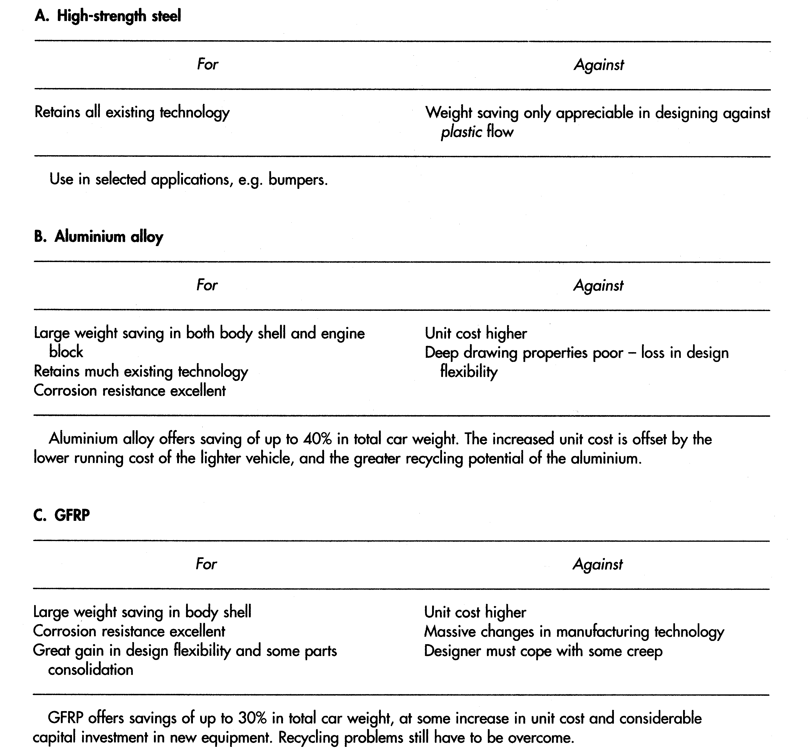
Conclusions

