Slide 1
Dive Into® Visual Basic 2010 Express
Visual Basic 2010 How to Program

Slide 2
2.1 Introduction
Visual Studio 2010 is Microsoft’s Integrated Development Environment (IDE) for creating, running and debugging programs (also called applications) written in various .NET programming languages.

Slide 3
2.2 Overview of the Visual Studio 2010 IDE
Introduction to Microsoft Visual Basic 2010 Express Edition
To start Microsoft Visual Basic 2010 Express Edition, select Start > All Programs > Microsoft Visual Studio 2010.
The Start Page displays.
The Start Page The Start Page links are organized into sections—Recent Projects, Get Started and Latest News
At any time, you can return to the Start Page by selecting View > Start Page.

Slide 4
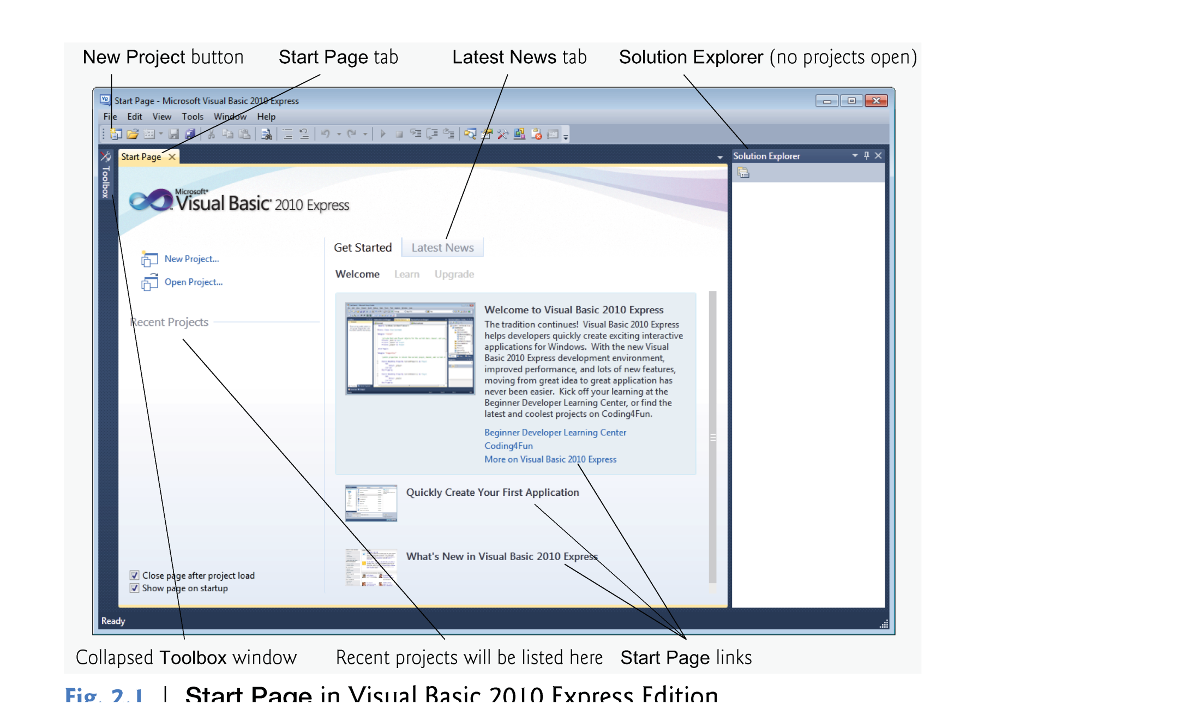

Slide 5
2.2 Overview of the Visual Studio 2010 IDE
The Recent Projects section contains information on projects you’ve recently created or modified.
The Get Started section focuses on using the IDE for creating programs and learning Visual Basic.
The Latest News tab provides links to the latest Visual Basic developments (such as updates and bug fixes).

Slide 6
2.2 Overview of the Visual Studio 2010 IDE
Customizing the IDE and Creating a New Project
To begin programming in Visual Basic, you must create a new project or open an existing one.
To create new project:
File > New Project
Or from the Start Page ->New Project
To Open existing project:
File > Open Project
Or from Start Page -> Recent Projects
Or also from Start Page -> Open Projects

Slide 7
2.2 Overview of the Visual Studio 2010 IDE
A project is a group of related files, such as the Visual Basic code and any images that might make up a program.
solutions is a group folder contains one or more projects.
Multiple-project solutions are for large-scale programs.
Each program we create consists of a single project.
Visual Studio provides several templates.
Templates are the project types users can create in Visual Basic—Windows Forms applications, console applications, WPF applications and others.

Slide 8
2.2 Overview of the Visual Studio 2010 IDE
In this chapter, we build a Windows Forms Application.
A Windows Forms application executes within a Windows operating system and has a graphical user interface (GUI)—the visual part of the program with which the user interacts.

Slide 9
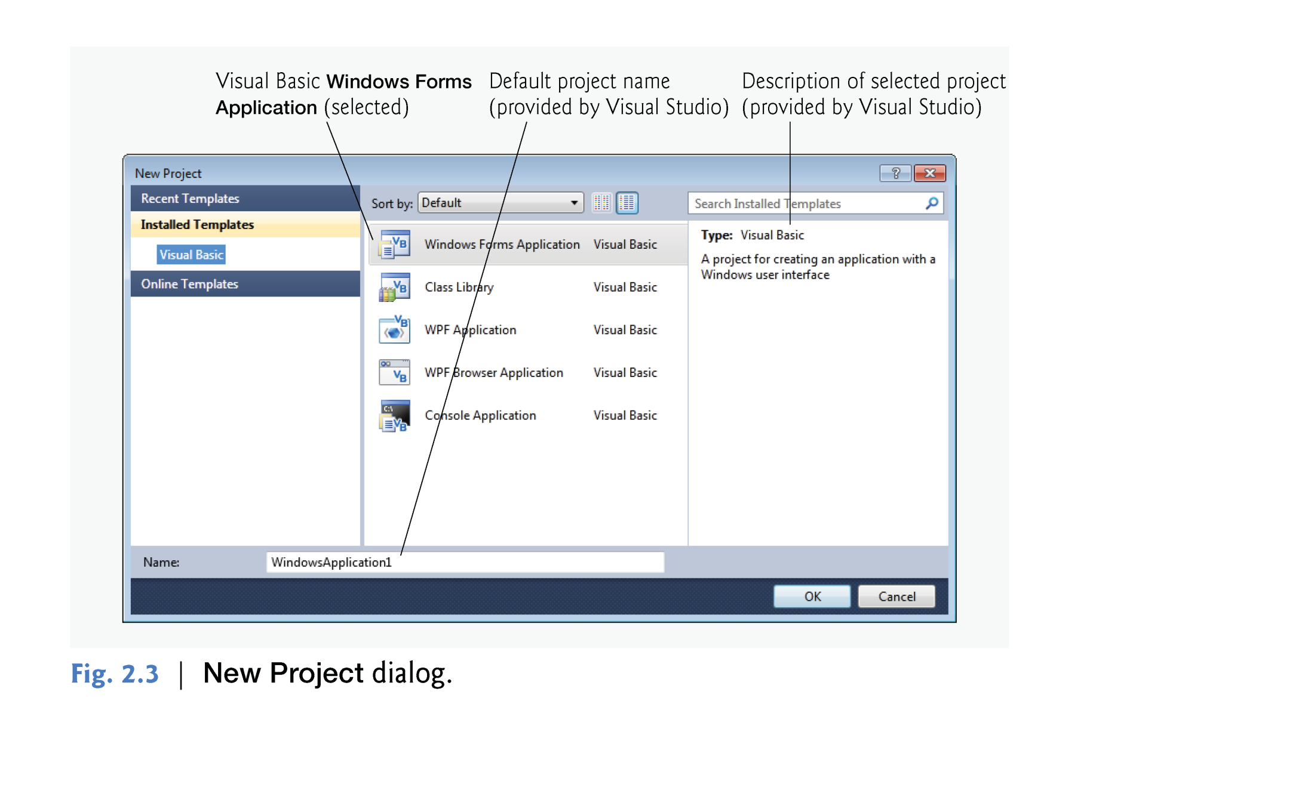

Slide 10
2.2 Overview of the Visual Studio 2010 IDE
By default, Visual Studio assigns the name WindowsApplication1 to a new Windows Forms Application project and solution.
Select Windows Forms Application, then click OK to display the IDE in Design view, which contains the features that enable you to create programs.

Slide 11
3.2.2 Modifying ASimpleProgram to Programmatically Change the Label’s Text Property
Viewing the Form
Design Mode
To view the Form in its design mode:
double click on the Form’s name in the Solution Explorer Window.
The Form will appear with tab having the following “FormName.vb [Design]”
Code Mode
To view the Form in its Code mode:
Right click on the Form.
Select View Code
Then the code will be viewed in a separate tab with the same name “FormName.vb”

Slide 12
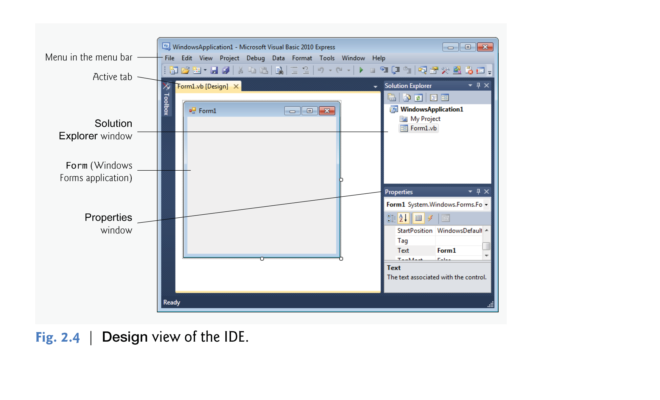

Slide 14
2.2 Overview of the Visual Studio 2010 IDE
The rectangle in the Design area titled Form1 (called a Form) represents the main window of the Windows Forms application that you’re creating.
Visual Basic applications can have multiple Forms (windows).
You can customize the Form by adding GUI controls
GUI controls includes Textboxes, buttons, labels, combobox,..etc.

Slide 15
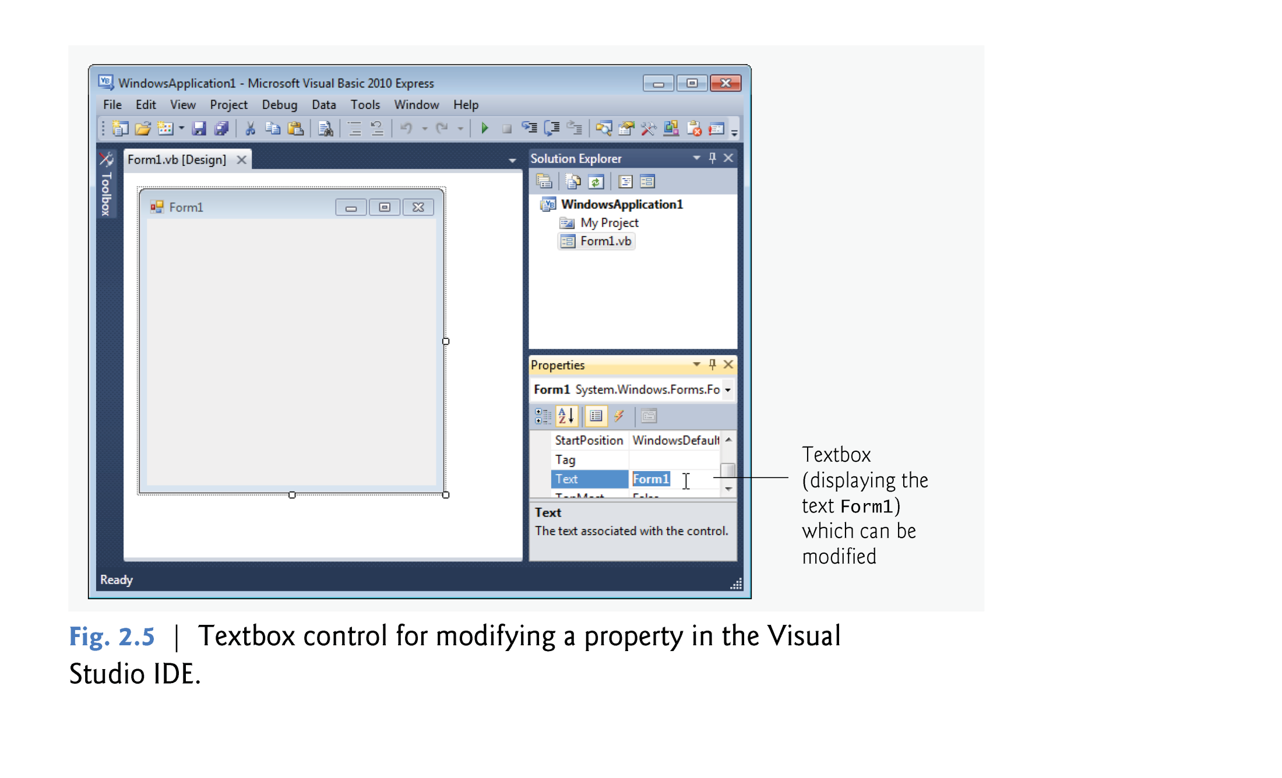

Slide 16
2.2 Overview of the Visual Studio 2010 IDE
Collectively, the Form and controls make up the program’s GUI.
Users enter data (inputs) into the program by typing at the keyboard, by clicking the mouse buttons and in a variety of other ways.
Programs use the GUI to display instructions and other information (outputs) for users to view.

Slide 17
2.3 Menu Bar and Toolbar
Commands for managing the IDE and for developing, maintaining and executing programs are contained in menus, which are located on the menu bar of the IDE
The set of menus displayed depends on what you’re currently doing in the IDE.

Slide 19
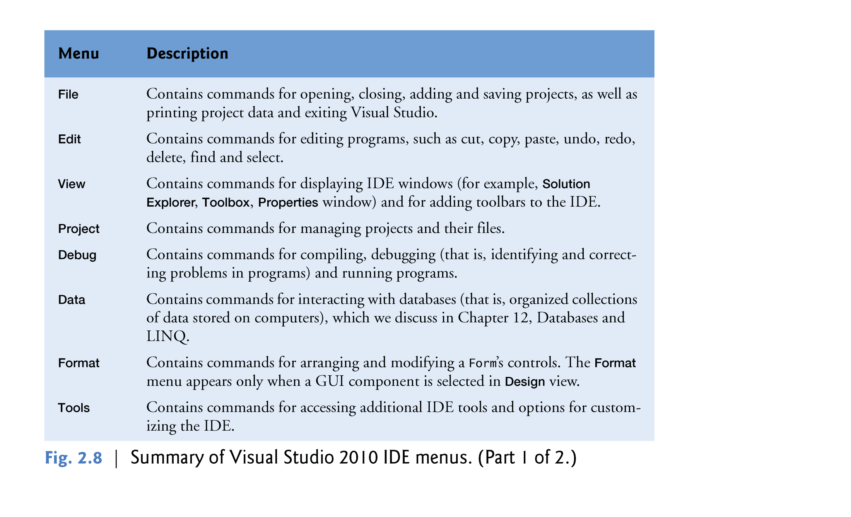

Slide 20
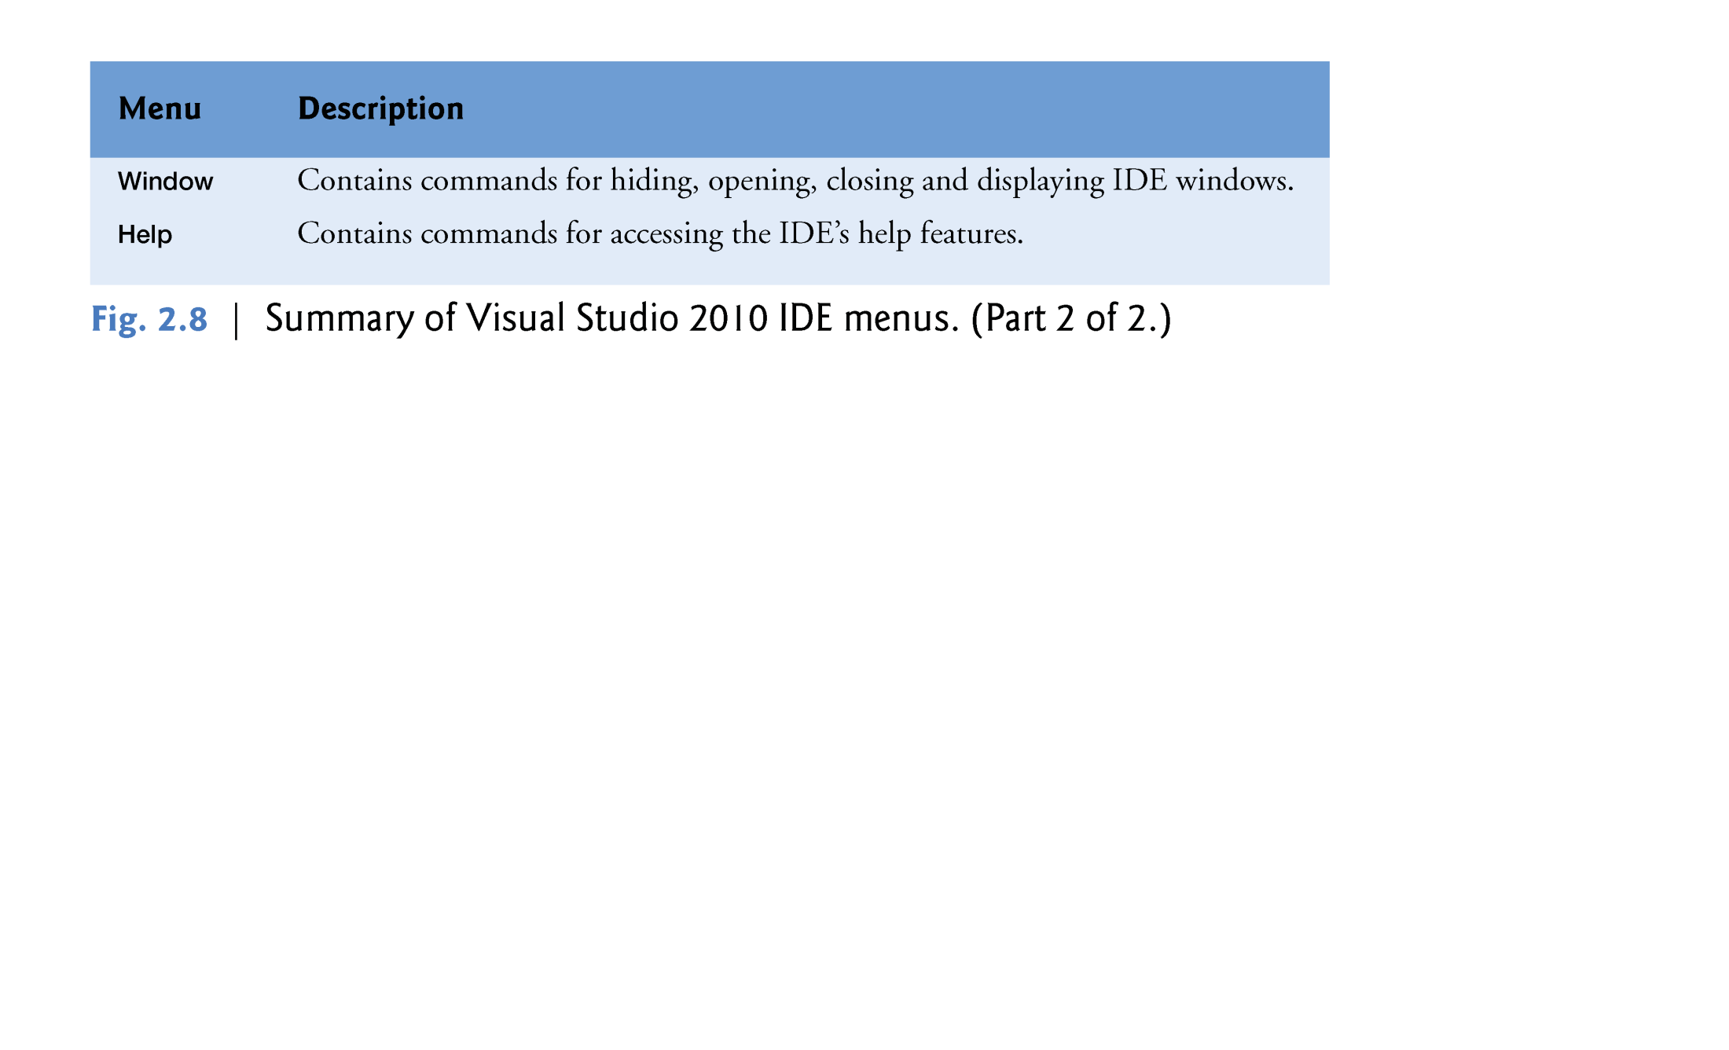

Slide 21
2.3 Menu Bar and Toolbar
You can access many of the more common menu commands from the toolbar.
The standard toolbar it contains icons for the most commonly used commands, such as opening a file, adding an item to a project, saving files and running applications .

Slide 22
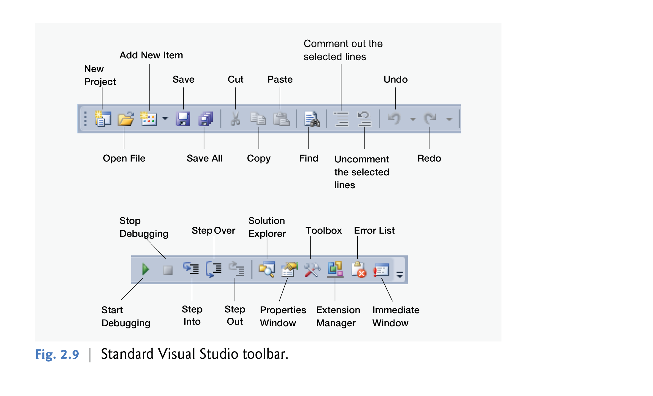

Slide 23
2.3 Menu Bar and Toolbar
You can customize the IDE’s toolbars.
Select View > Toolbars .

Slide 24
2.4 Navigating the Visual Studio IDE
The IDE provides windows for accessing project files and customizing controls.
This section introduces several windows that you’ll use frequently when developing Visual Basic programs.
These windows can be accessed via the toolbar icons or by selecting the desired window’s name in the View menu.

Slide 25
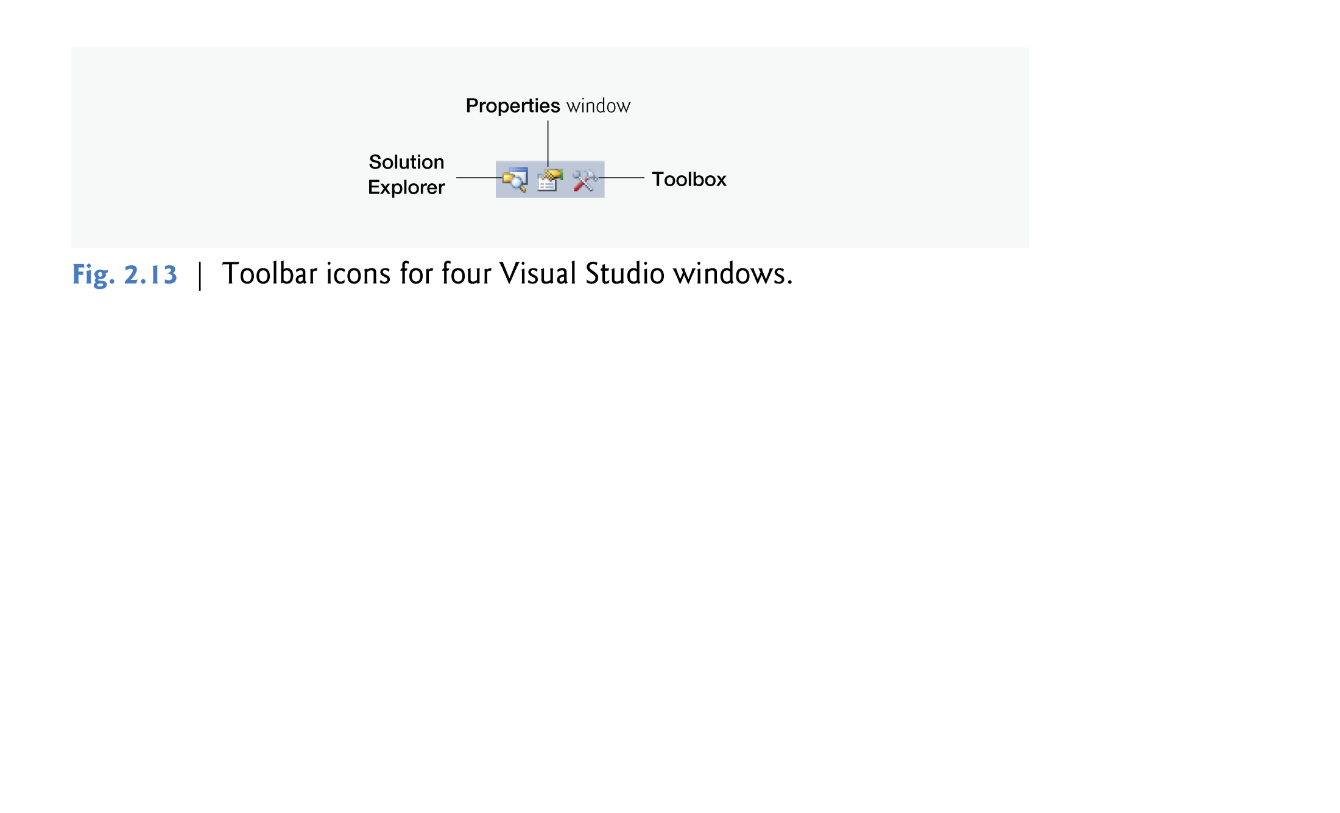

Slide 26
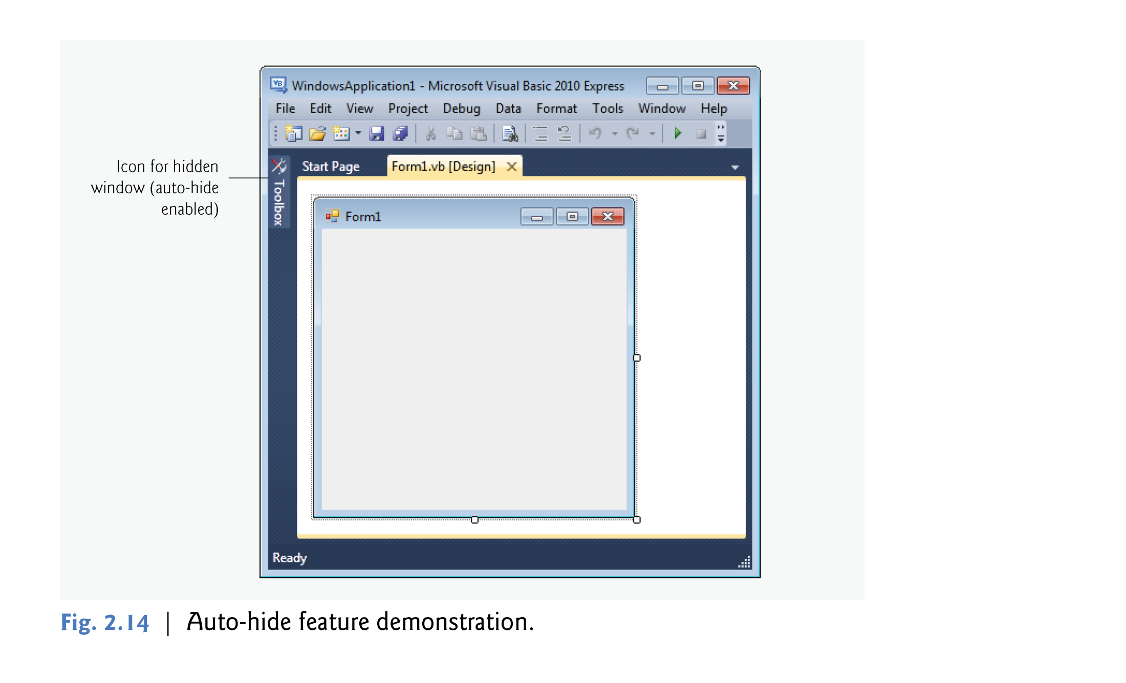

Slide 27
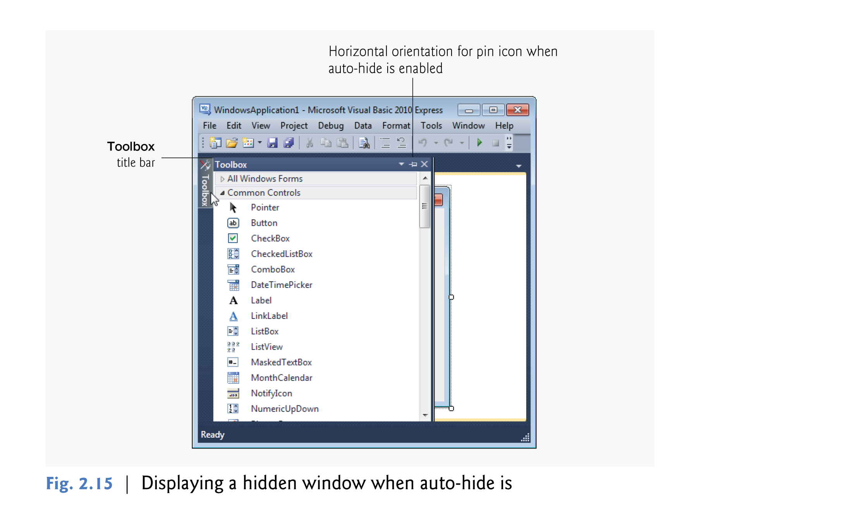

Slide 28
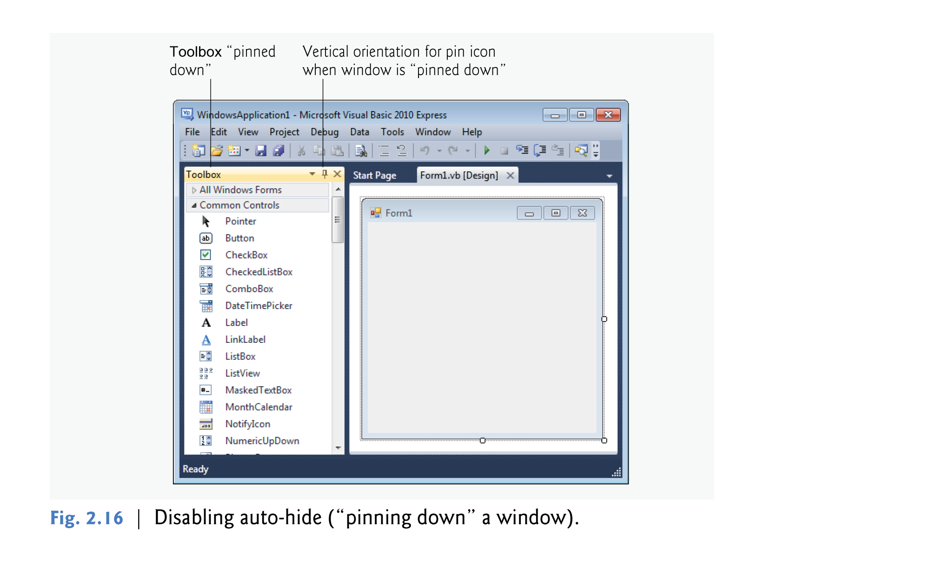

Slide 29
2.4 Navigating the Visual Studio IDE
The next few sections cover three of Visual Studio’s main windows—the Solution Explorer, the Properties window and the Toolbox.
These windows display project information and include tools that help you build your programs.

Slide 30
2.4.1 Solution Explorer
The Solution Explorer window provides access to all of a solution’s files.
If it’s not shown in the IDE, do the following:
Click the Solution Explorer icon in the IDE -> select View > Other Windows > Solution Explorer
or type <Ctrl> <Alt> L.

Slide 31
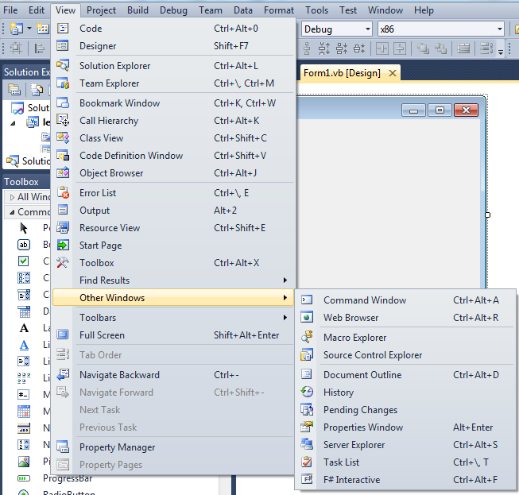

Slide 32
2.4.1 Solution Explorer
By default, the IDE displays only files that you may need to edit—other files that the IDE generates are hidden.
The Solution Explorer window includes a toolbar that contains several icons.
Clicking the Show All Files icon displays all the solution’s files, including those generated by the IDE .
Clicking the arrows to the left of a file or folder expands or collapses the project tree’s nodes.

Slide 33
2.4.2 Toolbox
The Toolbox (View > Other Windows > Toolbox) contains icons representing controls used to customize Forms.
With visual programming, you can “drag and drop” controls onto the Form.

Slide 34
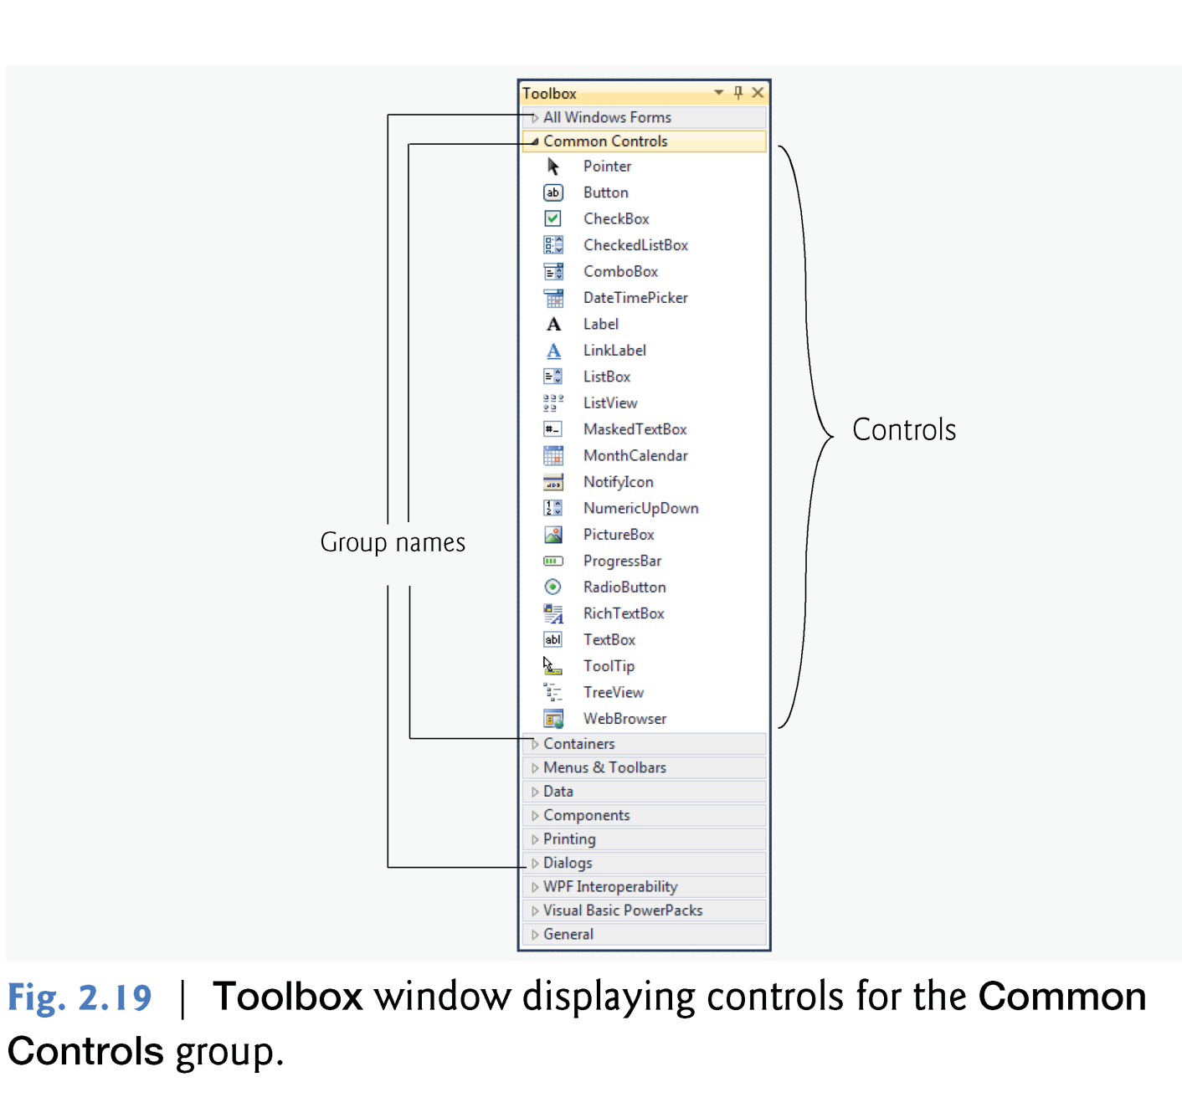

Slide 35
2.4.2 Toolbox
The Toolbox groups the GUI controls into categories as follows:
All Windows Forms
Common Controls
Containers
Menus & Toolbars
Data
Components
Printing
Dialogs
WPF Interoperability
Visual Basic PowerPacks
General

Slide 36
2.4.3 Properties Window
To display the Properties window:
select View > Other Windows > Properties Window,
click the Properties window toolbar ,
or press the F4 key.
The Properties window displays the properties for the currently selected Form, control or file in Design view.
Properties specify information about the Form or control, such as its size, color and position.

Slide 37
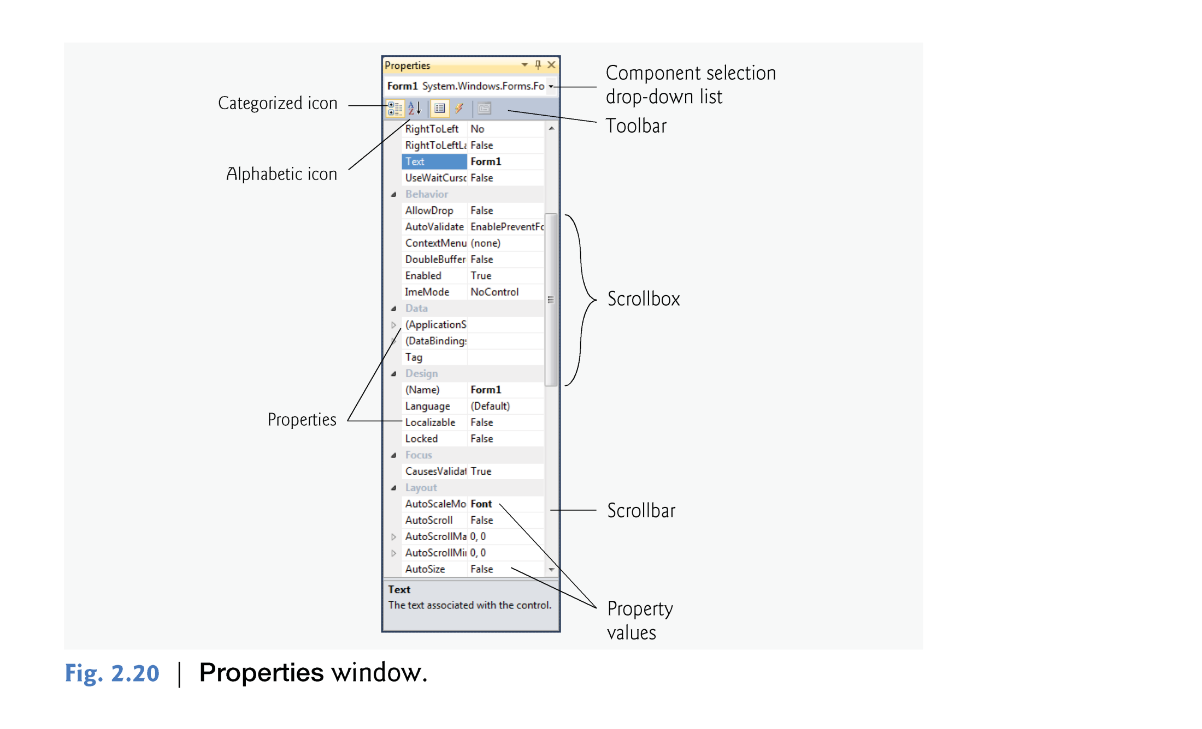

Slide 38
2.4.3 Properties Window
You can sort the properties window:
Alphabetically from (A-Z or (Z-A) (by clicking the Alphabetical icon)
or categorically (by clicking the Categorized icon).
Alphabetically icon
Event icon
Property icon

