Slide 1
Files and Streams

Slide 2
What is a file?
Up until now, any stored data within a program is lost when the program closes.
A file is a permanent way to store data

Slide 3
Introduction to Files and Streams
System.IO classes are used to work with files and streams
File - block of information stored on disk or another media
Text file - file that contains lines of written information that can be sent directly to the screen or printer
Binary file - file that contains bits that do not necessarily represent printable text Examples: Word file, machine language file
You can work with two kinds of files – text files (containing only characters) and binary files

Slide 4
Text vs Binary Files
A text file displayed in a text editor
A binary file displayed a text editor

Slide 5
Introduction to Processing Textual Data
One way to process textual files is from beginning to end using sequential access .This type of file is called a sequential file
Sequential files are useful for:
Storing text
Easy implementation in programs
Where real-time editing of file(s) is not required

Slide 6
Introduction to Processing Textual Data
Sequential files can be categorized into roughly three types
Free-form files have no particular format
Fields in a delimited file are separated with a special character called a delimiter
In a fixed-field file, each field occupies the same character positions in every record

Slide 7
Introduction to Processing Textual Data
Sequential files can be read one character at a time, one line at a time, or the entire file can be read at once
Sequential files are typically read into a string or an array

Slide 8
The Directory Class
We need to add
Imports System.IO
Common methods of the Directory class
Exists (path designation)
CreateDirectory (path designation)
Delete (path designation)
Code that uses some of the Directory methods
Dim dir As String = "C:\VB 2005\Files\"
If Not Directory.Exists(dir) Then
Directory.CreateDirectory(dir)
End If

Slide 9
The Directory Class

Slide 10
The Directory Class
The default location where the files we create are saved is the bin directory of the Windows Application with which we are working.

Slide 11
The File Class
Common methods of the File class
Exists (path)
Delete (path)
Copy (source, dest)
Move (source, dest)
Code that uses some of the File methods
Dim dir As String = "C:\VB 2005\Files\"
Dim path As String = dir & "Products.txt"
If File.Exists(path) Then
File.Delete(path)
End If

Slide 12
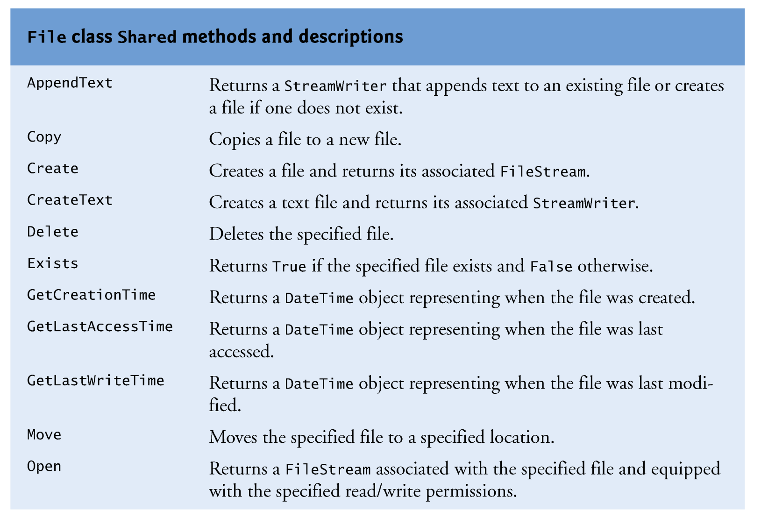
The File Class

Slide 13
The File Class

Slide 14
Files are manipulated in 3 stages
File Open : If the file does not exist it is created and then opened by the operating system. A portion of memory (RAM) is reserved by the Operating System.
Process File : When a file is open it can be written to or read from.
Close File : When a file has been opened and processed it must then be closed. The Operating system will then release the memory.

Slide 15
The Stream-File Connection
To perform file processing in Visual Basic, namespace System.IO must be referenced.
This namespace includes definitions for stream classes such as:
FileStream
StreamReader
StreamWriter
BinaryReader
BinaryWriter
Files are opened by creating objects of these stream classes.

Slide 16
Establishing Connections
There are several different ways to establish file-stream connections
Create a StreamReader object
Create a StreamWriter object
Create a FileStream object
The results of using these techniques are similar – they all result in the creation of (or opening of) a stream (fs) against which all subsequent file operations are written

Slide 17
The StreamReder Class
The StreamReader and StreamWriter classes belong to the System.IO namespace
The StreamReader constructor accepts one argument – the path and filename of the sequential file to open.
Dim CurrentReader As StreamReader = New _ System.IO.StreamReader("C:\Demo.txt")
The Close method closes a sequential file.
Always close files when processing is complete to prevent loss of data
Open files also consume system resources
Example:
CurrentReader.Close()

Slide 18
The StreamReder Class
The Read method reads a single character or many characters. Without arguments, the Read method returns the Integer code point of the character read
The ReadLine method reads a record. The carriage return at the end of the record is discarded. The method returns a String containing the characters read.
The ReadToEnd method reads from the current file position to the end of the file. The method returns a String containing the characters read

Slide 19
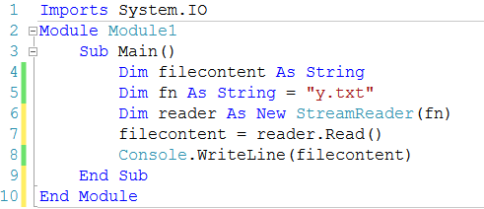
Example read()

Slide 20
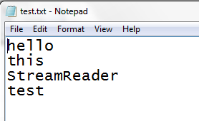
Example :Reading Entire Content of File

Slide 21
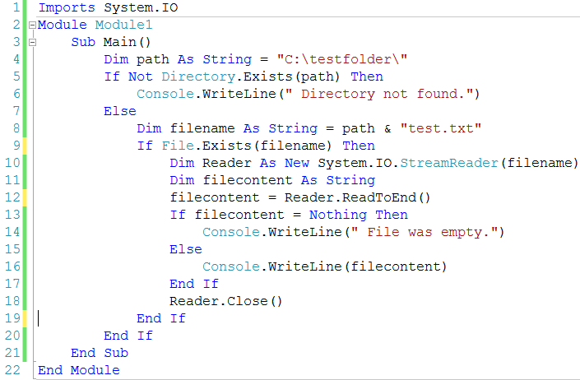
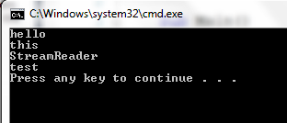

Slide 22
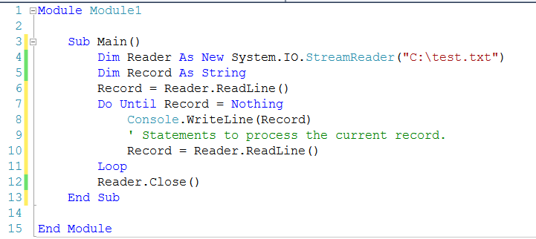
Reading a Sequential File One Record at a Time

Slide 23
The StreamWriter Class
The StreamWriter class of the System.IO namespace writes a sequential file
The constructor accepts one argument – the file to write
Example:
Dim CurrentWriter As New _
System.IO.StreamWriter("C:\Demo.txt")
' Statements to write the file.
CurrentWriter.Close()

Slide 24
The StreamWriter Class
The NewLine property contains the character(s) that mark the end of the line
The Close method closes the sequential file
It's imperative to close a sequential file once writing is complete to prevent loss of data
The Write method writes a character or array of characters
The WriteLine method writes data terminated by the character(s) stored in the NewLine property
If the data type passed to Write or WriteLine is not a string, these methods will call toString
Individual variables must be concatenated and separators must be used

Slide 25
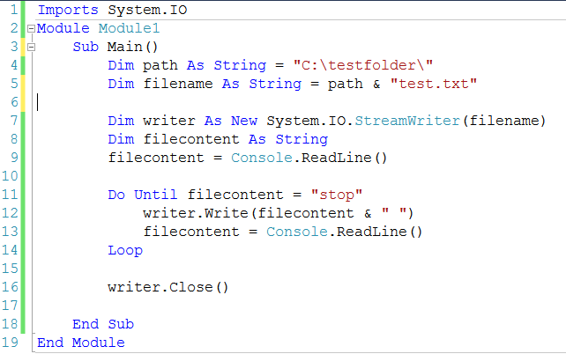
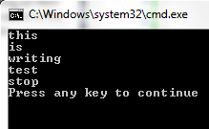
StreamWriter Example

Slide 26
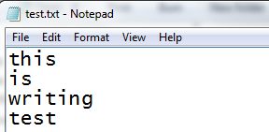
StreamWriter Example
Imports System.IO
Module Module1
Sub Main()
Dim path As String = "C:\testfolder\"
Dim filename As String = path & "test.txt"
Dim writer As New System.IO.StreamWriter(filename)
Dim filecontent As String
filecontent = Console.ReadLine()
writer.WriteLine(filecontent)
writer.Close()
End Sub
End Module

Slide 27
Writing a Freeform File
A freeform file can be written all at once as follows:
Dim StringData As String = "Freeform text"
Dim CurrentWriter As New _
System.IO.StreamWriter("C:\Demo.txt")
CurrentWriter.Write(StringData)
CurrentWriter.Close()

Slide 28
Writing a Delimited File

Slide 29
The FileStream Class
Create a FileStream object
Dim path as String = “C:\VB 2005\Files\Products.txt
Dim fs as New FileStream(path, FileMode.create, _
FileAccess.Write)
The syntax for creating a FileStream object
New FileStream(path, FileMode, FileAccess, share]])
Members in the FileMode enumeration
Append – opens a file if it exists and place the write pointer at the end of the file
Create – Creates a new file. If file exists it is overwritten
CreateNew – Creates a new file. If file already exists an exception is thrown
Open – Opens an existing file. If file does not exist, an exception is thrown
OpenOrCreate – Opens a file if it exists or creates a new file if it does not exist
Truncate –Opens an existing file and truncates it to zero bytes (erases its contents)

Slide 30
The FileStream Class
Members in the FileAccess enumeration
Read
ReadWrite
Write
Members in the FileShare enumeration
None
Read
ReadWrite
Write
Common method of the FileStream class
Close() // Closing a file disconnects the application from the file
Example
Dim path as String = “C:\VB 2005\Files\Products.txt
Dim fs as New FileStream(path, FileMode.create, FileAccess.Write)

Slide 31
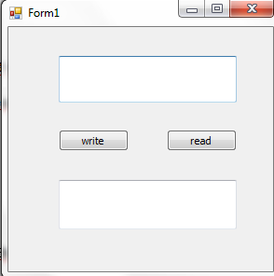
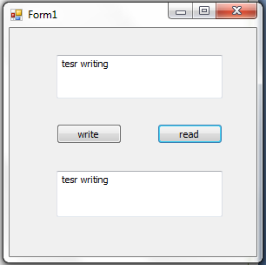
Example

Slide 32
Imports System.IO
Public Class Form1
Dim filecontent As String
Dim fn As String = "test1.txt"
Dim fs As FileStream
Private Sub Button1_Click(ByVal sender As System.Object, ByVal e As System.EventArgs) Handles Button1.Click
fs = New FileStream(fn, FileMode.OpenOrCreate, FileAccess.Write)
Dim writer As New StreamWriter(fs)
filecontent = TextBox1.Text
writer.WriteLine(filecontent)
writer.Close()
fs.Close()
MsgBox("writing complete")
End Sub
Private Sub Button2_Click(ByVal sender As System.Object, ByVal e As System.EventArgs) Handles Button2.Click
fs = New FileStream(fn, FileMode.Open, FileAccess.Read)
Dim reader As New StreamReader(fs)
filecontent = reader.ReadLine()
TextBox2.Text = filecontent
reader.Close()
fs.Close()
End Sub
End Class

Slide 33
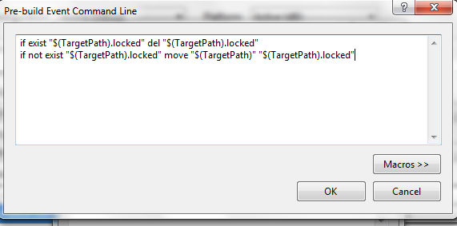
if exist "$(TargetPath).locked" del "$(TargetPath).locked"
if not exist "$(TargetPath).locked" move "$(TargetPath)" "$(TargetPath).locked"

