Slide 1
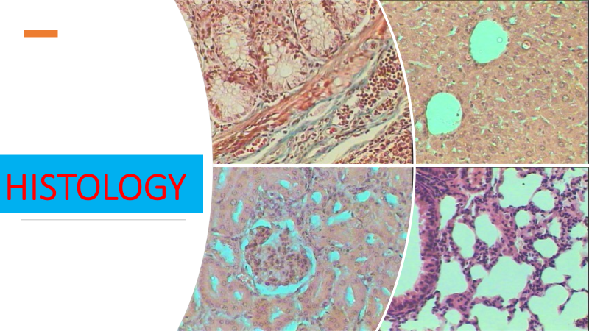
Lec 9
Urinary system

Slide 2
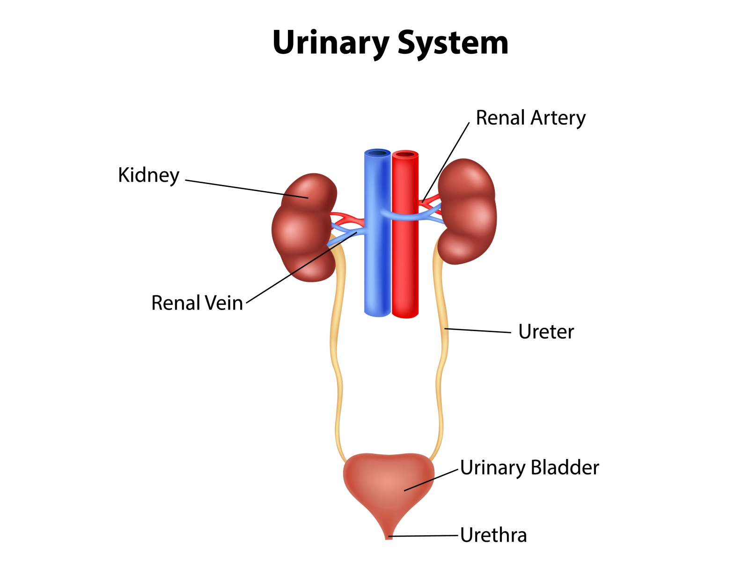

Slide 3
Urinary system
The urinary system, also known as the renal system or urinary tract
kidneys
ureters
bladder
urethra

Slide 4
The function of the urinary system
eliminate waste from the body
regulate blood volume and blood pressure
control levels of electrolytes and metabolites
regulate blood pH

Slide 5
The kidneys have an extensive blood supply via the renal arteries which leave the kidneys via the renal vein. Each kidney consists of functional units called nephrons.
Following filtration of blood and further processing, wastes (in the form of urine) exit the kidney via the ureters, tubes made of smooth muscle fibres that propel urine towards the urinary bladder, where it is stored and subsequently expelled from the body by urination (voiding)
The female and male urinary system are very similar, differing only in the length of the urethra

Slide 6
Urine is formed in the kidneys through a filtration of blood. The urine is then passed through the ureters to the bladder, where it is stored. During urination, the urine is passed from the bladder through the urethra to the outside of the body.
800–2,000 milliliters (mL) of urine are normally produced every day in a healthy human. This amount varies according to fluid intake and kidney function.

Slide 7
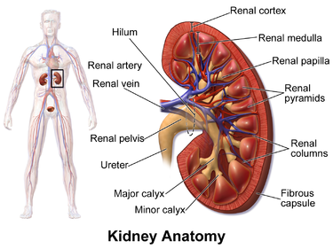
The kidneys are two bean-shaped organs found in vertebrates. They are located on the left and right in the retroperitoneal space, and in adult humans are about 11 centimetres (4.3 in) in length.

Slide 8
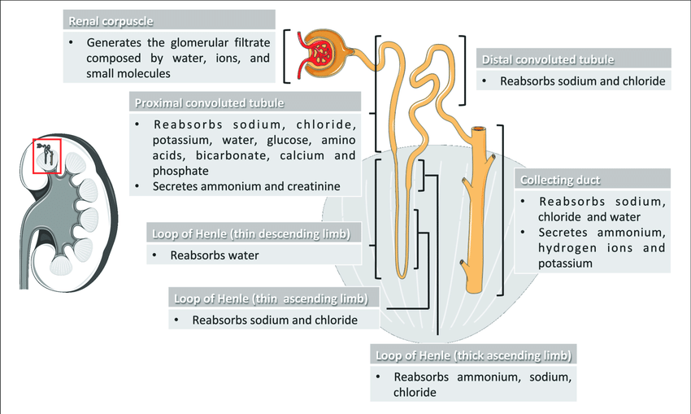

Slide 9
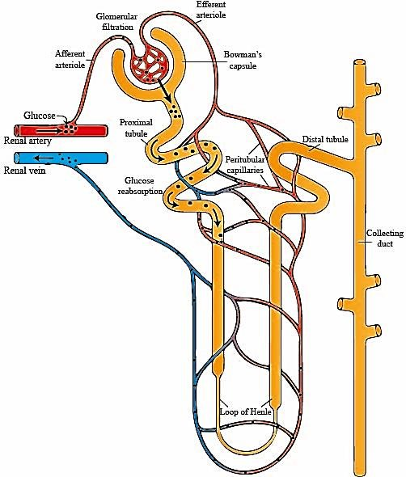
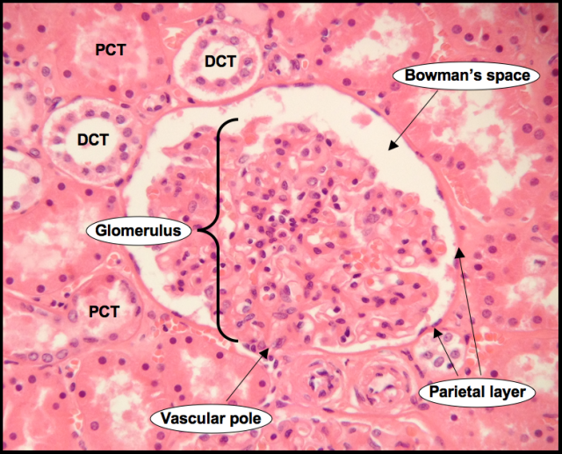
Histology of kidney cortex

Slide 10
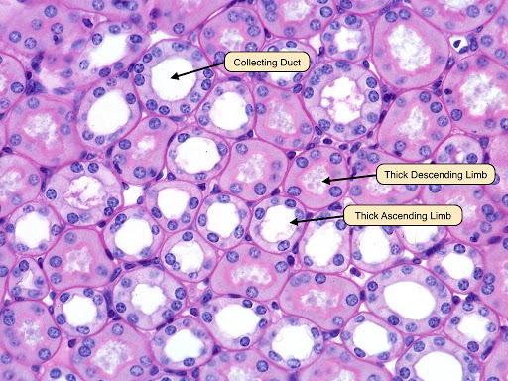
Histology of kidney medulla

Slide 11
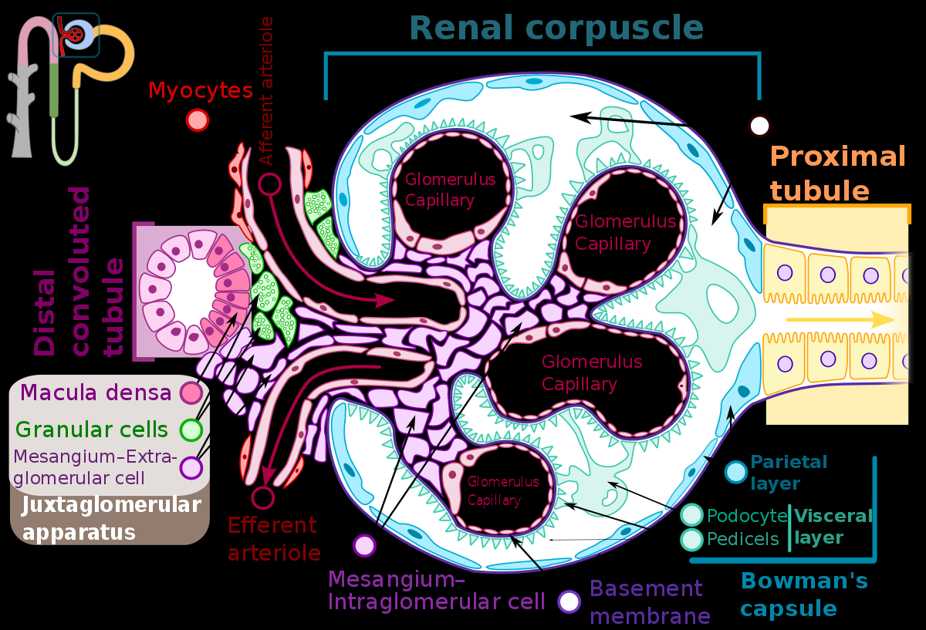

Slide 12
The juxtaglomerular apparatus
The juxtaglomerular apparatus (also known as the juxtaglomerular complex) is a structure in the kidney that regulates the function of each nephron, the functional units of the kidney. The juxtaglomerular apparatus is named because it is next to the glomerulus.
The juxtaglomerular apparatus consists of three types of cells:
1- the macula densa, a part of the distal convoluted tubule of the same nephron
2- juxtaglomerular cells, (also known as granular cells) which secrete renin
3- extraglomerular mesangial cells

Slide 13
The juxtaglomerular cells (JG cells, or granular cells) are cells in the kidney that synthesize, store, and secrete the enzyme renin. They are specialized smooth muscle cells mainly in the walls of the afferent arterioles (and some in the efferent arterioles) that deliver blood to the glomerulus. In synthesizing renin, they play a critical role in the renin–angiotensin system and thus in autoregulation of the kidney.
Renin
the renin–angiotensin–aldosterone axis—that mediates the volume of extracellular fluid (blood plasma, lymph and interstitial fluid) and arterial vasoconstriction. Thus, it regulates the body's mean arterial blood pressure.
Renin can also be referred to as a hormone, as it has a receptor, the (pro)renin receptor, also known as the renin receptor and prorenin receptor (see also below),[4] as well as enzymatic activity with which it hydrolyzes angiotensinogen to angiotensin I.

Slide 14
