Slide 1

Proteins and Enzymes

Slide 2
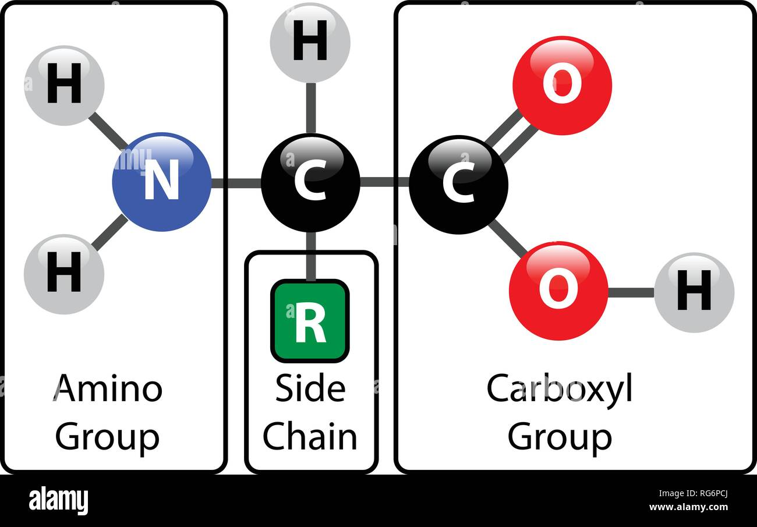

Slide 3
Proteins consist of polypeptides
Total proteins consisting of various amino acids
mercuric bromphenol blue
naphthol yellow
some basic proteins are stained with Fast green and gallocyanine chrome alum
some amino acids in proteins can be stained with specific dyes such as tryptophane and tyrosin with Millon reactions

Slide 4
Enzyme Histochemistry
Enzymes are the catalysts of most of biochemical reactions
Frozen tissues are used
Principle
1 - reaction (histochemical): enzyme + substrate →product
2 - reaction: demonstration of the product

Slide 5
Peroxidase
sections are incubated in a solution containing hydrogen peroxide and DAB (diaminoazobenzidine)
DAB is oxidized in the presence of peroxidase –result:insoluble, black, electrondenseprecipitate

Slide 6
Pigments
Several pigments can be found in various cells and tissues, such as melanin, lipofuscin, ceroids, hemoglobin, hemosiderin, bilirubin etc
Lipochrome (lipofuschin) pigments
Melanin stains
These are the breakdown products within cells from oxidation of lipids and lipoproteins. They are the wear-and-tear pigments found most commonly in heart, liver, CNS, and adrenal cortex (zona reticularis). The less highly oxidized "ceroid" pigment of testis interstitium and seminal vesicle is another form of lipochrome.
Melanin is normally found in the skin, eye, and substantia nigra. It may also be found in melanomas.
Sudan black B, long Ziehl-Neelson acid fast,
Fontana-Masson ("melanin stain")

Slide 7
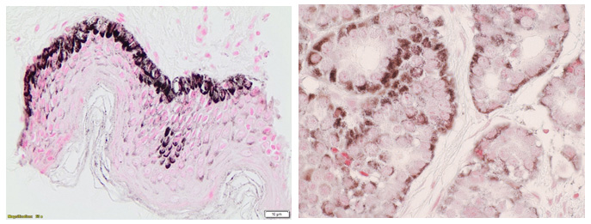
Melanin Fontana-Masson

Slide 8
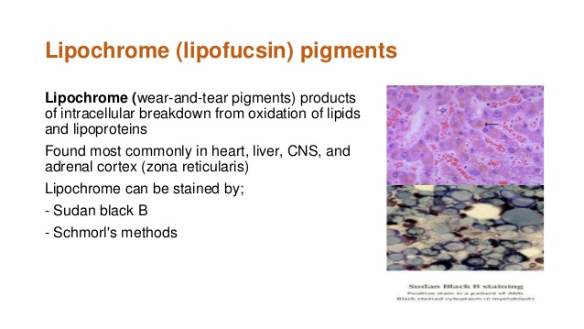

Slide 9
Inorganic Substances
Varieties of methods for demonstrating inorganic elements, especially metals, by color reactions have been developed since many years
The color reaction produced by union of a dye with a metal or metal salt is called as lake-formation
Numerous techniques exist for the demonstration of metals such as iron, copper, gold, silver, mercury, lead, nickel, aluminum, zinc etc

Slide 10
Iron (hemosiderin)
Hemosiderin (storage iron granules) may be present in areas of old hemorrhage or be deposited in tissues with iron overload (hemosiderosis is the term used if the iron does not interfere with organ function; hemochromatosis refers to a condition of iron overload associated with organ failure).
Perl's iron stain is the classic method for demonstrating iron in tissues. The section is treated with dilute hydrochloric acid to release ferric ions from binding proteins. These ions then react with potassium ferrocyanide to produce an insoluble blue compound (the Prussian blue reaction). Mercurial fixatives seem to do a better job of preserving iron in bone marrow than formalin.

Slide 11
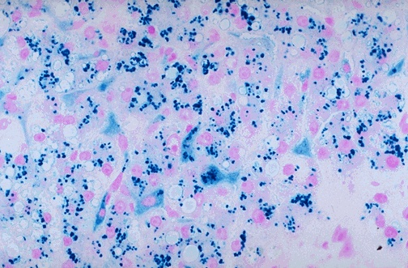

Slide 12
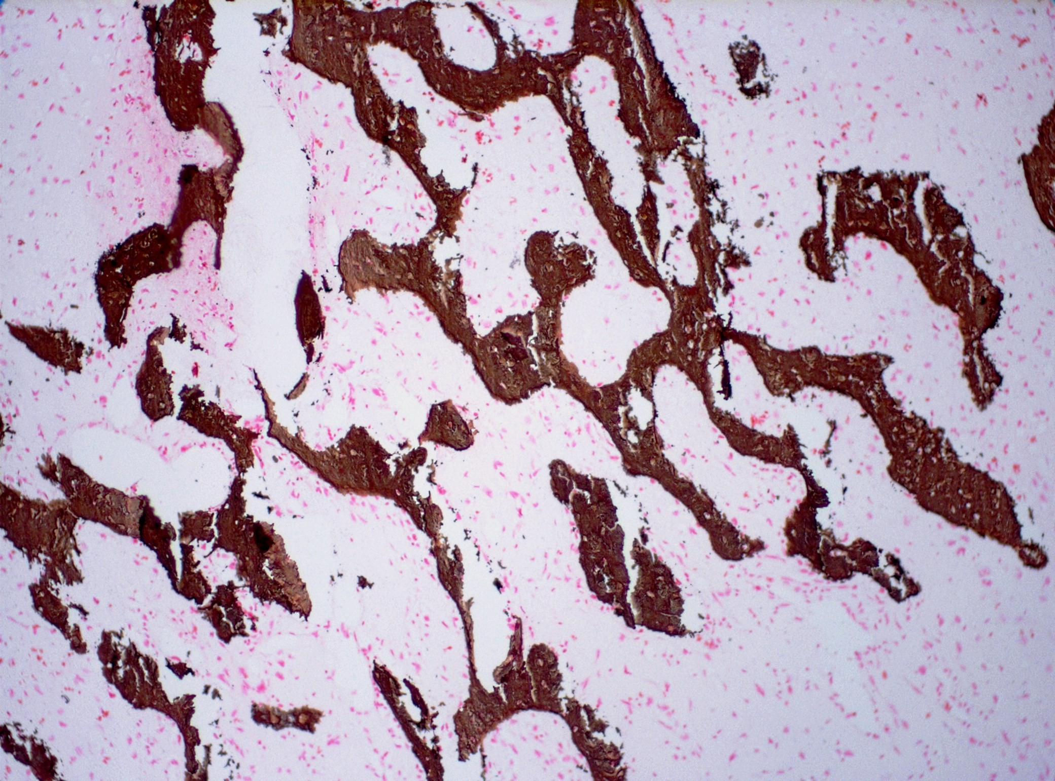
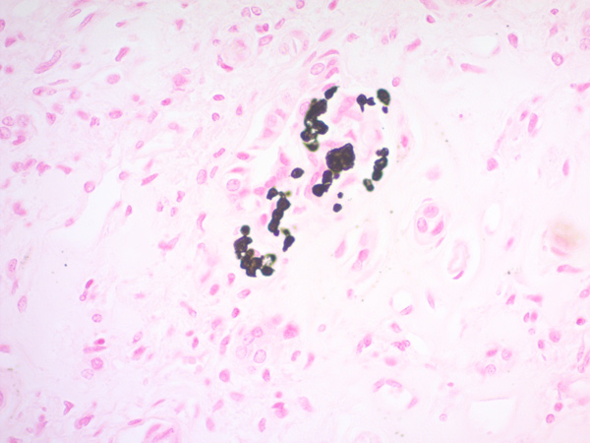
Calcium
Only calcium that is bound to an anion (such as PO4 or CO3) can be demonstrated. Calcium forms a blue-black lake with hematoxylin to give a blue color on H&E stain, usually with sharp edges.
VonKossa stain is a silver reduction method that demonstrates phosphates and carbonates, but these are usually present along with calcium. This stain is most useful when large amounts are present, as in bone.

