Slide 1
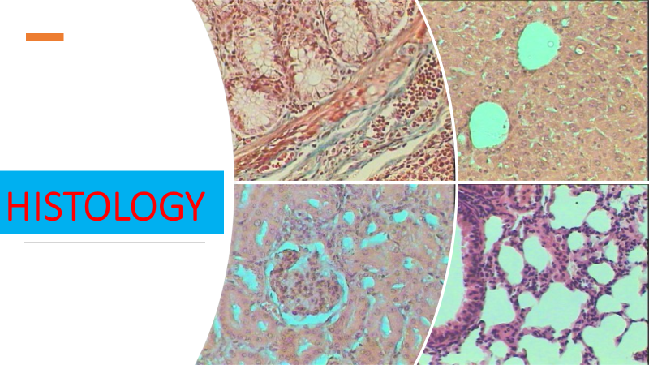
Lec 8
Liver
Goblet cells

Slide 2
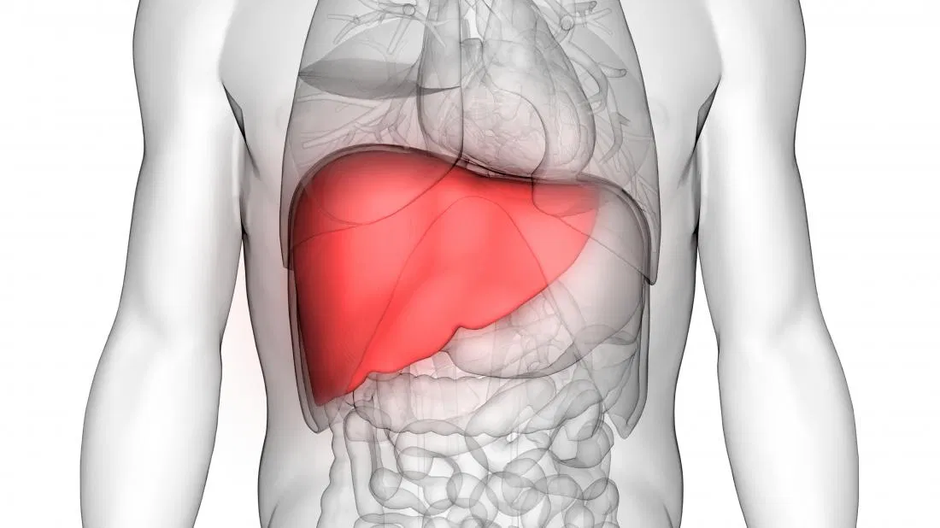
Liver

Slide 3
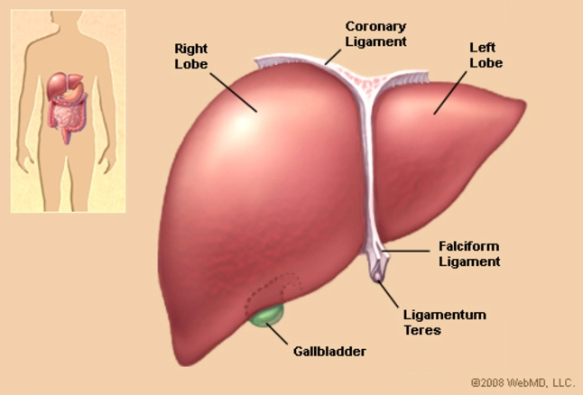
The liver is the largest solid organ and the largest gland in the human body. It carries out over 500 essential tasks.
Classed as part of the digestive system,

Slide 4
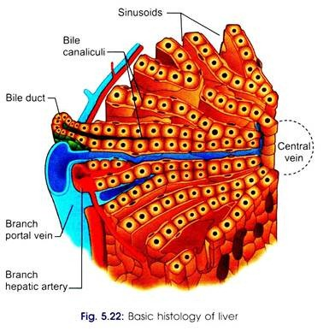
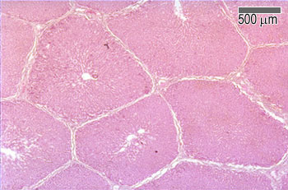
Liver histology

Slide 5
The major functions of the liver include
Bile production: Bile helps the small intestine break down and absorb fats, cholesterol, and some vitamins. Bile consists of bile salts, cholesterol, bilirubin, electrolytes, and water.
Absorbing and metabolizing bilirubin: Bilirubin is formed by the breakdown of hemoglobin. The iron released from hemoglobin is stored in the liver or bone marrow and used to make the next generation of blood cells.
Supporting blood clots: Vitamin K is necessary for the creation of certain coagulants that help clot the blood. Bile is essential for vitamin K absorption and is created in the liver. If the liver does not produce enough bile, clotting factors cannot be produced.

Slide 6
Fat metabolization: Bile breaks down fats and makes them easier to digest.
Metabolizing carbohydrates: Carbohydrates are stored in the liver, where they are broken down into glucose and siphoned into the bloodstream to maintain normal glucose levels. They are stored as glycogen and released whenever a quick burst of energy is needed.
Vitamin and mineral storage: The liver stores vitamins A, D, E, K, and B12. It keeps significant amounts of these vitamins stored. In some cases, several years’ worth of vitamins is held as a backup. The liver stores iron from hemoglobin in the form of ferritin, ready to make new red blood cells. The liver also stores and releases copper.

Slide 7
Helps metabolize proteins: Bile helps break down proteins for digestion.
Filters the blood: The liver filters and removes compounds from the body, including hormones, such as estrogen and aldosterone, and compounds from outside the body, including alcohol and other drugs.
Immunological function: The liver is part of the mononuclear phagocyte system. It contains high numbers of Kupffer cells that are involved in immune activity. These cells destroy any disease-causing agents that might enter the liver through the gut.
Production of albumin: Albumin is the most common protein in blood serum. It transports fatty acids and steroid hormones to help maintain the correct pressure and prevent the leaking of blood vessels.

Slide 8
Regeneration
The liver is the only visceral organ that can regenerate.
This regeneration is helped by a number of compounds, including growth factors and cytokines.
hepatocyte growth factor
insulin
transforming growth factor-alpha
epidermal growth factor
interleukin-6
norepinephrine

Slide 9
Liver enzymes
Liver function tests
alanine transaminase (ALT)
Elevated liver enzymes often indicate inflammation or damage to cells in the liver. Inflamed or injured liver cells leak higher than normal amounts of certain chemicals, including liver enzymes, into the bloodstream, elevating liver enzymes on blood tests.
aspartate transaminase (AST)
alkaline phosphatase (ALP)
Gamma-glutamyl transpeptidase (GGT)

Slide 10
Goblet cells
Definition
Goblet cells are modified epithelial cells that secrete mucus on the surface of mucous membranes of organs, particularly those of the lower digestive tract and airways.
Histologically, they are mucous merocrine exocrine glands.

Slide 11
Goblet cells secrete mucus – mucous glands
Their product is packed in vesicles inside the cell, and released by exocytosis – merocrine glands
They release their product on the surface of epithelium rather than in blood – exocrine glands

Slide 12
Location and morphology
Goblet cells are mostly found scattered in the epithelia of the small intestines and respiratory tract. The morphology of goblet cells reflects their function, with the cell containing all the organelles necessary for the production of glycosylated proteins called mucins.
In the respiratory tract, mucins play an important role in catching large particles inhaled by air. Going down the respiratory tree, the number of goblet cells decrease, while the number of club cells increase. This is due to terminal bronchiole needing different kinds of protection which club cells can bring them–breaking down of inhaled toxins that couldn’t be stopped by the mucus of goblet cells.

Slide 13
Besides containing the nucleus and mitochondria, the cytoplasm is especially rich in rough endoplasmic reticulum (RER) and Golgi complexes. Mucins are produced by mucinogen granules in RER and packed into vesicles in Golgi complexes. To make the entire process of synthesis more efficient, goblet cells are polarized, meaning that the organelles have a specific layout within the cytoplasm: the nucleus, mitochondria, RER, and Golgi apparatus are found in the basal portion of the cell; while the vesicles with mucins are located apically, in order to be close to the apical membrane through which their exocytosis occurs.
After exocytosis of the vesicles onto the surface of mucous membranes, the mucins become hydrated and form mucus. Mucus is easily washed out during histological preparation, which is why it stains very poorly with hematoxylin and eosin. But since mucins are heavily glycosylated, meaning they contain a lot of oligosaccharides, they stain purple with the periodic acid-Schiff method (PAS).

Slide 14
Functions
In the small and large intestines, goblet cells are dispersed between enterocytes. Their main function here is to produce mucus which protects and lubricates the surface of the intestines. In the respiratory tract, besides protecting the epithelial surface, mucus traps harming particles inhaled with air to protect the airway.
Goblet cells produce small amounts of mucus continually, which is known as basal (constitutive) secretion. Mucus production significantly increases when the epithelium is irritated, for example, by inhaling smoke . This kind of triggered secretion is called stimulated secretion.

