Slide 1

Lipids Histochemistry and Nuceli acids

Slide 2
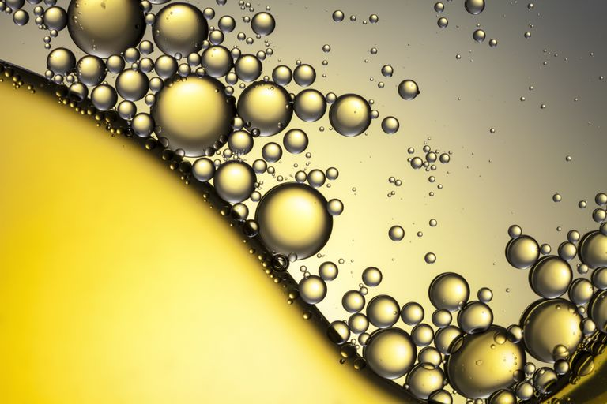
Lipids

Slide 3
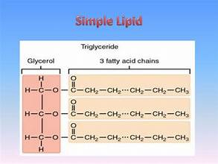

Slide 4
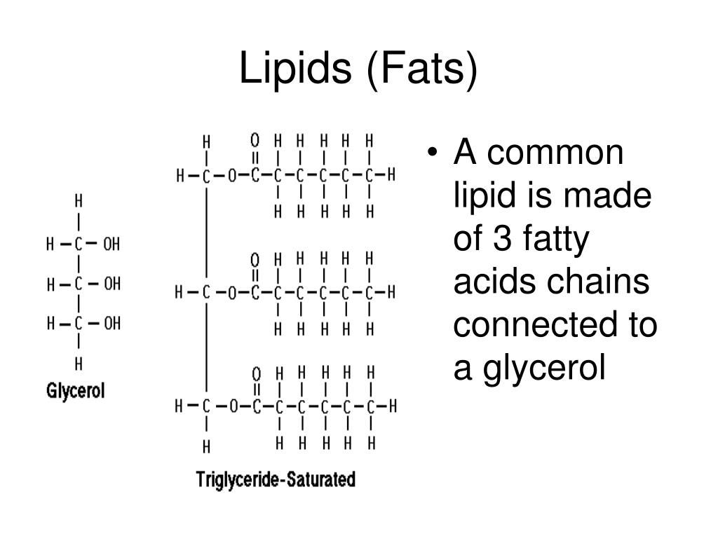

Slide 5
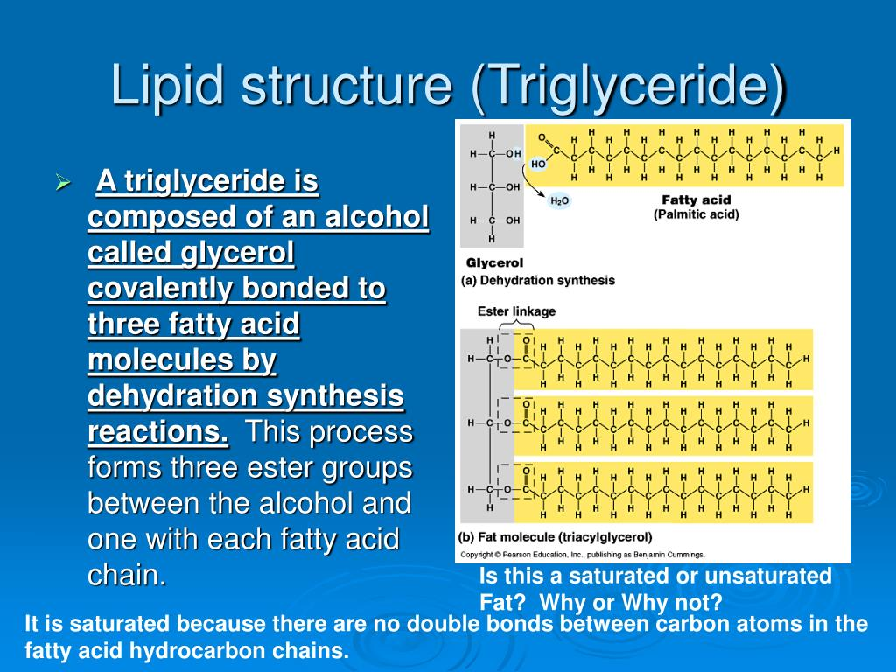

Slide 6
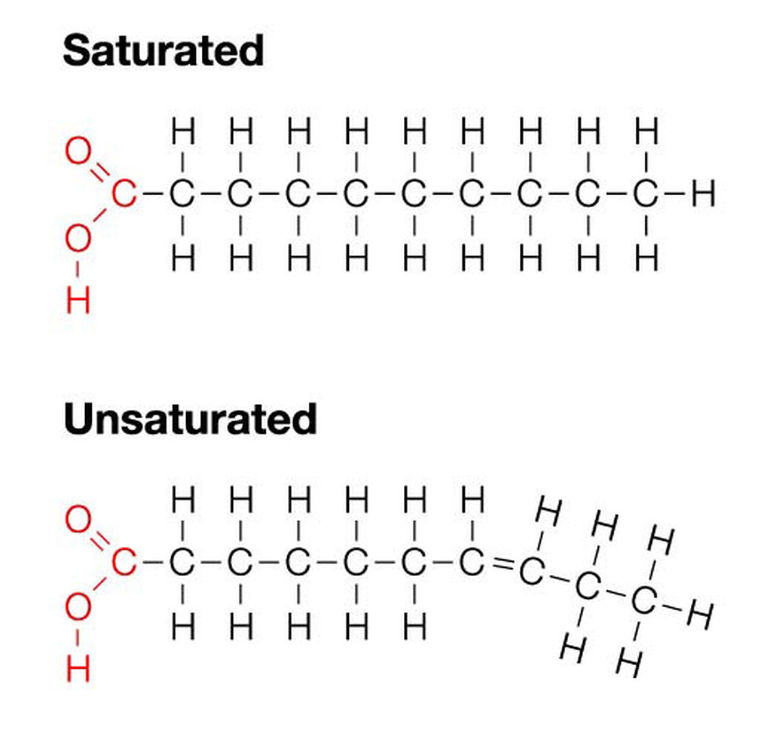

Slide 7
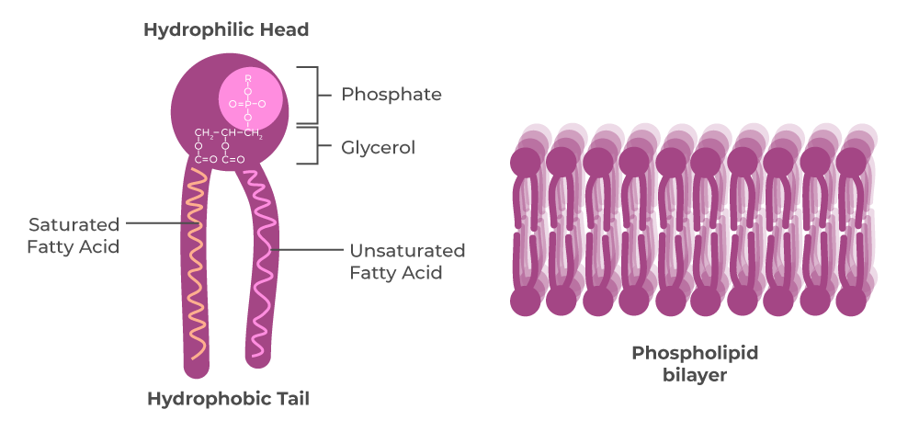
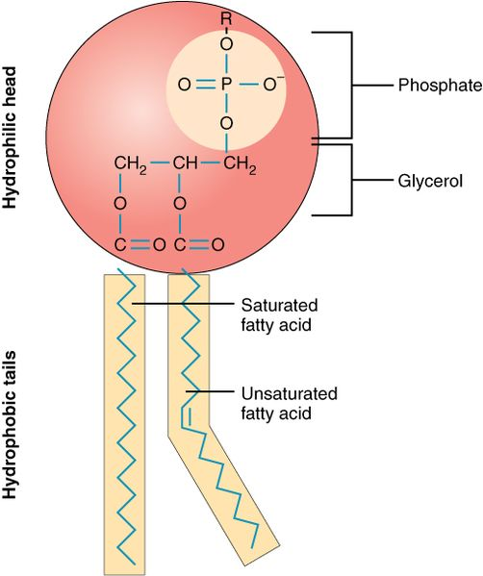

Slide 8
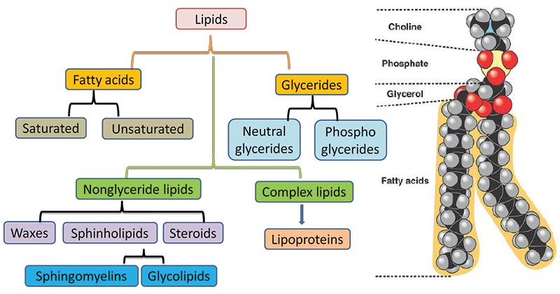

Slide 9
Lipids are insoluble in water and extracted from cells by only fat solvents
They consist of fatty acids and alcohols
simple lipid esters
compounds lipids

Slide 10
fresh frozen (cryostat) sections are used for the most authentic picture of tissue lipids
stained with dyes soluble in the lipids
Sudan IV, Sudan black, Oil red, Nile blue

Slide 11
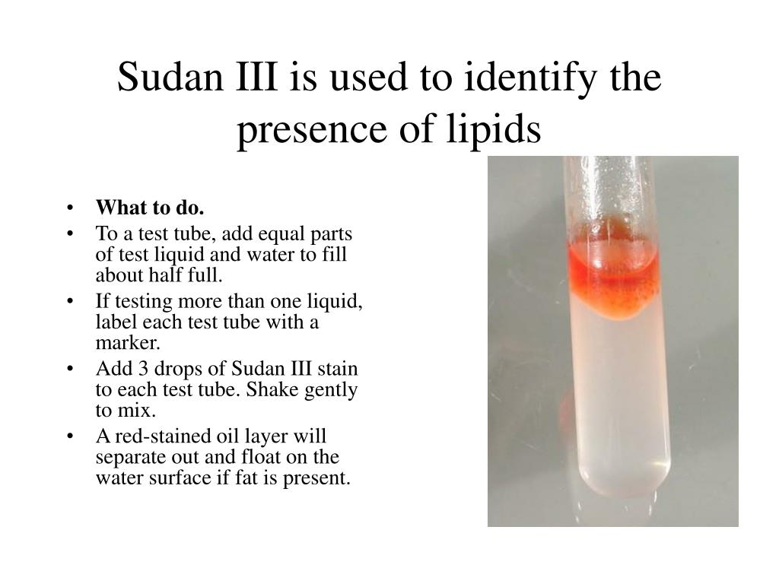

Slide 12
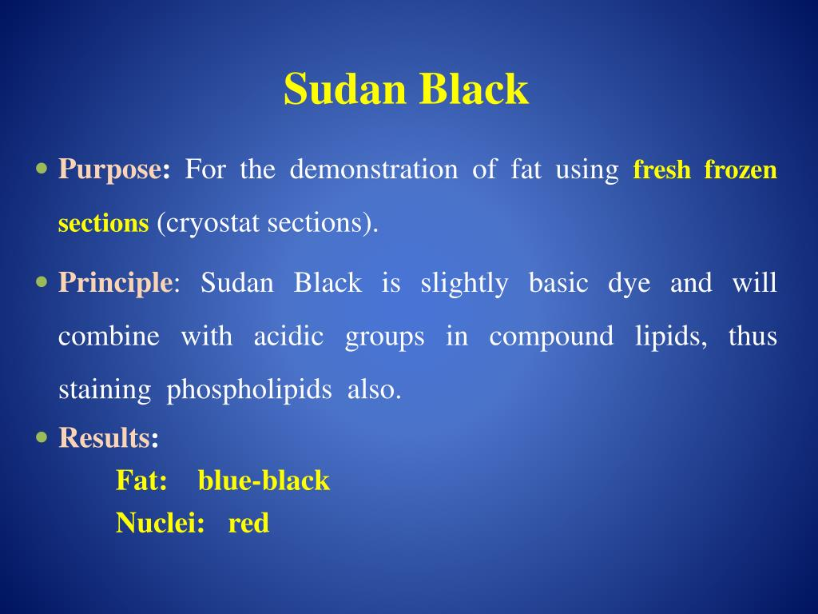

Slide 13
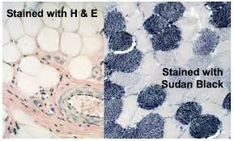

Slide 14
Nucleic acids
DNA
RNA
Feulgen’sreaction
RNA-rich organelles are stained with basic dyes
hydrolysis of DNA by hydrochloric acid
toluidineblue, methyleneblue
this process leads to the formation of aldehyde groups
Since the RNA is not the only basophilic substance in the tissue it is necessary to incubate a control slide with ribonuclease
free aldehyde groups react with the
Schiff reagent –result:insoluble red substance

Slide 15
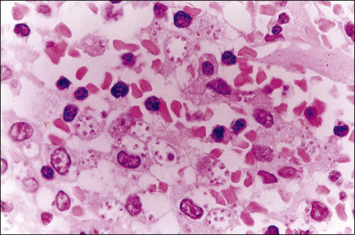
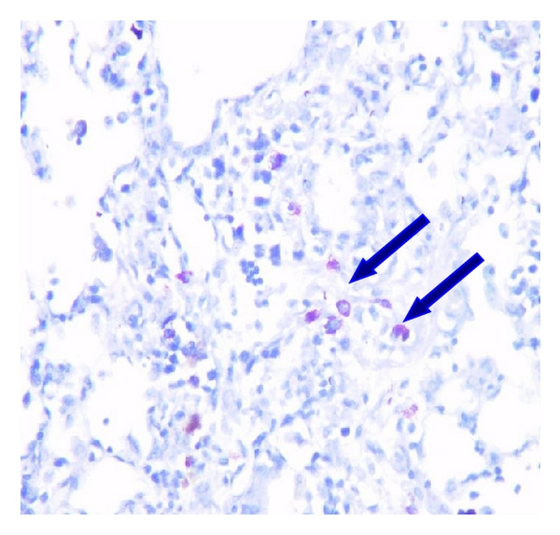
DNA Fuelgin
RNA toluidineblue

