Slide 1
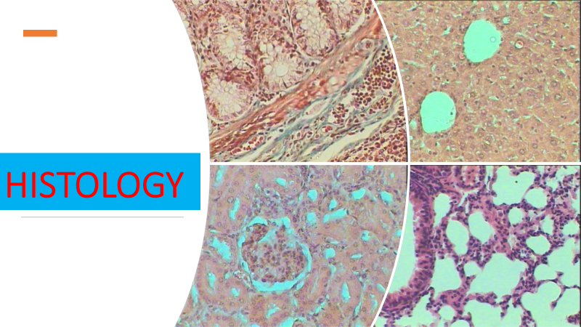
Lec 7
Alimentary tract

Slide 2
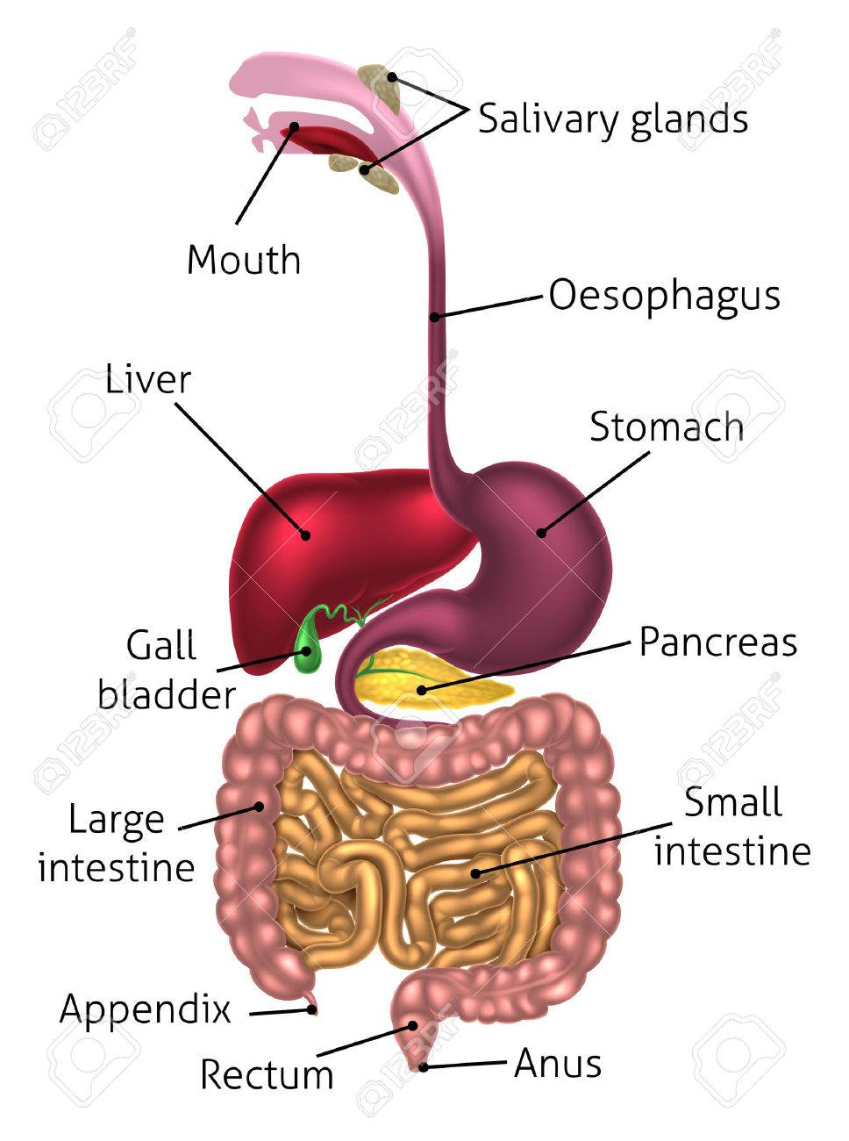
Gastointestinal Tract

Slide 3
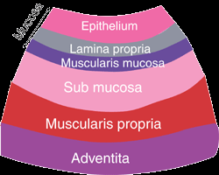
The GI tract contains four layers: the innermost layer is the mucosa, underneath this is the submucosa, followed by the muscularis propria and finally, the outermost layer - the adventitia. The structure of these layers varies, in different regions of the digestive system, depending on their function.

Slide 4
Mucosa
A lining epithelium, including glandular tissue
layer of loose connective tissue called the lamina propria
provides vascular support for the epithelium, and often contains mucosal glands
thin double layer of smooth muscle is often present - the muscularis mucosa for local movement of the mucosa.

Slide 5
Submucosa
A loose connective tissue layer, with larger blood vessels, lymphatics, nerves, and can contain mucous secreting glands.
Muscularis propria
smooth muscle layer
the inner layer is circular
the outer layer is longitudinal
used for peristalsis
(rhythmic waves of contraction)
to move food down through the gut
Adventia layer
outermost layer of loose connective tissue - covered by the visceral peritoneum
Contains blood vessels, lymphatics and nerves.

Slide 6
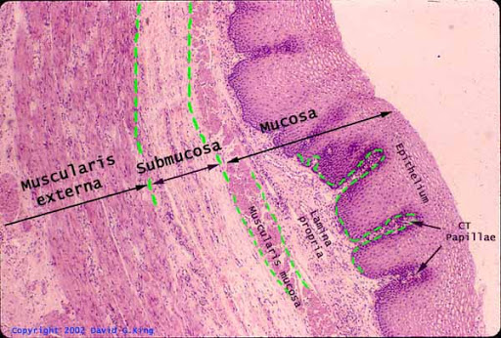
oesophagus

Slide 7
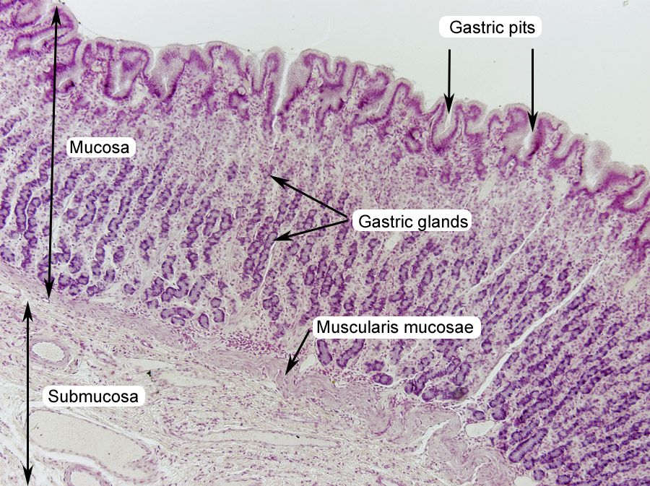
stomach

Slide 8
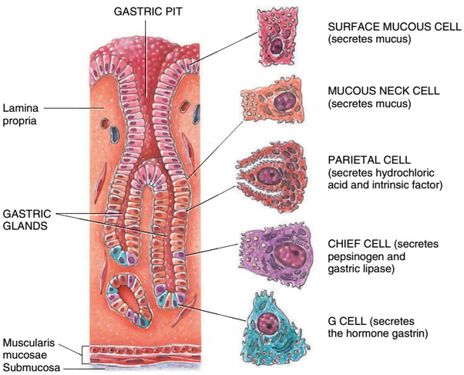
Stomach
gland

Slide 9
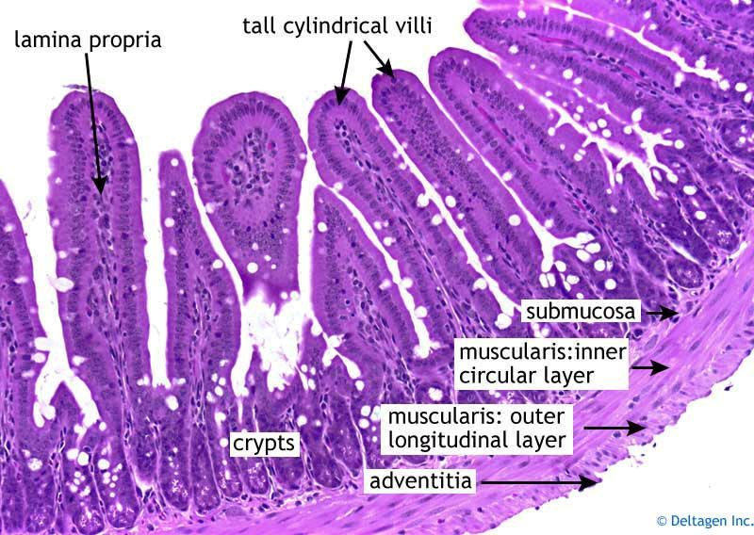
Small intestine

Slide 10
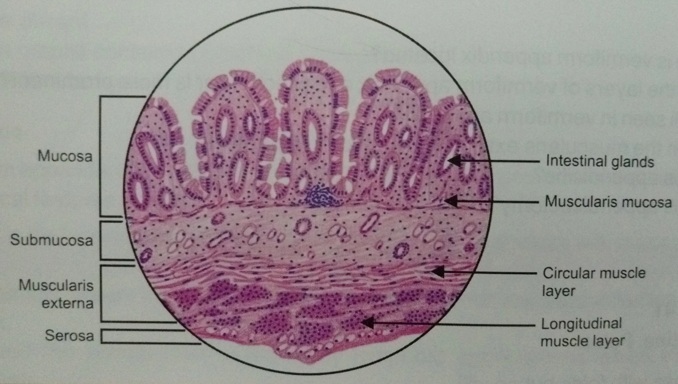

Slide 11
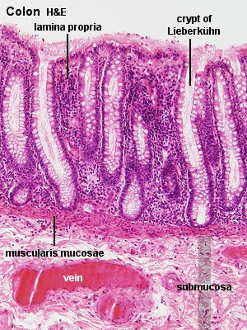
Large
intestine

