Slide 1
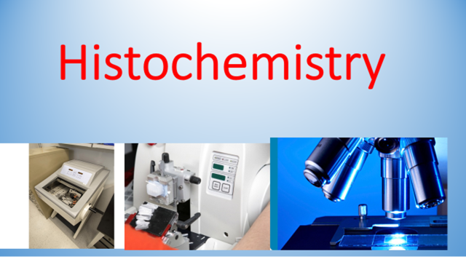

Slide 2
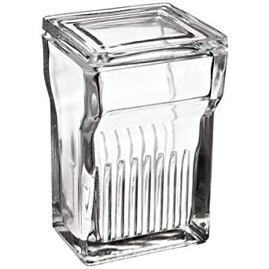
Staining
1
deparaffinization.
process in order to remove the paraffin wax from the tissue to allow water-soluble dyes to penetrate the sections
Xylene
2 changes
100% alcohol
2 changes
95% alcohol
70% alcohol
D W
Descending grades

Slide 3
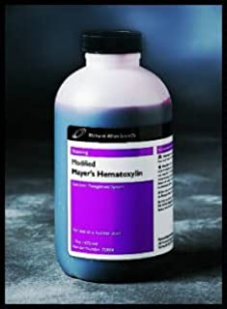
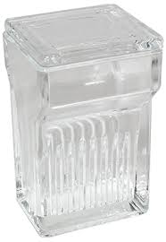
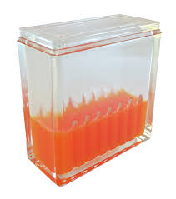
routine staining
2
H and E
This stain is used routinely as it provides the pathologist or researcher with a detailed view of the tissue, clearly staining, for example, the cytoplasm, nucleus
20 minutes to stain the nucleus
Running tap water for 10 minutes
10 minutes to stain cytoplasm
H
E

Slide 4

3
Dehydration
Removal of water
70% alcohol
95% alcohol
100% alcohol
xylene

Slide 5
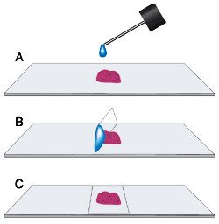
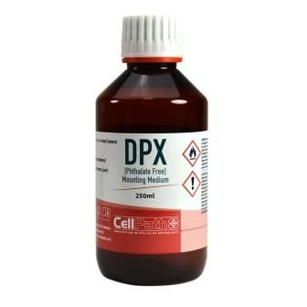
mounting
4

Slide 6
summary
deparaffinization
mounting
staining
Dehydration

