Slide 1
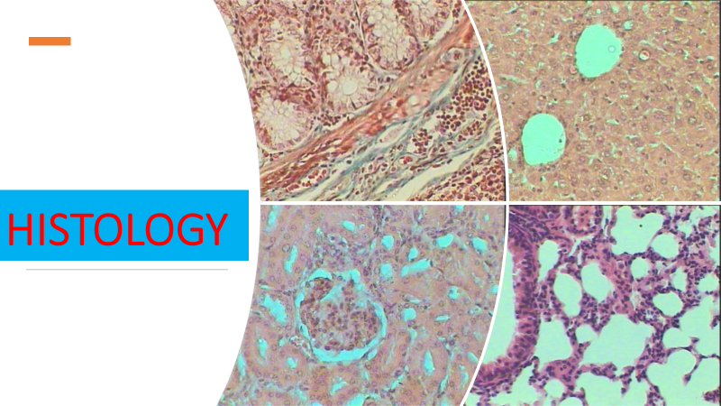
Lec 6
Muscular and Nervous tissue

Slide 2
Muscles
There are three types of muscles
Skeletal
Smooth
Cardiac
Two of these kinds—skeletal and smooth—are part of the musculoskeletal system.

Slide 3
Skeletal muscle
Skeletal muscle is what most people think of as muscle, the type that can be contracted to move the various parts of the body.
Skeletal muscles are bundles of contractile fibers that are organized in a regular pattern, so that under a microscope they appear as stripes (hence, they are also called striped or striated muscles).
Skeletal muscles, which are responsible for posture and movement, are attached to bones and arranged in opposing groups around joints.

Slide 4
For example, muscles that bend the elbow (biceps) are countered by muscles that straighten it (triceps).
These countering movements are balanced. The balance makes movements smooth, which helps prevent damage to the musculoskeletal system.
Skeletal muscles are controlled by the brain and are considered voluntary muscles because they operate with a person's conscious control. The size and strength of skeletal muscles are maintained or increased by regular exercise
In addition, growth hormone and testosterone help muscles grow in childhood and maintain their size in adulthood.

Slide 5
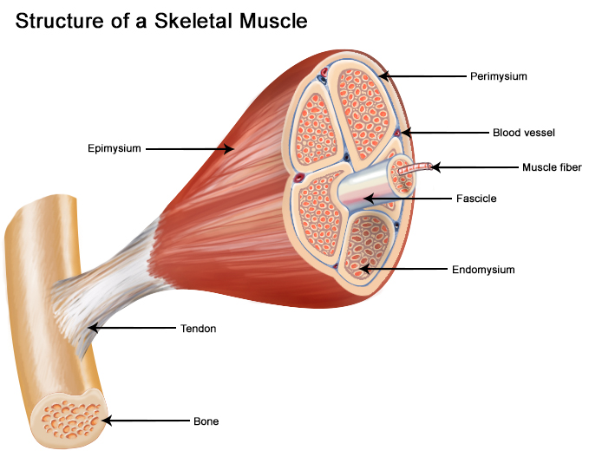

Slide 6
Structure
Endomysium surrounds individual muscle fibers. It is made up of a delicate layer of reticular fibers and permits only small-diameter nerve fibers and capillaries, thus acting as a site of metabolic exchange.
Perimysium is a slightly thicker layer of connective tissue consisting mainly of type I and III collagen and surrounds a group of fibers. This fiber group is referred to as a fascicle or bundle. Fascicles are the functional units of skeletal muscle tissue.
The perimysium contains slightly larger blood vessels and nerve fibers than those traveling through endomysium.
Epimysium surrounds the entire collection of fascicles making up an individual muscle. This dense connective tissue made up of mainly type I collagen contains the neurovascular supply to the muscle.

Slide 7
Sarcomeres
The sarcomere is the functional unit of a skeletal muscle cell. Each sarcomere is about 2.5 micrometers in length. It is made up of multiple myosin and actin filaments oriented in parallel. The actin and myosin filaments overlap in certain places creating several bands and zones.
Actines :They are almost 8 nm in diameter and have tightly bound regulatory proteins called troponin and tropomyosin.
Thick myosin filaments are found between the actin filaments. Their diameter is approximately 15 nm with a globular head region consisting of heavy and light chain. This head has an ATPase activity and ability to bind and move along actin filament.

Slide 8
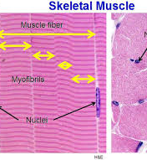
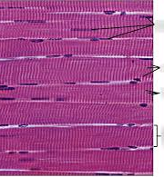

Slide 9
Smooth muscles
Smooth muscles control certain bodily functions that are not readily under a person's control.
Smooth muscle also is controlled by the brain but not voluntarily. The triggers for contracting and relaxing smooth muscles are controlled by the body's needs, so smooth muscles are considered involuntary muscle because they operate without a person's conscious control.
Smooth muscle surrounds many arteries and contracts to adjust blood flow.

Slide 10
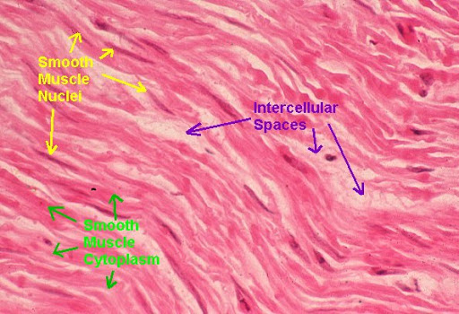

Slide 11
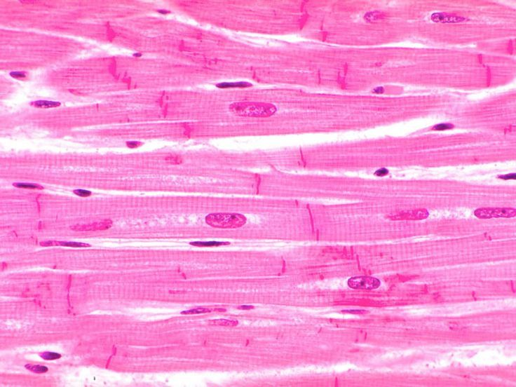
Cardiac muscle
Cardiac muscle forms the heart and is not part of the musculoskeletal system. Like skeletal muscle, cardiac muscle has a regular pattern of fibers that also appear as stripes under a microscope.
However, cardiac muscle contracts and relaxes rhythmically without a person's awareness

Slide 12
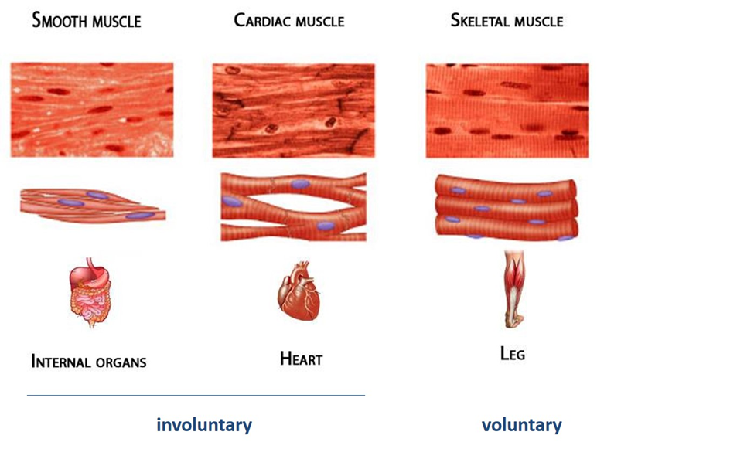

Slide 13
Nervous tissue
Nervous tissue is the term for groups of organized cells in the nervous system, which is the organ system that controls the body’s movements, sends and carries signals to and from the different parts of the body, and has a role in controlling bodily functions such as digestion. Nervous tissue is grouped into two main categories: neurons and neuroglia.
Neurons, or nerves, transmit electrical impulses, while neuroglia do not; neuroglia have many other functions including supporting and protecting neurons.

Slide 14
Function of Nervous Tissue
Nervous tissue makes up the nervous system. The nervous system is subdivided in several overlapping ways.
The central nervous system (CNS) is composed of the brain and spinal cord, which coordinates information from all areas of the body and sends nerve impulses that control all bodily movements.
The peripheral nervous system (PNS) consists of peripheral nerves that branch all throughout the body. It connects the CNS to the rest of the body and is directly responsible for controlling movements of specific parts of the body; for example, just before arm movement the CNS sends nerve impulses to the PNS nerves in the arm, which causes the arm to move.

Slide 15
Another subdivision of the nervous system is into the sympathetic nervous system (SNS) and the parasympathetic nervous system (PSNS).
The SNS activates in order to stimulate a fight-or-flight response in an organism when that organism encounters a threat and must decide whether to fight or flee from it.
Activation of the SNS causes the pupils of the eyes to dilate, inhibits digestion, increases sweat secretion, and increases the heart rate.
Conversely, the PSNS is activated during moments of “rest and digest”, when an organism is not facing an immediate threat. Nerves of the PSNS work to stimulate activities that can occur at rest such as digestion, waste excretion, and sexual arousal, and they also decrease the heart rate.

Slide 16
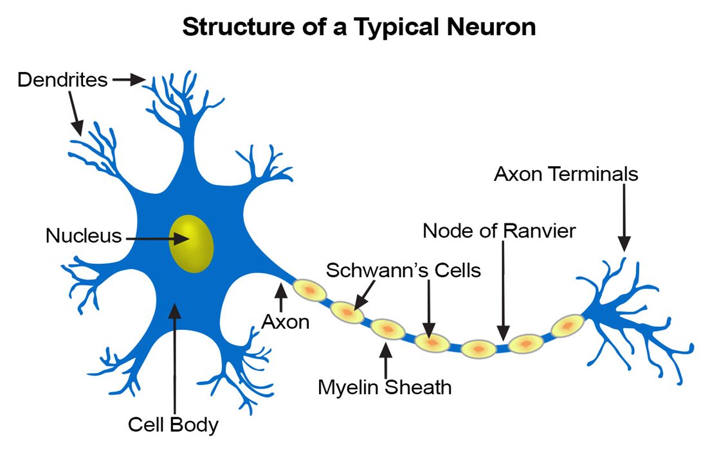
Neurons
Neurons are cells that can transmit signals called nerve impulses, or action potentials. An action potential is a quick rise and fall in the electrical membrane potential of the neuron, which transmits signals from one neuron to the next.

Slide 17
Types of Neurons
According to shape
1-unipolar
2-dipolar
3-multipolar
According to function
1- Sensory, or afferent neurons, relay information from the PNS to the CNS; different types of sensory neurons can detect temperature, pressure, and light.
2- Motor, or efferent neurons, send signals from the CNS to the PNS; these signals provide information to sensory neurons to “tell” them what to do (e.g., initiate muscle movement).
3- Interneurons connect sensory and motor neurons to the brain and spinal cord; they act as connectors to form neural circuits and are involved with reflex actions and higher brain functions like decision-making.

Slide 18
Summary
Types of muscles
Skeletal
Cardiac
Smooth
Structure
Nervous systems
Nervous tissue
Types of neurons

