Slide 1


Slide 2
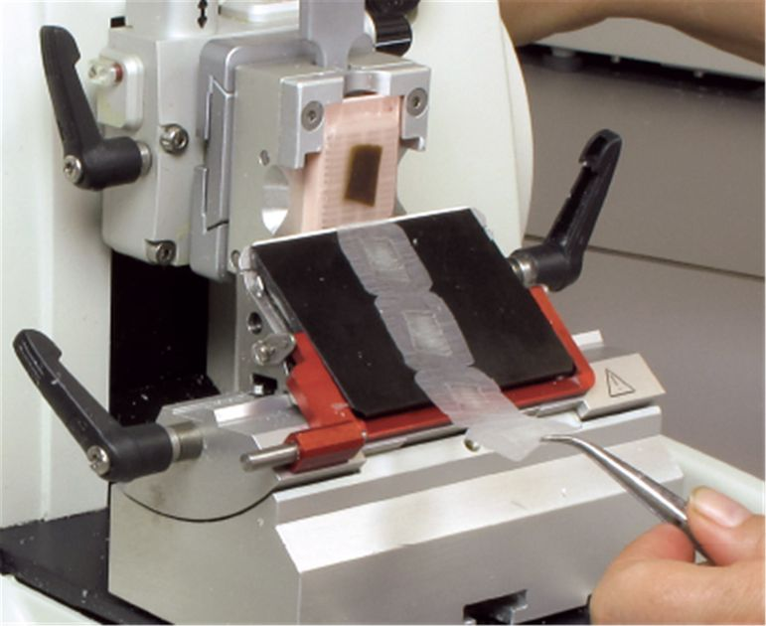
Microtomy
Rotatory Microtomy
Microtomes are used to cut the tissue into thin sections for microscopic viewing
The best sectioning range from 5 to 7 µm
Sections above 10 µm considered thick and appeared dark under microscopy

Slide 3
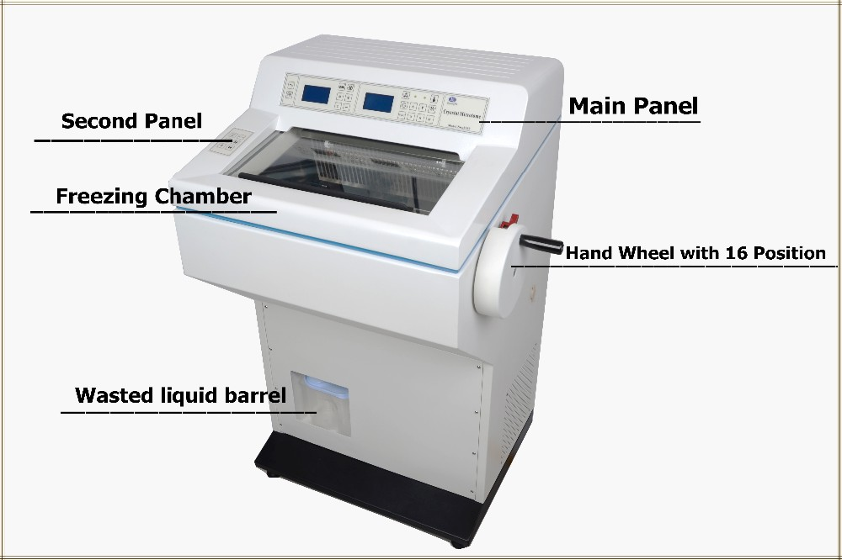
Cryostat
A cryostat or freezing microtome is used for obtaining thin sections of unfixed tissues.
It can be used, additionally, for observing fatty tissues
The microtome is maintained at −15 to −20°C in a refrigerated chamber

Slide 4
Microtome knives
There are many different types of microtome knives
stainless steel
diamond
glass
disposable blades
The knife’s edge should be cleaned with a clearing agent with a soft, moistened cloth in a fume hood
Glass, sapphire, and diamond knives are used for specimens embedded in hard resin plastic (e.g., epoxy, glycolmethacrylate)

Slide 5
Section adhesives, sectioning tissues, and sealing of blocks
Section adhesives
The use of adhesives in the water bath promotes bacterial and fungal growth
gelatin
Gelatin can be added to the water bath
casein glue
sodium hypochlorite solution
starch
Clorox soap
albumin
a thin coat of albumin can be applied directly to the slide by dipping it into the solution or using your fifth finger
subbing

Slide 6
A newer idea is to use “plus” (+) slides
immunohistochemistry
When creating a ribbon (what is a ribbon), i.e., a series of adjacent tissue sections, the hand wheel should be turned at a slow and even speed. Rotating the wheel too rapidly will cause sections of unequal thickness.

Slide 7
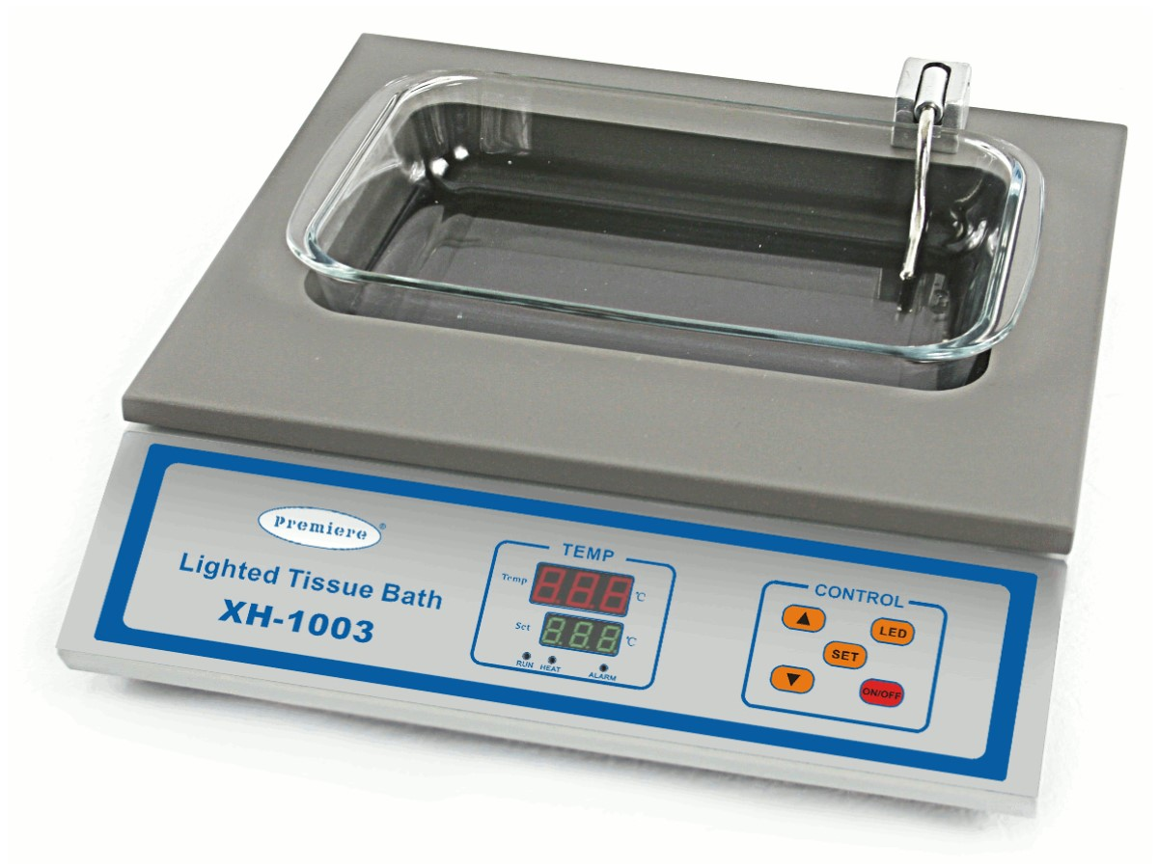
The floatation bath
distilled water
The ribbon should be gradually lowered onto the flotation bath to eliminate wrinkles and entrapped air
If the sections are wrinkling
a 70% alcohol solution can be added to the water bath prior to section collection
should be heated to a few degrees below the melting point of the paraffin wax 45 ̊C

Slide 8
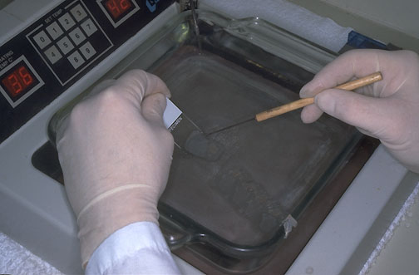
. Individual sections or tissue ribbons may be picked up by submerging a clean glass slide into the water bath at a ~45° angle, directly beneath the location of the section or ribbon.
The slide should be lifted out of the water slowly to ensure that the sections lay on the slide
Sections should be dried over night at the oven 55-60 ̊C

Slide 9
Problems encountered with sectioning tissue blocks
If the tissue block appears to be brittle
10% diluted ammonium hydroxide solution
If sections have holes
re-embed the block
Why
incompletely infiltrated tissue
Cracking after cutting
Replace the knife
The tissue in the corner of the block
Re-embedding

