Slide 1
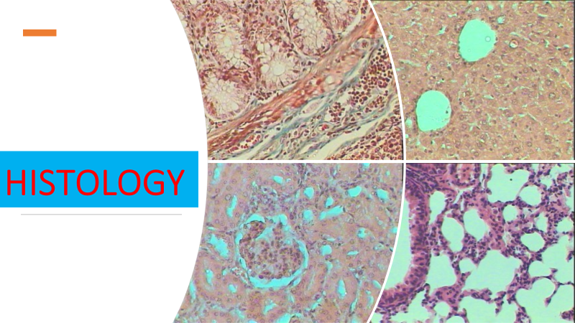
Lec 5
Cartilage
bone

Slide 2
2- Cartilage
Cartilage is a tough, semitransparent, elastic, flexible connective tissue consisting of cartilage cells scattered through a glycoprotein material that is strengthened by collagen fibers.
There are no nerves or blood vessels in cartilage, which is found in the joints, the rib cage, the ear, the nose, the throat, and between vertebral disks.

Slide 3
Function
The main purpose of cartilage is to provide a framework on which bone deposition may begin
Another important purpose of cartilage is to cover the surfaces of joints, allowing bones to slide over one another, thus reducing friction and preventing damage; it also acts as a shock absorber

Slide 4
Composition of cartilage
Cells: Chondrocytes and the precusor forms of chondrocytes known as chondroblasts are the only cells found in cartilage. Chondrocytes make up “cell nests,” groups of chondrocytes within lacunae. Chondroblasts are responsible for the secretion and maintenance of the matrix.

Slide 5
Fibers: Cartilage is composed of collagen and elastic fibers. In hyaline cartilage, type II collagen makes up 40% of its dry weight. Elastic cartilage also contains elastic fibers, and fibrocartilage contains more collagen than hyaline cartilage.
Matrix: The matrix is mainly composed of proteoglycans, which are large molecules with a protein backbone and glycosaminoglycan (GAG) side chains.

Slide 6
Types of cartilage
Fibrocartilage
Hyaline Cartilage
Elastic Cartilage

Slide 7
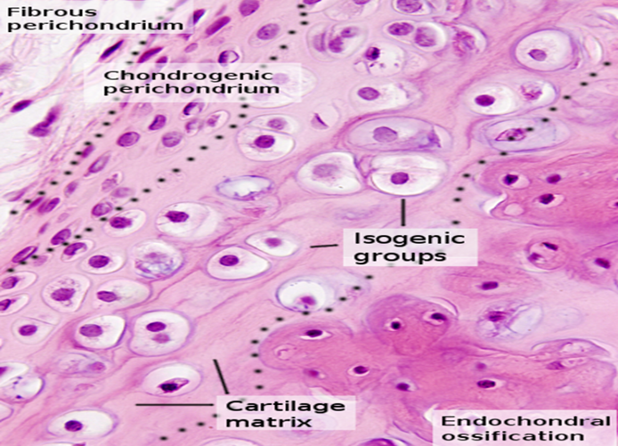
Hyaline Cartilage
Hyaline cartilage is the most abundant type of cartilage. Hyaline cartilage is found lining bones in joints (articular cartilage).
It is also present inside bones, serving as a center of ossification or bone growth. In addition, hyaline cartilage forms the embryonic skeleton.

Slide 8
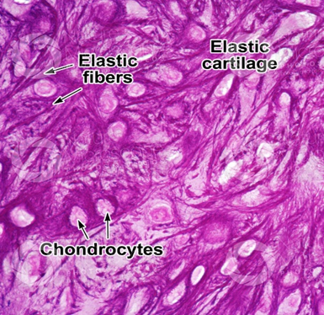
Elastic Cartilage
Elastic cartilage (also called yellow cartilage) is found in the pinna of the ear and several tubes, such as the walls of the auditory and eustachian canals and larynx. Elastic cartilage is similar to hyaline cartilage but contains elastic bundles (elastin) scattered throughout the matrix. This provides a tissue that is stiff yet elastic.

Slide 9
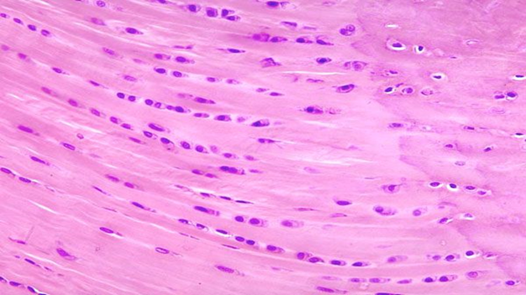
Fibrocartilage
Fibrocartilage (also called white cartilage) is a specialized type of cartilage found in areas requiring tough support or great tensile strength, such as between intervertebral disks, at the pubic and other symphyses, and at sites connecting tendons or ligaments to bones.

Slide 10
3-Bone
Bone, rigid body tissue consisting of cells embedded in an abundant hard intercellular material.
The two principal components of this material, collagen and calcium phosphate, distinguish bone from such other hard tissues as chitin, enamel, and shell. Bone tissue makes up the individual bones of the human skeletal system and the skeletons of other vertebrates.

Slide 11
The functions of bone
(1) structural support for the mechanical action of soft tissues, such as the contraction of muscles and the expansion of lungs
(2) protection of soft organs and tissues, as by the skull
(3) provision of a protective site for specialized tissues such as the blood-forming system (bone marrow)
(4) a mineral reservoir, whereby the endocrine system regulates the level of calcium and phosphate in the circulating body fluids.

Slide 12
Composition of bone
1- Bone forming cells (osteoblasts and osteocytes)
2- Bone resorbing cells (osteoclasts)
3- Nonmineral matrix of collagen and noncollagenous proteins (osteoid)
4- Inorganic mineral salts deposited within the matrix

Slide 13
Bone cells
Cells in our bones are responsible for bone production, maintenance and modeling
Osteoblasts: These cells are derived from mesenchymal stem cells and are responsible for bone matrix synthesis and its subsequent mineralization. In the adult skeleton, the majority of bone surfaces that are not undergoing formation or resorption (i.e. not being remodeled) are lined by bone lining cells.

Slide 14
Osteocytes: These cells are osteoblasts that become incorporated within the newly formed osteoid, which eventually becomes calcified bone. Osteocytes situated deep in bone matrix maintain contact with newly incorporated osteocytes in osteoid, and with osteoblasts and bone lining cells on the bone surfaces, through an extensive network of cell processes (canaliculi). They are thought to be ideally situated to respond to changes in physical forces upon bone and to transduce messages to cells on the bone surface, directing them to initiate resorption or formation responses.

Slide 15
Osteoclasts: These cells are large multinucleated cells, like macrophages, derived from the hematopoietic lineage. Osteoclasts function in the resorption of mineralized tissue and are found attached to the bone surface at sites of active bone resorption. Their characteristic feature is a ruffled edge where active resorption takes place with the secretion of bone-resorbing enzymes, which digest bone matrix.

Slide 16
Bone matrix
Osteoid is comprised of type I collagen (~94%) and noncollagenous proteins. The hardness and rigidity of bone is due to the presence of mineral salt in the osteoid matrix, which is a crystalline complex of calcium and phosphate (hydroxyapatite). Calcified bone contains about 25% organic matrix (2-5% of which are cells), 5% water and 70% inorganic mineral (hydroxyapatite).

Slide 17
Types of bone
Compact bone
cancellous) bone
A hard outer layer called cortical (compact) bone, which is strong, dense and tough.
A spongy inner layer called trabecular (cancellous) bone. This network of trabeculae is lighter and less dense than compact bone.

Slide 18
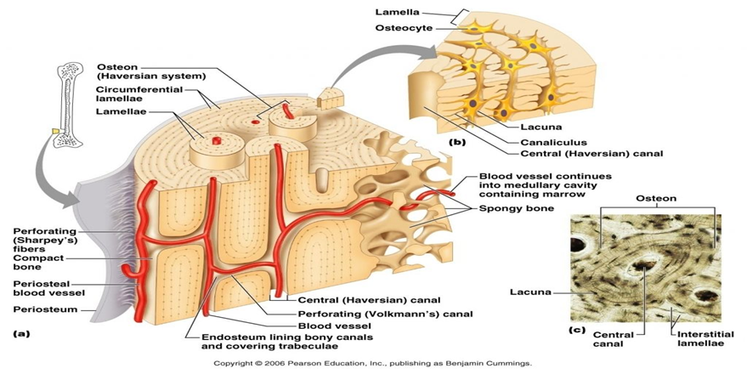
Compact bone

Slide 19
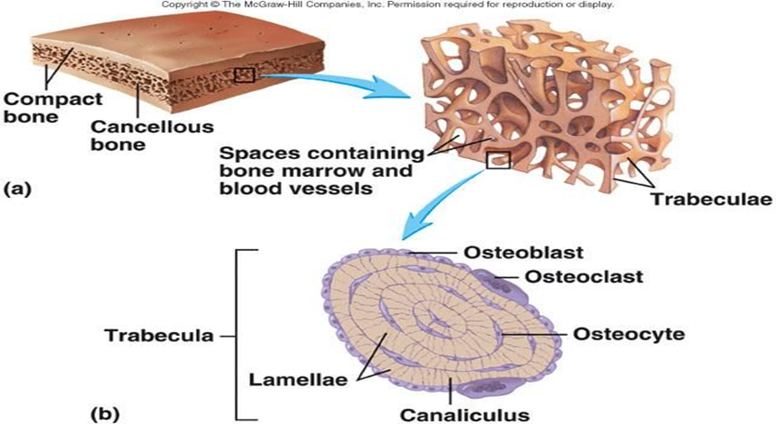

Slide 20
Summary
Bones
Cartilage
Function
Function
Composition
Cells
Fibers
mareix
Cells
Matrix
Composition
Types
Types
Hyaline Cartilage
Compact
Elastic Cartilage
Sponge
Fibrocartilage

