Slide 1


Slide 2
Clearing
The term “clearing” is related to the appearance of the tissue after it has been treated with a dehydrating agent
the tissue “clear” or translucent
the dehydrating agent must be removed from the tissue and replaced with a solvent of wax.
a clearing agent
xylene

Slide 3
Infiltration
The role of the infiltration agent is to remove the clearing agent from the tissue and to completely permeate the tissue with paraffin wax
This will allow the tissue to harden and produce a wax block from which thin histological sections can be cut.
Paraffin wax is commonly used and heated to a temperature that is 2–3°C above its melting point.
Any higher temperature will result in tissue hardening
The paraffin wax should be 20–25 times the volume of the tissue

Slide 4
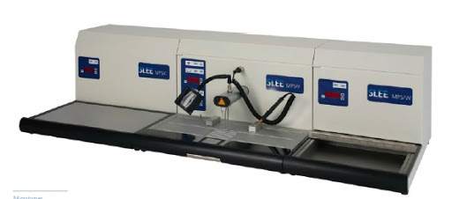
Embedding
After the infiltration process has been completed, it is necessary to obtain a solid block containing the tissue
using warmed forceps to help press the tissue against the base of the metal mold, in addition to reducing the chance of premature solidification
stainless steel or plastic histological base mold of suitable size to fit the tissue
an embedding cassette should be placed on top of the mold and labeled with the name of the tissue

Slide 5
Embedding media
wax
celloidin
water-soluble waxes
paraffin wax
cellulose nitrate
Ester wax
polyethylene glycol waxes
tissues must be dehydrated and embedded with solutions of cellulose nitrate dissolved in an alcohol/ether mixture
tissues are transferred directly from aqueous fixatives to wax for infiltration without dehydration or clearing

