Slide 1
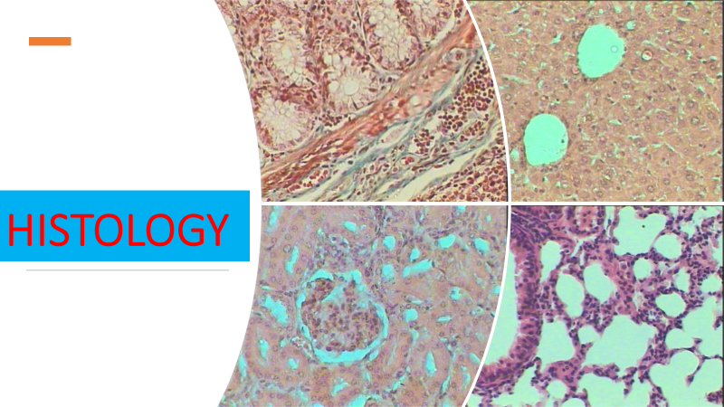
Lec 4
Connective tissue 2

Slide 2
Types of fibers
Three main types of fibers are secreted by fibroblasts
collagen fibers
elastic fibers
reticular fibers

Slide 3
1- Collagen fiber
Made from fibrous protein subunits linked together to form a long and straight fiber
Collagen fibers, while flexible, have great tensile strength, resist stretching, and give ligaments and tendons their characteristic resilience and strength.
These fibers hold connective tissues together, even during the movement of the body.

Slide 4
2- Elastic fiber
contains the protein elastin along with lesser amounts of other proteins and glycoproteins
The main property of elastin is that after being stretched or compressed, it will return to its original shape
Elastic fibers are prominent in elastic tissues found in skin and the elastic ligaments of the vertebral column

Slide 5
3- Reticular fiber
formed from the same protein subunits as collagen fibers; however, these fibers remain narrow and are arrayed in a branching network.
They are found throughout the body, but are most abundant in the reticular tissue of soft organs, such as liver and spleen, where they anchor and provide structural support to the parenchyma (the functional cells, blood vessels, and nerves of the organ).

Slide 6
ground substance - Extracellular matrix
All fiber types are embedded in ground substance. Secreted by fibroblasts, ground substance is made of polysaccharides, specifically hyaluronic acid, and proteins.
It is composed of macromolecules mainly glycosaminoglycans GAGs , proteoglycans and multiadhesive glycoproteins.

Slide 7
Types of Connective Tissue
Proper
Bone
Cartilage

Slide 8
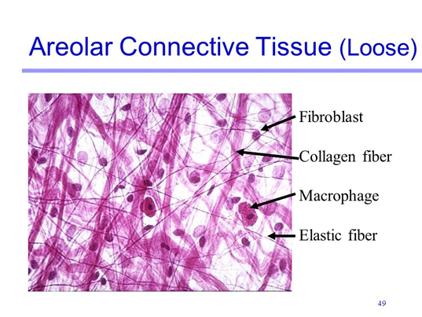
Connective tissue proper – 6 types
1- Loose Connective Tissue
Loose connective tissue is found between many organs where it acts both to absorb shock and bind tissues together
It allows water, salts, and various nutrients to diffuse through to adjacent or imbedded cells and tissues.

Slide 9
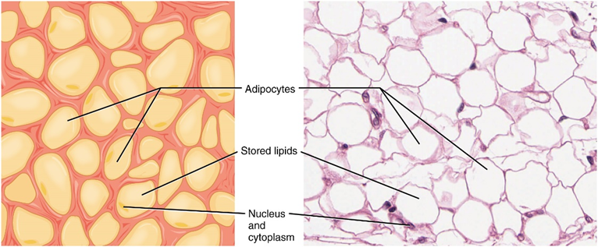
2- Adipose tissue
Adipose tissue consists mostly of fat storage cells, with little extracellular matrix
A large number of capillaries allow rapid storage and mobilization of lipid molecules. White adipose tissue is most abundant
It can appear yellow and owes its color to carotene and related pigments from plant food. White fat contributes mostly to lipid storage and can serve as insulation from cold temperatures and mechanical injuries.
It can appear yellow and owes its color to carotene and related pigments from plant food. White fat contributes mostly to lipid storage and can serve as insulation from cold temperatures and mechanical injuries.

Slide 10
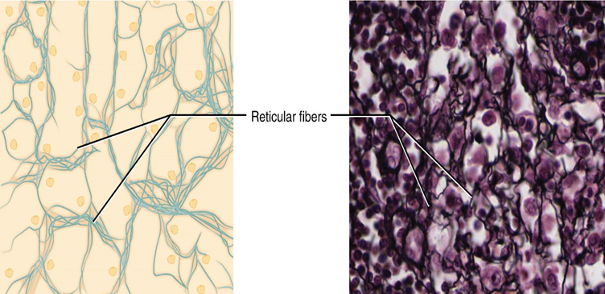
3- Reticular tissue
Reticular tissue is a mesh-like, supportive framework for soft organs such as lymphatic tissue, the spleen, and the liver Reticular cells produce the reticular fibers that form the network onto which other cells attach
It derives its name from the Latin reticulus, which means “little net.”

Slide 11
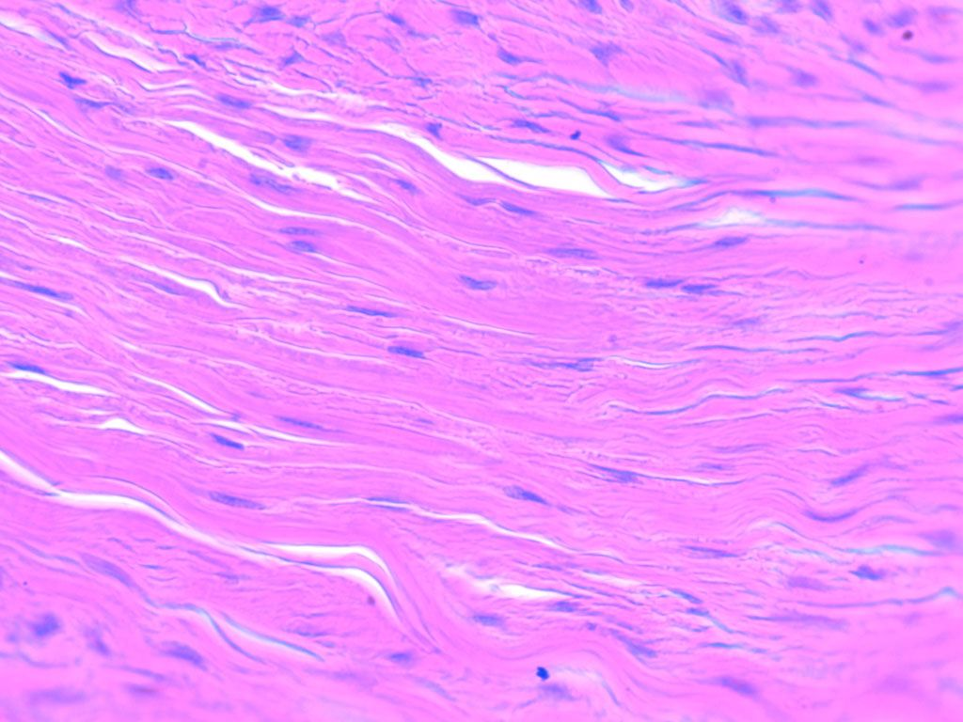
4- Dense regular
Dense regular connective tissue fibers are parallel to each other, enhancing tensile strength and resistance to stretching in the direction of the fiber orientations
Ligaments and tendons are made of dense regular connective tissue, but in ligaments not all fibers are parallel.

Slide 12
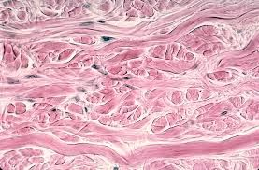
5- Dense irregular
Dense irregular connective tissue, the direction of fibers is random.
This arrangement gives the tissue greater strength in all directions and less strength in one particular direction
In some tissues, fibers crisscross and form a mesh

Slide 13
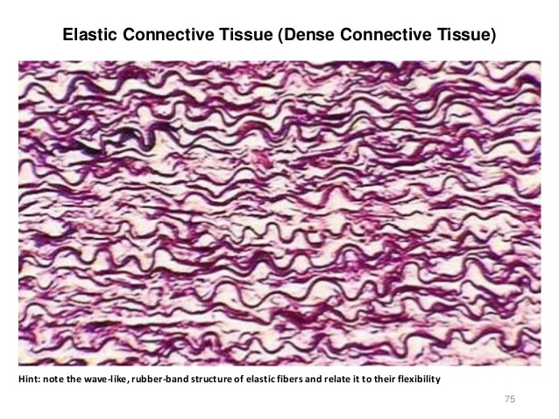
6- Dense regular elastic tissue
Dense regular elastic tissue contains elastin fibers in addition to collagen fibers, which allows the ligament to return to its original length after stretching.
The ligaments in the vocal folds and between the vertebrae in the vertebral column are elastic.

Slide 14
Summary
Ground substance
Types of fibers
Types of connective tissue
collagen
Proper
Cartilage
Bone
elastic
1-Loose
reticular
2- Adipose tissue
3-Reticular tissue
4-Dense regular
5- Dense irregular
6- Dense regular elastic tissue

