Slide 1
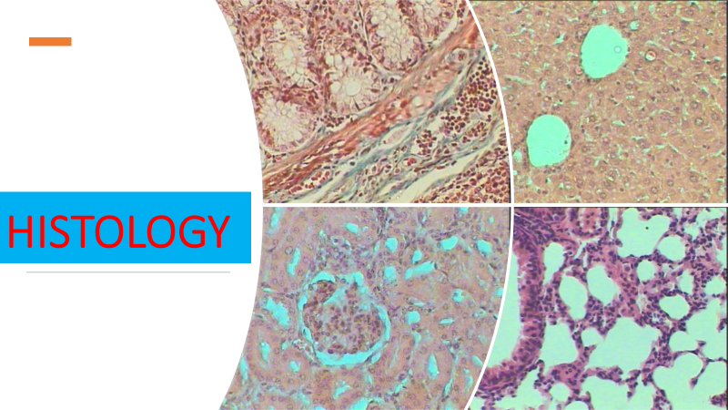
Types of tissues
Epithelial tissue
Lec 2

Slide 2
Tissue
The term tissue is used to describe a group of cells found together in the body.
The cells within a tissue share a common embryonic origin. Microscopic observation reveals that the cells in a tissue share morphological features and are arranged in an orderly pattern that achieves the tissue’s functions.

Slide 3
The Four Types of Tissues
Epithelial tissue
Nervous tissue
Connective tissue
Muscle tissue
also referred to as epithelium, refers to the sheets of cells that cover exterior surfaces of the body, lines internal cavities and passageways, and forms certain glands.
is also excitable, allowing the propagation of electrochemical signals in the form of nerve impulses that communicate between different regions of the body.
is excitable, responding to stimulation and contracting to provide movement, and occurs as three major types
as its name implies, binds the cells and organs of the body together and functions in the protection, support, and integration of all parts of the body.

Slide 4
Epithelial Tissue
Epithelial tissues are widespread throughout the body. They form the covering of all body surfaces, line body cavities and hollow organs, and are the major tissue in glands.
Functions
It perform a variety of functions that include
protection
absorption
secretion
sensation
excretion
filtration

Slide 5
Epithelial tissue
Structure
The cells in epithelial tissue are tightly packed together with very little intercellular matrix. Because the tissues form coverings and linings, the cells have one free surface that is not in contact with other cells. Opposite the free surface, the cells are attached to underlying connective tissue by a non-cellular basement membrane. This membrane is a mixture of carbohydrates and proteins secreted by the epithelial and connective tissue cells.

Slide 6
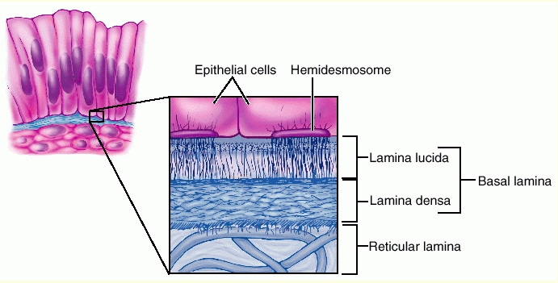
Basement membrane

Slide 7
Epithelial tissue
Types of epithelial tissue
Simple
stratified
One row of cells
More than one row of cells

Slide 8
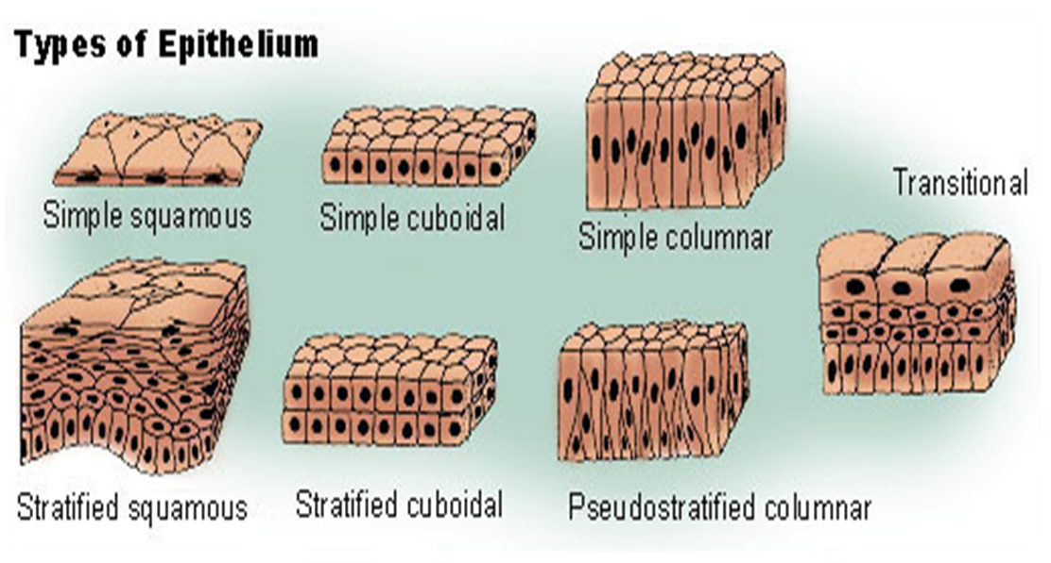
stomach and intestines
sinusoids
kidney tubules
Bladder
ureter
skin
Sweat glands
respiratory tract

Slide 9
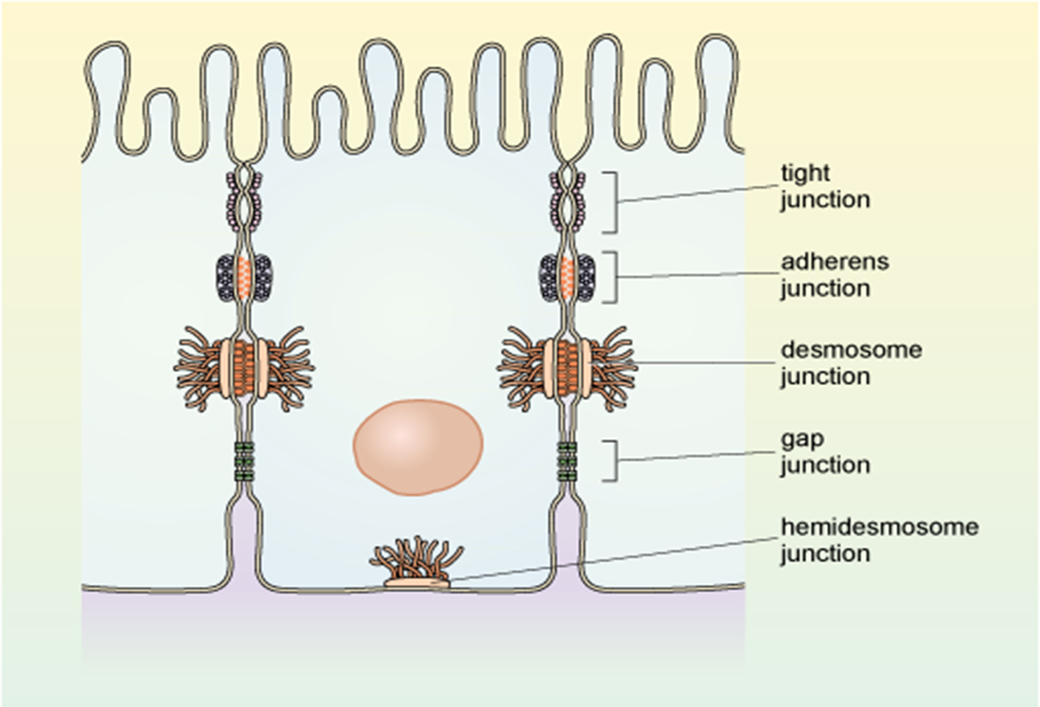
Modifications of epithelial cells ( cell membrane)
Cell junction

Slide 10
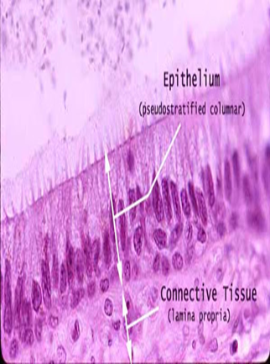
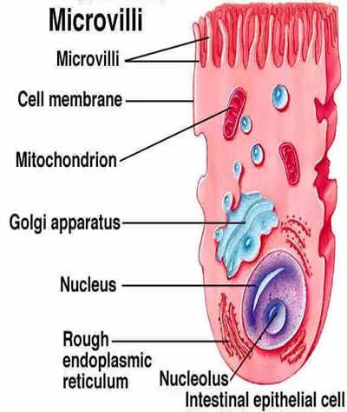
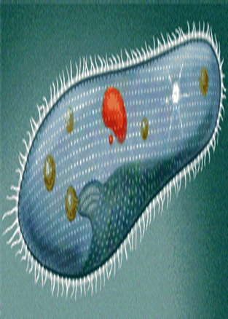
Stereocilli
Cilia
Specializations of the apical cell surface

Slide 11
Glands
Epithelia are a group of tissues derived from all three embryonic germ layers, which are involved in absorption, secretion, selective diffusion and physical protection. Epithelia primarily involved in secretion are arranged into structures known as glands.
Classification of glands according to site of secretion
exocrine
endocrine
mixed

Slide 12
Exocrine glands
Exocrine glands release their secretions onto an epithelial surface via a duct. Exocrine glands consist of two main parts, a secretory unit and a duct. The secretory unit consists of a group of epithelial cells, which release their secretions into a lumen. A duct is lined with epithelium and is involved in transporting the secretions from the secretory unit to an epithelium-lined surface.

Slide 13
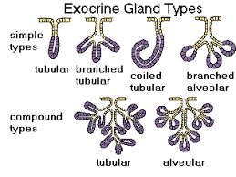
shape

Slide 14
Classification by type of secretion
They can be categorised into 3 subtypes according to their type of secretory product
Serous glands
Mucous glands
Mixed glands
Serous glands produce serous fluid, a watery substance containing enzymes
Mucous glands are involved in the production of mucus, a viscid (sticky) glycoprotein
Mixed glands are comprised of both serous and mucous glands and secrete a mixed substance containing both serous fluid and mucus.
Salivary
chief
Goblet
submaxillary

Slide 15
Classification by secretion mechanism
Exocrine glands can also be categorised into another 3 subtypes according to their secretion mechanism:
Merocine glands
Apocrine glands
Holocrine glands
Merocrine glands are the most common and release their secretory products via exocytosis. The major secretory products of these glands are usually proteins.
Apocrine glands release their secretory products contained within membrane-bound vesicles. This type of secretion is rare and these glands are found in the breast and constitute some sweat glands.
Holocrine glands release whole secretory cells, which later disintegrate to release the secretory products. This type of secretion is seen in sebaceous glands associated with hair follicles.

Slide 16
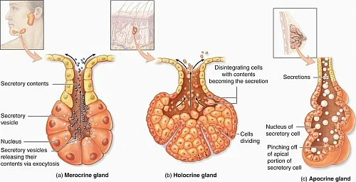
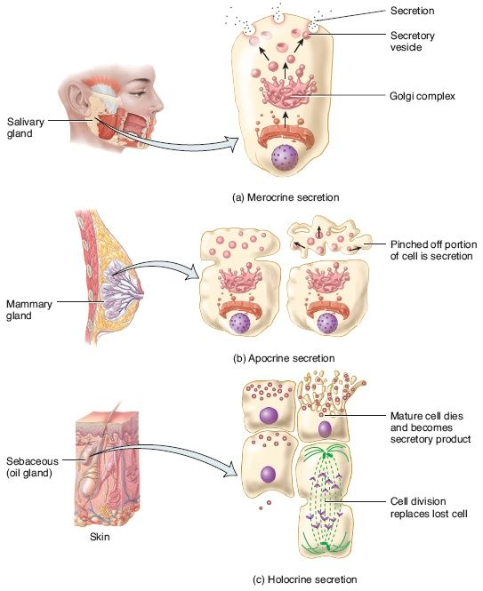

Slide 17
Endocrine glands
Endocrine glands release their secretory products directly into the bloodstream, rather than via a duct. These glands are surrounded by a strong connective tissue capsule, which has fibrous extensions known as trabeculae. These trabeculae provide internal support and give the gland a lobular appearance.
Endocrine glands release secretions known as hormones, which travel via the bloodstream to reach their target cells, where they elicit functional changes. The hormones are commonly stored intracellularly within secretory vesicles and are released intermittently via exocytosis
An exception to this is the thyroid gland, which stores its hormone extracellularly as an inactive precursor molecule. Secretion of hormones is usually regulated by negative feedback, where a rise in the level of hormone in the blood decreases its secretion.

Slide 18
Mixed glands
Pancreas
The pancreas is an organ comprised of both exocrine and endocrine glands.
exocrine function
The majority of the pancreas has an exocrine function and secretes an enzyme-rich alkaline fluid into the pancreatic duct, which joins the common bile duct before emptying into the duodenum. The exocrine glands secrete the proteolytic enzymes trypsinogen and chymotrypsinogen, which are activated to trypsin and chymotrypsin in the duodenum and aid in digestion. The exocrine pancreas also secretes bicarbonate ions, which neutralise the acidic chyme as it reaches the duodenum.

Slide 19
Pancrease
Endocrine function
There are also clusters of endocrine glands located within the exocrine tissue and these are referred to as islets of Langerhans. The two main hormones released from the endocrine glands of the pancreas are insulin and glucagon. The pancreas also secretes:

Slide 20
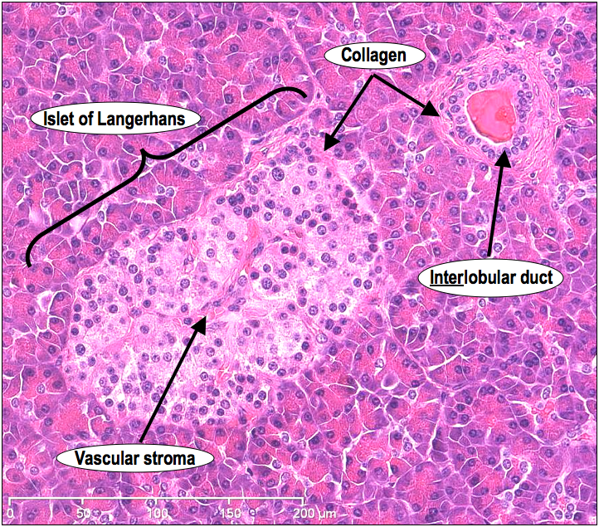

Slide 21
Summary
Tissue
Types of tissues
epithelial
connective
muscular
nervous
functions
modifications
epithelia
Mix
glands
types
Shape
Exocrine
Endocrine
Mechanism
Type of secretion

