Slide 1
KINGDOOM OF SAUDI ARABIA
King Saud University
College of Sciences - Department Botany & Microbiology
Plant morphogenesis
BIO 312
Dr. Abdulrahman Al-hashimi

Slide 2
plant Organ Systems
Objective of this Lecture:
Student will be able to: Describe the shoot organ system and the root organ system
Distinguish between meristematic tissue and permanent tissue
Identify and describe the three regions where plant growth occurs
Summarize the roles of dermal tissue, vascular tissue, and ground tissue
Compare simple plant tissue with complex plant tissue

Slide 3
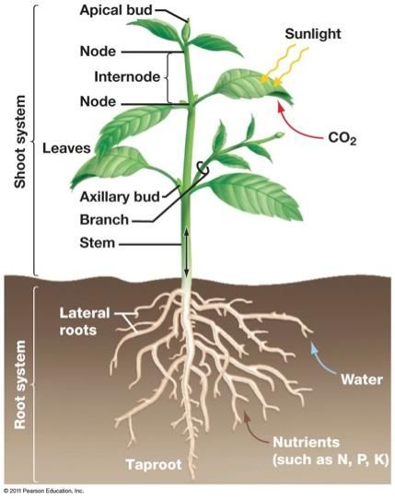
Introduction
Vascular plants have two distinct organ systems: a shoot system, and a root system.
The shoot system consists stems, leaves, and the reproductive parts of the plant (flowers and fruits)
The shoot system generally grows above ground, where it absorbs the light needed for photosynthesis.

Slide 4
The Root System
The roots of seed plants have three major functions:
Anchoring the plant to the soil, absorbing water and minerals, transporting them upwards, and storing the products of photosynthesis.
Some roots are modified to absorb moisture and exchange gases.
Most roots are underground. Some plants,
However, also have adventitious roots, which emerge above the ground from the shoot
جذور نباتات البذور لها ثلاث وظائف رئيسية:
تثبيت النبات في التربة ، وامتصاص الماء والمعادن ، ونقلها إلى أعلى ، وتخزين منتجات التمثيل الضوئي.
يتم تعديل بعض الجذور لامتصاص الرطوبة وتبادل الغازات.
معظم الجذور تحت الأرض
بعض النباتات لها أيضًا جذور عرضية ، تظهر فوق الأرض من اللقطة

Slide 5
Introduction
Root systems are mainly of two types:
Tap root systems have a main root that grows down vertically, and from which many smaller lateral roots arise. Tap roots penetrate deep into the soil and are advantageous for plants growing in dry soils.
Fibrous root systems are located closer to the surface and have a dense network of roots. Fibrous root systems can help prevent soil erosion. Fibrous roots are typical of monocots such as grasses
Root structures are evolutionarily adapted for specific purposes:
Aerial roots and prop roots are two forms of above-ground roots that provide additional support to anchor the plant.
Some tap roots, such as carrots, turnips, and beets, are adapted for sugar/starch storage.
Epiphytic roots enable a plant to grow on another plant
تتكون أنظمة الجذر بشكل أساسي من نوعين:
تمتلك أنظمة جذر وتدي: جذرًا رئيسيًا ينمو عموديًا ، وتنشأ منه العديد من الجذور الجانبية الأصغر. تخترق جذور الحنفية عمق التربة وتكون مفيدة للنباتات التي تنمو في التربة الجافة.
توجد أنظمة الجذر الليفية بالقرب من السطح ولديها شبكة كثيفة من الجذور. يمكن أن تساعد أنظمة الجذر الليفية في منع تآكل التربة. الجذور الليفية هي نموذجية لأحادي الفلقة مثل الحشائش
يتم تكييف التراكيب الجذرية تطوريًا لأغراض محددة:
الجذور الهوائية والجذور الداعمة نوعان من الجذور فوق الأرض التي توفر دعمًا إضافيًا لتثبيت النبات.
تتكيف بعض جذور الحنفية ، مثل الجزر واللفت والبنجر ، لتخزين السكر / النشا.
جذور نباتية تطفلية : تمكن النبات من النمو على نبات آخر

Slide 6
The shoot system: stems and leaves
Stems are a part of the shoot system of a plant. Their main function is to
Provide support to the plant, holding leaves, flowers and buds.
They also connect the roots to the leaves,
Transporting absorbed water and minerals from the roots to the rest of the plant
Transporting sugars from the leaves (the site of photosynthesis) to desired locations throughout the plant.
Stems can be of several different varieties:
Herbaceous stems are soft and typically green
Woody stems are hard and wooded
Unbranched stems have a single stem
Branched stems have divisions and side stems
السيقان هي جزء من نظام النبتة. وظيفتهم الرئيسية هي
تقدم الدعم للنبات ، وحمل الأوراق والزهور والبراعم.
هي أيضا تربط الجذور بالأوراق ،
نقل المياه والأملاح الممتصة من الجذور إلى باقي أجزاء النبات
نقل السكريات من الأوراق (موقع البناء الضوئي) إلى المواقع المرغوبة في جميع أنحاء النبات.
يمكن أن تكون السيقان من عدة أنواع مختلفة:
السيقان العشبية لينة وعادة ما تكون خضراء
السيقان الخشبية صلبة ومشجرة
السيقان غير الممنوحة لها ساق واحد
السيقان المتفرعة لها انقسامات وسيقان جانبية

Slide 7
The tip of the shoot contains the apical meristem within the apical bud
يحتوي طرف الخضري على النسيج الإنشائي القمي داخل البرعم القمي
axillary bud is usually found in the area between the base of a leaf and the stem where it can give rise to a branch or a flower.
عادة ما توجد برعم إبطي في المنطقة الواقعة بين قاعدة الورقة والساق حيث يمكن أن تؤدي إلى فرع أ
Leaves are the main sites for photosynthesis: the process by which plants synthesize food. Most leaves are usually green, due to the presence of chlorophyll in the leaf cells.
الأوراق هي المواقع الرئيسية لعملية التمثيل الضوئي: العملية التي تقوم بها النباتات بتجميع الطعام. عادة ما تكون معظم الأوراق خضراء بسبب وجود الكلوروفيل في خلايا الأوراق.

Slide 8
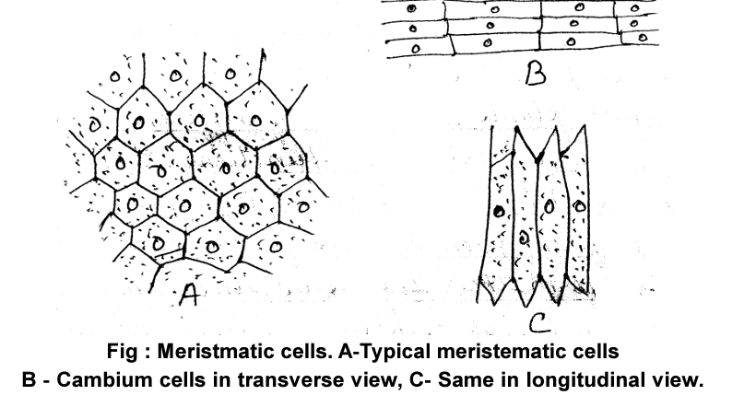
MERISTEMS AND GROWTH OF PLANT BODY
The term meristem is derived from the Greek word ‘meristos’ which mean ‘divisible’ Meristematic tissue , are immature tissue in which growth and cell division occur or they retain their power of division.

Slide 9
The characteristic features of meristematic tissue are :
1. They are composed of immature cells which are in a state of division and growth.
2. Usually the intercellular spaces are not found among these cells.
3. Each cells of meristenatic tissue possesses abundant cytoplasm and one or more nuclei in it.
4. The vacuoles in the cells may be quite small or absent.
5. The cells may be rounded, oval or polygonal in shape; they are always living and thin-walled.

Slide 10
Synthesis of new living substance is a fundamental part of the process of formation of new cells.
But the meristems carry on such activity indefinitely, for they do not add cells to the plant body but also make themselves;
that is some of the product of division in the meristems do not develops into adult cells but remain meristematic.

Slide 11
The meristems usually occurs at the apices of all shoots and roots, main and lateral, their number in a single plant may be large, Furthermore, many plants possess additional extensive meristens, the vascular and cork cambium, concerned with the secondary increase in thickness of the axis.
They primary growth, initiated in the apical meristems, expands the plant body, increases its surfaces and its area of contact with air and sail, and eventually produces the re-preoductive organs.

Slide 12
MERISTEMS AND MATURE TISSUE
The meristems is a formative tissue, adding new cells to the plant body and at the same time perpetuating themselves as meristems
Thus in active meristems a part of the products of cell division remain meristematic, the initiating cells, and other develop into the various tissure elements.
Since the cells of vascular plant vary so much in their function and their Morphologic characteristic, they also vary in details of different degree of differentiation as composed with their common meristenatic precursors

Slide 13
For variable length of time , during the differentiation of tissue from meristems, the derivatives of meristematic cells synthesize protoplasm, enlarge, and divide
These processes of growth may persist to some degree even after the derivatives shows indications of differentiation into specific kinds of cells.
The development of meristenatic derivatives into mature cell is gradual.
Some activities characteristic of mature tissues may occur while these tissue are still developing.

Slide 14
CLASSIFICATION OF MERISTEMS
Meristems are classified on several criteria mode of origin, position in plant, stage of development, function topography.
The important classification on the basis of their
(a) Stage of development
(b) Origin of Initiating cells
(c) Positions
(d) Functions

Slide 15
(a) Stage of development : this is the region of new organs and tissue. The term embryonic meristem may also be applied to this which consists of young initials and their derivatives.
(b) Origin of Initiating cells : On the basis of their origin, meristems are of two types
(i) Primary meristems (i)
(ii) Secondary meristems

Slide 16
Primary Meristems : They build up the fundamental or primary Part of the plant and are part of promeristem.
The primary meristems are found at the apices of stem and roots and the primordia of leaves and similar appendages.
Secondary Meristems : The cells first differentiate and function as members of some mature tissue system, then again take up meristematic activity, the resulting meristems is called secondary.
The secondary meristems are so called because they originate from permanent cells.

Slide 17
(c) According to position : On the basis of position in the Plant body, meristems can be classified into following groups:
Apical Meristems
Intercalary Meristems
Lateral Meristems

Slide 18
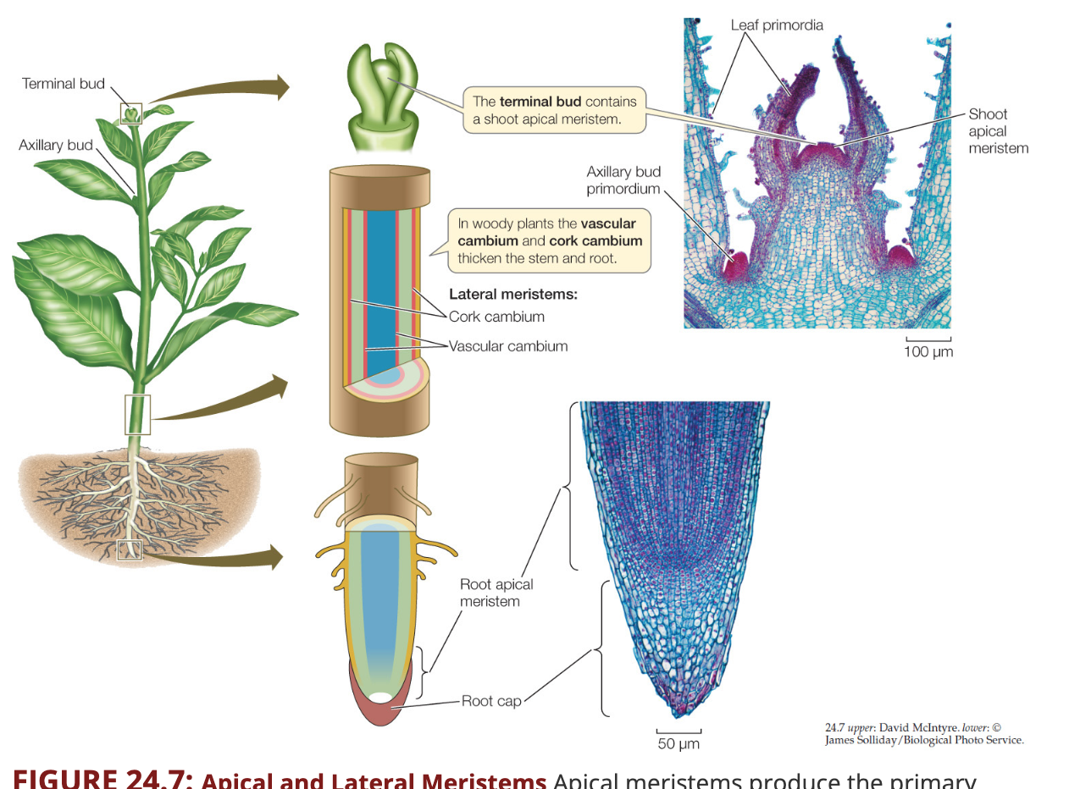
1. Apical Meristems : Apical meristems are also known as growing points.
They are found at the apex of stems, roots and branches of the vascular plants.
The initiating cells may be single or in groups.
https://www.macmillanhighered.com/BrainHoney/Resource/6716/digital_first_content/trunk/test/hillis2e/hillis2e_ch24_3.html

Slide 19
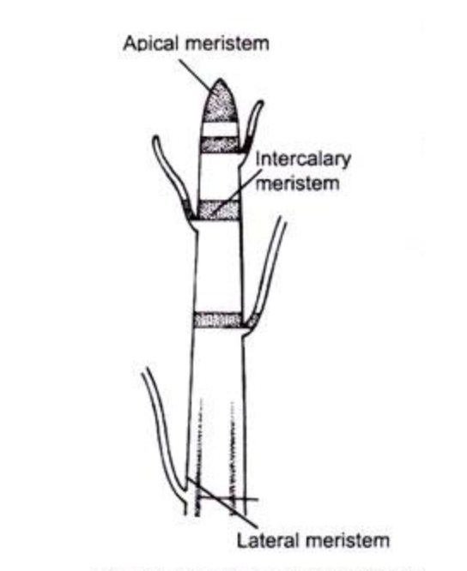
2. Intercalary Meristems : These are portions of apical meristems that have become separated from the apex during growth.
They remain intercalated in between the permanent tissue.
3.Lateral Meristems : These meristems are present along the side of the stem in dicotyledons and gymnosperms Lateral meristems are responsible for forming secondary tissues.
https://www.toppr.com/guides/biology/tissues/meristematic-tissue/

Slide 20
(D)According to Functions : The primary meristems at the apices of shoot and roots when partially differentiated for the organization of tissue system were distinguished as follow:
Protoderms
2. Procambium
3. Ground Meristem

Slide 21
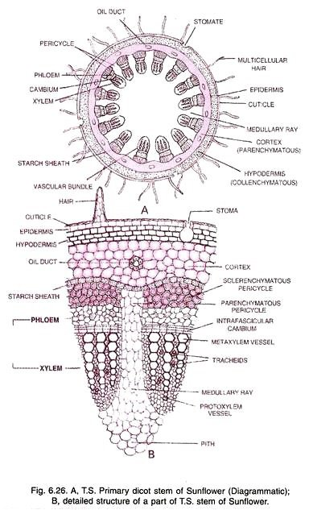
D. According to Functions :
The primary meristems at the apices of shoot and roots when partially differentiated for the organization of tissue system were distinguished as follow:
1.Protoderms 2. Procambium 3. Ground Meristem
Protoderm : It is the outermost layer of young growing region. It develop into epidermal tissue system.
Procambium : The cells of the Procambium are narrow and elongated. Procambium develops into primary vascular tissue (xylem, phloem, Cambium).
https://www.quora.com/What-is-the-difference-between-the-meristem-and-the-cambium
Notes:
تح

Slide 22
Ground Meristems :
This meristem develops into fund ground tissues.
The cells of this region are large and thin-walled which in later stages become differentiated into hypodermis, cortex, endodermis, peri cycle, medulla (pith) and medullary rays.
In stem apices, dermatogen is outer most layer that form epidermal system.
Next to periblem that form cortex and endodermis.
The central core histogen is called plerome, that form vascular system, pith and medullary rays

Slide 23
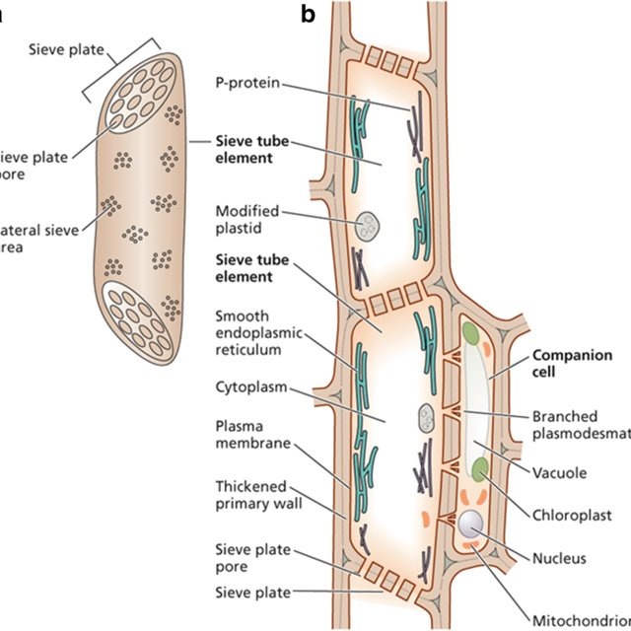
For example, that certain walls of the sieve-tube elements are differentiated into sieve plates, that the xylem tissue is differentiated into tracheary elements, fibres, parenchyama, and the vascular tissure system into xylem and phloem.

Slide 24
Many cells are so strongly modified during differentiated that they ultimately reach an irreversible state.
Such a state is usually associated with a profound alteration of the protoplast or its complete disappearance.
The cell thus loses the capacity to differentiate and to resume meristematic activity

