Slide 1
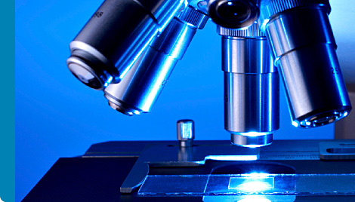
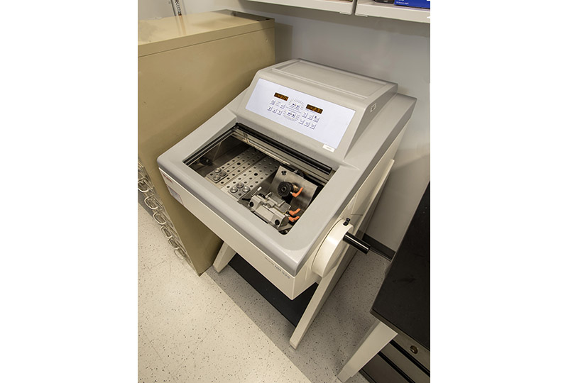
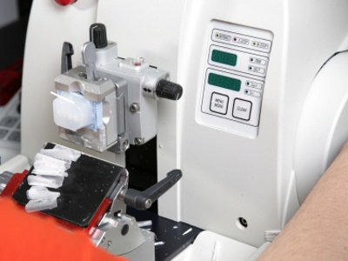
Histochemistry

Slide 2
Histochemistry
Definition
Histochemistry is the study of identification and distribution of chemical compounds in biological cells and tissues .
Cytochemistry
The study of the actions of chemical compounds within the living cell.
Immunohistochemistry
The process of detecting antigen in the section of intact biological tissue using the principle of antibodies binding to specific antigen in biological tissue.

Slide 3
Who Uses Histochemistry?
Scientists, pathologists, veterinarians, and others that want to study normal tissue function or identify changes that may indicate a disease stage can all use histochemistry. Simply put, if you need a microscope, chances are you need histochemistry!

Slide 4
What is Microscopy?
Microscopy is the technical field of creating and/or using microscopes to view objects that are too small to be seen with the naked eye, from the structure of a hair to tiny bacteria, all the way to single molecules. There are many types of microscopes, each one best suited for a particular application. Light microscopes are the most common, and used to image tissues and cells either live or stained. Fluorescence microscopes shine a light with a particular color on the sample, to detect the light that the sample shines back, at a different color. Electron microscopes use a beam of accelerated electrons to image very small objects, such as subcellular components (the plasma membrane, mitochondria, or part of a nucleus, for example). Lastly, single molecule microscopes are highly advanced instruments that can image tiny molecules with nanometer resolution.

Slide 5
Microtechnique
Microtechnique is an aggregate of methods used to prepare micro-objects for studying. It is currently being employed in many fields in life science
four types of methods are commonly used, which are whole mounts, smears, squashes, and sections
Plant microtechnique contains direct macroscopic examinations, freehand sections, clearing, maceration, embedding, and staining
three preparation ways used in zoological micro observations are paraffin method, celloidin method, and freezing method.

Slide 6
Whole mounts
observers need to use a whole organism or do some detailed research on specific organ structure
This method requires objects in which moisture can be removed, like seeds and micro fossils
Whole-mounts can be divided into three categories
Temporary whole mounts
Semi-permanent whole mounts
permanent whole mounts.
teaching activities in class
longer using time
hygrobutol method and glycerine-xylol method
no more than fourteen days
unicellular and colonial algae, fungal spores

Slide 7
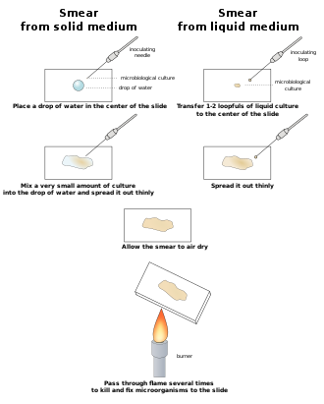
Smears
Smears is an easy way for preparing slices
Smears can be employed when making slide specimens by spreading liquid or semi-liquid materials or lose tissues and cells of animals and plants evenly on the slide.
When the solid material is smeared, the material should be placed on the glass slide and wiped away
use the blade to press the material on one side. The cells should be pressed out and distributed evenly on the glass slide in a thin layer, such as the anther smeared.

Slide 8
Squashes
Squashes are methods, in which objects are crushed with force
This method is suitable for preparing both transparent and tender tissues.
When preparing squashes slides, specimens are supposed to be thin and transparent so that objects can be observed clearly under microscopes
This technique is to place the material on the glass slide and remove it with the scalpel or to dissect needle, then add a drop of dye solution.

Slide 9
Sections
Sections are known as thin slices need to be tested in all studies of cellular structure
This technique can be used for the preparation of tissue of animals and plants.
Microtome can be used in sectioning of sufficiently thin slices.
If the objects cannot satisfy the requirement of thickness, materials are required to be dehydrated using alcohol before section
Three commonly used sectioning method are freehand section technique, paraffin method, and celloidin method.

Slide 10
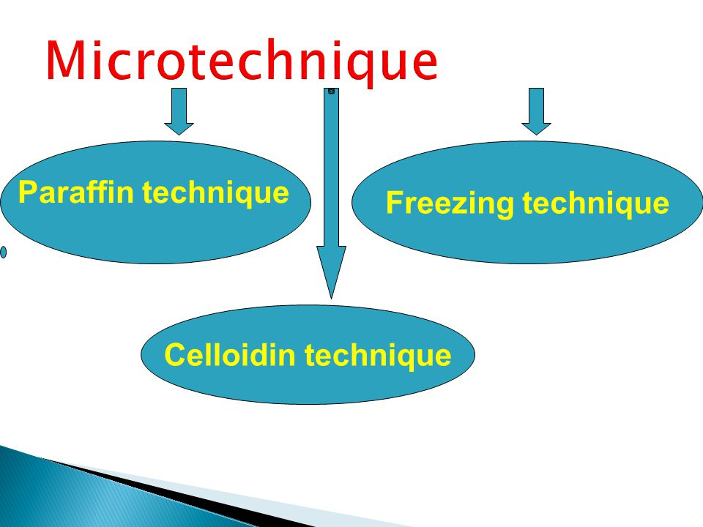
Microtechnique used for animal observation

