Slide 1
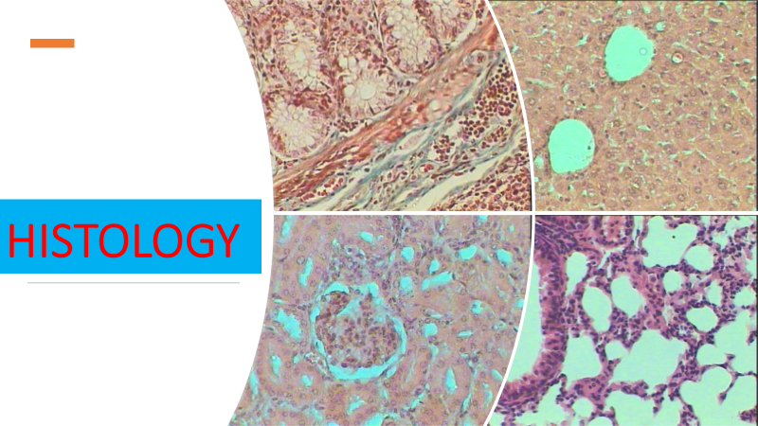
Lec 1
Introduction of Histology

Slide 2
Introduction of Histology
Definition
Histology is the branch of anatomy that deals with the study of tissues structure and function in animals and plants
It is the science of the microscopic structure of cells, tissues and organs. It also helps us understand the relationship between structure and function.
The subject interwines the discipline in cell biology, pathology, physiology and biochemistry

Slide 3
What is anatomy?
Anatomy (Greek anatomē, 'dissection') is the branch of biology concerned with the study of the structure of organisms , their parts and the location of systems and organs .
Anatomy is a branch of natural science which deals with the structural organization of living things. It is an old science, having its beginnings in prehistoric times
The discipline of anatomy is divided into macroscopic and microscopic. Macroscopic anatomy, or gross anatomy, is the examination of an animal's body parts using unaided eyesight. Gross anatomy also includes the branch of superficial anatomy. Microscopic anatomy involves the use of optical instruments in the study of the tissues of various structures, known as histology, and also in the study of cells.

Slide 5
Microscopy
It is the method used in the study of tissues , cells and its structure using microscope
Main types of microscope
Light microscope
Flurescent microscope
Electron microscope

Slide 6
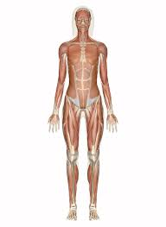
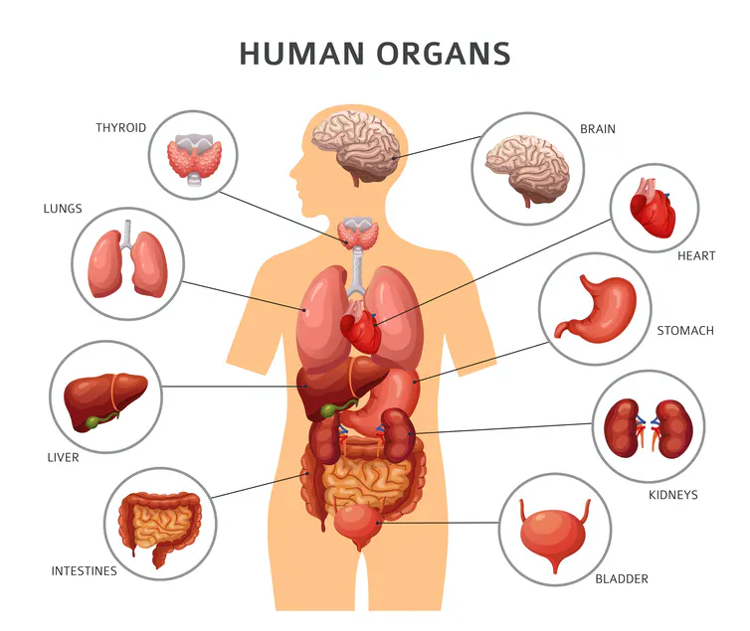
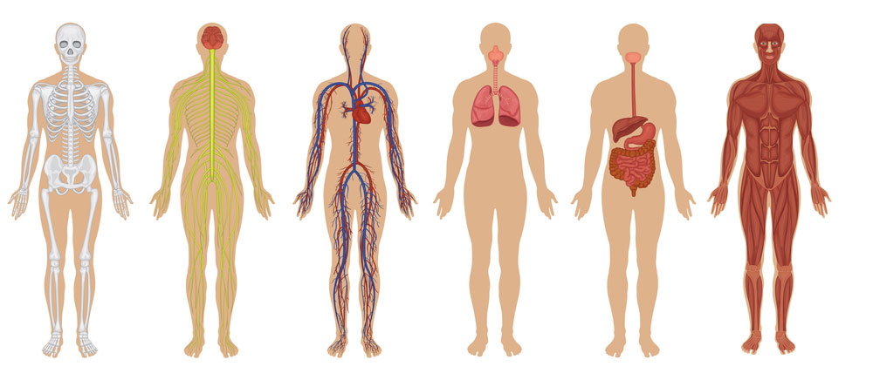
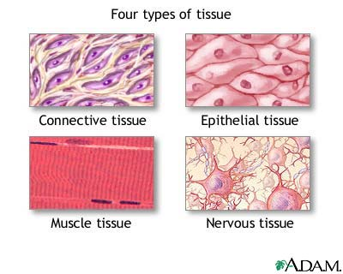
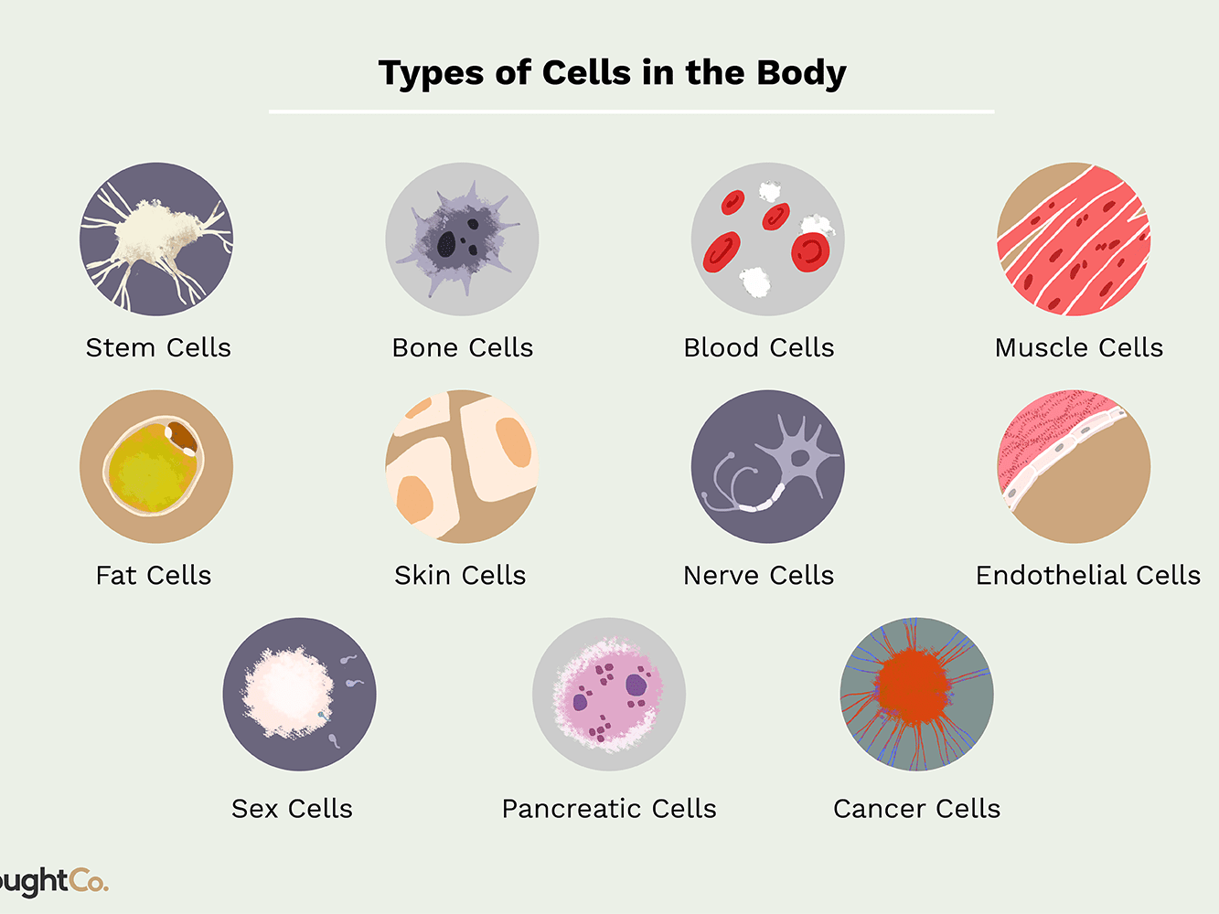
systems
organs
Body
cells
tissues

