Slide 1
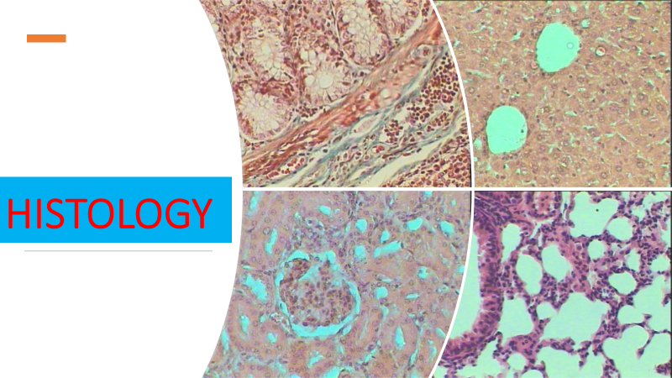
Lec 10
Skin

Slide 2
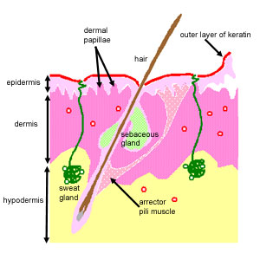
Three layers of skin
The epidermis: a thin outer portion, that is the keratinised stratified squamous epithelium of skin. The epidermis is important for the protective function of skin. The basal layers of this epithelium are folded to form dermal papillae. Thin skin contains four types of cellular layers, and thick skin contains five

Slide 3
The dermis: a thicker inner portion. This is the connective tissue layer of skin. It is important for sensation, protection and thermoregulation. It contains nerves, the blood supply, fibroblasts, etc, as well as sweat glands, which open out onto the surface of the skin, and in some regions, hair. The apical layers of the dermis are folded, to form dermal papillae, which are particularly prominent in thick skin.
The hypodermis. This layer is underneath the dermis, and merges with it. It mainly contains adipose tissue and sweat glands. The adipose tissue has metabolic functions: it is resonsible for production of vitamin D, and triglycerides.

Slide 4




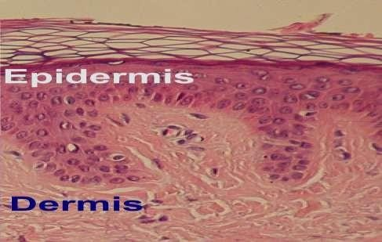
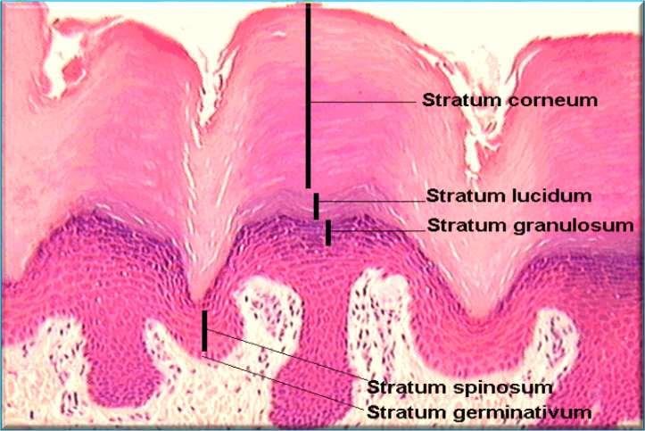
The most superficial layer of the skin.
The first barrier of protection from the invasion
of foreign substances.
The epidermis is subdivided into five layers or
strata:
Basal layer Stratum germinativeum.
Stratum spinosum (Malpighian layer).
Stratum Granulosum.
Stratum Lucidum.
Stratum Corneum.

Slide 5



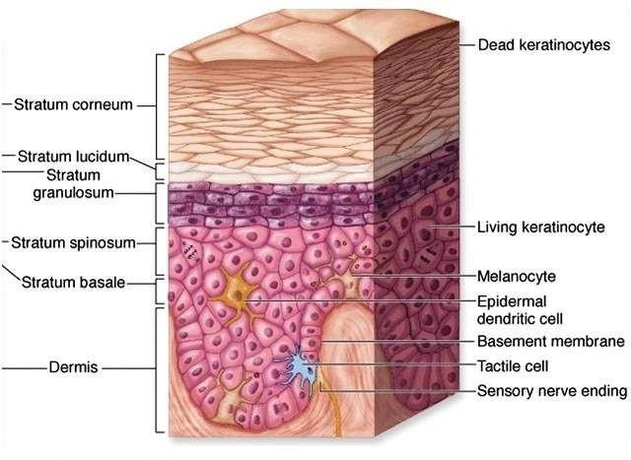
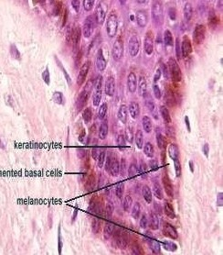
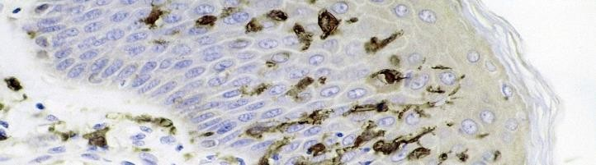
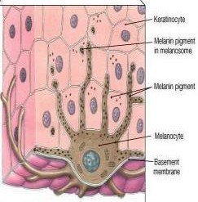
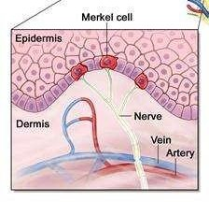
(3)- Langerhans cells:
They are responsible for keratin formation.
Formed of many layers that continuously shed and regenerate every 2-4 weeks.
They are dendritic cells (antigen-presenting immune cells) of the skin.
Found in upper layers of st.spinosum.
Have branched shape
&central nuclei.
(2)-Melanocytes:
(4)-Merkel cells
Found inbetween cells of
the basal layer.
Branched cells centeral nuclei,
Found in basal cell layer.
They are sensory nerve fibers.
Function as touch receptors.
with contains protein
organelles for synthesizes (rER,
Golgi,
mitochondria).
They form melanin.

Slide 6
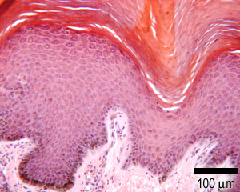
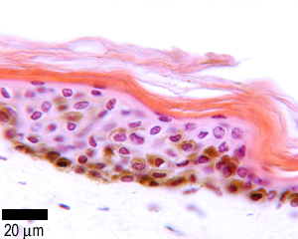
Dermis: Thick skin has a thinner dermis than thin skin, and does not contain hairs, sebaceous glands, or apocrine sweat glands.
Thick skin is only found in areas where there is a lot of abrasion - fingertips, palms and the soles of your feet.
There are only four layers in the epidermis of thin skin. The stratum lucidum layer is absent
Dermis: Thin skin actually has a thicker dermis than thick skin, which makes thin skin easier to suture, if it gets damaged. Thin skin also has fewer eccrine/merocrine sweat glands.

Slide 7
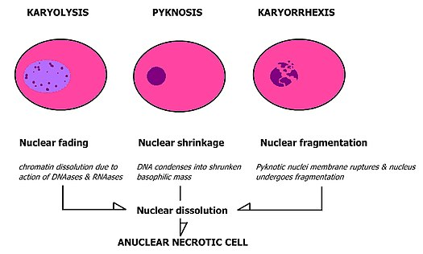
apoptosis
Karyolysis is the complete dissolution of the chromatin of a dying cell due to the enzymatic degradation by endonucleases. The whole cell will eventually stain uniformly with eosin after karyolysis. It is usually associated with karyorrhexis and occurs mainly as a result of necrosis, while in apoptosis after karyorrhexis the nucleus usually dissolves into apoptotic bodies.

