Slide 1
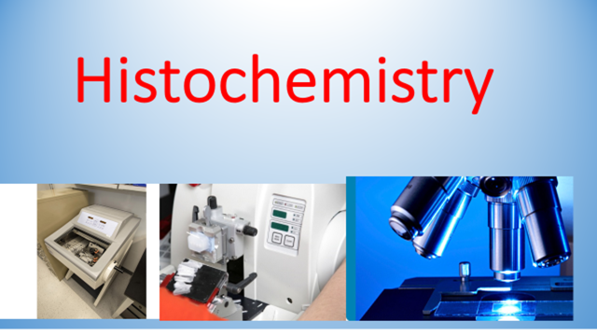
Immunohistochemistry

Slide 2
Immunocytochemistry
Is a technique for identifying cellular or tissue constituents (antigens) by means of antigen-antibody interactions
Antigens
proteins, glycoproteins, proteoglycans
Antibodies
serum proteins known as immunoglobulins
formed in the humoral immune system by plasma cells
there are five types of antibody found in the blood IgA, IgD, IgE, IgGand IgM
IgG is the commonest and the most frequently used antibody for immunohistochemistry

Slide 3
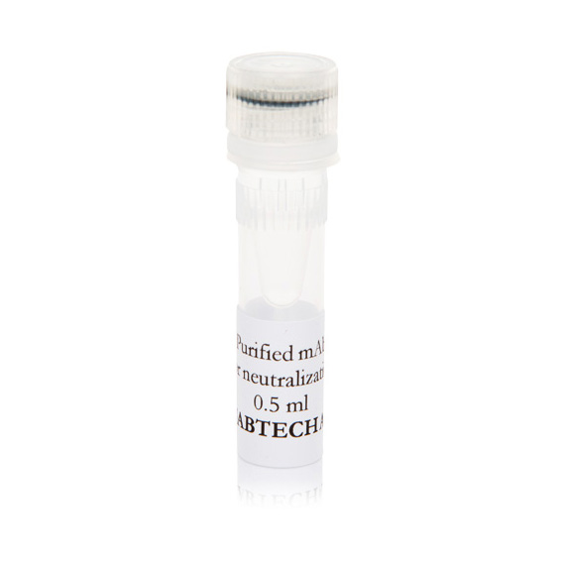
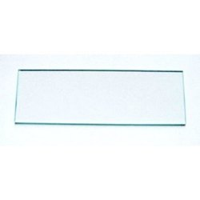
Antigen

Slide 4
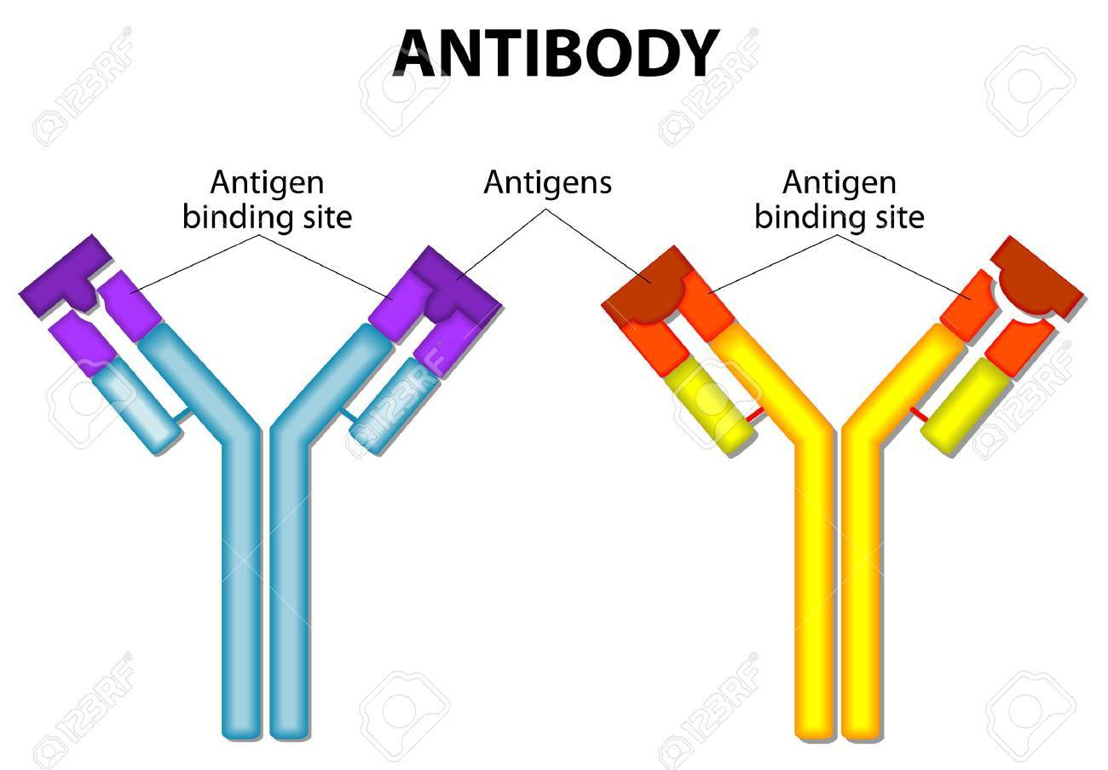
Antibodies
An antibody molecule is composed of four polypeptide chains, two identical light chains and two identical heavy chains

Slide 5
Antigenic Determinants (Epitopes)
The specific site of an antigen that binds to an antibody is called an antigenic determinantor epitope
Most antigens have a variety of epitopes that generate a number of different antibodies that are called polyclonal
A single immune response to an antigen is termed monoclonal

Slide 6
Monoclonal antibodies
Monoclonal antibodies are “cloned” antibodies that all respond to exactly the same epitope of the same antigen –they are exceptionally specific
Activated B cells (plasma cells) contain a mixture of antibodies directed against different epitopes
Activated B cells have a limited lifetime when grown in culture
Antibodies can be raised in mice by injection of an antigen.
Repeated injections create a pool of activated B cells.

Slide 7
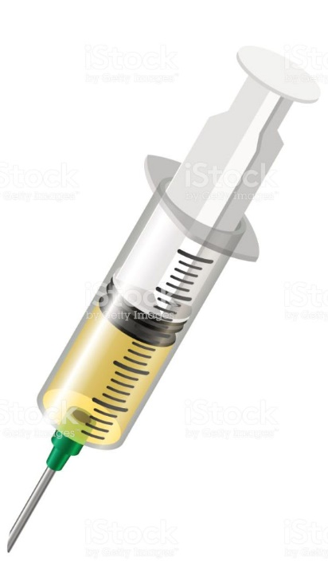
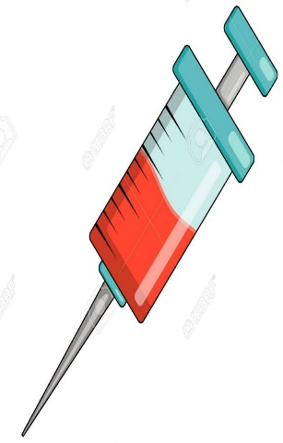
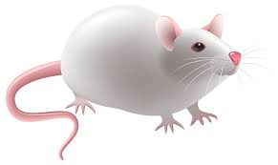

Antigen
Antibody

Slide 8
Methods of LabellingAntibodies
•Enzyme labels (peroxidase)
•Colloidal metal labels (EM)
•Fluorescent labels
•Avidin-biotin techniques

Slide 9
Fluorescent Compounds
Fluochromes are substances which can absorb radiation in the form of ultraviolet or visible light
This absorbed radiation causes an “excited state” followed by emission of radiation of a different wavelength
The fluorescent substances then appear as shiny particles on a dark background
Fluorochromes: FITC(fluorescein isothiocyanate), rhodamine, DAPI, etc.

Slide 10
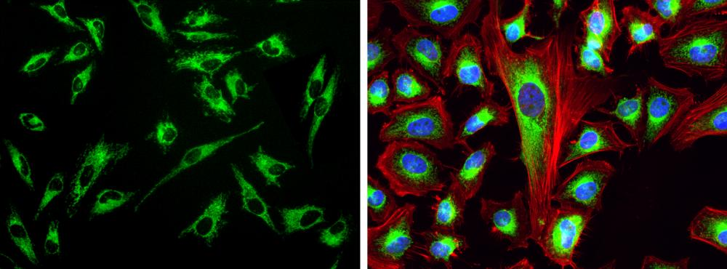

Slide 11
Avidin-biotin Techniques
These methods rely on the affinity of the glycoprotein avidin for biotin
Biotin, a low molecular weight vitamin, is easily conjugated to antibodies and enzyme markers
Up to 150 biotin molecules can be attached to one antibody molecule →increased sensitivity

Slide 12
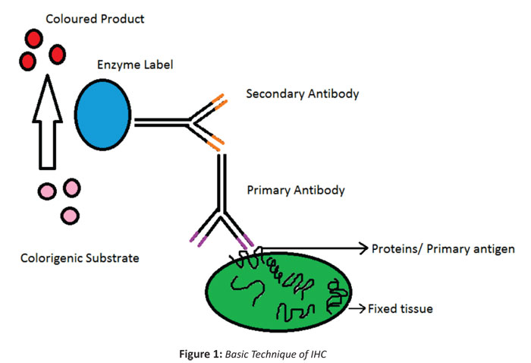

Slide 13
Method of Avidin – Biotin Complex Method ABC
1- Deparaffinization of sections by xylene 2- Rehydration by descending grades of ethanol then distilled water
3- Unmasking or retrieval : immerse sections in buffer with specific pH
4- Incubation with primary antibody (overnight at -4°) or 2 days at room temperature
5- incubation with secondary antibody compatible with primary
6- Incubation with Avidin Biotin
7- Incubation with DAB
8- Counterstain
9- fast dehydration

Slide 14
