Slide 1
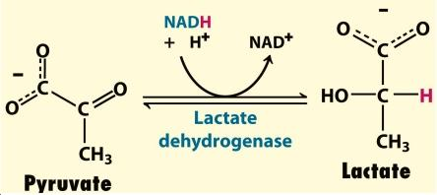
Determination of plasma enzymes
Determination of Lactate dehydrogenase in serum

Slide 2
Objectives
To determine the level of LDH in serum.
To evaluate the presence of tissue damage.

Slide 3
Plasma enzymes
Plasma proteins, also termed serum proteins or blood proteins, are proteins present in blood plasma which have several functions.
Some blood proteins also act as enzymes
These enzymes are classified into functional and non-functional enzyme

Slide 4
Plasma enzymes

Slide 5
NON FUNCTIONAL PLASMA ENZYME
Very small amount of the enzymes are released in blood as a result of normal turnover of cells of different organs.
Hence under normal condition the enzymes are present in very small amount in blood where they have no specific function, so termed as plasma nonfunctional enzyme

Slide 6
Increase of Non-Functional plasma enzyme
Tissue damage or necrosis resulting from injury or disease is generally accompanied by increases in the levels of several nonfunctional enzyme

Slide 7
Sources of non-functional enzymes
Cell damage with the release of its content of enzymes into blood e.g. Myocardial infarction and viral hepatitis
Obstruction of normal pathways e.g. Obstruction of bile duct increases alkaline phosphatase
Increase of the enzyme synthesis e.g. bilirubin increases the rate of synthesis of alkaline phosphatase in obstructive liver disease
Increased permeability of cell membrane as in hypoxia
So estimation of the plasma concentration of these enzymes in blood is useful for the diagnosis of disease depending on their tissue origin.

Slide 8
MEDICAL IMPORTANCE OF NON FUNCTIONAL ENZYMES
Measurement of non functional enzymes is important for:
Diagnosis of diseases
Prognosis of the disease: following up of the treatment by measuring plasma enzymes before and after treatment.

Slide 9
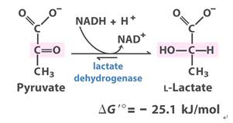
LACTATE DEHYDROGENASE (LDH)
LDH is a hydrogen transfer enzyme which catalyzes the interconversion of pyruvate and lactate.
Lactic acid dehydrogenase (LDH) is an enzyme that helps produce energy.
LDH is most often measured to evaluate the presence of tissue damage (diagnostic)
The enzyme LDH is in many body tissues, especially the heart, liver, kidney, skeletal muscle, brain, blood cells, and lungs.

Slide 10
LACTATE DEHYDROGENASE (LDH)
The optimum pH for lactate pyruvate (L→ P) reaction is 8.8 – 9.8
While for pyruvate to lactate (P→ L) is 7.7 – 7.8.

Slide 11
LDH ISOENZYMS
LDH exists in 5 forms (isoenzymes), which differ slightly in structure. • All of these isoenzymes can be measured in the blood, and can be separated by electrophoresis.
Tissues | LDH Isoenzyme
is found primarily in heart muscle and red blood cells. | LDH-1
is concentrated in while blood cells. | LDH-2
is highest in the lung | LDH-3
is highest in the kidney, placenta, and pancreas | LDH-4
is highest in the liver and in skeletal muscle | LDH-5

Slide 12
High LDH in plasma
Examples | Diseases | High LDH in plasma
 | Myocardial infarction
Toxic jaundice | Liver Disease
Viral hepatitis
Obstructive jaundice
Pernicious anemia | Anemia
Megaloblastic anemia
Tubular necrosis | Renal Diseases
Pyelonephritis
Lung Cancer | Malignant Disease
Hodgkin’s disease

Slide 13
Principle

Slide 14
method

Slide 15
Results
 | Time (min) | Absorbance at 340 nm
A1 | 1
A2 | 2
A3 | 3

Slide 16
Calculations
ΔA1= A2 - A1
ΔA2 = A3 – A2
ΔA/min = ( ΔA1 + ΔA2) / 2
LDH (U/L) = ΔA x 4984
Normal Values 109 to 245 U/L

