Slide 1
Digital Modulation Basics – Part 2
Lab 5 – 2019/1440
By: Elham Sunbu

Slide 2
OUTLINE
Use the Simulink to generate a PAM modulated signal.
PCM modulator.

Slide 3
Pulse Amplitude Modulation (PAM)

Slide 4
Blocks Required:
- Signal Generator Block -Pulse Generator Block - Product Block – Scope
We can find these blocks in the following locations of Simulink Library
Signal Generator and Pulse Generator blocks:
Simulink → Sources → Sine wave
Simulink → Sources → Pulse Generator
Product Block
Simulink → Math Operations→ Product
Scope Block:
Simulink → Sink → Scope

Slide 5
Simulink

Slide 6
Settings
Generate a PAM signal where the message signal is 2 sin(6πt).
Generate a PAM signal where the message signal is 3 sin(5πt) with period 5, width 60.
(Evaluation)

Slide 7
OUTPUT

Slide 8
Pulse Code Modulation (PCM)

Slide 9
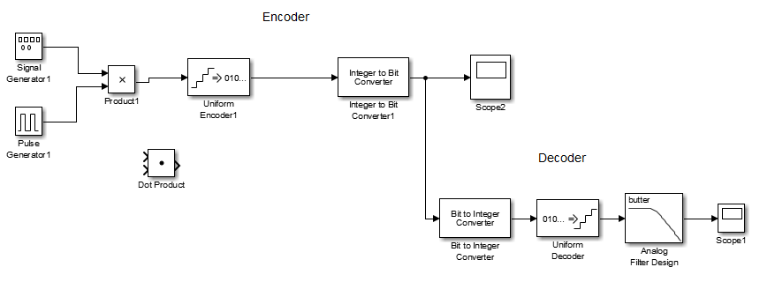
Simulink

Slide 10
Generate a PCM Modulator and demodulator for the following signals:
Application
Evaluation
2 sin(6πt)

Slide 11
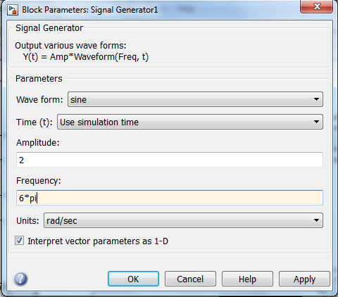
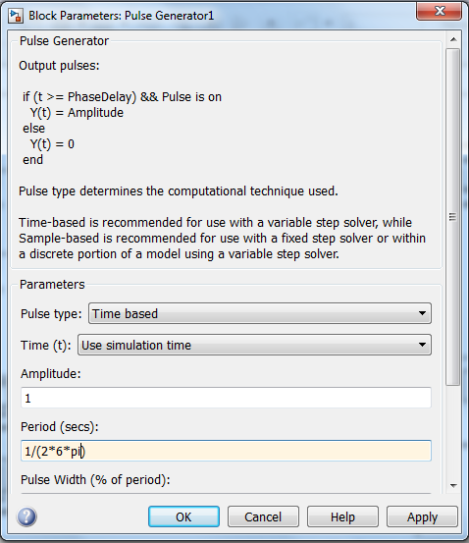
Settings

Slide 12
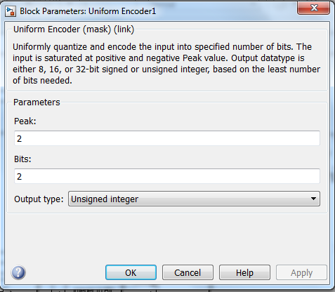
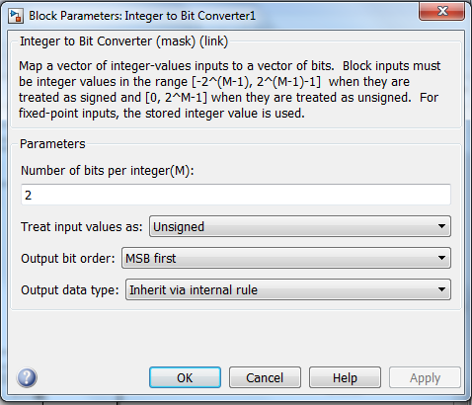

Slide 13
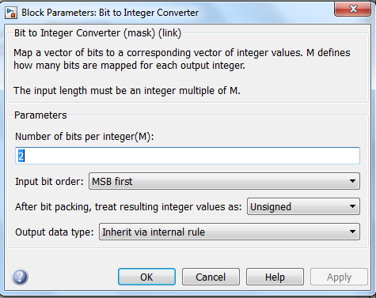
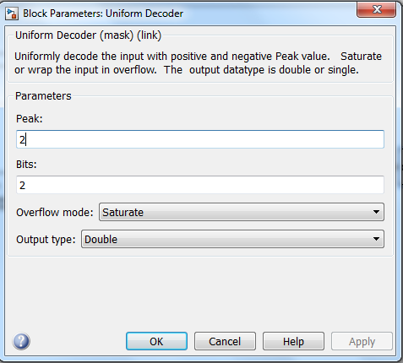

Slide 14
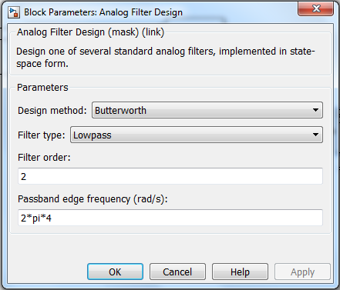
Generate a PCM Modulator and demodulator for the following signals:
4 sin(5πt)(Evaluation)
8 sin(8πt)

Slide 15
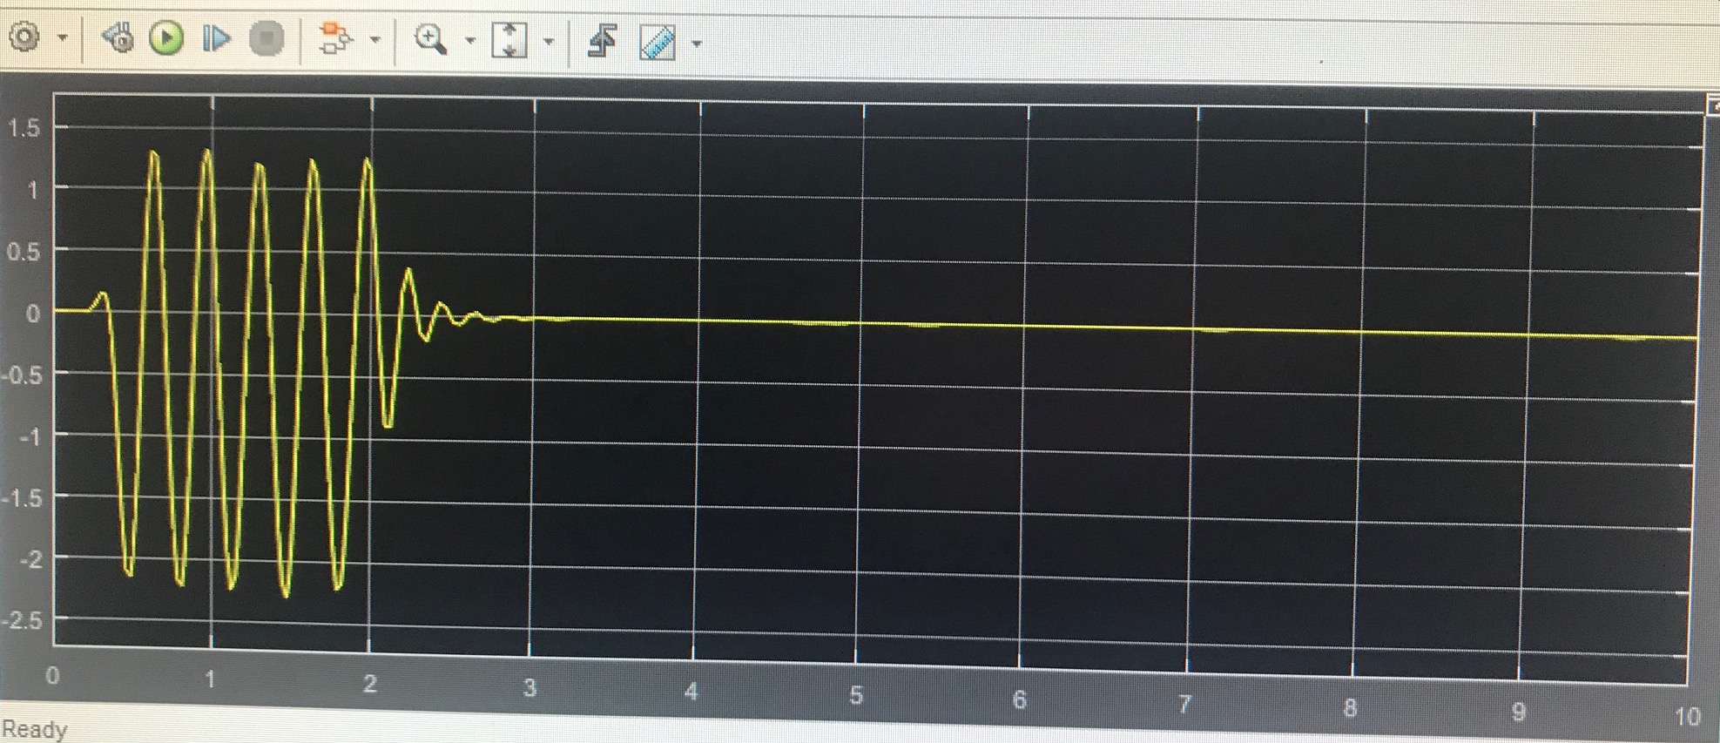
OUTPUT
Scope of encoder
Scope of decoder

Slide 16
Thank You

