Slide 1
Digital Modulation Basics – Part 2
Lab 4 – 2019/1440
By: Elham Sunbu

Slide 2
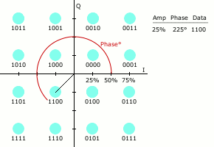
OUTLINE
Quadrature Amplitude Modulation (QAM)
16QAM

Slide 3
Quadrature Amplitude Modulation (QAM)

Slide 4
Quadrature Amplitude Modulation
How can the data rate be increased further?
A combination of modulation techniques that change two characteristics of a carrier at the same time.
The most sophisticated technology combines ASK and PSK
One of such is known as Quadrature Amplitude Modulation (QAM) or Quadrature Amplitude Shift Keying (QASK).
the approach uses both change in phase and in amplitude
To represent QAM on a constellation diagram
We use distance from the origin as a measure of amplitude
Figure 10.8 shows the constellation diagram for a variant known as 16QAM with dark gray areas indicating the amplitudes
.

Slide 5
Quadrature Amplitude Modulation
.

Slide 6
Simulink

Slide 7
Settings

Slide 8
Settings

Slide 10
OUTPUT

Slide 11
Thank You

