Slide 1
ZOO 103 Lab 8

Slide 2
Ascaris
External Features:
Kingdom: Animalia,
phylum; Nematoda (Roundworms)
Class: Rhalditea
Order: Ascariida
Family: Ascariidae
Genus: Ascaris
Species: Ascaris lumbricoides
The body form, is cylindrical, long (length varies according to species).
sex being in A. vitulorum (15-26 cm in the male and 22-30 cm in the female) and tapering at both ends.

Slide 3
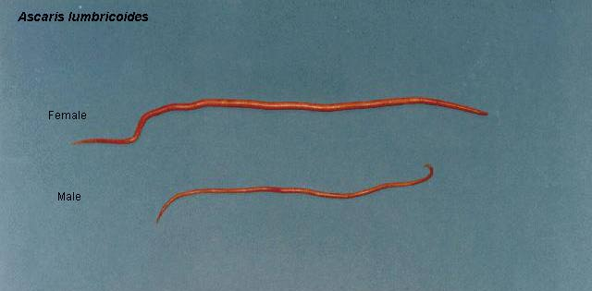
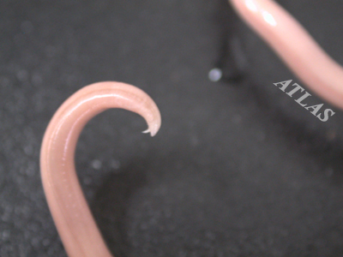
External Features:
The sexes are separate, the female is the larger and has a straight posterior end.
the male is more slender and has its posterior end sharply curled ventrally.

Slide 4
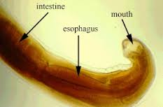
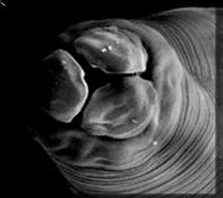
Four longitudinal streaks run the entire length of the body, 2 thin white dorsal and ventral lines, and 2 broader and darker lateral lines.
The mouth lies at the anterior end of the body and is guarded by three finely papillated lips, one dorsal and two ventro-lateral.

Slide 6
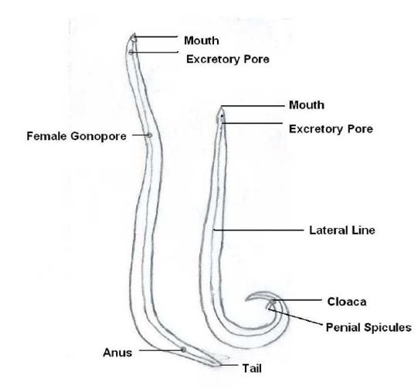
The minute excretory pore lies on the ventral side, 2 mm behind the mouth.
The genital aperture in the female is situated on the ventral side some distance from the anterior end (at about one third the length of the body in A. lumbricoides).

Slide 7
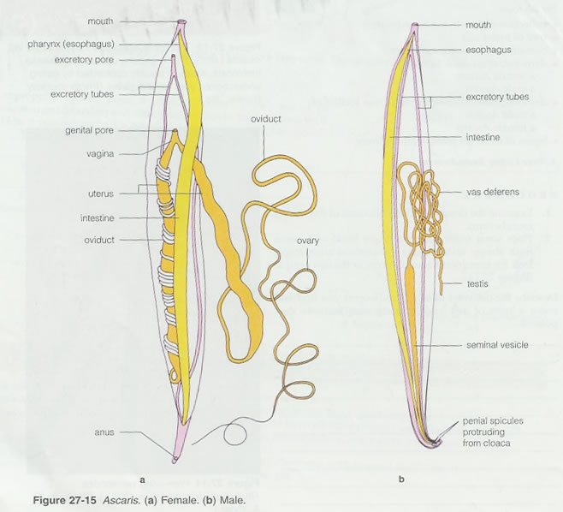
In the male, the genital duct joins the hind gut and both open by a common cloaca a short distance from the posterior end.
- A pair of minute copulatory spicules project from the latter aperture.
The female has a separate slit-like anus.

Slide 8
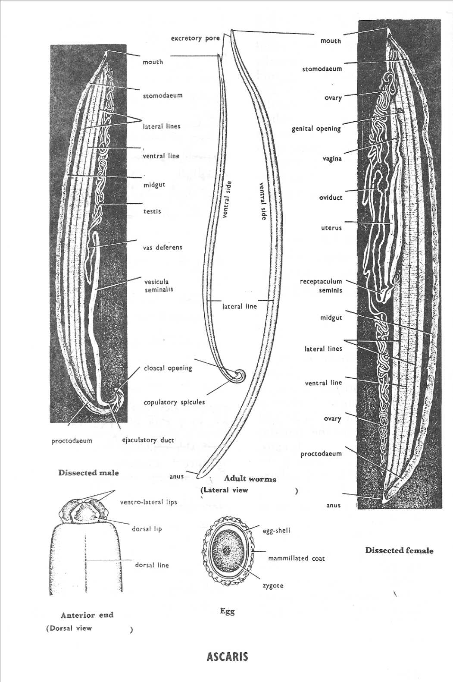

Slide 9
The Earthworm – Allolobophora:
External Features:
The body form is cylindrical pointed anteriorly and dorso-ventrally flattened posteriorly.
The dorsal surface is somewhat darker in colour.
The mouth and anus open terminally at the anterior and posterior ends respectively.
The body is divided into a great number of segments, separated by conspicuous intersegmental grooves.
The clitellum (secretes the cocoon) is the thickened skin of segments 26-34, and lies on the dorsal and lateral sides concealing the segments .
Kingdom: Animalia
Phylum: Annelida
Class: Oligochaeta
Genus: Allolobophora (Earthworm)
Species: caliginosa
Allolobophora caliginosa

Slide 10
These, however, are distinct on the ventral side, where the edges of the clitellum are thickened on segments 31-33 forming two puberty crestsعرف البلوغ .
The head is composed of a peristomium حول الفم(first segment) surrounding the mouth and a prostomium قبل الفم which is dorsal and forms an upper lip that extends in front of the mouth; the prostomium is not to be considered a segment.
The chaetae or setae اشواك are minute chitinous structures which can be felt by passing the finger from behind forwards on the ventral surface of the worm (preferably preserved).
Everybody segment, except the first and the last, carries four pairs of chaetae, two pairs on the ventral surface and one pair on each lateral side. Use a hand-lens to see that the chaetae are directed backwards.
The female openings are two small openings which lie ventrolaterally on segement 14.

Slide 11
The male openings are two slit-like apertures with thickened lips. They lie on the ventrolateral sides of segemnt 15.
The spermathecal pores ثقوب المستودعات المنوية are two pairs of minute openings which lie on the ventral side in the intersegmental grooves between segments 9/l0 and 10/11. They are surrounded by three pairs of copulatory papillae on segemnts 9, 10 and 11.
The dorsal pores are minute single pores which communicate the coelom with the outside.They lie mid dorsally on the intersegmental grooves starting with 8/9 to the posterior end.
The excretory pores or nephridiopores are the minute pores of the nephridia to the outside. They are ventral in position, two per segment, except the first three and the last segment where they are absent.

Slide 12
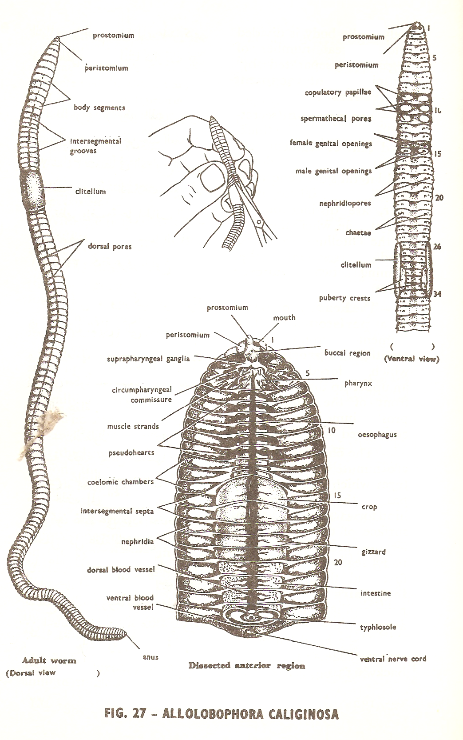

Slide 13
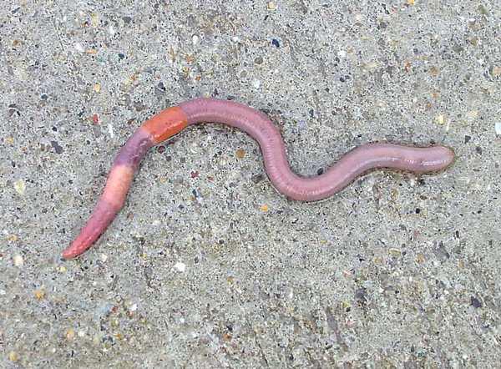

Slide 14
Hirudo
External Features:
Body form and colour, dorsoventrally flattened (not rounded) with a greenish-brown colour, paler below than above.
The dorsal surface is marked with yellowish longitudinal bands spotted with black pigment, while the ventral surface is irregularly mottled.
The suckers: a cup-shaped anterior sucker with the mouth opening in its middle, and a larger imperforated disc-like posterior sucker, both are ventrally directed.
Kingdom: Animalia
Phylum: Annelida
Class: Hirudinea (leeches)
Genus: Hirudo
Species: medicinalis
Hirudo medicinalis.

Slide 15
External annulation:
The body is externally divided into a large number of rings or annuli which are actually more numerous than the true internal segments.
The animal has a fixed number of segments, only 33. Ever/ 5 annuli correspond to one true segment except at the anterior and hind ends where the number of annuli per segment is less.
The eyes are five pairs on the dorsal surface of the first 5 segments.

Slide 16
The nephridiopores are 17 pairs of minute openings on the ventral surface, one pair in each of the segments 7-23 inclusive, and located on the annulus immediately in front of the one bearing the papillae.
The male genital opening lies in the mid ventral line on the 4th annulus of segment 11.
The female genital opening lies in the mid ventral line on the 4th annulus of segment 12.
The anus opens mid dorsally at the point of junction between segment 26 and the posterior sucker

Slide 17
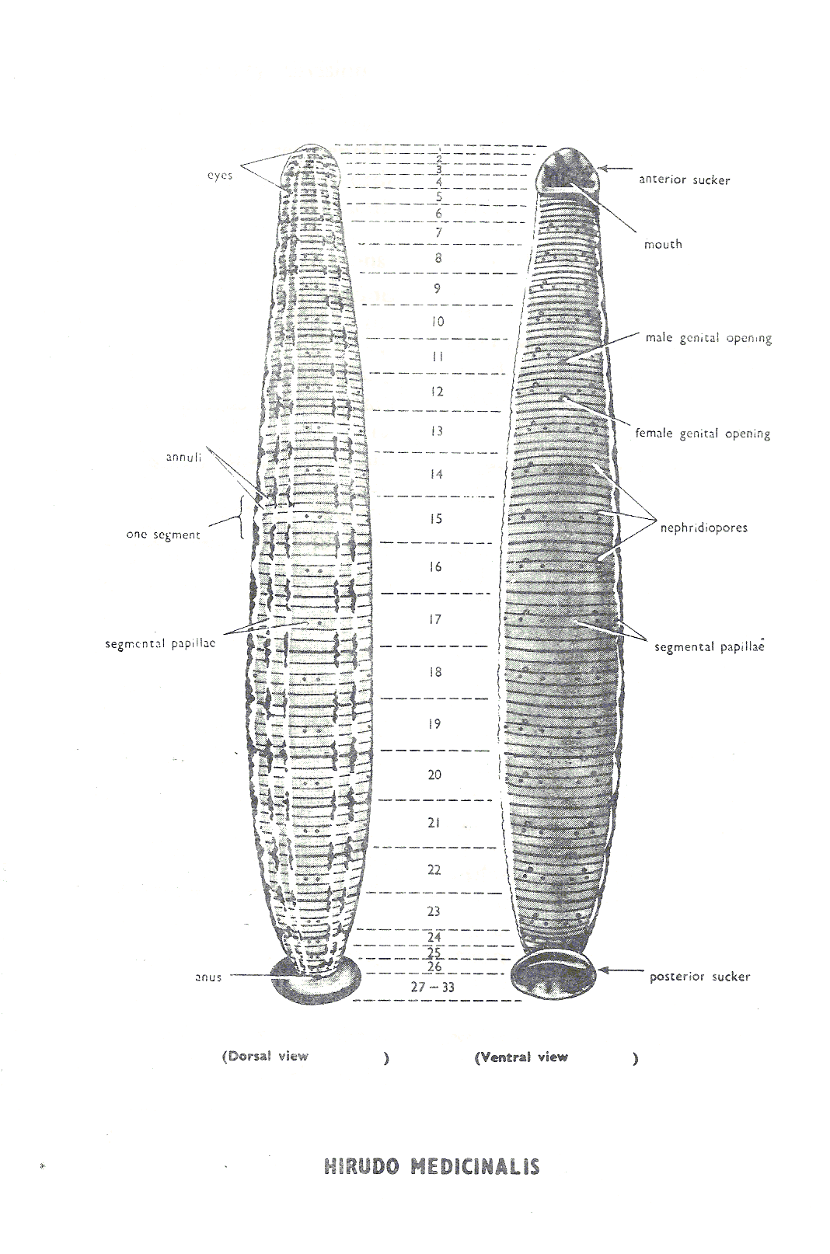

Slide 18
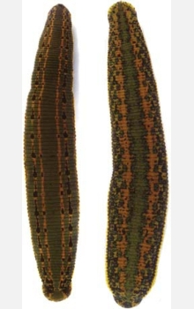

Slide 19
The cuttlefish – Sepia:
Kingdom: Animalia
Phylum: Mollusca
Class: Cephalopoda
Genus: Sepia
Species: savignyi
Sepia savignyi
External Features:
The body is mainly divided into a distinct head and a conical visceral humpحدبة حشوية , separated from one another by a short neck.
The head carries 2 large eyes, similar to those of vertebrates. It bears anteriorly the mouth opening surrounded by a prominent circular lip, and 2 large horny jaws project from it.

Slide 20
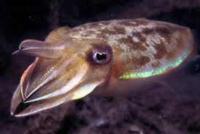
Eight pointed arms,each provided with 4 rows of suckers on its inner surface, and 2 much longer tentacles, carrying suckers only at their expanded tips, arise at the anterior end of the head, around the mouth opening (the tentacles are used in catching the prey and the arms for holding it while it is being devoured).
The arms and tentacles probably represent the highly modified anterior part of the foot, and hence the name Cephalopoda.

Slide 21
The posterior part of the foot is modified to form the large muscular funnel قمع which you see on the ventral side of the head (through which water is forced out of the mantle cavity, causing the animal to jerk quickly backwards

Slide 22
The Starfish
Kingdom: Animalia
Phylum: Echinodermata
Class: Asteroidea
Genus: Astropecten
Species: relitaris
Astropecten relitaris
(Sea star).
External Features:
The body is star-shaped consisting of a central disc prolonged radially into 5 felxible triangular arms with tapering tips.
The body is markedly flattened, with two distinct surfaces, a lower oral surface and an upper aboral surface.
On the oral surface, note the mouth opening in the centre, surrounded by-a soft membranous area, the peristome.
Five broadly open ambulacra grooves ميازيب حركية pass extend out from the mouth and each along the entire length of one of the arms.

Slide 23
Note that a series of long conical structures known as the tube feet اقدام انبوبية project in 2 rows along each ambulacral groove (organs of locomotion which-are capable of great extension and contraction during life).
The terminal tube foot or tentacle, which stands at the tip of each arm, has a pigmented spot, the eye, at its base (light sensitive).
Note that very small modified spinesاشواك , known as pedicellariaeملاقط , project around the spines (serve to clean the body surface and ambulacral grooves from detritus and foreign objects).
Each has 2 distal ossiclesعظيمات working opposite each other like pincer blades,and a 3rd basal ossicle as a stalk.

Slide 24
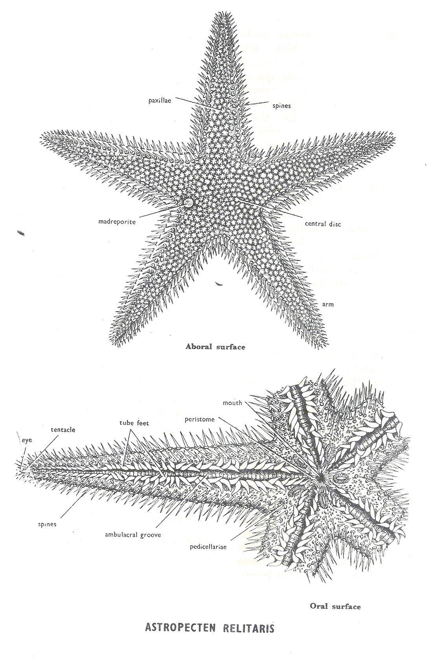
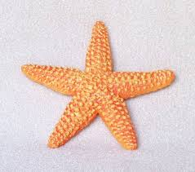

Slide 25
Thank you
for your attention

