Slide 1
KING SAUD UNIVERSITY
COLLEGE OF APPLIED STUDIES AND COMMUNITY SERVICE
CT 1402
Lab sheet #8
1st semester 1440-2018
Noise to ASK, FSK and PSK
BY: T. Elham Sunbu

Slide 2
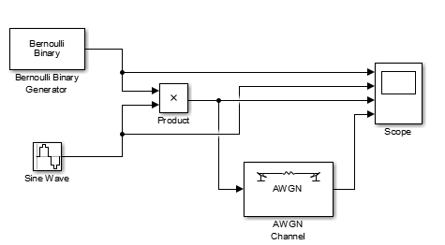
OOK Modulator with noise
Apply a OOK for a random digital signal using the following carrier
3 sin (70πt) , SNR_{db} = 5
2 sin (2π20t), SNR_{db} = 10
4 sin (50πt), SNR_{db} = 15

Slide 3
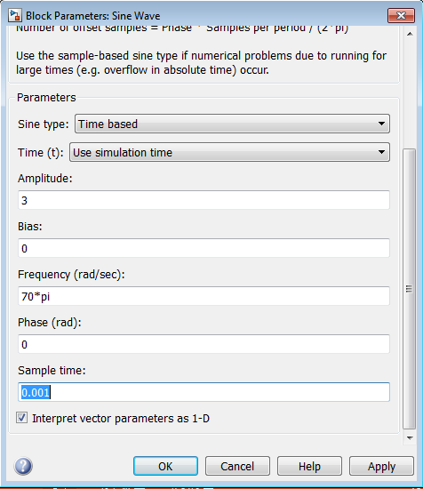
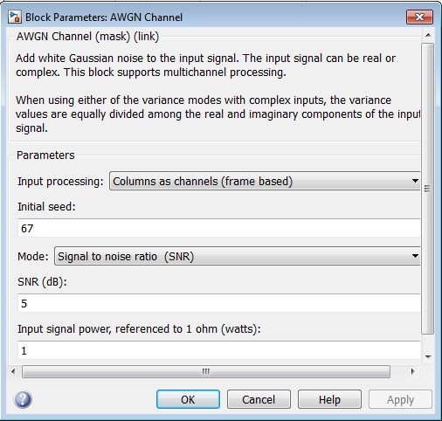

Slide 4
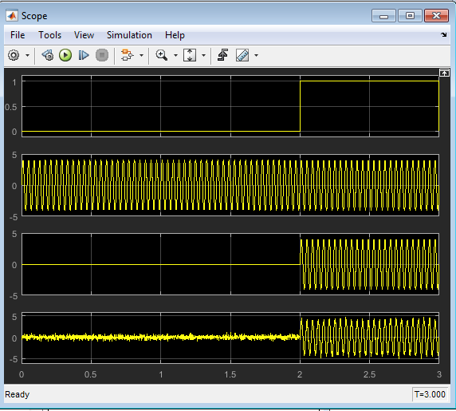
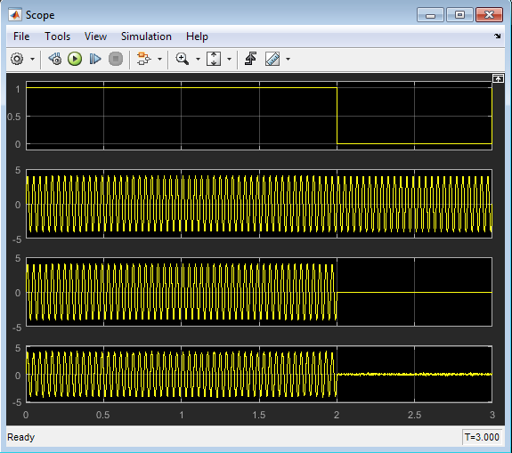
SNR =10
SNR =20

Slide 5
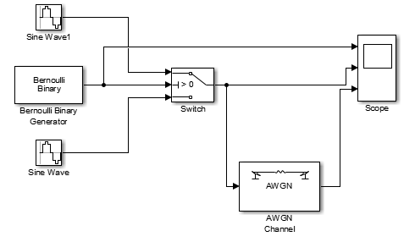
FSK Modulator with noise
Implement a BFSK modulation that use the following carriers:
1- f_{c1} = 2π40 and f_{c2} = 2π10 SNR_{db} = 10
2- f_{c1} = 100π and f_{c2} = 50π , SNR_{db} = 20
3- f_{c1} = 90π and f_{c2} = 30π SNR_{db} = 25

Slide 6
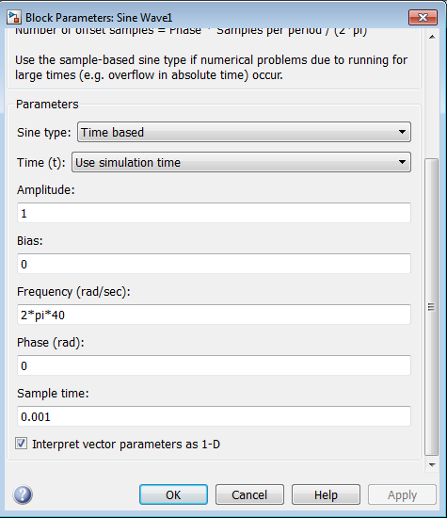
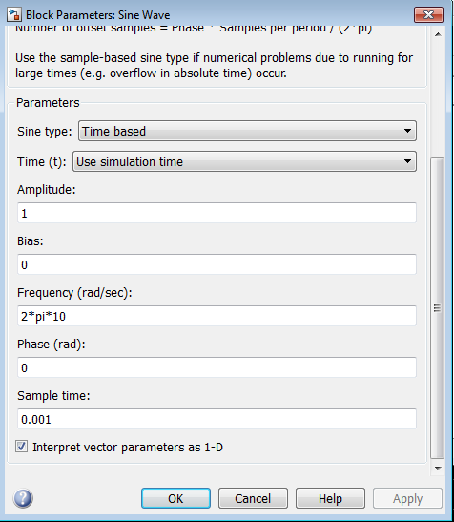

Slide 7
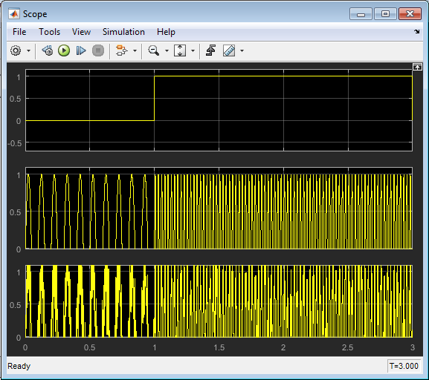
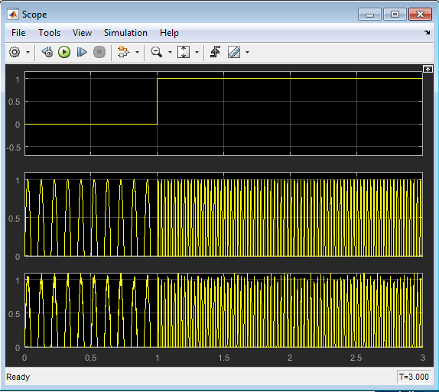
SNR =10
SNR = 25

Slide 8
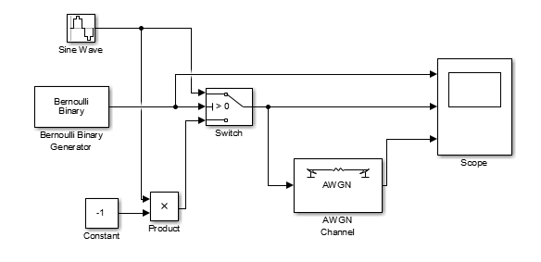
PSK Modulator
Implement a BPSK modulation that use the following carriers:
1- f = 2π7 Hz SNR_{db} = 10
2- f = 2π4 Hz SNR_{db} = 23
3- f = 2π 5 Hz SNR_{db} = 18

Slide 9
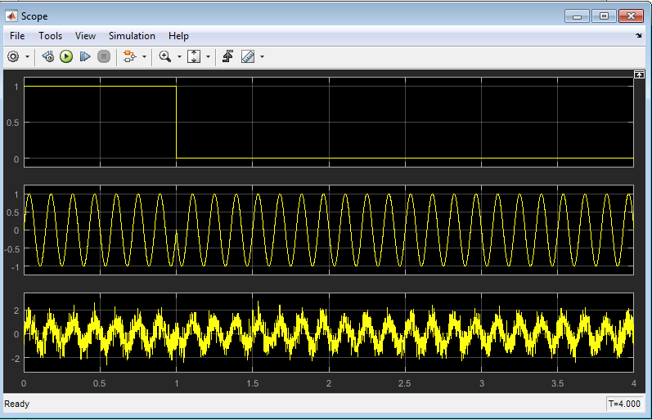
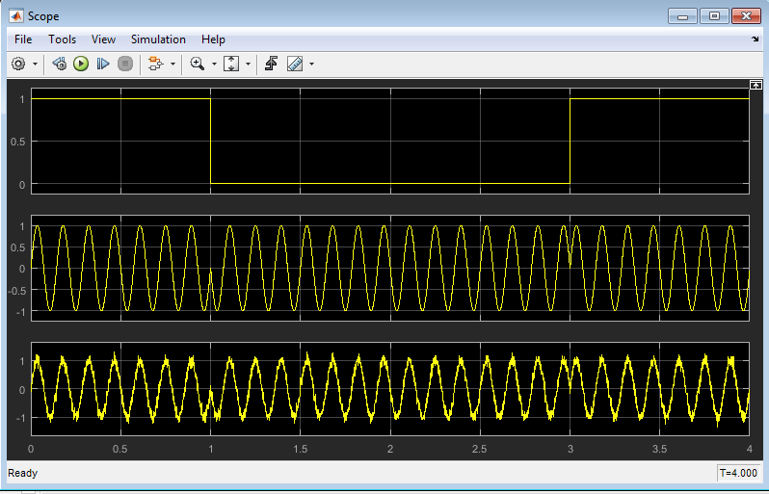
SNR =5
SNR =20

Slide 10
Any Question?

