Slide 1
Hb electrophoresis

Slide 2
Electrophoresis
The movement of charged molecules in electrical field used to analyze the protein.
Depend on:
-Intensity of electrical field
-Nature of charged particles(-ve charge)
-Medium in which the movement may occur (character of buffer)

Slide 3
Types of electrophoresis:
1-Paper
-Cellulose acetate
2-Gel
-Acrylamide gel
-Agarose gel

Slide 4
Hb electrophoresis (specific test)
It is a confirmatory test to detect the most common clinically important different type of Hb as Hb S, C and A ;using cellulose acetate paper. principle:
At alkaline PH 8.4 - 8.6 , Hb is a protein carry
–ve charge when subjected to electrical field will migrate toward the anode +ve then there are a separation of Hb S,C,F and A.

Slide 5
Hb electrophoresis depend on:
Hb molecular weight.
-ve charges of Hb
Hb A carry more –ve charge.so,the more the –ve charges ,the movement will be faster.

Slide 6
:advantages
Simple
Reliable
rapid

Slide 7
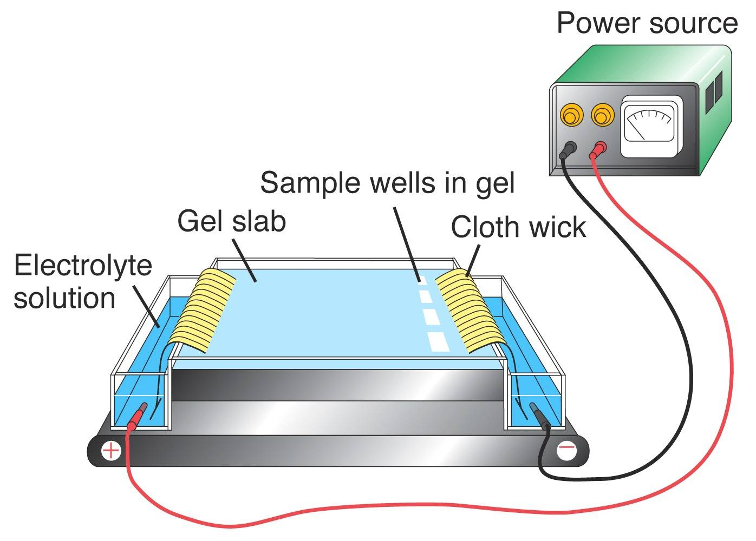
Equipments:
Electrophoresis tank & power source.
Wicks of filter
Blotting paper
Applicators
Cellulose acetate membrane.

Slide 8
Reagents:
Electrophoresis buffer: TEB(Tris/ EDTA/boric acid)
Stain: ponceau stain.
Destaining solution: 5% acetic acid.
Hemolysing reagent
Dehydration by methanol
Clearing by clearing solution:
methanol, acetic acid, clearing aid

Slide 9
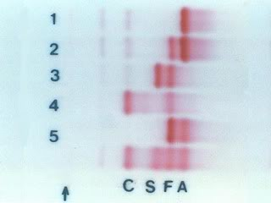
All samples showing a single band

Slide 10
Hb A
Hb S
Low MWT
Soluble
More –ve charge
High MWT
Insoluble
Less –ve charge

Slide 11
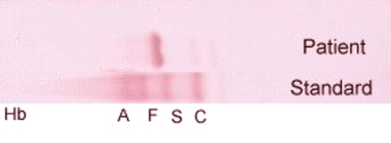
Hb SS in Hb electrophoresis
No normal Hb A is detected.
The amount of Hb F is variable and is usually 5-15%.

Slide 12
Hb AS: Hb S varies from 25- 45% of total Hb
Normal Hb in adults:
A:96-98%
A 2: 1.5-3.2%
F:0.5-0.8%

