Slide 1
KING SAUD UNIVERSITY
COLLEGE OF APPLIED STUDIES AND COMMUNITY SERVICE
CT 1402
Lab sheet #6
1st semester 1440-2018
Frequency Shift Keying (FSK)
BY: T. Elham Sunbu

Slide 2
OUTLINE:
FSK model

Slide 3
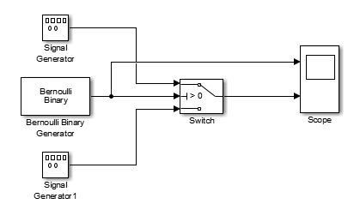
FSK Modulator

Slide 4
FSK Modulator
Implement a BFSK modulation that use the following carriers:
f_{c1} = 100 Hz and f_{c2} = 20Hz

Slide 5
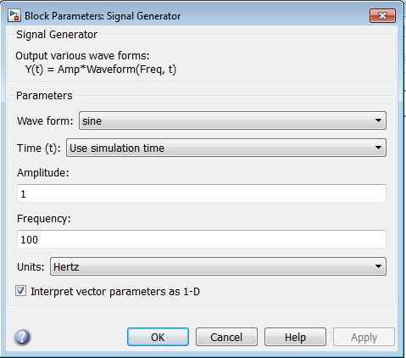

Slide 6
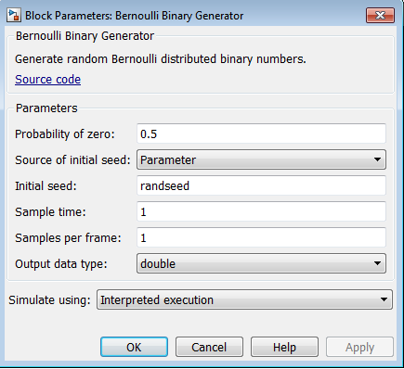
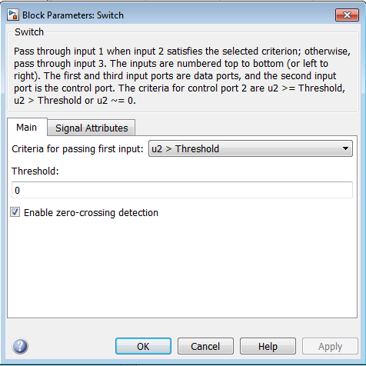

Slide 7
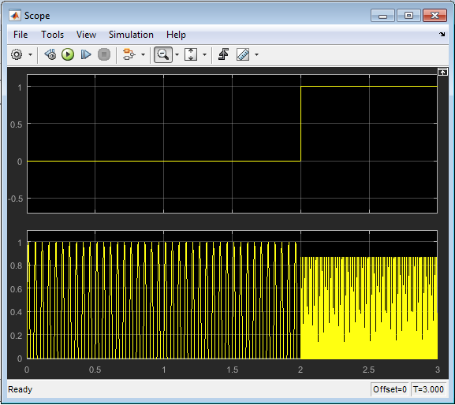
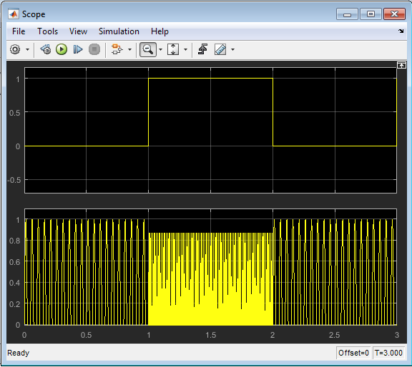

Slide 8
Evaluation
f_{c1} = 180 Hz and f_{c2} = 50Hz

Slide 9
Any Question?

