Slide 1
KING SAUD UNIVERSITY
COLLEGE OF APPLIED STUDIES AND COMMUNITY SERVICE
CT 1402
Lab sheet #5
1st semester 1440-2018
Amplitude Shift Keying (ASK)
BY: T. Elham Sunbu

Slide 2
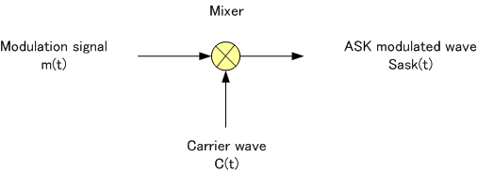
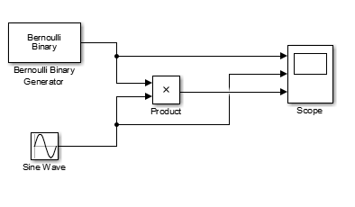
OOK Modulator

Slide 3
OOK Modulator
Apply a OOK for a random digital signal using the following carrier
2 sin (2π20t)

Slide 4
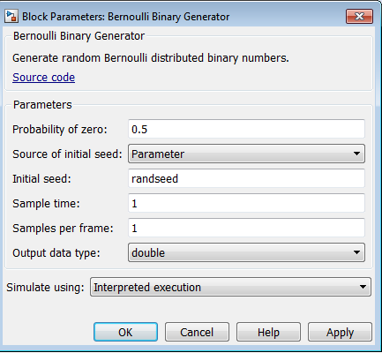
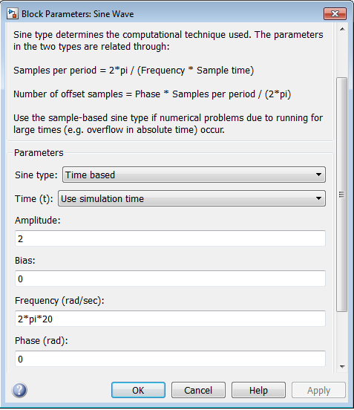

Slide 5
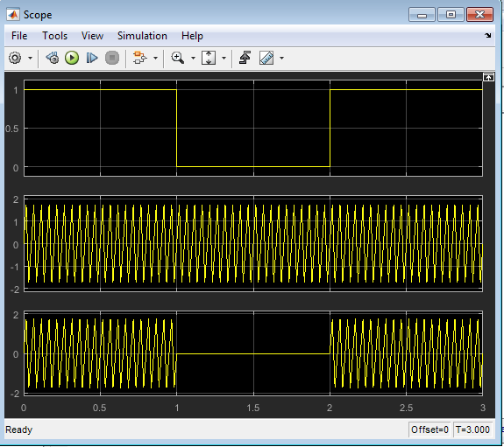
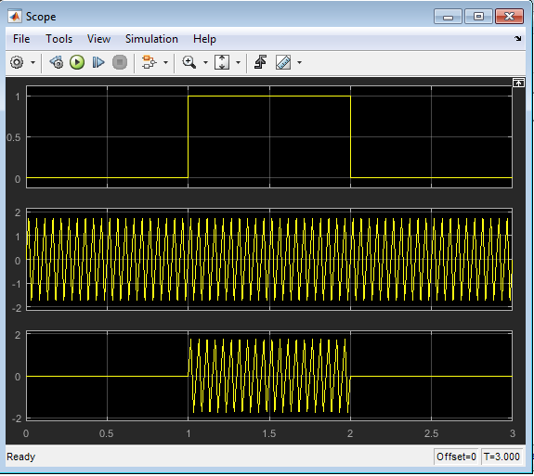

Slide 6
Evaluation
4 sin (50πt)

Slide 7
Any Question?

