Slide 1

NETWORK SECURITY LAB
Lab
5. Passive Attacks and
Reconnaissance
- Operating Systems Fingerprinting & Scanning

Slide 2

What are Passive Attacks?
• Passive Attacks
– Network attack to monitor target systems, through port scanning or other means to locate and identify vulnerabilities.
– Passive attacks include:
• Active Reconnaissance
• Passive Reconnaissance

Slide 3
How is it realized?
• Scanning
- The first active action taken against target computer/network.
- The action taken is based on the information gathered through ‘Foot printing’
- Scanning allows penetrating deep into target network.
- Usually done to identify the type, size and topology of network along with live systems and technology.

Slide 4
Scanning
• Ports and Service Scanning
– Ports: Can be hardware/software, allow computers to communicate.
– Service: An application running at the network application layer and above, allows storing, presentation and logistics of data.

Slide 5
Port & Service Scanning
• Port Scanning:
– Refers to running a query in target computer/network to identify which ports is the machine listening on.
• Ex: netstat –abno OR taskmanager with port column
• Onlineportscanner
• Service Scanning:
– Refers to running a refined and sophisticated query using specialized tools on target computer/network to identify which services are functioning. To be addressed in Systems Enumeration

Slide 6

What
happens
in
Port
Scanning
Identify Vulnerabilities that can be exploited

Slide 7
Port Scanning an IP – Hands on
Preparation: Download Port Query from MEGA folder
• Identify the computers in the network:
– Open Command Prompt with Admin privileges
– Run the command ‘Net View’
Review the list of computers and select one computer as target – Note its name
– Unzip and Run the Port Query
– Enter the name of the target computer in the Port Query Scanner
» Select ‘Manually input Query Ports’
» Enter ‘100-200’ in ports to query
» Click on Query
Review the results of scan and note the port numbers on which the target computer is listening

Slide 8
Analysis of Port Scan
Firewalls cannot protect the network if there are vulnerabilities in the systems:
– Ex: Port 80 allowed through firewall
– Anyone from outside can access this port
– To identify vulnerabilities within the network /
systems:
• Vulnerability Scanner / Security Scanner
• Functions exactly like hackers port scanner, used for vulnerability assessment.

Slide 9
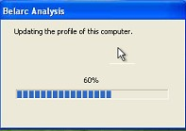
Vulnerability Scanner – Hands on
• Download ‘Belarc Advisor’ from vdrive folder
– Extract and Run the installable
– Step 1: Allow the software to update the profile of the computer

Slide 10
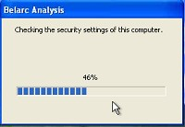
Belarc Advisor
Post profiling the network of the computer, Belarc will start analyzing the security settings of the computer:

Slide 11
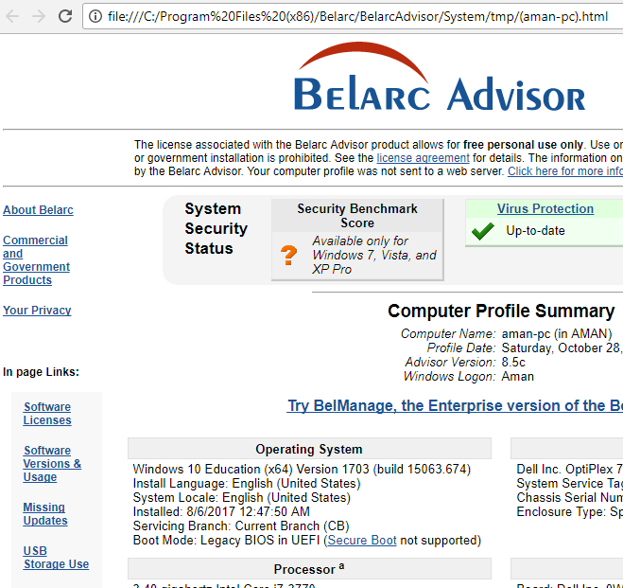
Reporting
• Belarc will revert with report as html file.
• Use any browser to view the report

Slide 12
Analysis of the reports
• Carefully review the following sections:
– Operating System
– Local Drives
– Users
– Virus Protection
– Network Map
– Software Installed

Slide 13
OS Fingerprinting
– Process of determining the Operating System used by a host on a network.
• Forensics Wiki
– What are the contents of an OS Fingerprint?
• Just like human fingerprints have unique characteristics, OS fingerprints are unique too.
• These characteristics are reflecting during communication.
• By capturing and analyzing certain protocol flags and data packets, we can accurately establish the identity of the OS that relayed it.

Slide 14
How is it different than Scanning?
Scanning is done against IP addresses of computers only such as mail servers, web servers or standalone PC’s.
OS fingerprinting can be don all network based devices such as Routers, switches, printers, etc.,

Slide 15
Points to ponder about nMap
• nMap is a very noisy solution
Raises a lot of alerts in IDS/IPS solutions while scanning.
The trick is to use nMap with different switches smartly so that the scans remain less frequent yet result effective.
– Usage of switches

Slide 16
Hands On – Lab Activity
Download and install the nMap Utility

Slide 17
Target
To keep the scanning legal and ethical we will use the following url to scan.
The url is provided freely by nMap to be scanned and exploited for practice purposes:
– http://scanme.nmap.org

Slide 18
Switches to be used in nMap
-V : returns the version number of the service you are hosting
-A / -O: Enables OS detection, version detection, script scanning
- Using the nMap GUI run a scan against scanme.nmap.org

Slide 19
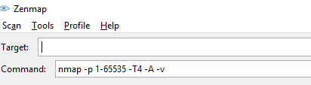
Objective
• To intense scan a network (system / server
/ router)
• Run the nMap utility in GUI Mode
Scanme.nmap.org

Slide 20
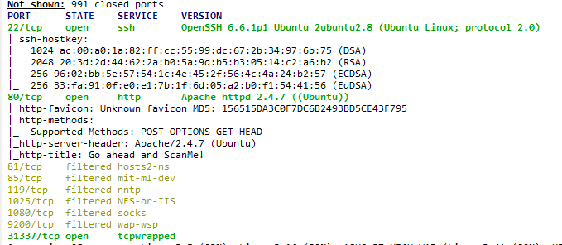
Scanning through nMap
• nMap returns with results

Slide 21
Scanning a target for specific ports
• Nmap –p <<port number>> 22 <<ssh port>>
– target
• nMap –p 22 scanme.nmap.org

Slide 22
Aggressive Scanning using nMap
• nMap –A <<aggressive>> target
– nMap –A scanme.nmap.org
Gives the Operating System version of the target.
• nMap –F target
– Fast scanning (100 ports) of the target
• nMap –open target
– Runs a fast probe on target and retrieves only open ports on the target.

Slide 23
Report Work:
•
Using nMap commands and switches
provide the result for the following information:
–
Scan http://www.altoromutual.com
using
nMap
to
•
•
•
•
•
identify:
The version of the Operating System
The Services Running on the target
Search for ports 8080, 22 and 443 on the target
Use a fast scan on the target
Retrieve only the open ports on the target
•
Provide the answers in the following format:
Command with switch
Result

Slide 24
Questions

