Slide 1
KING SAUD UNIVERSITY COLLEGE OF APPLIED STUDIES AND COMMUNITY SERVICE
CT 1402 | Lab sheet 2 | 2nd semester 1438-1439
Line Encoding

Slide 2
:2- Polar RZ
With random number data

Slide 3
:Polar RZ
Change the Binary number generator parameter as in NRZ
Change the Pulse Generators as following:

Slide 4
Polar RZ:

Slide 5
Polar RZ with Decoder:

Slide 6
Polar RZ:
Data input from the user

Slide 7
Polar RZ:

Slide 8
3- Polar MAN:
With random number data

Slide 9
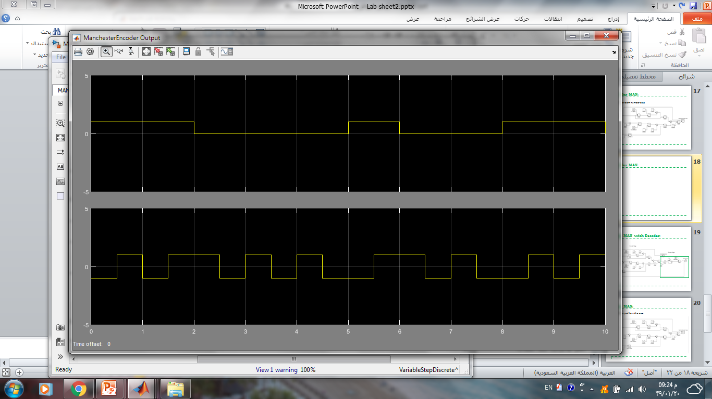
3- Polar MAN:

Slide 10
Polar MAN with Decoder:

Slide 11
Polar MAN:
Data input from the user

Slide 12
Polar MAN:

