Slide 1
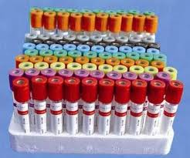
Haemolysing Agents& Detection of blood

Slide 2
Blood components

Slide 3
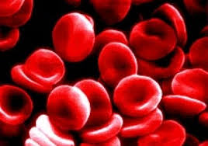
Erythrocytes (RBC’s)
Life cycle – 120 days
Lack a nucleus and other organelles.
33% of weight is hemoglobin molecules
Function: gas transport
RBCs are flattened biconcave discs

Slide 4
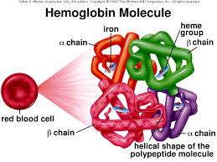
Haemoglobin
(Hb or Hgb) is the primary constituent of RBCs
It gives the characteristic red color to erythrocytes and to the blood

Slide 5
Hemolysis
Hemolysis: is the breakage of the RBC’s membrane, causing the release of the hemoglobin and other internal components into the surrounding fluid
The concentration of potassium inside red blood cells is much higher than in the plasma
and so elevated potassium is usually found in biochemistry tests of hemolysed blood.

Slide 6
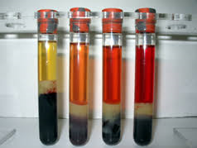
Hemolysis cont..
Conditions that can cause hemolysis include: Immune reactions, Infections, Medications. Toxins and poisons.

Slide 7
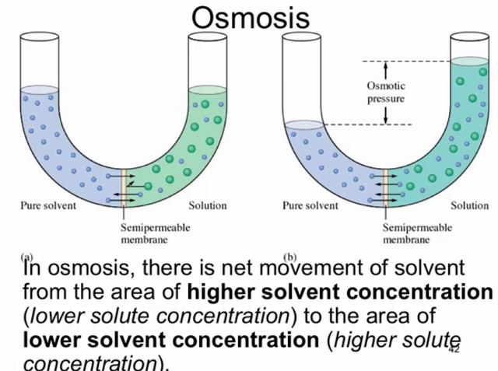
osmotic pressure Diffusion of water across a membrane – osmosis – generates a pressure called osmotic pressure If the pressure in the compartment into which water is flowing is raised to the equivalent of the osmotic pressure, movement of water will stop.

Slide 8
Isotonic Solution
A solution that has the same salt concentration
normal cells of the body and the blood, having equal osmotic pressure.
such as sodium chloride 0.9%, have the same osmotic pressure in serum and RBC
intravenous fluid is isotonic

Slide 9
hypotonic solution
A solution that has a higher water potential a lower solute concentration lower osmotic pressure than another solution.
In a hypotonic solution, the plasma membrane of RBC would swell ,the red blood cells would hemolyze or burst.
Examples of Hypertonic Solutions
0.45% NaCl Lower concentration than normal salin 0.9%NaCl
Dextrose 2 or 2.5% in water.

Slide 10
hypertonic solution
A solution that has a lower water potential a higher solute concentration higher osmotic pressure than another solution.
In a hypertonic solution, the plasma membrane of RBC would separate and pull away from the cell membrane.
Examples of Hypertonic Solutions
1.2% NaCl higher concentration than normal salin 0.9%NaCl

Slide 11
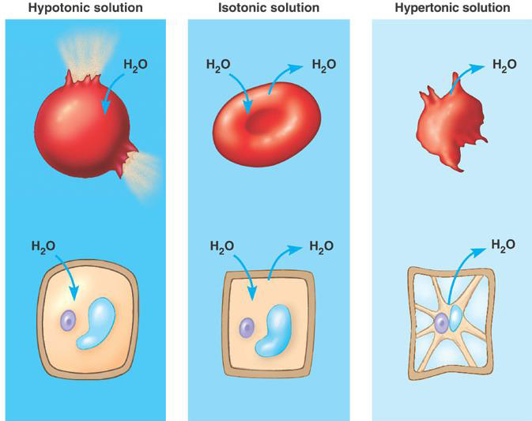

Slide 12
Why the solution concentration effect on RBC ?
Since the cell membranes of red blood cells are selectively permeable (allowing for diffusion of solvent, when the concentration of solvent is greater on one side), equilibrium allows the red blood cells to retain their shape.

Slide 13
Objective :
Study different Haemolysing Agents
Detect the present of blood by BENZIDINE test

Slide 14
How to calculate the osmolarityof the Sol.
Blood plasma is = 0.308 Osmolar
For 0.9% NaCl
O =M ×(no. of dissociation particles )
M=no. of moles/ volume (L)
no.of moles=weight/ Molecular weight
So,
weight= M x V x Molecular weight=
0.9= M x 0.1 x 58.4 =
M=0.154 M
O =0.154 x 2 = 0.308 Osmolar(isotonic:same osmolarityof plasma)

Slide 15
Procedure Into seven dry clean test tubes (A, B, C, D, E, F, G), pipette 3 drops of the suspended RBC‟s in Saline solution, and add to each tube as indicated the following table:
G | F | E | D | C | B | A
 |  |  |  |  |  | 5ml | NaCl 0.45%
 |  |  |  |  | 5ml |  | NaCl 1.2%
 |  |  |  | 5ml |  |  | Sucrose 6%
 |  |  | 3drops |  |  |  | NaOH 0.1M
 |  | 3drops |  |  |  |  | HCl 0.1M
 | 5ml |  |  |  |  |  | Ds H2O
5ml |  | 5ml | 5ml |  |  |  | NaCl0.9%

Slide 16
Procedure cont..
Heat slowly in the water bath and note the temperature at which haemolysis started.
Wait 30 minutes.
Observe whether Haemolysis has taken place, i.e. whether the colour of the solution is changed or Centrifugation may be of help.

Slide 17
Detection of Blood by BENZIDINE test
Principle
It is often necessary to detect the presence of small quantities of blood in urine, stomach contents etc.
small amounts of blood in presence of peroxide catalyze the oxidation of benzidine giving a blue colour.
the test is not specific for blood because peroxidases present in milk, potatoes and pus, as well as the ions of Fe+3, Cu+2 and K+1 will give false positive results.

Slide 18
Reagents
1- Red Blood cells suspended in saline solution.
2- Benzidine solution 3% in glacial acetic acid (freshly prepared).
3- Hydrogen peroxide solution 6% (freshly prepared).
4- Boiling water bath.

Slide 19
Procedure
1- 3ml of suspended blood cells solution is boiled in water bath for 3 minutes and then cool it under tap water.
2- Add 2 ml of benzidine solution, followed by 1 ml of hydrogen peroxide solution. A blue color is obtained.

Slide 20
The general principle is that:
if the test is negative, blood is absent.
But
if the test is positive,blood is probably, not definitely present.
For this reason the tests are often described as "presumptive" tests.

