Slide 1
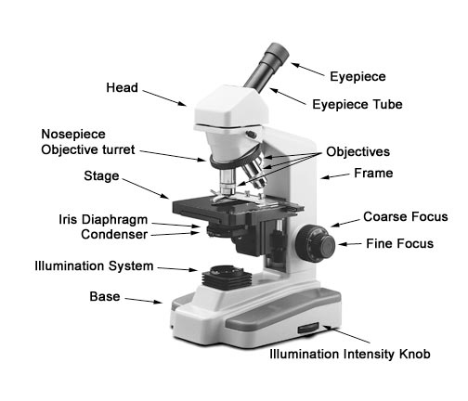
Microscope parts:

Slide 2
RBC counting
Normal range:
Men: 5 + 0.5 x 10⁶ cells /µL
5 + 0.5 x 10¹² cells /L
Women: 4.3 + 0.5 x 10⁶ cells /µL
4.3 + 0.5 x 10¹² cells /L
it is a screening test for anemia or polycythemia

Slide 3
In RBC count use diluent →3.2formal citrate=3.2 sodium citrate+ formaldehyde → transparence → gives color to RBCs and platelets and lyses the WBC
method:
20 µL from EDTA blood
+
4mL from diluent(formal citrate)=4000µL

Slide 4
Using Improved neubauer counting champer
Called ( haemocytometer)
Contain 9 squares each square area size is 1mm X 1mm , each square contain a volume of 0.1µL of diluted blood
examine at 40 X objective

Slide 6
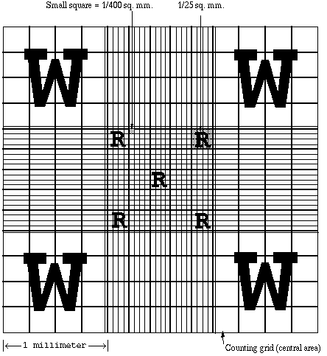

Slide 7
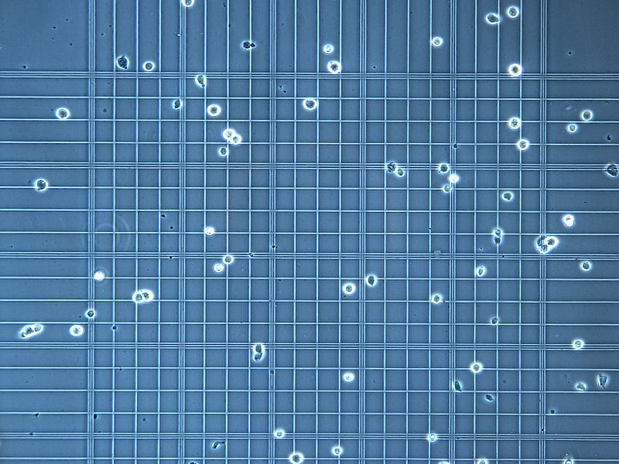

Slide 8
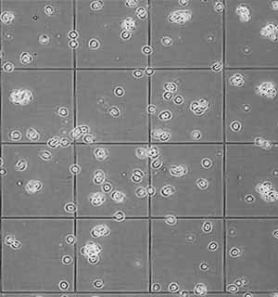

Slide 9
20µL of blood 4000µL of diluent
1 200
Dilution factor= 200
RBC Square volume =0.1µL
The volume of diluted blood in the 5 squares is
=0.1X1 =0.02µl
5

Slide 10
N 0.02µL
? 1µL
Number of cells in 1ML in diluted blood=
= N =N= NX100= NX50
0.02 2 2
100
Number of cells in 1ML in whole blood = NX50X200
= NX10000
e.g:N= No of RBC in 5squares=500
Number of cells in 1µL in whole blood=5000000
= 5X10⁶ Cell/µL
=5X10¹² Cell/L

Slide 11
Red cell indices ( absolute values)
They are calculated using:
PCV,Hb and RBC counts
Used for:
Diagnosis and classification of anaemia.
The most used indices are:
MCV ,MCH and MCHC.

Slide 12
1- MCV mean corpuscular cell volume
Def: the average volume of a single red cell
Unit: Femtoliter (FL)
Calculate it by using: PCV and RBC count
MCV = PCV% x 10
RBC

Slide 13
e.g: Pcv=0.45L/L RBC=5X10¹² Cell/L MCV=PCV RBC
0.45L/L X 10³ =450 =90 X10-¹⁵ L=90FL
5X10¹² /L 10³ 5X10¹⁵
Simplified calculation:
MCV=PCV % X10=45X10= 90 FL
RBC W/O 10¹² 5

Slide 14
MCV normal range :76 – 96 fL
We can determine the size of RBC
Within normal range=normal=normocytic
Below the normal range=small=microcytic
Above the normal range=large=macrocytic
The MCV increased in Macrocytic anaemia:
e.g: megaloblastic anaemia
MCV decreased in Microcytic anaemia:
e.g:iron deficiency anaemia

Slide 15
2-MCH Mean cell hemoglobin
Def:the average weight of Hb in one red cell
Unit:Picogram (Pg)
Calculate it by using :Hb and RBC
MCH=Hb g/dlx10
RBC

Slide 16
e.g:Hb=150 g/L RBC=5X10¹² Cell/L MCH=Hb RBC
=150 =30=30X10-¹² g=30 Pg
5X10¹² 10¹²
Simplified calculation:
MCH=Hb g/dl X10=15x10=30 pg RBC W/O 10¹² 5

Slide 17
MCH normal range:27-32 Pg
We can determine the Wt of Hb inside one RBC
Within normal range=normal=normochromic
Below the normal range=pale=hypochromic
Above the normal range=dark=hyperchromic

Slide 18
3-MCHC Mean cell haemoglobin concentration
Def:concentration of Hb per unit volume of red cell.
Unit: % or g/dL or g/L
Normal range=32-36 g/dL or (%)
320-360 g/L
Calculate it by using: PCV and Hb
MCHC=Hb g/dl x 100
PCV %
MCHC is the only measurment which can obtained accuracy by manual method

Slide 19
e.g: Hb=15 g/dl pcv=45% MCHC=Hb x100 pcv
=15 x100=33.3% or g/dl =333 g/L
45

Slide 20
Fully saturated RBC has Hb concentration of 36 g/dl.
by using MCHC we can determine the degree of hypocromia present in iron deficiency anaemia

