Slide 1

NETWORK SECURITY LAB
Lab
2. Authentication & Message
Authentication

Slide 2

What is Authentication?
• Short answer: establishes identity
➢ Answers the question: To whom am I speaking?
Long answer: evaluates the authenticity of identity proving credentials
‣ Credential – is proof of identity
‣ Evaluation – process that assessing the correctness of the association between credential and claimed identity.
• Usually for a purpose
• Policy driven (what constitutes a good cred.?)

Slide 3
Why Authentication?
• World of rights, permissions, and duties?
Authentication establishes our identity so that we can obtain the set of rights/products and services
E.g., we establish our identity with Tiffany’s by providing a valid credit card which gives us rights to purchase goods ~ physical authentication system.
• Q: How does this relate to security?

Slide 4
Authentication in Computer World
The Customer and Vendor are not physically located in same place.
• Prove the repudiation of what we are.
– Ex: Buying something online using a credit card:
– Authentication needed:
• Credit Card number
• CVV
• OTP
• Personal Details (Name, Email, Age, etc.,)

Slide 5
Proving Identity
• How to verify “Who am I”?
• Documentary resembling proofs;
– Driver’s license
– Credit Card
– Signature Verification
– Biometric Verification

Slide 6
Proving Identity (2)
• Other methods of verifying Identity are:
– Something I know
• Mother’s maiden name, First school, Fav. Actor etc.,
– Something I have
• Smart chip cards, valid photo ID cards, etc.,
– Something I am (Bio-Metric)
• Fingerprints
• Iris
• Face Recognition

Slide 7
Message Authentication
• What confirms Message Authentication?
– A Received message from source that claims it sent
– Message that hasn’t been altered in anyway.
– Message sequence is unchanged
– Message timing is unchanged
• Relay
• Delay
• Replay
– Non-repudiation by sender
– Non-repudiation by recevier
it.

Slide 8
Authentication Functions
• Lower level Functions
– Authenticator or Value
– Ex: Getting an OTP or verification message
• Higher level functions
– Authenticator to verify authenticity of message
– Ex: Getting OTP only after attempting login in bank site
• Functions to produce authentication
– Message Encryption (Ciphertext, AES, DES, RSA, etc)
– Message Authentication Code (Checksum, MAC, etc)
– Hash functions
• Mapping messages to value

Slide 9
keyed hash functions

Slide 10
Message Authentication
Code
• Also known as cryptographic checksum
– MAC = C_{K}(M)
– K = Key shared between sender and receiver
– C_{K}(M) = Fixed Value authenticator
• MAC is readied at source after the message is
• The receiver of the message can verify the
– Re-computing the MAC of the message
– M = Message
ready.
authenticity of message by:

Slide 11
Message Authentication
Code
Authentication √
Integrity √

Slide 12
MAC is vulnerable to attacks
• Encryption in MAC
– Dependent on length of the key
– Brute force attacks: 2^{K-1} combinations of K bit
key

Slide 13
Unkeyed hash functions

Slide 14
MD5 – Message Digest 5
• Step 1: Appending padding bits
– All block size are of 512bits
– Padding bits: 1000…512th(0)
– (Msg + pad bits + 64 bit for length) = n X 512
• Step 2: Append length
• Step 3: Initialize MD Buffer
• Step 4: Process message in 512 bit blocks
• Step 5: output 128 bit checksum

Slide 15
MD5 – Hands-on
• Refer to student lab manual for hands-on

Slide 16
Secure Hashing Algorithm (SHA)
• Secure Hashing Algorithm
• MD5 -Dead
• SHA -1
• SHA -2
• SHA -3

Slide 17
Secure Hashing Algorithm (2)
SHA based algorithms are used for authentication.
• Iterative one way hashing algorithm that process a message to produce a condensed representation called a “Message Digest”
• Message digest ensures integrity:
• That means if a message changes, the message digest will also change.

Slide 18
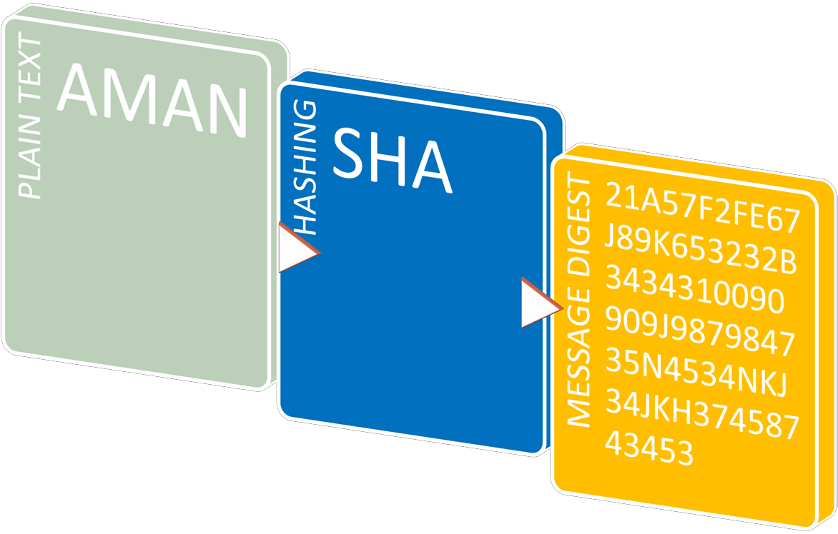
Secure Hashing Algorithm (3)

Slide 19
Why different versions of SHA?
Based on the Algorithm that is applied to the text/file the block size of the message digest will change.
– Example if SHA-1 is applied the message digest will result in a 512 block OR 160 Bit
– SHA-2: A family of two similar hash functions, with different block sizes, known as SHA-256 and SHA-
512. They differ in the word size; SHA-256 uses 32- bit words where SHA-512 uses 64-bit words.
– SHA-3: A hash function formerly called Keccak, It supports the same hash lengths as SHA-2, and its internal structure differs significantly from the rest of the SHA family.

Slide 20
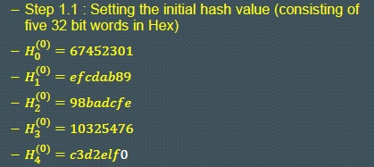
How
SHA
Works?
• Step 1 - Preprocessing
• A Two step procedure
• Based on algorithm of SHA, the initial values will
also change

Slide 21
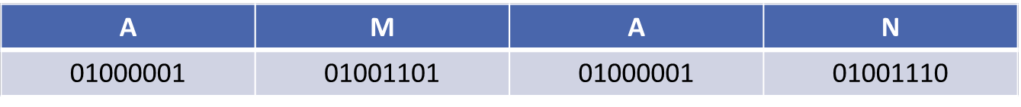
How SHA Works? (2)
• Step 1.1 – Padding message
• The binary representation of the message
– Message Contains 8X4=32 bits

Slide 22
How SHA Works? (3)
• Remaining Steps:
• Step 2: Compute Message digest
– Identify the binary value of the message after padding
– Iterate the message schedule from 0-15 (based on algorithm)
– Initialize the working variable with the (i-1)^{st} hash value
• Step 3:
– Iterate the function for t=0 to 79
– Identify the value of ws (as defined in the secure hash standard)
• Step 4:
– Compute the i^{th} value for intermediate hash value

Slide 23
Report Work
• Using MD5
– Produce a checksum for:
• An image
• A text file
• A pdf fie
– Create a text file with the checksums
– Append the image, text in the file and pdf file
– Produce the checksum again and submit both the checksums: before and after the changing the file.

Slide 24
Message Authentication
Code
Authentication X
Integrity √

