Slide 1
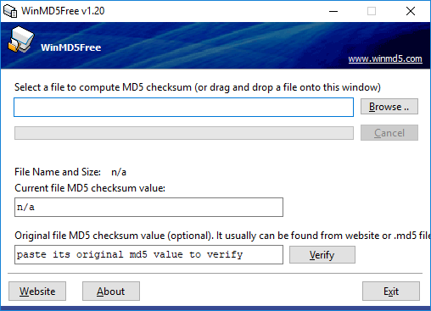
LAB # 2 – MESSAGE AUTHENTICATION
STUDENTS MANUAL
FUNCTION: CHECKSUM USING MD5
STEP 1 : DOWNLOAD AND INSTALL WINMD5 FROM HTTP://WWW.WINMD5.COM/ STEP 2: RUN THE INSTALLED MD5
1. SELECT A TEXT FILE
1

Slide 2
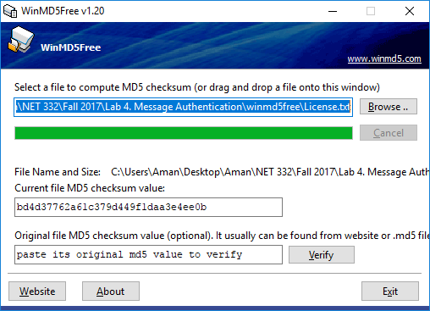
LAB # 2 – MESSAGE AUTHENTICATION
STUDENTS MANUAL
FUNCTION: CHECKSUM USING MD5
STEP 3 : COPY & SAVE THE CHECKSUM
2. COPY THE CHECKSUM
2

Slide 3
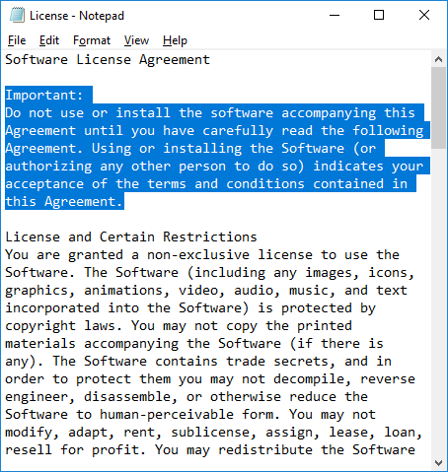
LAB # 2 – MESSAGE AUTHENTICATION
STUDENTS MANUAL
FUNCTION: CHECKSUM USING MD5
STEP 4 : EDIT THE TEXT FILE USED FOR PRODUCING THE CHECKSUM AND SAVE IT AGAIN.
3. DELETE SOME TEXT
3

Slide 4
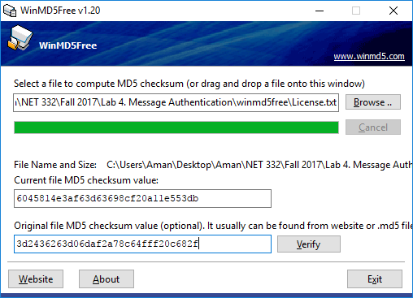
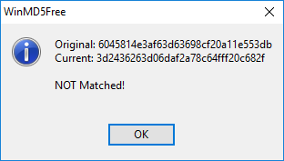
LAB # 2 – MESSAGE AUTHENTICATION
STUDENTS MANUAL
FUNCTION: CHECKSUM USING MD5
STEP 5 : PRODUCE THE CHECKSUM AGAIN
4. PASTE THE
PREVIOUSLY COPIED
CHECKSUM
4

Slide 5
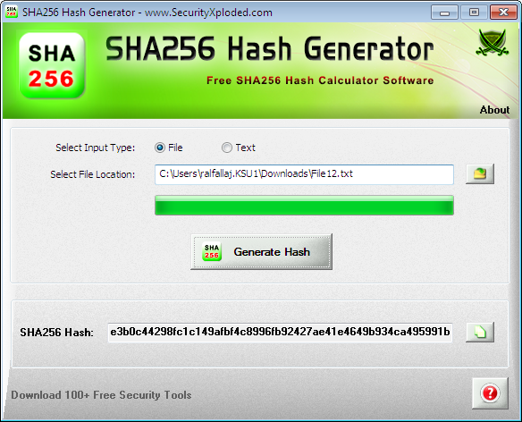
LAB # 2 – MESSAGE AUTHENTICATION
STUDENTS MANUAL
FUNCTION: CHECKSUM USING SHA-1
STEP 1 : DOWNLOAD AND INSTALL sha1generator and repeat the previous experiment using the new tool to generate different types of hash values.
1.Select the file
2. Generate the hash value
5

Slide 6
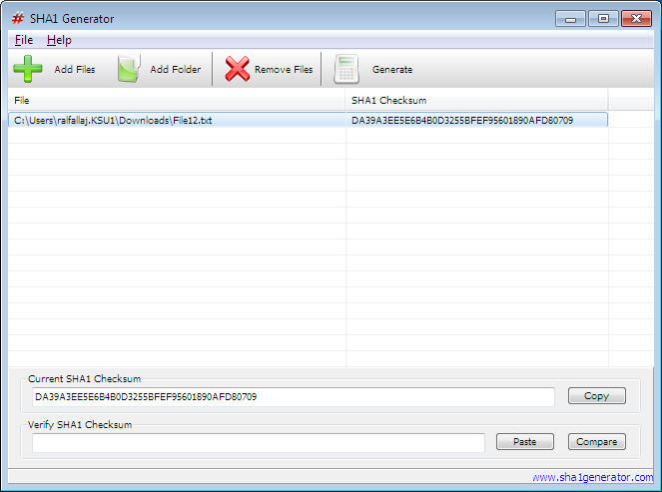
LAB # 2 – MESSAGE AUTHENTICATION
STUDENTS MANUAL
FUNCTION: CHECKSUM USING SHA-2
STEP 2 : DOWNLOAD AND INSTALL sha256hashGenerator and repeat the previous experiment using the new tools to generate different types of hash values.
2. Generate the hash value
1.Select the file
3. Paste a hash value to compare
6

