Slide 1
hazards
chemical hazards
e.g. toxic ,flammables , corrosives and reactive
biological hazards
e.g. microbes and plants
Radiation
e.g. ionizing and non ionizing radiation
Physical hazard
e.g. heating device ,cuts and noise
Electrical hazards
e.g. fire and shock

Slide 2
Safety Precautions:
1- Wear lab coat.
2- Wear Disposable plastic gloves during work.
3- Don’t eat or drink in the lab.
4-Take care if some one has any wounds.
5-Use disposable syringes, needles and lancets.
6-Specimens should be sent to the lab in closed plastic bags, separated from the request forms to prevent their contamination.

Slide 3
Lab design safety
Safety cabinet
First aid bag
Storage room for flammables reagents
Fire extinguisher
The floor should be rough
Un bind the wires

Slide 4
Types of specimens in hematology lab:
(A) Venous blood
it is common specimen for hematology.
collected from anticubital vein and from the dorsum of the hand in obese patients.
Needles 19 or 21G for adults and 23 G for children.

Slide 5
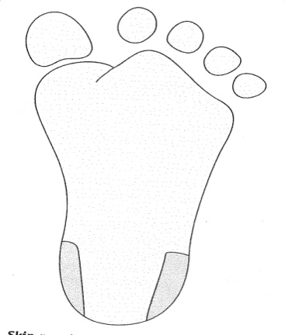
(B) Capillary blood:
It should be used only with infants under 1 year or when it is not possible to obtain venous blood .
1- heel
2- the ball of the middle finger
3-Ear lobe
`

Slide 6
Disadvantages of capillary blood:
Capillary blood is freely flowing So, there is greater risk of transmission of disease and contamination.
So, venous blood is more convenient for handling and the results from it are considered to be more accurate.

Slide 7
Cellular part: RBC, WBC and Platelets
plasma:
clear yellowish fluid portion of blood has fibrinogen (cloting factor) so, it clots very fast.
Serum = plasma- fibrinogen

Slide 8
Serum & plasma
To obtain serum should be delivered into sterile tube or tube that has gel.
To obtain Plasma should be delivered in a tube with anticoagulant.

Slide 9
ANTICOAGULANTS:
1-EDTA (lavender top)
Contain: sodium or potassium salt that cause the anticoagulant effect.
Chemical action : (remove free Ca ⁺⁺ by chelation ).
Transform Ca ⁺⁺ to un ionized form it becomes not free (bound calcium)
Concentration: 1.5 + 0.25 mg /mL of blood
Excess EDTA: ↓ PCV, ↑MCHC, shrinkage of RBC ,slight high platelets count.

Slide 10
EDTA
Uses: for routine Hematology,blood count ,blood films and platelets count because it prevents clumping.
Disavantages: not suitable for coagulation study because it destroys factorV and VIII.

Slide 11
2-Trisodium citrate (blue top) contain: 3.2%or 3.8% tri sodium citrate
Used for:
Coagulation studies and ESR.
Conc:
9 volume of blood to 1 volume of trisodium citrate for coagulation study 4 volume of blood to 1 volume of trisodium citrate for ESR.
Chemical action:
it removes free Ca ⁺⁺ by loosely binding to form a calcium citrate complex

Slide 12
3-Heparin (green top)
It is a natural dry substance
It is synthesized by the liver
It does not alter the size of RBC
It is important because it reduce the chance of lysis that occur after blood has been withdraw
Chemical action:
With the aid of co factor located in albumin fraction of the plasma,heparin neutralize thrombin which is essential for coagulation
.
Con: 10 – 20 IU per ml of blood.

Slide 13
heparin
Uses:
1-For red cell enzyme estimation e.g. G6PD
2- For osmotic fragility tests e.g. hereditary elleptocytosis and spherecytosis.
3-for immunophenotyping
heparin is Not used for:
1- cell counting because of clumping effect of platelets and WBC.
2- blood smears made from it are difficult to stain clearly with Romanowsky dyes

Slide 14
Blood cells: RBC-WBC-Platelets
Size
numbers
Functions

Slide 15
Hb is a protein inside RBC .
It contains :
Haem=iron
Globin chain =protein
3 types of Hb
Hb A consist of α2β2
Hb A2 consist of α2 δ2
Hb F α2 γ2

Slide 16
In adults the major Hb is Hb A :96-98%
Hb A2:1.5-3.2%
Hb F: 0.5-0.8%
In fetus the major Hb is Hb F.

Slide 17
Hb measurment methods
1- by measurements of its colour
2- by its power of combining with O2 or CO2
3-by iron content estimated by spectrophotometer
i.e Cyanmethaemoglobin method

Slide 18
Hi CN Method: Principle: Blood is diluted in a solution called Drabkins Solution which contains potassium cyanide and potassium ferricyanide ( pH 7-7.4).
Blood + Drabkins solution
↓
Hb
Oxidized by
Potassium ↓
Ferricyanide
Methaemoglobin
Combines with
potassium ↓
cyanide
Cyanmethaemoglobin
Measure absorption of color at 540 nm by spectrophotometer.
Absorption α concentration

Slide 19
Advantages: 1-Screening test for anemia or polycythemia. 2-Viability of stable and reliable reference preparation. 3-Measurment of all forms of Hb except SHb "sulphaemoglobin“. 4- It is a standard method.
Disadvantage:
1-Drabkins solution Contain potassium Cyanide

Slide 20
Method: 4 mL Drabkin + 20 µL of EDTA blood sample Calculation : Hb (g/dL) = A x 64500 X DF 44 X D X 1000 X 10 Hb = A x 29.3
A = reading of Abs of Hb solution
64500 = Mwt of Hb
44 = millimolar extinction co efficient.
D = Thickness of cuvette = 1 cm
1000 =conversion factor from mg to gm
10 = conversion factor from mL to dL
DF = Dilution factor = 200

Slide 21
Normal Ranges:
Men 13 – 17 g/dL
Women 12 – 15 g/dL
At birth 14-22 g/dL
Pregnant ladies 11 g/dl

Slide 22
PCV (packed cell volume)& HCT(Haematocrit) determination
PCV=manual method
HCT(Haematocrit)=automated coulter counter
PCV: Percentage of a volume of blood occupied by red cells
i.e the ratio of the height of red cell column to that of the whole blood sample in the tube.
Used for: 1-screening test for anemia or polycythemia (PCV=3Hb) 2- calculate red cell indices

Slide 23
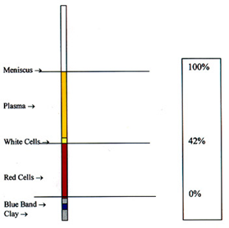
Methods:
Macro method using wintrobe method which is no longer used in routine use b/c it takes big amount of blood & more time to PPT.
Micro method by using capillary tubes with a centrifugal forces of 6000 rpm and 3min.
Adv: 1-better backing of RBC
2- Short time of centrifugation

Slide 24
PCV units: % or L/L
Volume of RBC ÷ volume of whole blood x100
Normal range:
men 0.45 + 0.05 L/L (40-50%)
women 0.41 + 0.05 L/L (36-46%)
infant 0.60 + 0.15 L/L (45-75%)

