Slide 1
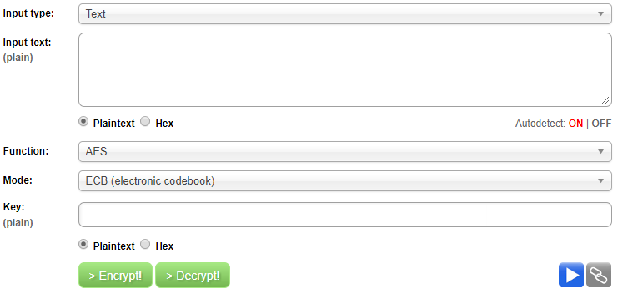
LAB # 1 – AES ENCRYPTION
STUDENTS MANUAL
FUNCTION: ENCRYPTING PLAIN TEXT [1/3]
STEP 1 : VISIT THE SITE HTTP://AES.ONLINE-DOMAIN-TOOLS.COM/
^{STEP 2:} 1. SELECT ‘TEXT’ FROM THE DROP DOWN
1

Slide 2
LAB # 1 – AES ENCRYPTION
STUDENTS MANUAL
FUNCTION: ENCRYPTING PLAIN TEXT [2/3]
STEP 1 : VISIT THE SITE HTTP://AES.ONLINE-DOMAIN-TOOLS.COM/
STEP 2:
_{HELLO, WORLD!} 2. ENTER THE MESSAGE IN PLAIN
3. ENSURE ‘PLAIN TEXT’ IS SELECTED
4. TRY DIFFERENT MODES FROM
PL@YERSAG3!$ ^{HERE}
6. ENTER A STRONG KEY HERE COMBINATION OF LETTERS, NUMBERS AND SPL. CHARACTERS
7. CLICK ‘ENCRYPT’
TEXT THAT IS TO BE ENCRYPTED
2

Slide 3
LAB # 1 – AES ENCRYPTION
STUDENTS MANUAL
FUNCTION: ENCRYPTING PLAIN TEXT [3/3]
STEP 1 : VISIT THE SITE HTTP://AES.ONLINE-DOMAIN-TOOLS.COM/
STEP 2:
_{HELLO, WORLD!} 2. ENTER THE MESSAGE IN PLAIN
3. ENSURE ‘PLAIN TEXT’ IS SELECTED
4. TRY DIFFERENT MODES FROM
HERE
5. CLICK ‘ENCRYPT’
TEXT THAT IS TO BE ENCRYPTED
2

Slide 4
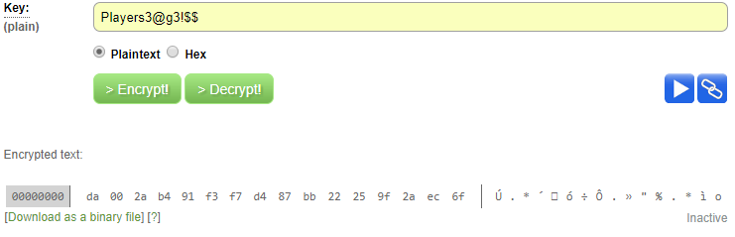
LAB # 1 – AES ENCRYPTION
STUDENTS MANUAL
FUNCTION: GENERATING CIPHER TEXT
STEP 3 : COPY AND SAVE THE ENCRYPTED/CIPHER TEXT GENERATED AFTER ENCRYPTION
COPY AND SAVE THE CIPHER
TEXT IN A NOTEPAD
3

Slide 5
LAB # 1 – AES ENCRYPTION
STUDENTS MANUAL
FUNCTION: DECRYPTING CIPHER
STEP 1 : REFRESH THE SITE HTTP://AES.ONLINE-DOMAIN-TOOLS.COM/
STEP 2:
21 15 21 89 55 5A F7 B9 62 00 72 60 2C 8F 54 08 2. ENTER THE CIPHER TEXT COPIED
3. ENSURE ‘HEX’ IS SELECTED
4. ENSURE SAME MODE IS USED
5. CLICK ‘DECRYPT’
IN THE NOTEPAD
2

Slide 6
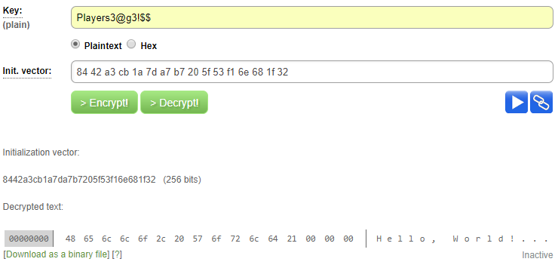
LAB # 1 – AES ENCRYPTION
STUDENTS MANUAL
FUNCTION: GENERATING PLAIN TEXT
STEP 3 : COPY AND SAVE THE ENCRYPTED/CIPHER TEXT GENERATED AFTER ENCRYPTION
VERIFY THE ORIGINAL
PLAIN TEXT MESSAGE
3

