Slide 1
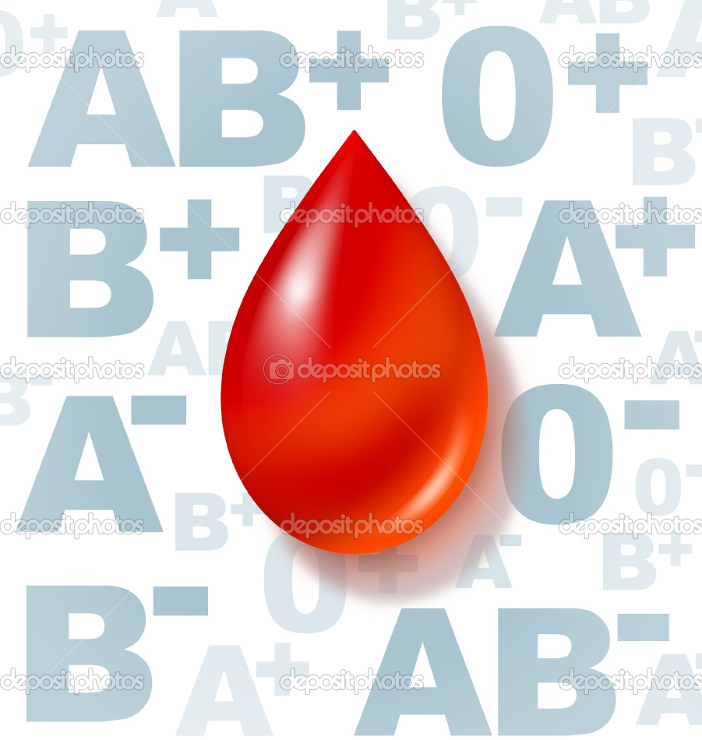
Blood Groups

Slide 2
ABO blood group system:
The most well-known and medically important blood types are in the ABO group.
All humans and many other primates can be typed for the ABO blood group.
There are four principal types: A, B, AB, and O.
There are two antigens and two antibodies that are mostly responsible for the ABO types.

Slide 3
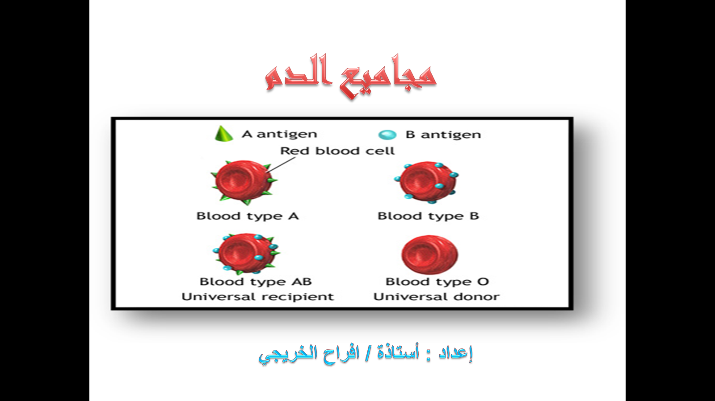

Slide 4
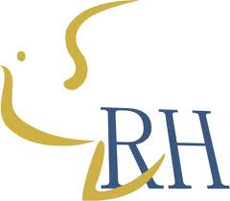
Rh blood group system :
The Rh system is the second most significant blood-group system in human-blood transfusion with currently 50 antigens.
The most significant Rh antigen is the D antigen, because it is the most likely to provoke an immune system response of the five main Rh antigens .

Slide 5

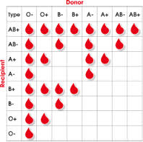
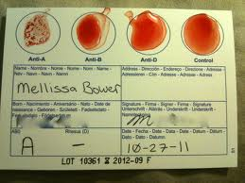
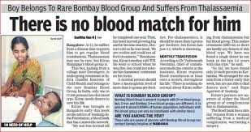
We can say :
The presence or absence of D Ag determines if the person is Rh+ or Rh-

Slide 6
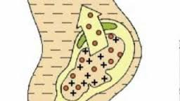
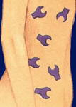
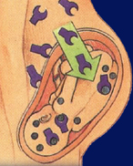
Rh antibodies
Result from the exposure to Rh antigens
Bind at 37°C
Anti-Rh⁺ antibodies
Possible subsequent pregnancies
Mother makes anti-Rh⁺ antibodies.

Slide 7
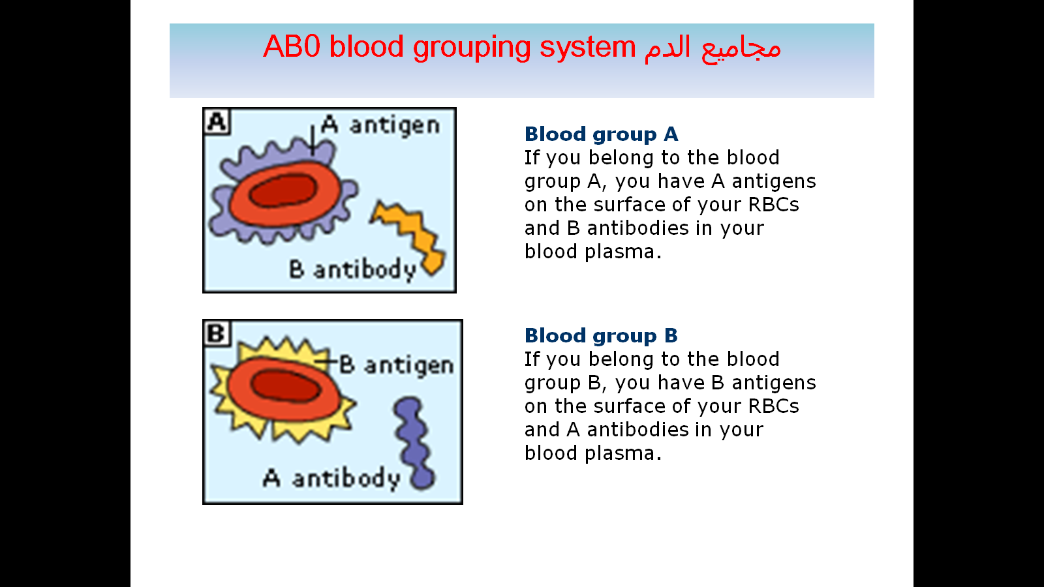
ABO blood group system

Slide 8
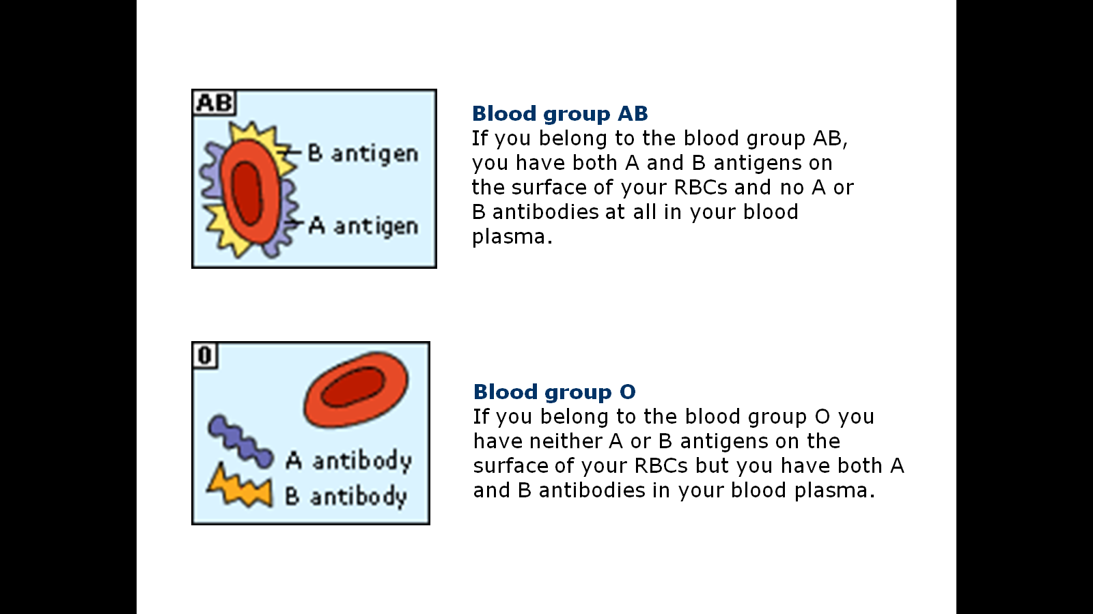
ABO blood group system

Slide 9
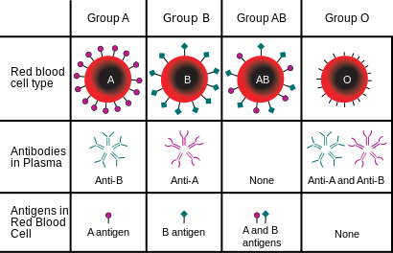
The Antigens and Antibodies

Slide 10
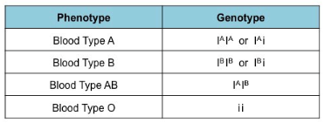
ABO blood group system:
Phenotype and Genotype

Slide 11
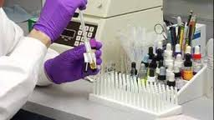
BLOOD GROUP TEST

Slide 12
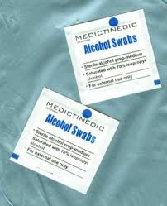
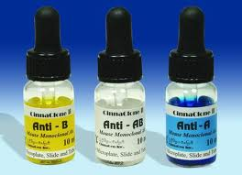

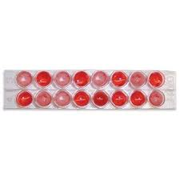
BLOOD GROUP TEST
YOU NEED:
3
1
2
4

Slide 13
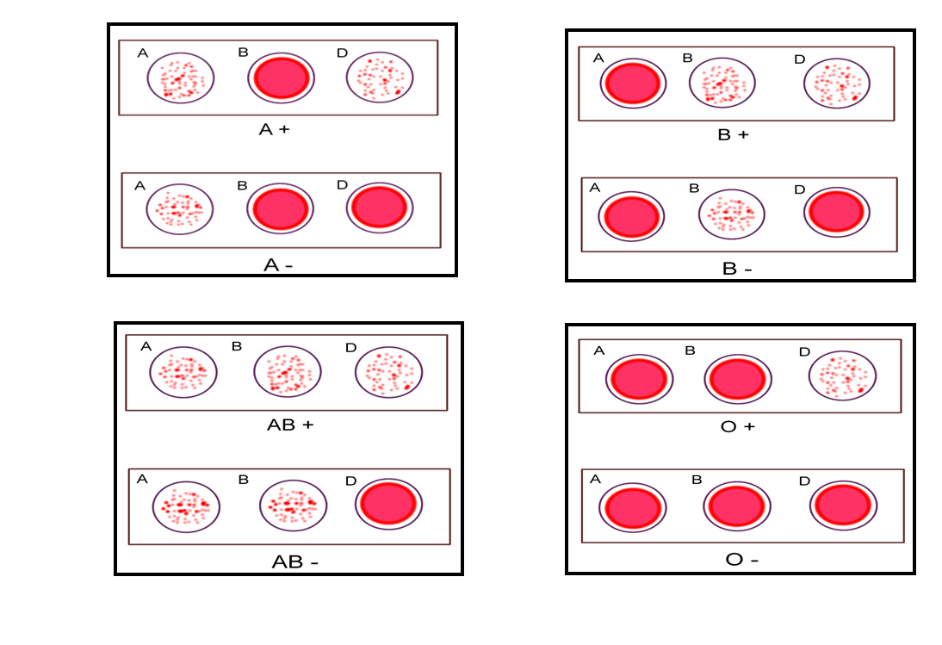
The Result WITH D(+,-)

Slide 14




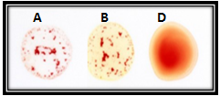
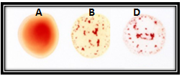


Exercise

Slide 15


