Slide 1

NETWORK SECURITY LAB
Lab
2&3. AES & RSA Encryption

Slide 2

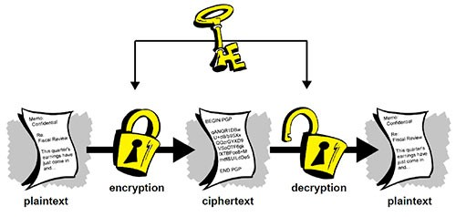
What is Encryption?
The process of converting information or data into codes to prevent unauthorized access’

Slide 3
Encryption
• Data/Information – i
• Encrypted data = cipher = C
• Encryption Algorithm = E
• Encryption Key = K
• Decrypted data = plaintext = d
i=E(K,C) OR C= E_{K}(i)
d=E(K,C) OR d=E_{K}(C)

Slide 4
Encryption - Terminology
• Encryption or Enciphering: Process of converting plain text to cipher text.
• Encryption Algorithm: Performs encryption
– Inputs needed: plain text and secret key
• Deciphering or Decryption: Process of recovering plain text from cipher
• Secret Key: used for encryption or decryption

Slide 5
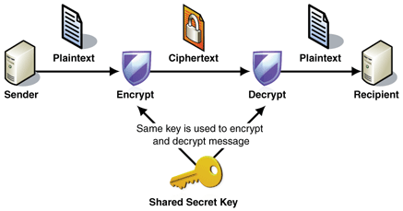
Encryption - Types
• Symmetric Encryption: Process encryption where same key is used to encrypt and decrypt the
data:

Slide 6
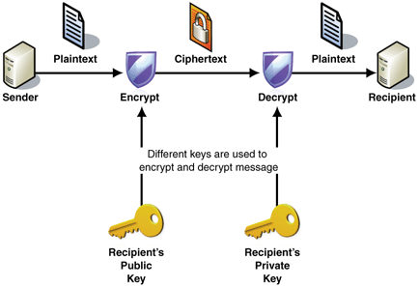
Encryption – Types (2)
• Asymmetric Encryption AKA PKI: Process encryption where public and private keys are used to encrypt and decrypt the data:

Slide 7
Symmetric Encryption- Uses
• Commonly used in database as there are no two separate end points to send and receive data.
• Widely used due to its speed factor compared to PKI.
• Often used in encrypting backup tapes for offline storage and digital streaming.
• Used to securely store private information, credit card information, etc.,

Slide 8
Symmetric Encryption- Deep Dive
• Symmetric encryption uses a number of algorithms:
– Two Fish (Open source)
– Blow Fish
– 3DES
– DES
– AES
• In late 1990’s the National Institute for Standards and Technology (NIST) felt the need for new standard for cryptography.

Slide 9
Symmetric Encryption- Deep Dive (2)
• Belgian Cryptographers : Vincent Rijmen and Joan
Daemen developed the AES.
• Acquired by Federal Government and named as
FIPS197.
• Widely accepted by the private sector.
• Testing protocols for AES

Slide 10




HOW AES Works?
• Requirements:
– Software that implements the AES Algorithm
– Inputs: Data (credit card number, plain text) and
Key (encryption key)
Plain Text AES Engine Key
Encrypted Unreadable binary
Data format data
Reversal for decryption
ryp

Slide 11
AES- Behind the Scene
• AES is a block cipher
• Has an Initialization Vector (IV) for rounds of
• Size of the block is 16 bytes
• Encryption Key Sizes:
– 128 bit (16 Bytes)
– 192 bit (24 Bytes)
– 256 bit (32 Bytes)
encryption for the data in the block.

Slide 12
AES- Strong Encryption
Key
• Encryption Key – A passphrase
• Should be complex and not a easy guess
• Use combination of letters, numbers, cases and
Ex: PlayerR@g3!$$
• How keys are generated?
– Random Number Generated (RNG)
– Password Based Encryption (PBE) = Password
– Split Passwords = Passwords entered by 2 or
special
characters.
+ Software for encryption
and hashing.
more users.

Slide 13
Where can I find AES?
• Software Vendors:
– Microsoft
– IBM
– SUN
• Products with Encryption
– Third party vendors
• Free subscriptions
– Online applications
– Free web applications

Slide 14
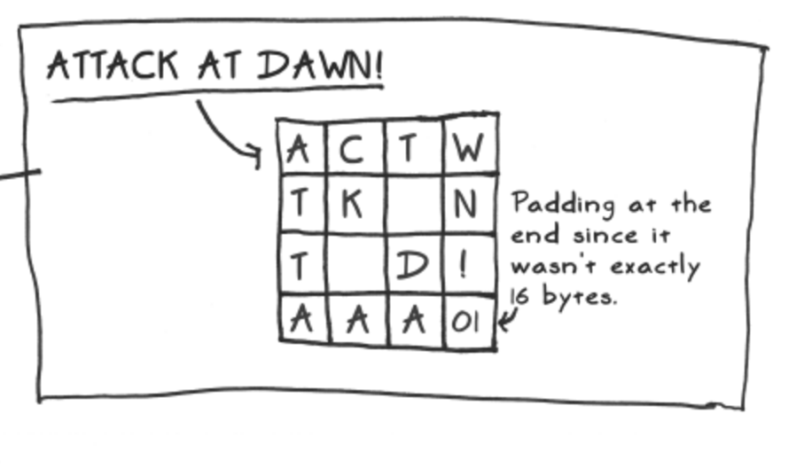
AES Functionality
The plain text Message

Slide 15
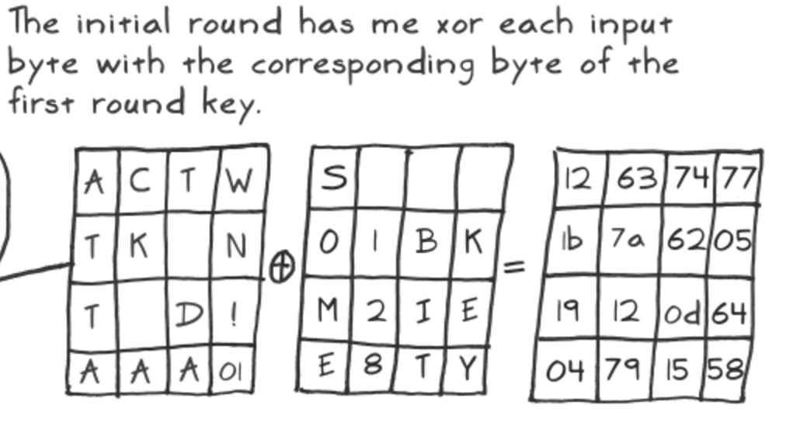
Encryption
Initial encryption with Key (128bit)

Slide 16
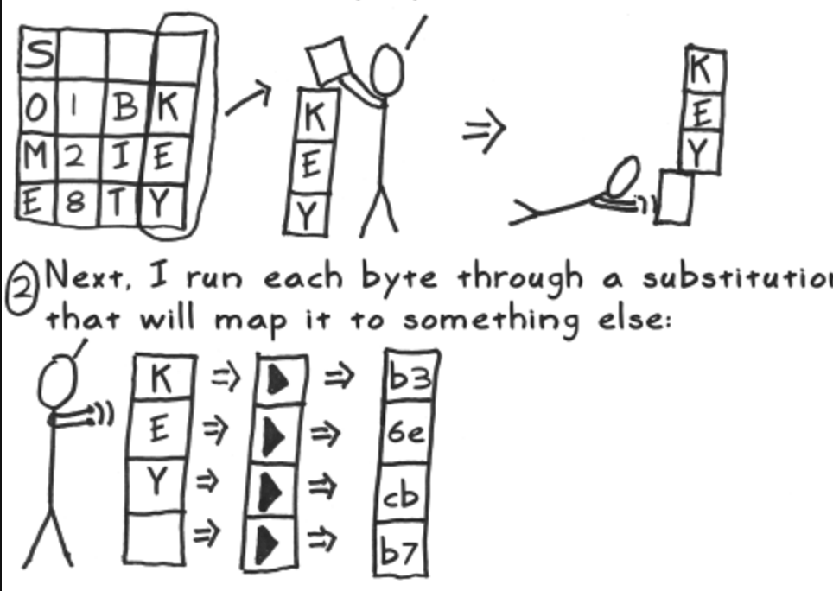
Encryption
Substitution technique for other keys

Slide 17
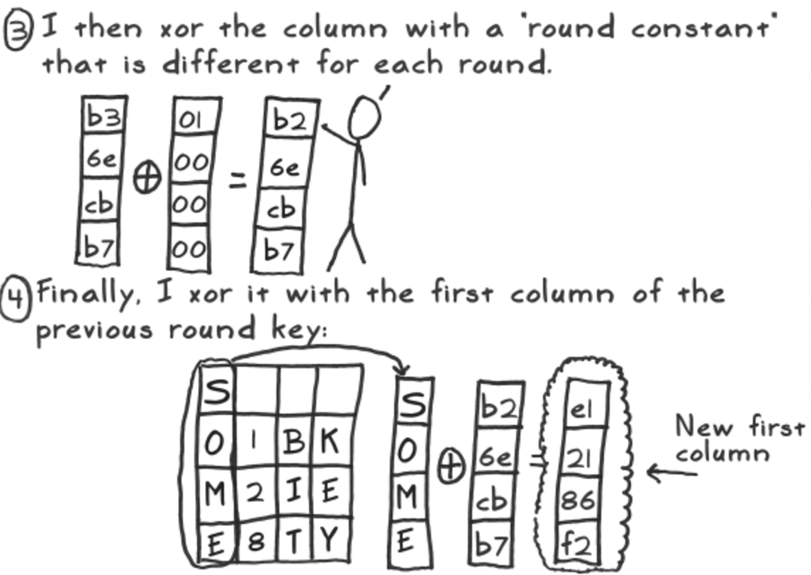
Keep Iterating
Substitution technique for other keys

Slide 18
Application
Hands on Application for AES
http://aes.online-domain-tools.com/
Encryption

Slide 19
Asymmetric Encryption- RSA
• Public-Private Key encryption AKA PKI
• Developed by Ron, Shamir and Adleman in
1997.
• Using Public Key and Private key to encrypt and decrypt the messages
• Encrypts using public key and decrypt using private key

Slide 20
RSA Algorithm
• Choose 2 different prime numbers P,Q
• Calculate Modulus N = P*Q
• Calculate Totient X(N) = (P-1) (Q-1)
• Choose an integer E (Public Key)
– Should be between 1 and X(N)
– The GCD (E and X(N) = 1
• Calculate D (Private Key)= 1 + K * X(N) / E

Slide 21
RSA Algorithm (value)
• Prime numbers P =3 ,Q =5
• Calculate Modulus N = P*Q = 15
• Calculate Totient X(N) = (P-1) (Q-1)
X(N) = (2) (4) = 8

Slide 22
RSA Algorithm (value 2)
• Choose an integer E (Public Key)
– Random selection that should satisfy:
– Should be between 1 and X(N) (8)
– The GCD (E and X(N) = 1
– Therefore E=7 as its the number
• Between 1 and 8
• GCD of E and X(N) is 1

Slide 23
RSA Algorithm (value 3)
• Calculate D (Private Key)
– Formula D = 1 + K * X(N) / E
– K will be a random value starting from 0,1,2…
– Value of K should be less than the value of E=7
– The value of k will be changed until the value of equation is an integer and not a fraction
– Assume K =1
• 1+1*8/7 = 1+8/7= 9/7 = 1.24
• 1+2*8/7 = 1+16/7= 17/7 = 2.42
• 1+6*8/7 = 1+48/7= 49/7 = 7
– Therefore the value of D = 7

Slide 24
RSA –Encryption
• Encryption:
– Cipher = C , Message = M = 2
– C = ((M)^E)mod pq
– C = ((2)^7) mod 15
– C= (128) mod 15
– C=128 mod 77 = 8

Slide 25
RSA –Encryption (2)
• Cipher:
1446436027249695724085187034261343407637345227512175264736046413631785764689
5726366662225378971531954686536966572938530962015355961280039128824192279946
1900336928606242039205889723393039751165794039846990733677929842721509238963
3158926727411186195914142933026219981117920960369465642159463357586198511098
7540055893001309752836398564218504892953596650409594770352818416521701283436
8463658830038592096291421132889989793954497271306896737716409455275151550293
8623905950509780011746717729167078502200271395230314167889507200139908687846
5401346837727212873235227364587270216164844338039376435790769437622961938823
3504142648252743944924390551560704492709089383951117980259418257445822558139
1615536441987006546174978414995768699027758443604904566916432858899133931230
5897118534509075405405954247767707520522917844002365256660070562128174601189
4818223044281817138874614763635023450960993983575312156062075089134523100430
036429569055865730319563634831414589143605553545057773590087890625
• Mod: 65

Slide 26
RSA –Decryption
• Message M = (C^D) mod PQ
• M = (8^7) mod 15
• M = 2097152 mod 15
• M = 2

Slide 27
REPORT WORK
• Prepare a brief write up on the different components of the AES Encryption.
• Explain in short the process of encryption in AES.

