Slide 1

NETWORK SECURITY LAB
1. ETHICAL ISSUES IN
NETWORK SECURITY

Slide 2





Coverage
INTRODUCTION
NETWORKS
ISSUES
COUNTER
MEASURES

Slide 3




Coverage
INTRODUCTION
NETWORK
ISSUES
COUNTER
MEASURES

Slide 4




Coverage
INTRODUCTION
NETWORK
ISSUES
COUNTER
MEASURES

Slide 5
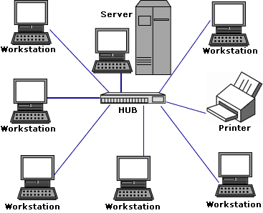
What is a Network?
• Group of computers
interconnected.
• Sharing Resources
• Types of Networks:
– LAN
(Local Area Network)
– MAN
(Metro Area Network)
– WAN
(Wide Area Network)

Slide 6
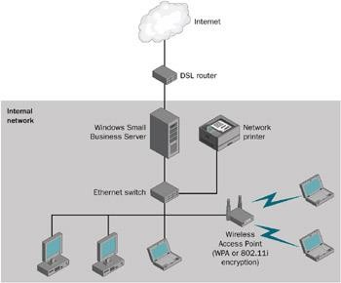
Local Area Network (LAN)
• Configured in a smaller Area ex: an office, Home, etc.,
• Peer-Peer Network
• Centralized Network
• Computer connected to
switch/hub.
• Hub – Server
• Hub – Internet
• Hub – Server - Internet

Slide 7
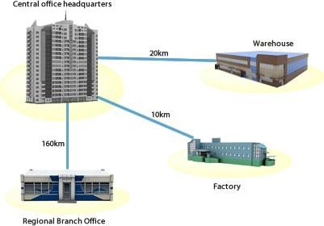
Metro Area Network (MAN)
• Network Configured to
interconnect offices in
a city. Ex: Branches in a
same city/state.
• Centralized Network
• Branches are
connected through:
– Telephone lines
– Internet
– Satellite

Slide 8
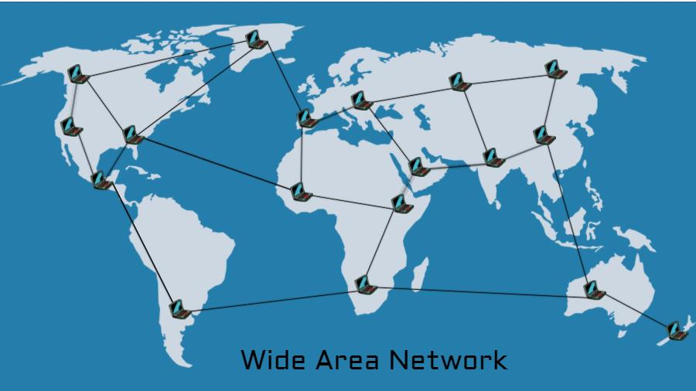
Wide Area Network (WAN)
• Network Configured to interconnect branches in a country or across countries.
• Centralized Network
• Connected through:
– Satellites
– Dedicated Leased Lines
• Largest WAN : Internet

Slide 9
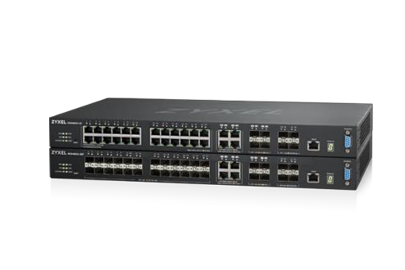

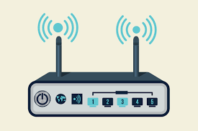
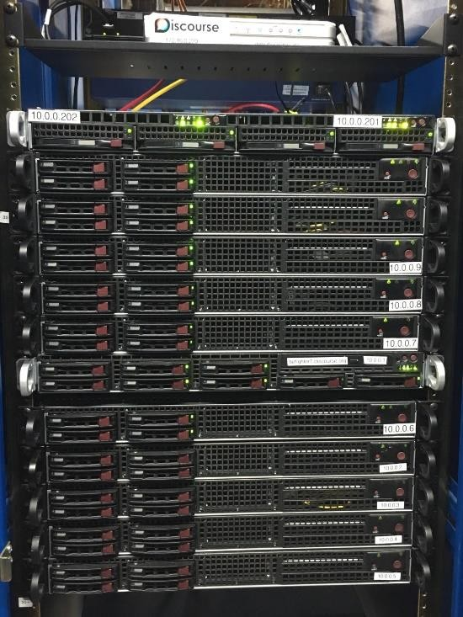
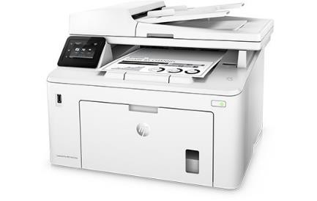

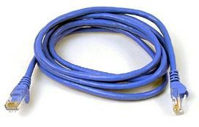
Devices that make a Network
Switches
Computers
Wireless
Printers
Smartphones
Servers
Cables

Slide 10
Coverage
INTRODUCTION
NETWORK
ISSUES
COUNTER
MEASURES

Slide 11
Network Security Issues/Threats
• Network security is prime most concern of all
organizations.
• The information passed between Computers is very vulnerable.
• In the last decade there has been a massive increase of Hackers & Crackers creating:
– Viruses
– Ransomware
– Other malicious threats

Slide 12
Security Threats
• The following is a list of commonly known
security threats
• Viruses, Worms and Trojans
• SPAM
• Phishing
• Packet sniffing
• Malicious Websites
• Password Attacks
• Improperly secured wired/wireless networks

Slide 13
Viruses, Worms and Trojans
• Virus: A malicious program or code that acts by
attaching to a host program, once loaded on
to the computer and corrupts data and system services.
– Ex: MyDoom, Sasser & Netsky, etc.,
• Worms: Similar to Virus, but doesn’t need a host program to operate, it can operate on its own.
– Ex: MSBlast!, Michelangelo, ILOVEYOU
• Trojans: A program disguised, contains harmful
codes inside that may target data and file
allocation table, thereby causing severe damage
to computer.

Slide 14
SPAM and Phishing
• SPAM: Flooding a computer or a network with millions of copies of the same message. Affects the performance of the target by slowing down the network and results in Denial of Service (DOS)
• Phishing: Fraud emails disguised as legitimate communication to collect personal/financial information of targets.

Slide 15
Packet Sniffing – Malicious Sites
• Packet Sniffer:
– A program that enables listening onto the
network (eavesdropping).
– Monitors the traffic on the network (packets).
– Also capable of capturing the packets from network channel.
• Malicious Sites:
– Websites that contain malicious codes and scripts.
– Capable of capturing data from computers.

Slide 16
Password Attacks
• Password Attacks:
– Used to determine the password of any user on
a network.
– Achieved through automatic tools.
• Example: Brute force.
– Once password is determined, the hacker can easily access all the personal information stored on the computer.

Slide 17
Open wire and wireless networks
• Threats:
– Open networks are the most favorite entry points
of hackers.
– Shared data on open network can cause serious
damages.
– Nodes (computers) on open network can be used as botnets to forward the infections/malware deeper into network levels.

Slide 18
How
to
protect
your networks?
Threats:
• Viruses, Worms & Trojans
• SPAM
• Phishing
• Packet Sniffers
• Malicious Sites
• Password Attacks
Countermeasures:
• Antiviruses, hardware and software IDS/IPS
• SPAM filters enable email
• Phishing filters enabled email
• Obtain Strong Encryption
• Obtain security suite to detect
• Strong Password policies throughout the network users
services.
and web browsing clients
technology.
infected sites

Slide 19
Protect your Network - II
• Other measures include
– Updating Operating System with latest service
packs.
– Updating Antivirus/IDS/IPS software with latest
databases of signatures.
– Following network maintenance best practices such as:
• Monitor access permissions regularly on network.
• Devising a Security policy and strict adherence.
• File Integrity Management (FIM) Solutions.
• Keep up with existing and future threads.

Slide 20
REPORT WORK
• Prepare a report on recent ransomware
attacks : Wannacry and Petya:
– What was the attack (type, source, point of origination)
– What infection did it cause.
– Countermeasures taken.

