Slide 1
PPP Protocol

Slide 2
Outline
Serial Communication
Point-to-Point Communication Links
HDLC Encapsulation
Point-to-Point Protocol (PPP)
PPP components
Establishing a PPP Session
PPP Authentication Protocols
PPP Configuration
Configuring PPP Authentication

Slide 3
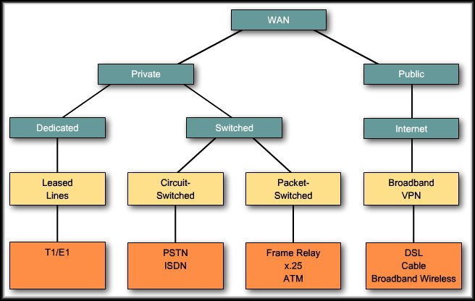
Introduction to WANs
WAN Connection Options

Slide 4
Serial and Parallel Ports
Communications across a serial connection is a method of data transmissions in which the bits are transmitted sequentially over a single channel.
In parallel communications, bits can be transmitted simultaneously over multiple wires.
Notes:
3.1.1.1 Serial and Parallel Ports

Slide 5
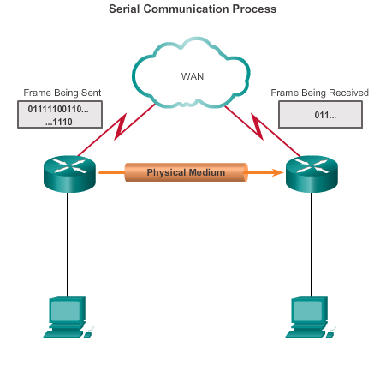
Serial Communications Serial Communication
On the WAN link, data is encapsulated by the protocol used by the sending router.
Encapsulated frame is sent on a physical medium to the WAN.
Receiving router uses the same communications protocol to de-encapsulate the frame when it arrives.
Three serial communication standards for LAN-to-WAN connections: RS-232, V.35, HSSI
Notes:
3.1.1.2 Serial Communication

Slide 6
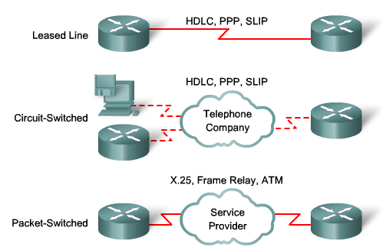
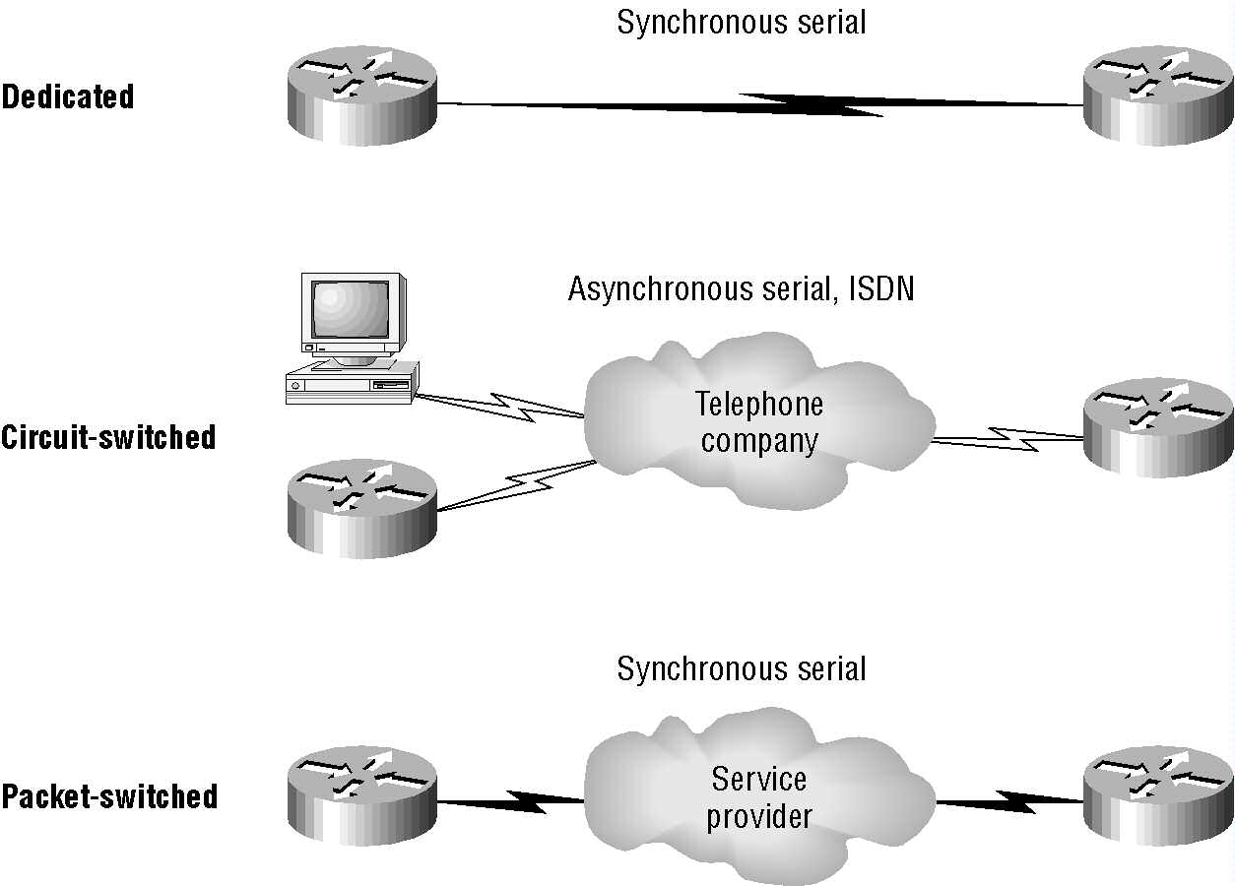
WAN Connection Types
WAN Data Link
Protocolos

Slide 7
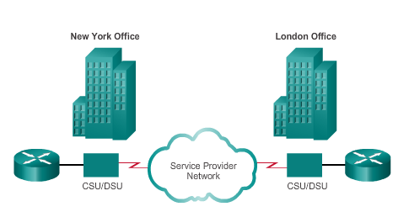
Serial Communications Point-to-Point Communication Links
Point-to-point links can connect two geographically distant sites.
Point-to-point connections are used to connect LANs to service provider WANs.
Also referred to as a serial connection or leased-line connection
Carrier dedicates specific resources for a line leased by the customer (leased-line).
Point-to-point links are usually more expensive than shared services.
Notes:
3.1.1.3 Point-to-Point Communication Links

Slide 8
HDLC Encapsulation HDLC Encapsulation
A data link layer protocol developed by the International Organization for Standardization (ISO) . (standard HDLC)
Defines a Layer 2 framing structure
Cisco has developed an extension to the HLDC protocol to solve the inability to provide multiprotocol support (Cisco HLDC also referred to as cHDLC).
Notes:
3.1.2.2 HDLC Encapsulation

Slide 9
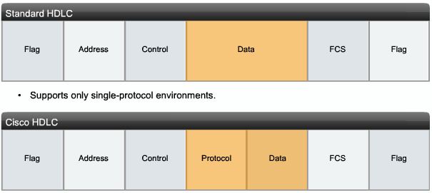
HDLC Encapsulation
HDLC defines a Layer 2 framing structure

Slide 10
HDLC Encapsulation
Standard HDLC
does not support multiple protocols on a single link, as it does not have a way to indicate which protocol is being carried.
Cisco HDLC
The frame uses a ‘protocol' field that enables multiple network layer protocols to share the same serial link.

Slide 11
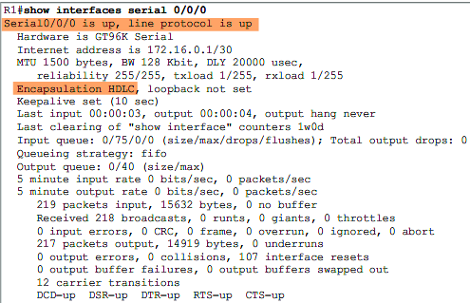
HDLC Encapsulation HDLC Encapsulation
Default encapsulation method used by Cisco devices on synchronous serial lines
Point-to-point protocol on leased lines between two Cisco devices
Connecting to a non-Cisco device, use synchronous PPP

Slide 12
HDLC Encapsulation Configuring HDLC Encapsulation
Notes:
3.1.2.4 Configuring HDLC Encapsulation

Slide 13
Point-to-Point Protocol (PPP)
Point-to-Point Protocol (PPP) is also data link protocol used on serial links just like HDLC.
However PPP is has more advanced features when compared with HDLC which is quite primitive. For example:
Link quality management feature monitors the quality of the link. If too many errors are detected, PPP takes down the link
Supports PAP and CHAP authentication

Slide 14
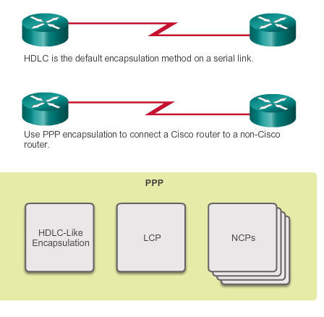
Benefits of PPP Introducing PPP
PPP contains three main components:
HDLC protocol for encapsulating datagrams over point-to-point links
Extensible Link Control Protocol (LCP) to establish, configure, and test the data link connection
Family of Network Control Protocols (NCPs) to establish and configure different network layer protocols (IPv4, IPv6, AppleTalk, Novell IPX, and SNA Control Protocol)
Notes:
3.2.1.1 Introducing PPP

Slide 15
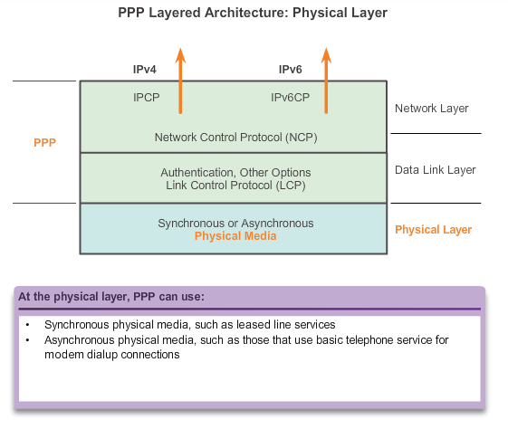
LCP and NCP PPP Layered Architecture
LCP sets up the PPP connection and its parameters and terminates it
NCPs handle higher layer protocol configurations
Notes:
3.2.2.1 PPP Layered Architecture

Slide 16
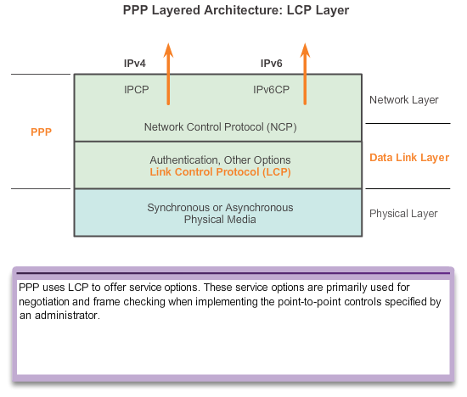
LCP and NCP PPP Control Protocol (LCP)
PPP uses the LCP to negotiate and setup control options on the WAN link.
Authentication, Compression, Error Detection, Multilink for load balancing, and link monitoring functions.
Notes:
3.2.2.2 PPP – Link Control Protocol (LCP)

Slide 17
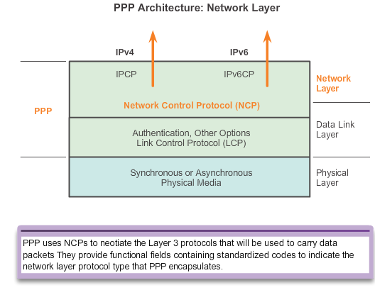
LCP and NCP PPP Network Control Protocol (NCP)
PPP permits multiple network layer protocols to operate on the same communications link.
For every network layer protocol used, PPP uses a separate NCP.
Notes:
3.2.2.3 PPP – Network Control Protocol (NCP)

Slide 18
PPP Sessions Establishing a PPP Session
Phase 1 – LCP must first open the connection and negotiate configuration options;
Notes:
3.2.3.1 Establishing a PPP Session

Slide 19
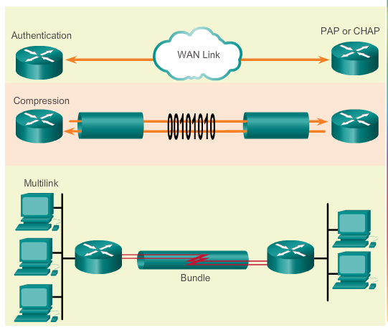
PPP Sessions PPP Configuration Options
Optional functions include:
Authentication using either PAP or CHAP
Compression using either Stacker or Predictor
Multilink that combines two or more channels to increase the WAN bandwidth
Notes:
3.2.3.4 PPP Configuration Options

Slide 20
Configure PPP PPP Configuration Options
Authentication – Two authentication choices are Password Authentication Protocol (PAP) and Challenge Handshake Authentication Protocol (CHAP).
Compression – Increases the effective throughput on PPP connections by reducing the amount of data in the frame that must travel across the link. The protocol decompresses the frame at its destination. Two compression protocols available in Cisco routers are Stacker and Predictor.
Multilink – This alternative provides load balancing over the router interfaces that PPP uses. Multilink PPP provides a method for spreading traffic across multiple physical WAN links while providing packet fragmentation and reassembly, proper sequencing, multivendor interoperability, and load balancing on inbound and outbound traffic.
Notes:
3.3.1.1 PPP Configuration Options

Slide 21
PPP Sessions Establishing a PPP Session (cont.)
Phase 2 –Authentication Phase
After the link has been established and the authentication protocol decided on, the peer may be authenticated.
Authentication, if used, takes place before the network layer protocol phase is entered.
PPP uses PAP and CHAP as authentication protocols
As part of this phase, LCP also allows for an optional link-quality determination test.
The link is tested to determine whether the link quality is good enough to bring up network layer protocols.
Notes:
3.2.3.1 Establishing a PPP Session

Slide 22
PPP Sessions Establishing a PPP Session (cont.)
Phase 3 – Network Layer Protocol Phase.
In this phase the PPP devices send NCP packets to choose and configure one or more network layer protocols, such as IP.
Once each of the chosen network layer protocols has been configured, packets from each network layer protocol can be sent over the link.
Notes:
3.2.3.1 Establishing a PPP Session

Slide 23
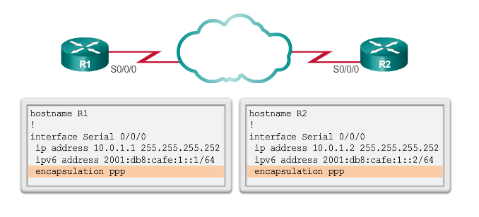
Configure PPP PPP Basic Configuration Command
Notes:
3.3.1.2 PPP Basic Configuration Command

Slide 24
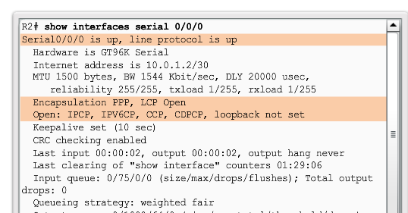
Configure PPP Verifying PPP Configuration
Notes:
3.3.1.6 Verifying PPP Configuration

Slide 25
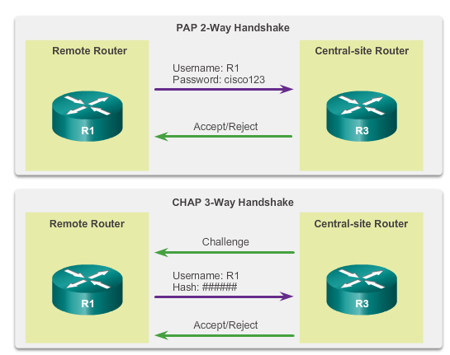
PPP Authentication PPP Authentication Protocols
Notes:
3.3.2.1 PPP Authentication Protocols

Slide 26
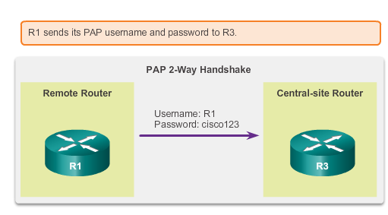
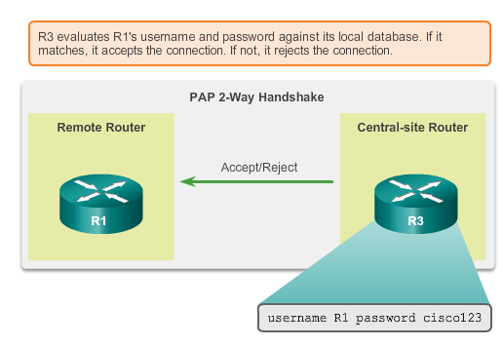
PPP Authentication Password Authentication Protocol (PAP)
Initiating PAP
Completing PAP
Notes:
3.3.2.2 Password Authentication Protocol (PAP)

Slide 27
Password Authentication Protocol (PAP)
PAP provides a simple method for a remote node to establish its identity, using a two-way handshake.
The authentication process is one way authentication method and one or both devices can authenticate each other separately.
PAP is not a strong authentication protocol.
Passwords are sent across the link in clear text and there is no protection from playback or repeated trial-and-error attacks.
Notes:
After the PPP link establishment phase is complete, a username/password pair is repeatedly sent by the remote node across the link until authentication is acknowledged or the connection is terminated.

Slide 28
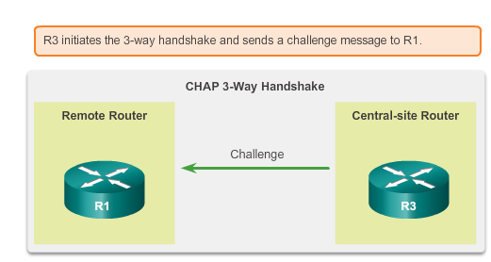
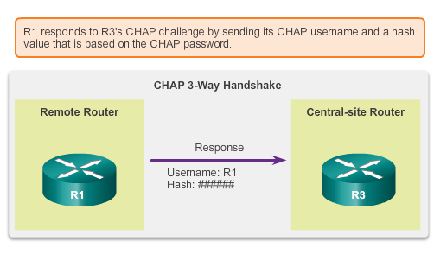
PPP Authentication Challenge Handshake Authentication Protocol
Initiating CHAP
Responding CHAP
Notes:
3.3.2.3 Challenge Handshake Authentication Protocol (CHAP)

Slide 29
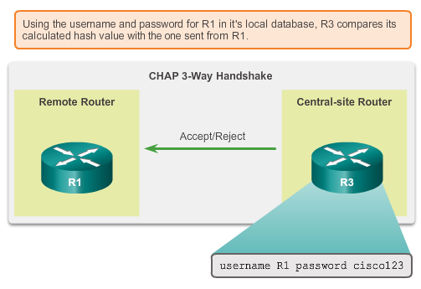
PPP Authentication CHAP (cont.)
Completing CHAP
Notes:
3.3.2.3 Challenge Handshake Authentication Protocol (CHAP)

Slide 30
CHAP
CHAP uses a three-way handshake to verify the identity of the remote node.
After the PPP link establishment phase is complete, the local router sends a "challenge" message to the remote node.
The remote node responds with a value calculated using a one-way hash function, which is typically Message Digest 5 (MD5).
This response is based on the password and challenge message.
The local router checks the response against its own calculation of the expected hash value.
If the values match, the authentication is acknowledged, otherwise the connection is immediately terminated.

Slide 31
CHAP
CHAP provides protection against playback attack through the use of a variable challenge value that is unique and unpredictable.
Since the challenge is unique and random, the resulting hash value will also be unique and random.

Slide 32
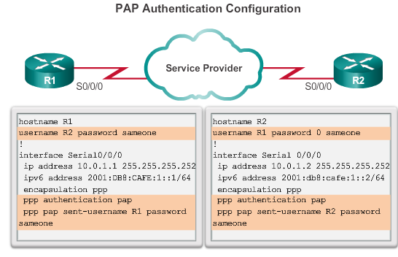
PPP Authentication Configuring PPP Authentication (cont.)
Notes:
3.3.2.6 Configuring PPP with Authentication

Slide 33
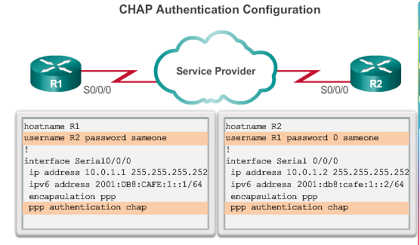
PPP Authentication Configuring PPP Authentication (cont.)
Notes:
3.3.2.6 Configuring PPP with Authentication

