Slide 1
بسم الله الرحمن الرحيم
140 Micro
Lab 7: Simple stain
+ Gram stain

Slide 2
Purpose
To recognize the three basic shapes
of bacterial cells.

Slide 3
The three common shapes of bacteria :
1-Coccus
Bacillus 2-
Spiral 3-

Slide 4
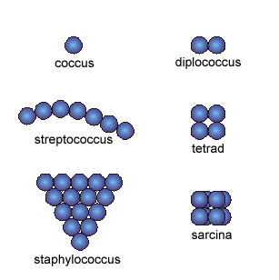
1-Coccus
having one of the following arrangements :
Diplococcus: a pair of cocci
Streptococcus: a chain of cocci
Tetrad: a square of 4 cocci
Sarcina: a cube of 8 cocci
Staphylococcus:
cocci in irregular, often grape-like clusters

Slide 5
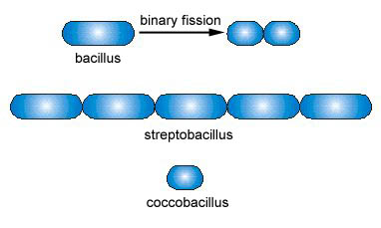
Bacillus 2-
Bacillus: a single bacillus
Streptobacillus: bacilli in chains
Coccobacillus: oval and similar to a coccus

Slide 6
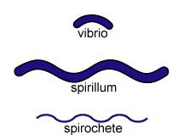
Spiral 3-
Vibrio: an incomplete spiral or comma-shaped
Spirillum: a thick, rigid spiral
Spirochete: a thin, flexible spiral

Slide 7
Simple stain

Slide 8
Simple stain :
The simple stain is a very simple staining procedure involving only one stain.
You may choose from methylene blue, safranin, and crystal violet.

Slide 9
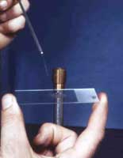
Simple stain :
Prepare the smear.
- place a small drop of water on a clean slide. Drag the sterile inoculating needle tip through the edge of colony.
- Gently spread the mixture into a circle to spread out.

Slide 10
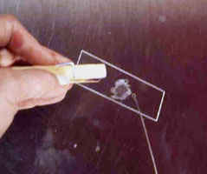
Simple stain :
2. Let the smear air dry completely.

Slide 11
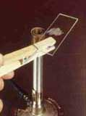
Simple stain :
3. Heat-Fix the smear.
Smears are heat-fixed by quickly passing the slide through a flame two or three times.
This causes the microbes to stick to the slide and not get washed off during the staining process.

Slide 12
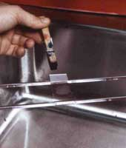
Simple stain :
4. Stain the smear.
Place the slide on a rack over the sink. Flood the smear with stain and let it for 60-90 seconds. Rinse gently and blot dry.

Slide 13
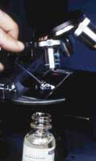
Simple stain :
5. Then, place a drop of oil directly on the stained smear .Turn the oil lens into position and fine focus to observe the cells.

Slide 14
Result

Slide 15
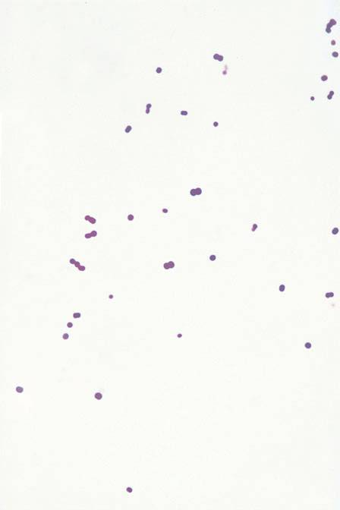
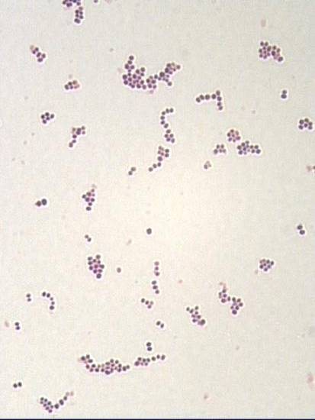
Coccus (cocci pl.)

Slide 16
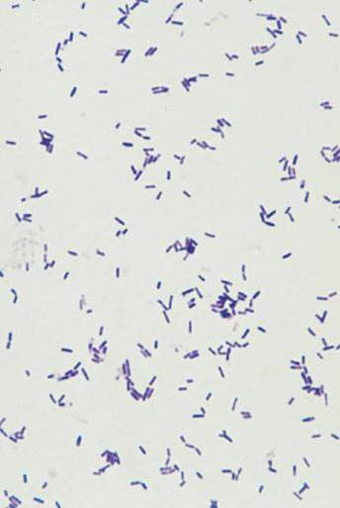
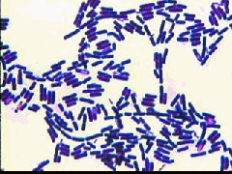
Bacillus (Bacilli pl.)

Slide 17
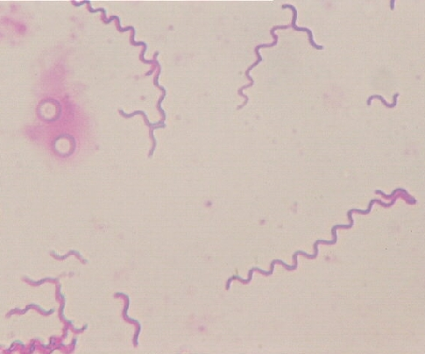
Spirillum (Spirilli pl.)

Slide 18
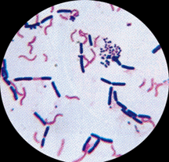
Gram stain
(( صبغة جرام ))

Slide 19
It is used to differentiate between gram-positive and gram-negative bacteria, which have distinct and consistent differences in their cell walls.

Slide 20
The gram stain is called a differential stain
because it stain cell differently
based on their cell wall structure .

Slide 21
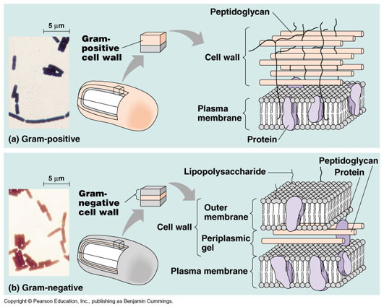
The cell wall structure

Slide 22
Gram-positive bacteria
Have a thick peptidoglycan layer surrounds the cell.
The stain gets trapped into this layer and the bacteria turned purple.
Gram-negative bacteria
have a thin peptidoglycan layer that does not retain crystal violet stain.
Instead, it has a thick lipid layer which dissolved easily upon decoulorization with Alcohol.
Therefore, cells will be counterstained with safranin and turned red.

Slide 23
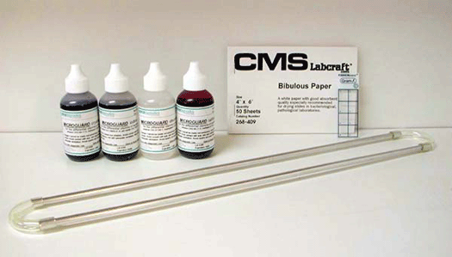
The material :
    Cultures of : Staphylococcus aureus,
    Bacillus subtilis,
    E.coli
Crystal violet .
Iodine solution .
Alcohol 95% .
Safranin .
Water .

Slide 24
The method

Slide 25
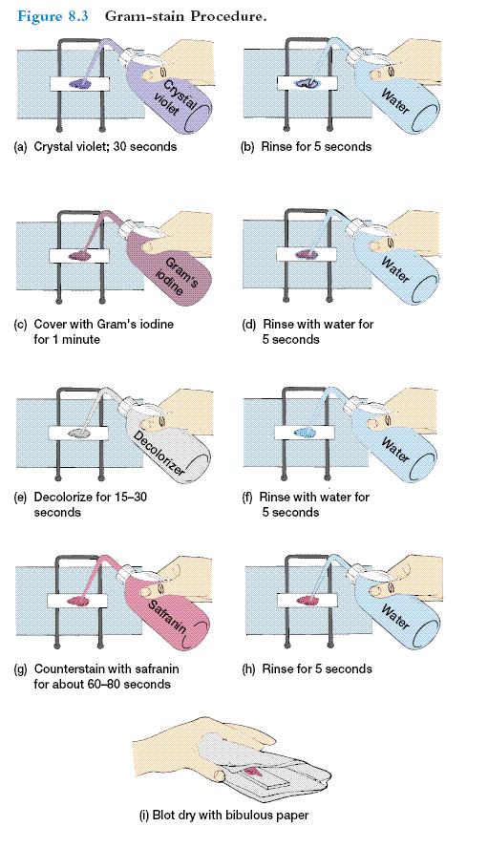

Slide 26
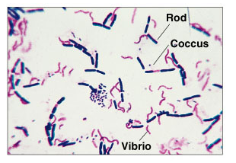

Slide 27
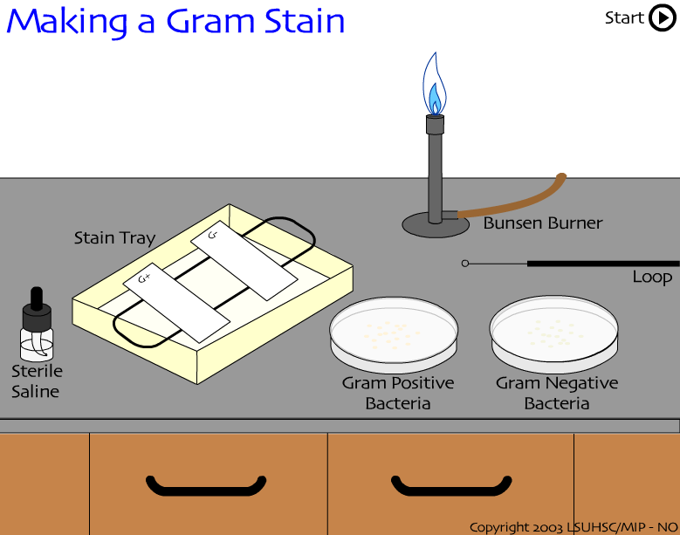

Slide 28
The bacteria under the microscope

Slide 29
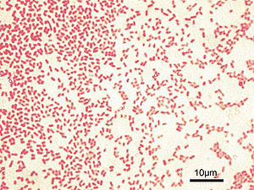
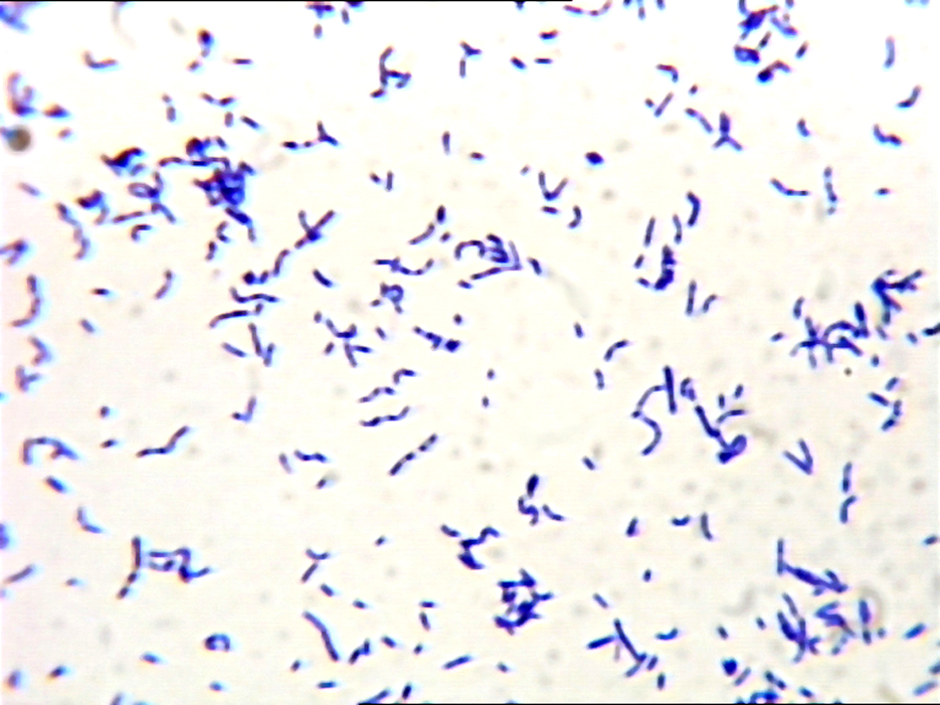
Gram –ve Gram +ve

Slide 30
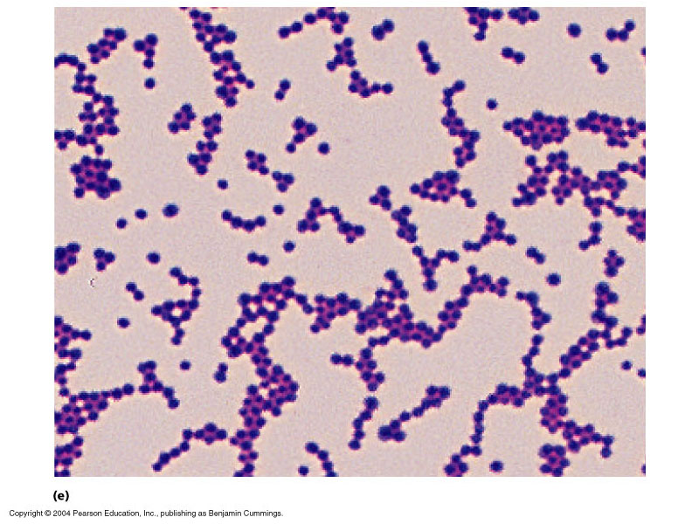
Results:
Shape: Cocci
Arrangment: irregular clusters
Colour: Violet
Gram’s reaction: Gram’s +ve
Name of microorganism: Staphylococci

Slide 31
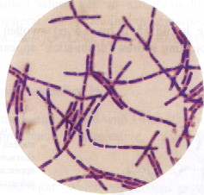
Results:
Shape: Bacilli
Arrangment: Chains
Colour: Violet
Gram’s reaction: Gram’s +ve
Name of microorganism: Bacillus

Slide 32
Thank you
بالتوفيق....

Slide 33

Let’s see

